Slide 1
One-dimensional Staged Self-Assembly
Andrew Winslow
Ph.D. Qualifications Research Talk
Department of Computer Science, Tufts University

Slide 2
Computing in a Petri Dish
Particles
Computation
Petri dish

Slide 3


Mix x 4
Mix x 6
Mix x 15
…
Like all analogies,
this is a gross simplification.
Metal
Computer
DNA
Computer

Slide 4
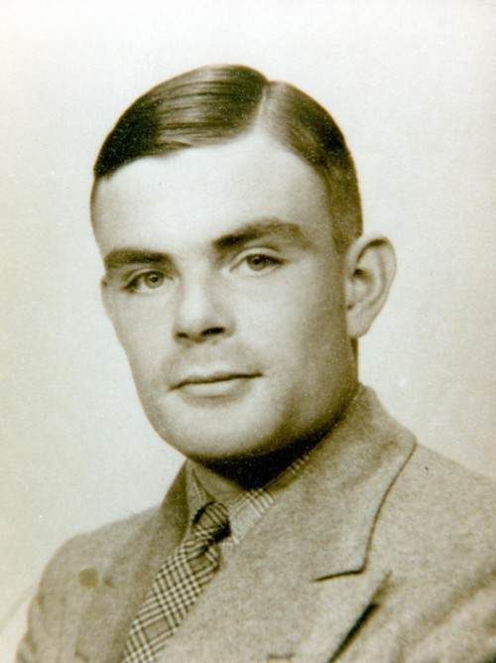

Alan Turing might have said:
Hark! I object to your slides twice.
1. Such a computer cannot exist!
2. If it did, it would not be powerful!
(As powerful as a Turing machine)
In 1997, Erik Winfree proved:
1. Such a computer is buildable.
2. This computer is Turing complete.
(As powerful as a Turing machine)

Slide 5
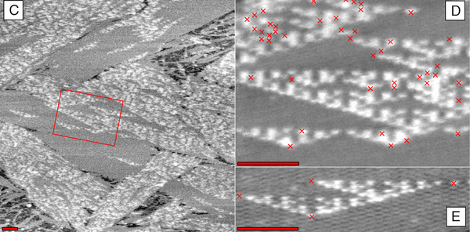
The output of a DNA computer: crystals.
P. W. K. Rothemund, N. Papadakis, E. Winfree, Algorithmic self-assembly of DNA Sierpinski triangles. PLoS Biology (12), 2004.
The crystal forms not a Turing-like tape,
but a Turing-like tableau.

Slide 6
Staged Tile Assembly Model
Tiles are labeled squares with glues on their edges.
A
B
Tiles are mixed in bins and bond at common glues.
B
A
C
Mixing events are done in sequential stages.
C
B
A
The composite objects created are assemblies.
C
B
A
Notes:
mention what happens if an assembly has same left and right side glues

Slide 7
Specifying a Self-Assembly System (SAS)
An acyclic directed graph of mixing steps (mix DAG).
The size of a SAS is the number of edges
in its mix DAG.
A set of starting tiles.
A
F
B
C
E
D
Notes:
address *many* tiles mixing simultaneously

Slide 8
Self-assembly Systems are String Encodings
Please passively believe in futuristic chemical computers and nanoscale machines made out of DNA (I do).
Focus on self-assembly systems as encodings of strings:
≈
≈
“FABCED”
F
A
B
C
E
D
Question: How good is the SAS model at encoding strings?
Notes:
justify realism by collaboration with Hyunmin, mention existing community/work

Slide 9
Restricted Context-Free Grammars (RCFGs)
Terminal symbol
S₁
Non-terminal symbol
S₂
S₁ S₂D
S₂ S₃S₅
S₃ S₄B
S₄ FA
S₅ CE
S₃
Size of RCFG
S₅
S₄
A
F
B
C
E
D
RCFG deriving only one string: FABCED
Parse tree for FABCED
Notes:
just using binary productions (two right-hand side symbols), but this will be fixed soon.

Slide 10
Converting SAS to RCFG
FABCED
FABCE
FAB
FA
CE
A
F
B
C
E
D
A
F
B
C
E
D

Slide 11
Implications of SAS-to-RCFG Conversion
Given a string S, a SAS encoding S can be converted to a RCFG encoding S of the same size.
Thus, RCFGs are at least as good at encoding strings as SASs.
Question: Can a RCFG be converted to a SAS too?
Answer: Yes, but the conversion produces a SAS 12x larger.

Slide 12
RCFG-to-SAS Conversion
A natural idea is to do a SAS-to-RCFG conversion in reverse:
S₁
S₂
S₃
S₄
S₅
A
F
B
C
E
D
This requires converting productions to mixings:
F
A
B
S₃ S₄B
F
A
B

Slide 13
RCFG-to-SAS Conversion
This requires converting productions to mixings:
F
A
B
S₃ S₄B
F
A
B
What if a rule S_{j} ABCDEF exists?
We need tiles with many different glues!
What if both rules S_{i} BS_{k} and S_{j} S_{k}B exist?
The glues can’t match!

Slide 14
RCFG-to-SAS Conversion
Intuition: A production rule contains more information than a mixing (specifies input and positions).
Approach for conversion:
Convert the RCFG to a binary RCFG.
Create six copies of the same assembly in six bins. Each copy has a unique pair of glues.
F
A
B
S₃ S₄B
F
A
B

Slide 15
RCFG-to-SAS Conversion Example
F
A
B
F
A
B
F
A
B
F
A
B
F
A
B
F
A
B
F
A
F
A
F
A
B
B
B
F
A
F
A
F
A
B
B
B

Slide 16
RCFG and SAS Conclusion
The main practical problem on SASs is disassembly:
given an assembly, find the smallest SAS that produces it.
Because of the conversion, a solution for the equivalent problem for RCFGs yields a solution for disassembly.
There are solutions to the grammar problem.
(approximation)
As a proof-of-concept, we built a web application for solving the disassembly problem.

Slide 17
Web Application: Self-Disassembler
The algorithm is simple:
Take an input assembly.
Convert to a string.
Find a small RCFG generating the string.
Convert this RCFG to a SAS using the previous algorithm.
The result is available at selfdisassembler.appspot.com
Gives a O(log(n))-approximation to the smallest SAS that produces the assembly.
(Doing better than O(log(n)/loglog(n)) in poly-time is probably impossible.)
Notes:
mention use by wet lab collaborators

Slide 18
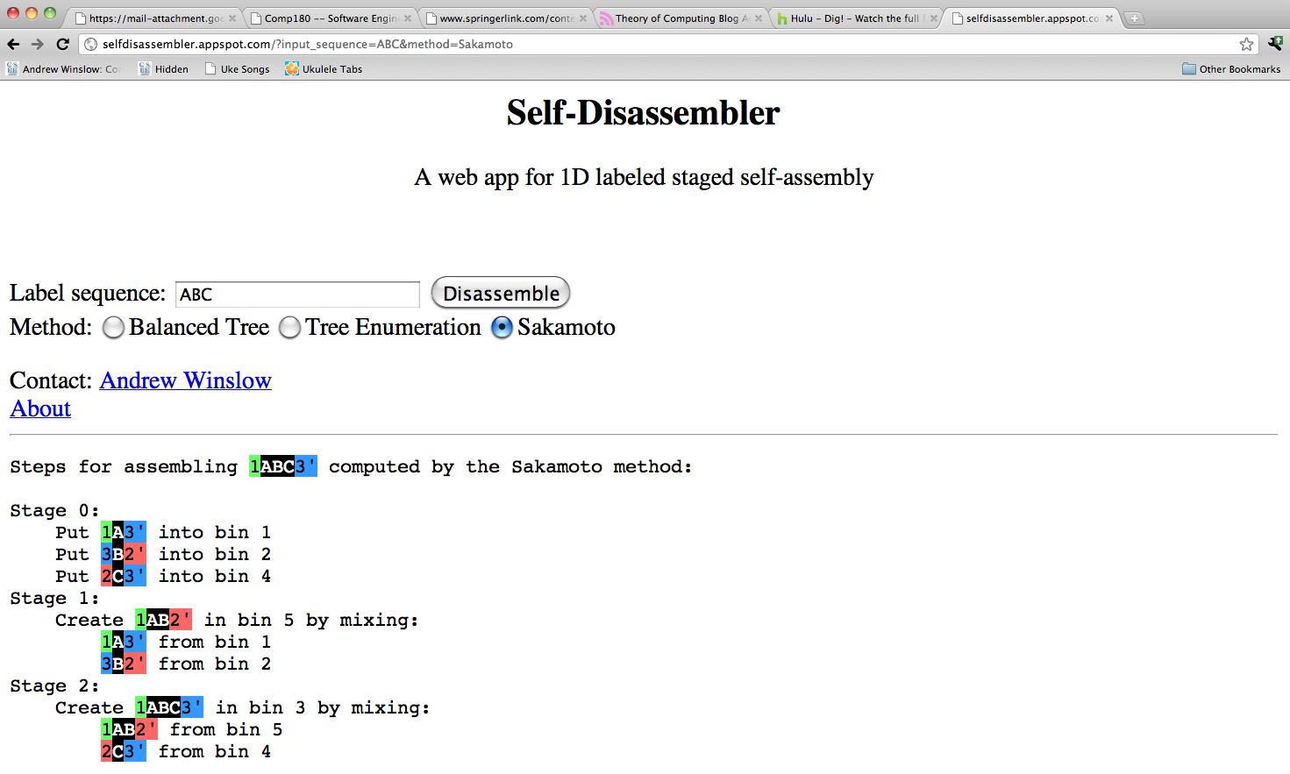
Software is using a grammar algorithm inside.
Computation of < 1s for
sequences of 10,000 labels

Slide 19
A Rude Awakening
The previous result made a subtle assumption about SASs.
This assumption is consistent with previous work, but still!
The truth is:
1. The SASs considered so far are actually a special subclass.
2. The general class has much greater compressive power.

Slide 20
A Mixing Example
Mixing starts with all input assemblies.
A
B
C
A
B
C
Assemblies combine in all possible ways.
C
A
B
C
B
C
A
B
C
A
B
C
A
The mixing products are the distinct
terminal assemblies.

Slide 21
Why This Definition Matters
Previous work only used mixings with one product.
In the general SAS model, mixings may have many products.
A
B
C
A
B
C
A
A
B
B
A
A SAS where every mixing has one product is a SSAS:
a single self-assembly system.

Slide 22
SSAS ≅ RCFG
Until now, the “SAS” model we’ve explored is actually the restricted SSAS model.
The SSAS-to-RCFG conversion works because the mapping from mixing products to left-hand side symbols is 1-to-1.
Now we’ll examine SASs containing many-product mixings.
We’ll see that the SAS-to-RCFG conversion may require a RCFG up to θ((n/log(n))^0.5) larger.

Slide 23
Intuition for RCFG vs. SAS
Reconsider expressing a string as a RCFG and a SAS.
RCFGs can describe patterns in adjacent characters.
But they cannot describe patterns in interleaved characters.
Good: ABCDEF ABCDEF ABCDEF
Bad: ADBECF AEBFCD AFBDCE
SASs can describe these patterns.
Notes:
interleaved string pattern is obvious (to us), but difficult for RCFGs

Slide 24
Interleaving with SASs
1[ADBECF]7
1[AFBDCE]7
2[D]3
1[A]2
4[D]5
4[E]5
3[B]4
6[E]7
6[F]7
5[C]6
2[F]3
Interleaving requires many copies of the same set of assemblies with different glues.
Naively using tiles with same labels, different glues requires many bins, large SAS.

Slide 25
Interleaving Efficiently with SASs
4[-D-]5
Solution: add tiles to “swap” glues.
4[-]2
2[D]3
3[-]5
This idea scales to swap glues on many tiles in one mixing.
Producing the assembly
4[D]5 using the tile 2[D]3.
Composing swap steps gives a very efficient way to generate many copies of the same assembly with different glues.
(nearly)

Slide 26
Proving Separation
Goal: Show for a set of strings S_{k}, k > 0 that the size of any RCFG encoding them is asymptotically larger than some SAS that encodes them.
Separation is the worst-case asymptotic difference in the size of the smallest RCFG and SAS encoding the same string.
Notes:
separation is a formalization of previous slide

Slide 27
Constructing S_{k}
The actual string is binary, has many “filler” tiles from the swap steps, and details.
In essence, the string constructed has the structure:
An interleaved string
Shift permutations of the interleaving
ADBECF AEBFCD AFBDCE
(Example for k = 3)
A static string
A composition of these interleavings
For odd k, |S_{k}| = θ(k²log(k)) and the SAS has size θ(k).

Slide 28
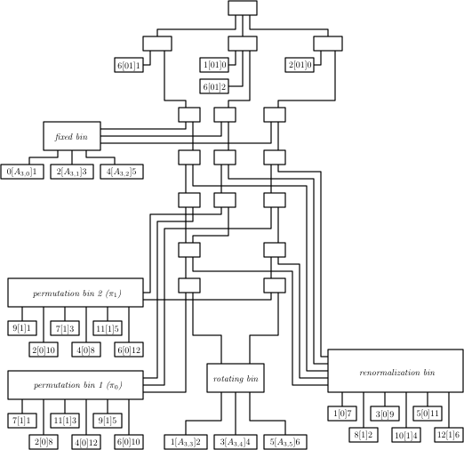
Actual S₃ Mix DAG
Notes:
afbced

Slide 29
RCFG Lower Bound for S_{k}
Consider a Lempel-Ziv factorization of S_{k}:
ADBECF AEBFCD AFBDCE
AD
AE
AF
BE
BF
BD
θ(k²) factors
CF
CD
CE
Rytter (2005): The size of the Lempel-Ziv factorization of a string is smaller than the size of any RCFG generating it.
Thus any RCFG has size Ω(k²).

Slide 30
Separation Summary
We have shown for k > 0 there exists a string of length
θ(k²log(k)) encoded by a SAS of size θ(k) such that any RCFG encoding it has size Ω(k²).
In terms of the string length n, the SAS has size
θ((n/log(n))^0.5) and any RCFG has size Ω(n/log(n)).
So the separation between SASs and RCFGs is
Ω(k) = θ((n/log(n))^0.5). This is tight (not shown).

Slide 31
Summary of Results
SSAS and RCFG encodings differ by a factor of at most 12.
This implies practical algorithms for the disassembly problem on SSASs, as well as hardness of improving these algorithms.
In the worst case, SASs can encode strings of length n more compactly than RCFGs by a factor of θ((n/log(n))^0.5).

Slide 32
Moving Forward: Extending CFG-SAS Connection
Extending this idea to 2D is a natural idea, but one with many hidden challenges:
Defining context-free grammars in 2D.
Developing 2D CFG algorithms.
Dealing with ambiguity issues imposed by higher dimensions (adapt jigsaw method?).
An easier line of work is to reconsider the definition of SAS size to incorporate real constraints like mixing time, yields, glue interactions and scheduling.
Notes:
add reference to ‘staged nano-scale manufacture’

Slide 33
Moving Forward: Geometric Self-Assembly
As we are mostly geometers, an easier idea is to consider models that aren’t “squares on a line”:
Non-square tiles (contact-area based bonding?).
Sticks, graphs, and linkages instead of tiles.
Tiles folding into polyhedral surfaces (latin cross to cube).
Items #1 and #2 were developed with collaborators in the Chemical and Biological Engineering Department based upon the constraints in real systems and research.

Slide 34
Moving Way Forward: Reversible Computing
Alternative computing models have become increasingly popular recently (quantum, distributed, biological).
One of the more fun models is a reversible or zero-energy computer, in which everything can be “undone”.
A major aspect of self-assembly I have not talked about is temperature, which models the role kinetics play in molecular interactions.
It would be interesting to see what is computable in a self-assembly system by varying temperature alone.

Slide 35
Collaborators
This work was done in collaboration with many great researchers whom I am grateful to work with:
Tufts CS:
Michelle Ichinco
Mashhood Ishaque
Tony Lin
Diane Souvaine
MIT CSAIL:
Erik Demaine
Martin Demaine
Sarah Eisenstat
Andre Schulz
Tufts ChemBioE:
Hyunmin Yi
Jihae Sohn
Jennifer Rego
Funding was provided in part by NSF grant CBET-0941538.

