Slide 1
Inapproximability of the Smallest Superpolyomino Problem
Andrew Winslow
Tufts University

Slide 2
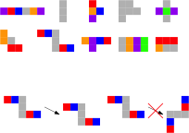
Polyominoes
Colored poly-squares
(stick)
Rotation disallowed

Slide 3

Smallest superpolyomino problem
(stick)
Given a set of polyominoes:
Find a small superpolyomino:

Slide 4

Smallest superpolyomino problem
(stick)
Given a set of polyominoes:
Find a small superpolyomino:

Slide 5

Smallest superpolyomino problem
(stick)
Given a set of polyominoes:
Find a small superpolyomino:

Slide 6

Smallest superpolyomino problem
(stick)
Given a set of polyominoes:
Find a small superpolyomino:

Slide 7

Smallest superpolyomino problem
(stick)
Given a set of polyominoes:
Find a small superpolyomino:

Slide 8

Smallest superpolyomino problem
(stick)
Given a set of polyominoes:
Find a small superpolyomino:

Slide 9

Smallest superpolyomino problem
(stick)
Given a set of polyominoes:
Find a small superpolyomino:

Slide 10
Smallest superpolyomino problem is NP-hard. ☹
Known results
(stick)
But greedy 4-approximation exists! ☺
Yields simple, useful string compression. ☺

Slide 11

Smallest Superpolyomino Problem
Given a set of polyominoes:
Find a small superpolyomino:

Slide 12

Smallest Superpolyomino Problem
Given a set of polyominoes:
Find a small superpolyomino:

Slide 13

Smallest Superpolyomino Problem
Given a set of polyominoes:
Find a small superpolyomino:

Slide 14

Smallest Superpolyomino Problem
Given a set of polyominoes:
Find a small superpolyomino:

Slide 15

Smallest Superpolyomino Problem
Given a set of polyominoes:
Find a small superpolyomino:

Slide 16

Smallest Superpolyomino Problem
Given a set of polyominoes:
Find a small superpolyomino:

Slide 17

Smallest Superpolyomino Problem
Given a set of polyominoes:
Find a small superpolyomino:

Slide 18
Smallest Superpolyomino Problem
Given a set of polyominoes:
Find a small superpolyomino:

Slide 19
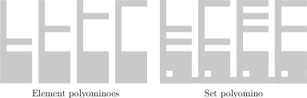
O(n^{1/3 – ε})-approximation is NP-hard. ☹
(ε > 0)
(even if only two colors)
NP-hard even if only one color is used. ☹
Simple, useful image compression? No

Slide 20
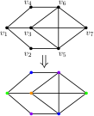

Reduction Idea
Reduce from chromatic number.
Polyomino ≈ vertex.
Polyominoes can stack iff
vertices aren’t adjacent.

Slide 21
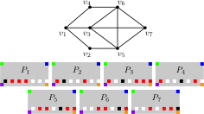
Generating polyominoes from input graph

Slide 22
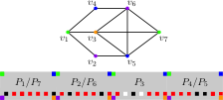
Chromatic number from superpolyomino
4 stacks ≈ 4-coloring

Slide 23
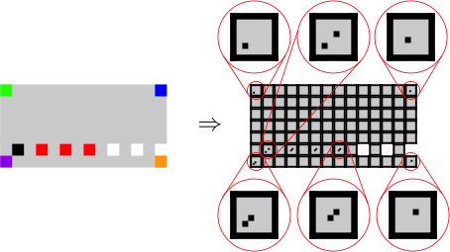
Two-color polyomino sets

Slide 24
One-color polyomino sets
Reduction from set cover.

Slide 25





Sets
Elements

Slide 26
Smallest superpolyomino problem is NP-hard. ☹
The good, the bad, and the inapproximable.
(stick)
KNOWN
But greedy 4-approximation exists. ☺
One-color variant is trivial. ☺
Smallest superpolyomino problem is NP-hard. ☹
O(n^{1/3 – ε})-approximation is NP-hard. ☹
One-color variant is NP-hard. ☹

Slide 28
Open(?) related problem
The one-color variant is a constrained version of:
“Given a set of polygons, find the
minimum-area union of these polygons.”
What is known? References?

Slide 29
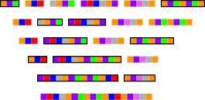
Greedy approximation algorithm
input:
output:
Gives superpolyomino at most 4 times
size of optimal: a 4-approximation.

Slide 30
Inapproximability ratio
Stack size is θ(|V|²)
k-stack superpolyomino has size θ(k|V|²):
k is (n^{1-ε})-inapproximable.
So smallest superpolyomino is O(n^{1/3-ε})-inapproximable.

Slide 31
Cheating is as bad as worst cover.
So smallest superpolyomino is a good cover
and finding it is NP-hard.

Slide 32
Smallest superpolyomino problem
(stick)
Given a set of polyominoes:
Find a small superpolyomino:

