Slide 1




The Power of Seeds in Tile Self-Assembly
Andrew Winslow
Department of Computer Science, Tufts University

Slide 2


Abstract Tile Assembly Model (aTAM)

Slide 3










Abstract Tile Assembly Model (aTAM)

Slide 4
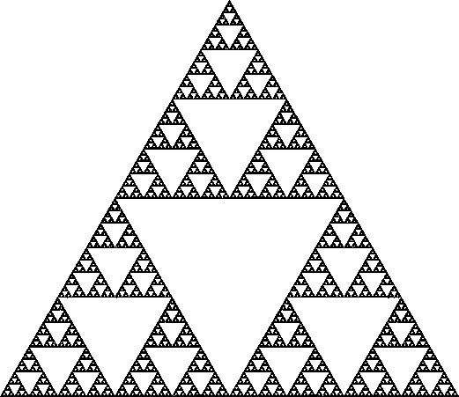
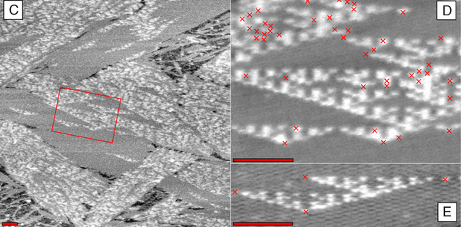
Tile Assembly
P. W. K. Rothemund, N. Papadakis, E. Winfree, Algorithmic self-assembly of DNA Sierpinski triangles. PLoS Biology (12), 2004.
Notes:
100 nm scale bars

Slide 5
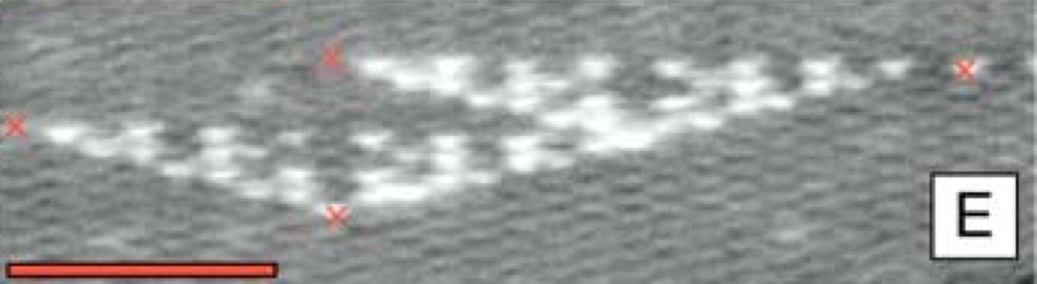
Tile Assembly

Slide 6
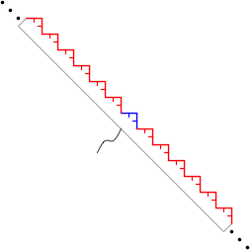
Tile Assembly

Slide 7
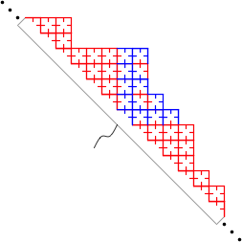
Tile Assembly

Slide 8
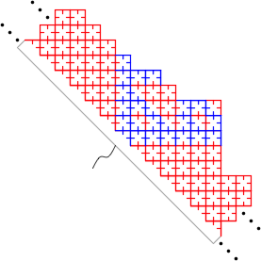
Tile Assembly

Slide 9
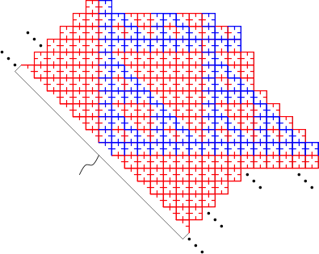
Tile Assembly

Slide 10
Tile Assembly

Slide 11
Tile Assembly

Slide 12

Tile Assembly

Slide 13
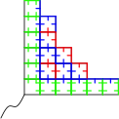
Tile Assembly

Slide 14
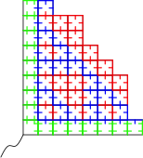
Tile Assembly

Slide 15
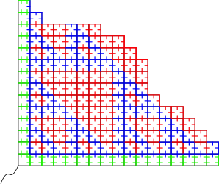
Tile Assembly

Slide 16
Tile Assembly

Slide 17


Slide 18

A Seedless World?

Slide 19
A Seedless World?

Slide 20
A Seedless World?

Slide 21
A Seedless World?

Slide 22
A Seedless World?
• • •
• • •

Slide 23




Two-Handed Assembly Model (2HAM)

Slide 24
Two-Handed Assembly Model (2HAM)

Slide 25






Two-Handed Assembly Model (2HAM)

Slide 26
How powerful is 2HAM relative to aTAM?
Are there techniques that require a seed?
No.

Slide 27
Every aTAM system can be
simulated with a 2HAM system.

Slide 28






Simulation

Slide 29






Simulation

Slide 30
Simulation captures dynamics

Slide 31
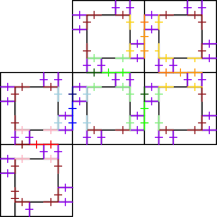
Simulation captures production

Slide 33
Starting the Seed Mortar

Slide 35
Single-Bond Brick & Mortar

Slide 37
Double-Bond Brick &Mortar

Slide 38
That simulation is mostly correct…

Slide 40
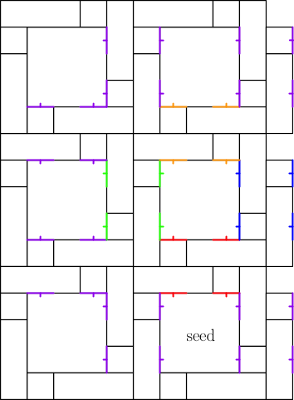
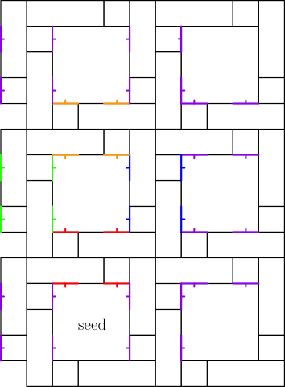
Interacting Seed Assemblies

Slide 41

Inward and Outward Glues
Invariant: every exposed glue on an
assembly containing a seed is outward.

Slide 42
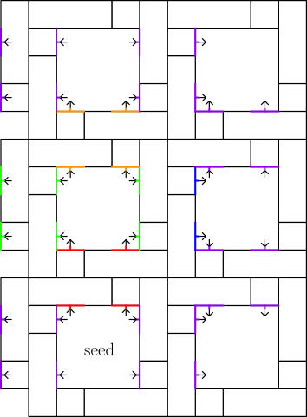
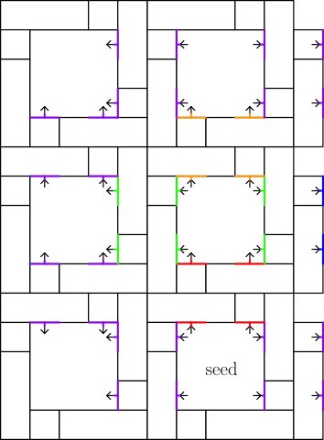
Inward and Outward Glues

Slide 43


Slide 44
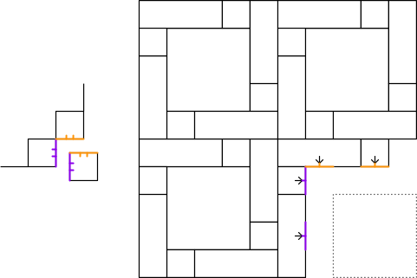

Slide 45
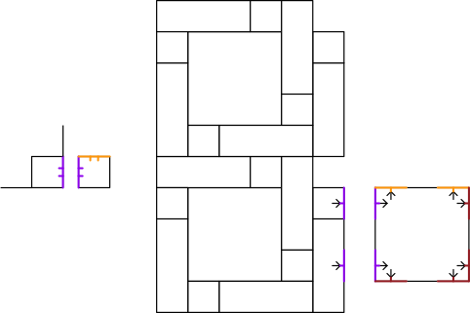

Slide 46
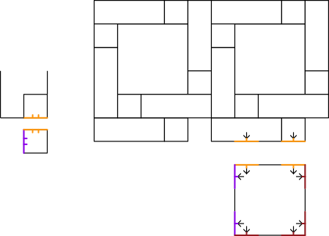

Slide 47
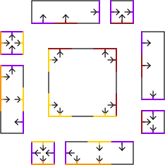

Minimal Glue Sets

Slide 48
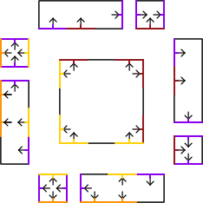
Minimal Glue Sets

Slide 49



Minimal Glue Sets

Slide 50
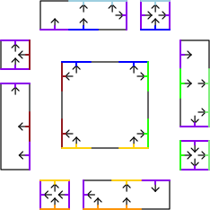
Minimal Glue Sets

Slide 51
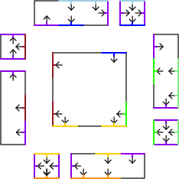
Minimal Glue Sets

Slide 52
Preventing Seed Assembly Interaction
Idea #1: maintain that all exposed glues on any seed assembly are outward glues.
Idea #2: ensure every attaching brick uses all inward glues to attach, leaving only outward glues exposed.

Slide 53


Generalizations

Slide 54
Simulating 2HAM dynamics with aTAM?
?
Can’t simulate dynamics

Slide 55





A Troublesome Shape
• • •
Notes:
In the aTAM, each orange tile must be distinct!

Slide 56



A Troublesome Shape
• • •

Slide 57



2HAM Binary Counter
Counter Tiles
Counter Tiles
Counter Tiles

Slide 58


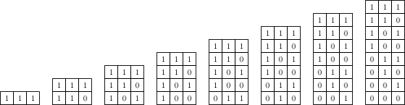
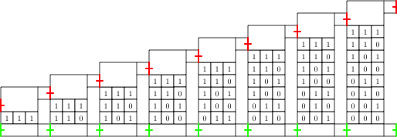
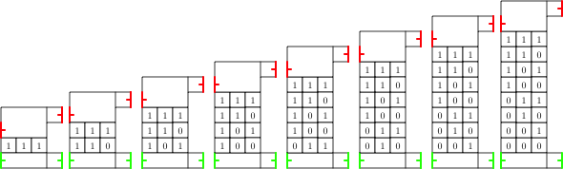
2HAM Staircase Assembly
Counter Tiles

Slide 59
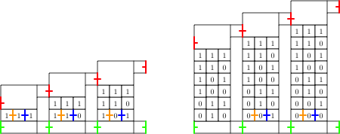
2^{b} pillars
Can’t simulate production
b
•••
•••
aTAM needs ≈2^{b} tiles
2HAM needs ≈b tiles

Slide 60
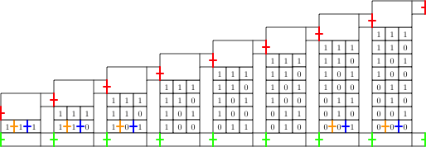
Conclusions
aTAM ≤ 2HAM always
2HAM ≤ aTAM at times

Slide 61
Acknowledgements
Joint work with:
Sarah Cannon, Erik and Martin Demaine,
Sarah Eisenstat, Matthew Patitz,
Robert Schweller, and Scott Summers.
Research funded in part by NSF grant CBET-0941538

