Slide 1
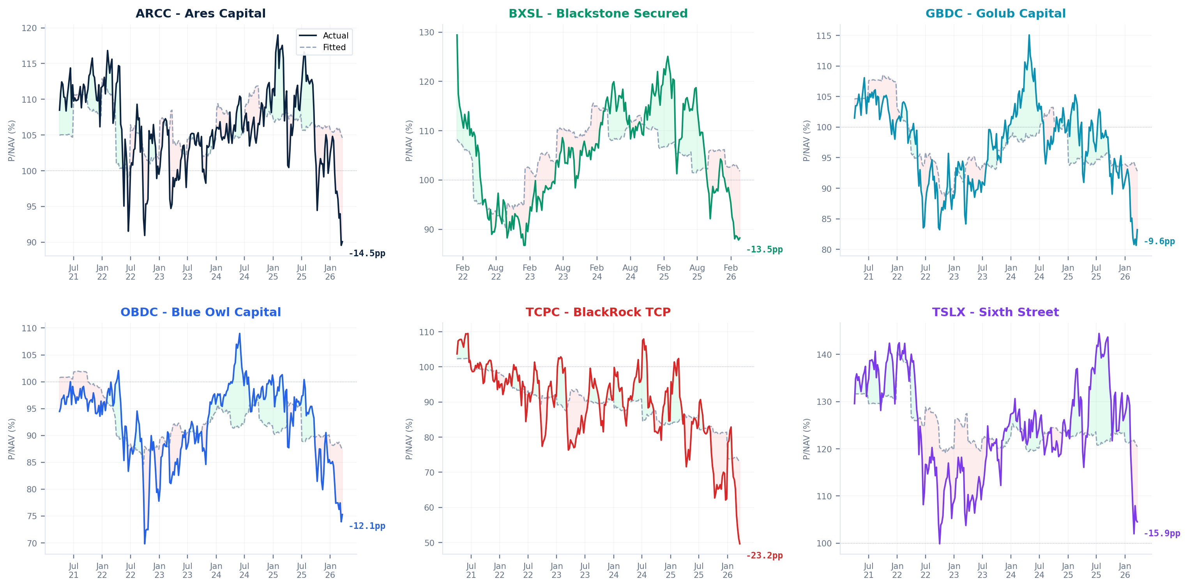
BDC P/NAV: Actual vs Model-Fitted
P/NAV ~ 2Y Treasury + NII/sh + FV/Cost + Debt/NAV + Name FE | N=7,591 | R²=77.2% | Daily panel, Q2'21 - Mar'26
Red shading = below model fair value | Green shading = above | Annotation = current residual (pp) | Source: S&P Capital IQ, SEC EDGAR

