Slide 1
Experimental Study of Directed Feedback Vertex Set Problem
Xi Wu
With Rudolf Fleischer and Liwei Yuan
Fudan University, Shanghai

Slide 2
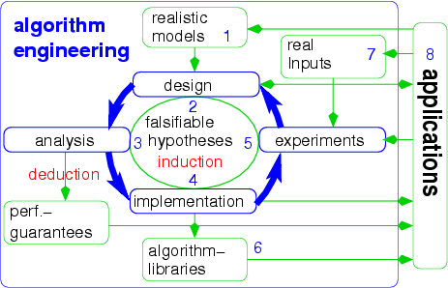
Algorithm Engineering for DFVS
Deadlock recovery
New data reduction rules
New data reduction rules
New data reduction rules
New data reduction rules
Heuristics
Heuristics
Heuristics
When helpful? When not?
When helpful? When not?
When helpful? When not?
When helpful? When not?
When helpful? When not?
When helpful? When not?
Experimental analysis
Experimental analysis
Experimental analysis
Experimental analysis
Quantify the benefits
Quantify the benefits
Quantify the benefits
Quantify the benefits
Chen’s FPT algorithm
Chen’s FPT algorithm
Chen’s FPT algorithm
Chen’s FPT algorithm
Implement these rules
Implement these rules
Implement these rules
Implement heuristics
Implement heuristics
Peter Sanders, Festschrift Mehlhorn 60th, 2009

Slide 3
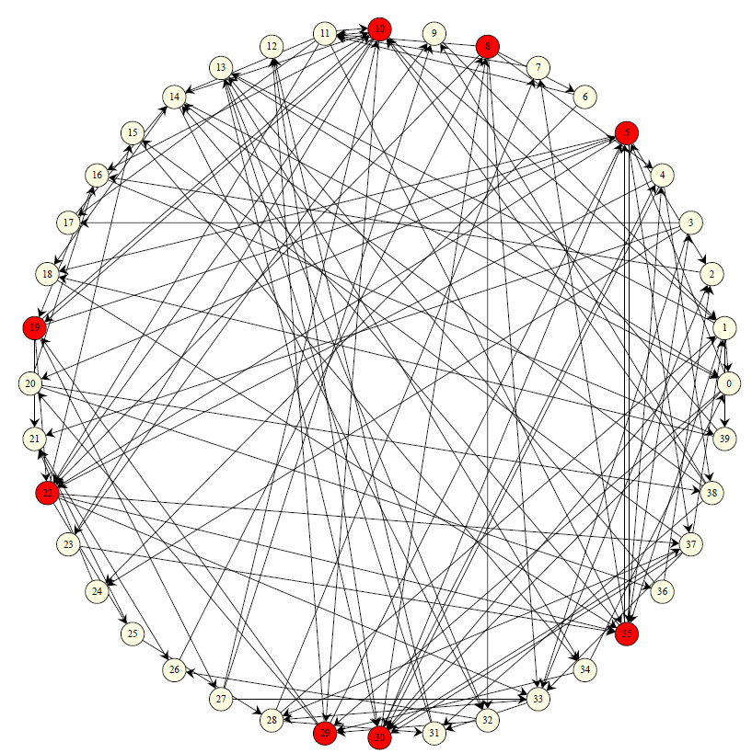
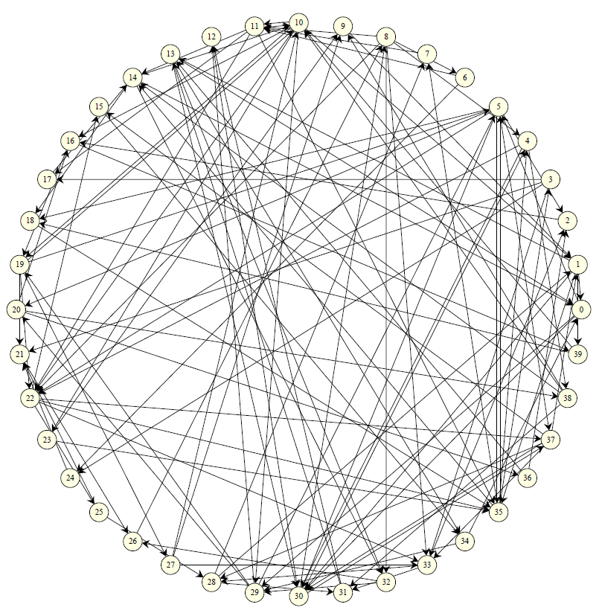
Directed Feedback Vertex Set
(DFVS)
Find k vertices to destroy all cycles
What about this one with k=8?
Minimum DFVS is NP-hard
1-FVS

Slide 4
DFVS vs. Undirected Feedback Vertex Set (UFVS)
Both NP-hard, but UFVS is better understood
 | DFVS | UFVS
Approximation | O(min{τ*logτ*loglogτ*, τ*logN loglogN)-approximation [Even ‘98] (τ* is the optimum fractional solution) | 2-approximation [Bafna ‘1999]
FPT algorithm | O(k! 4^{k} n^{O(1)}) [Chen STOC‘2008] | O(4^{k} k n) [Becker ‘2000]
Kernelization | Polynomial kernel? | Quadratic kernel [Thomasse SODA‘2008]

Slide 5
Our Work
Test engine: random graph generator
  Controlling various parameters
Experimental study of Chen’s FPT algorithm for DFVS [Chen STOC‘2008]
  With various parameters
Data reductions and heuristics
  Quantify the benefits
Application: deadlock recovery
  DFVS not more helpful than cycle detection

Slide 6
Random Graph Generator
Goal: difficult, random graphs
Parameters controlled:
  n: Number of nodes
  k: Size of the minimum FVS
  edge density: ed = #edges/n
A nontrivial task…

Slide 7
A Non-trivial Task
Spanning tree
  Wilson’s algorithm
Connected DAG
  Melancon’s algorithm
Control
  solution size, overlapping cycles, edge density …

Slide 8



Chen’s Algorithm
G
(k + 1)-subgraph
(k + 2)-subgraph G’
(G’-H) is acyclic
|U| ≤ k-|I|
Compress into k-FVS
k-FVS
(k+1) –FVS H
|I| ≤ k
(H-I) is acyclic
x
Iterative Compression

Slide 9
Start Configuration of Chen’s Algorithm
Consider heuristic solution X:
  choose a k-subset Y of X
  start with S = (G – (X – Y))
    If X is good, then better performance

Slide 10
Chen’s Original Algorithm
Configuration
  n: from 40 to 200, step by 20
  k: in {2, 4, 6, 8}
  ed in {2.0, 3.0, 3.5, 4.0}
Generate 10 graphs for (n, k, ed)
  Record max, min and average
Timeout: 3 hours
  Count as 3 hours

Slide 11
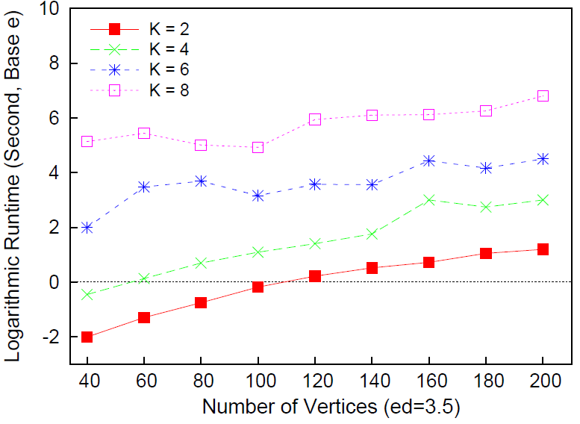
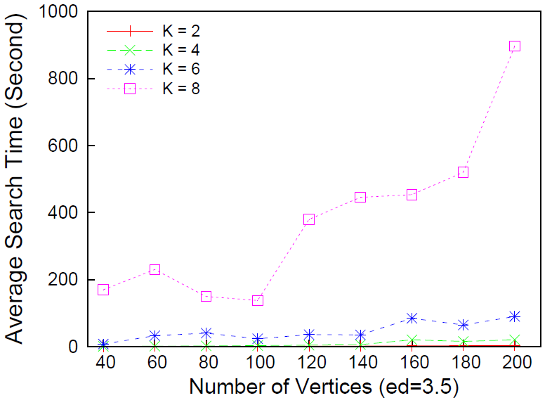
Runtime Performance
Logarithmic runtime (ed=3.5)
Runtime (ed=3.5)
Algorithm is slow, even with small parameter k
Performance fluctuates when n increases

Slide 12
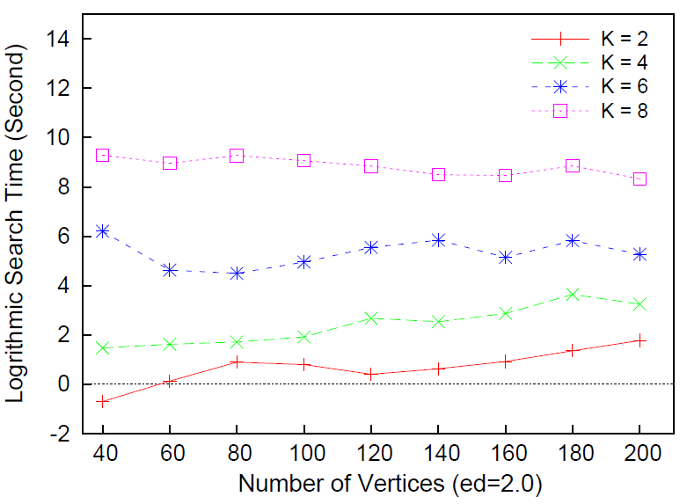
Low Edge Density: High Runtime
Worst performance for n=40

Slide 13


Many Independent Cycles:
High Runtime
An intuitive example: “Pyramid”
The optimum solution for the first 3 layers are the 2nd layer
The optimum solution for the whole graph is the 1st and 3rd layers

Slide 14
Reduction Rules
Reduction: in polynomial time
  reduce (G, k) to (G’, k’)
  (G, k) is a YES-instance iff (G’, k’) is a YES-instance
Kernelization
  |G’| is bounded by f(k)
  k’ ≤ k

Slide 15
Reduction Rules I (Chen)
Trivial rules:
  Self-loops: add node to DFVS
  Parallel-edge: delete multiple edges

Slide 16
Reduction Rule II
Dummy
  in-degree/out-degree = 0;
Other part of the graph
u
delete u

Slide 17
Reduction Rules III
Chain
  in-degree/out-degree = 1;
Other part of the graph
v
u
merge u and v

Slide 18
Reduction Rule IV
Flower
  (k+1) vertex-independent cycles exactly intersecting on u: add u to DFVS
Other part of the graph
x
y
z
k = 2
petal(u) = {x, y, z}
u

Slide 19
Reduction Rule V
Shortcut
  petal(u) = {v}: bypass u
x
z
x
z
v
u
y
w
y
w
u

Slide 20
Remarks
These rules do NOT give a kernelization
We need rules when 2 ≤ |petal(u)| ≤ k

Slide 21
Non-Reducible Graphs
…
…
u
v
| petal(u) | = | petal(v) | = 2
u, v are useless

Slide 22
Non-Reducible Graphs
…
…
u
v
w
When can we safely reduce u, v, w?

Slide 23
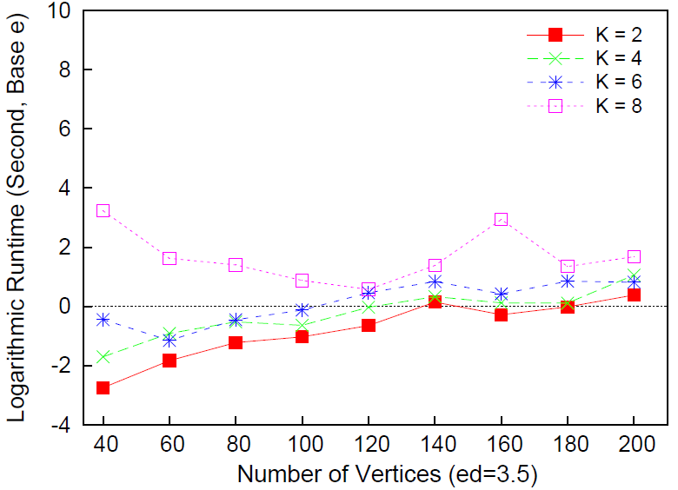
Runtime with Reductions
(n small, k small)
No reductions
With reductions
4X ~ 140X speedup

Slide 24
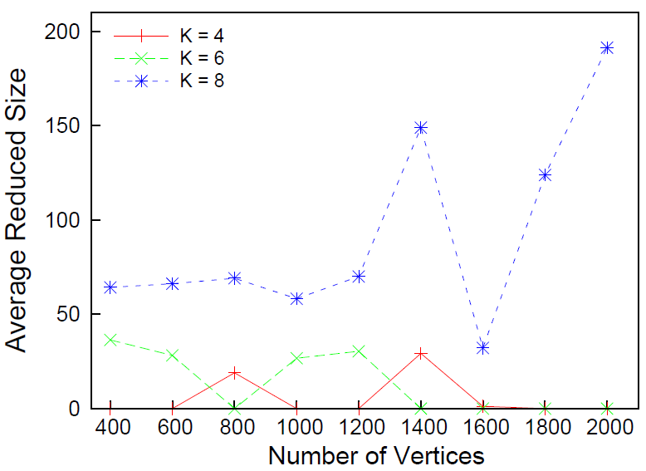
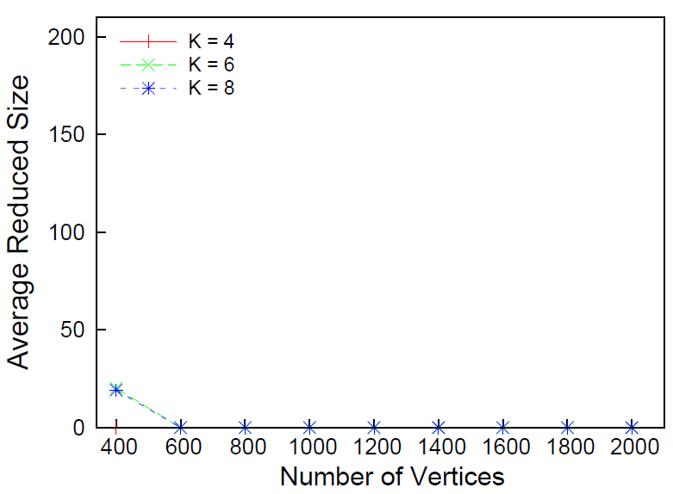
Reduced Size
(n large, k small)
ed = 2.0
ed = 3.0
90% nodes reduced
Many flowers found !

Slide 25
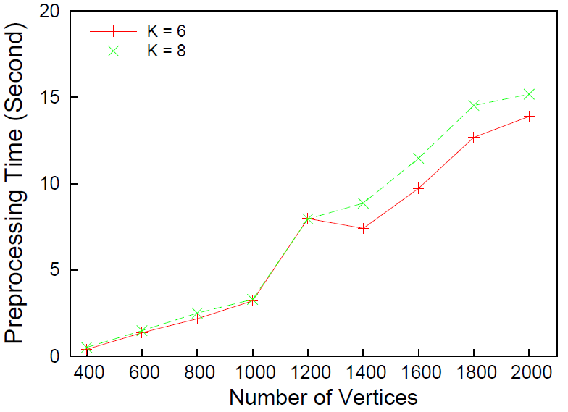
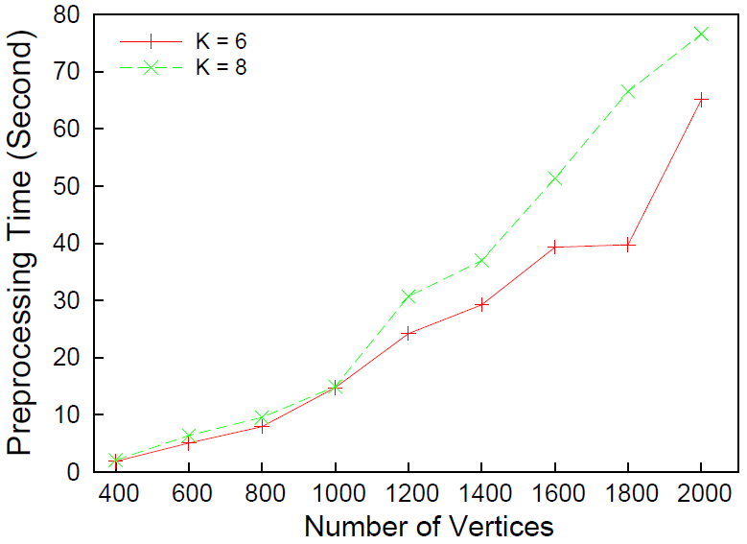
Preprocessing Time
(n large, k small)
ed = 2.0
ed = 3.0
Scales linearly with n and ed

Slide 26
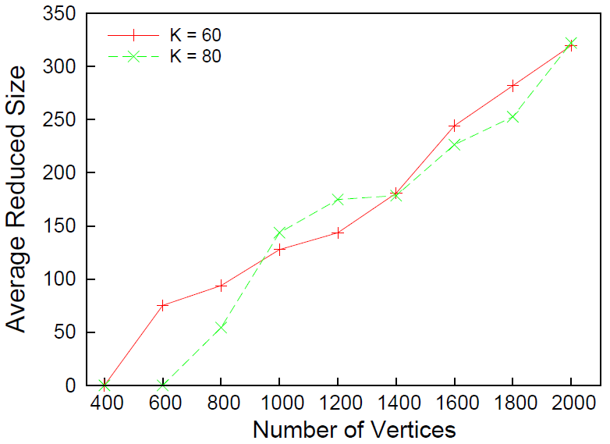
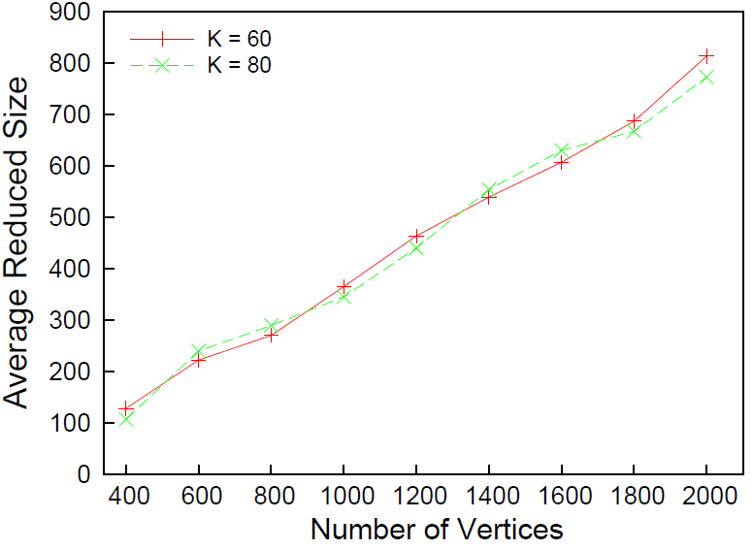
Reduced Size
(n large, k large)
ed = 2.0
ed = 3.0
Now flower reduction does not work well

Slide 27
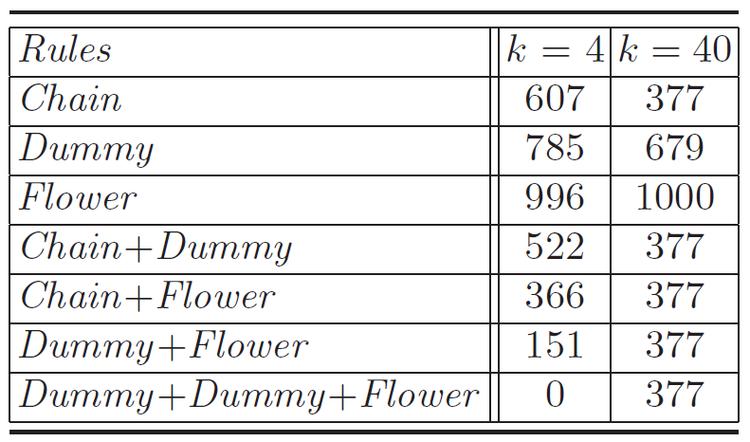
Which Rules are Powerful?
n = 1000 and ed = 3.0
No flowers found…
s

Slide 28
Start Heuristics
Three heuristics:
  Big-Degree
  pick biggest total degree vertices until acyclic
  Even’s Fractional Approximation
    pick the most heavy weight set
  Even’s Full Approximation
    pick the approximation solution

Slide 29
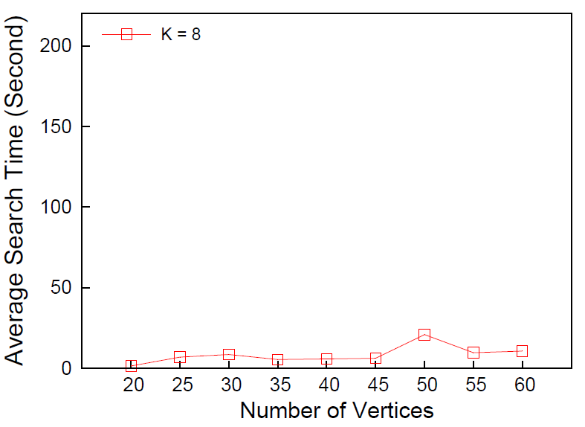
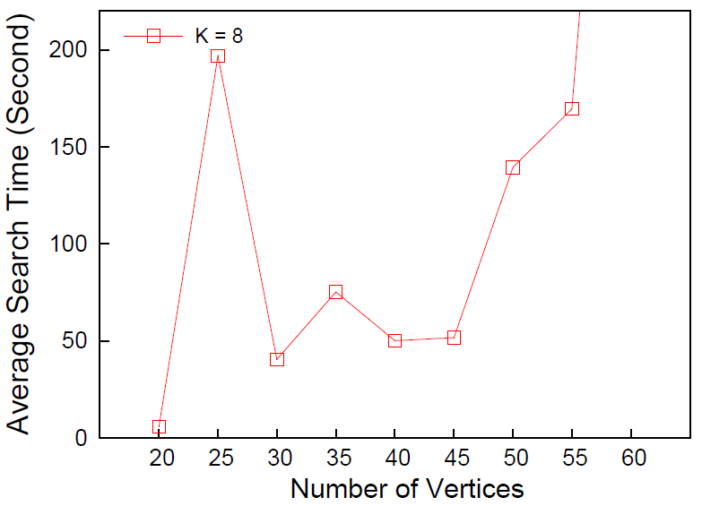
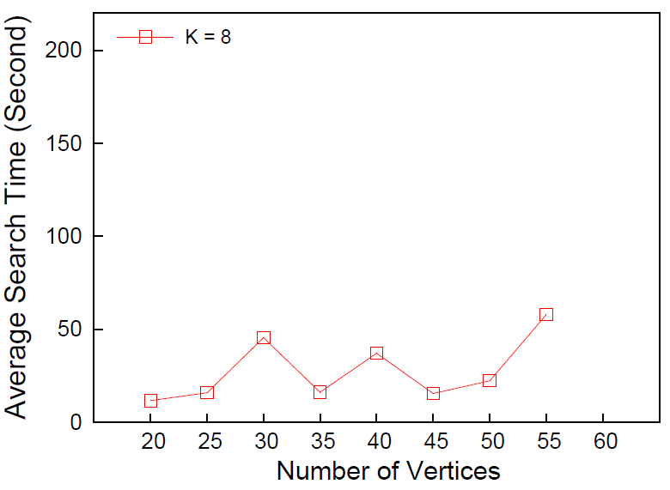
Evaluating Heuristics
Big Degree
No heuristic
Fractional Approximation
4x-50x speedup
40+s
20+s
20+s
10s
Practical Scheme:
  Preprocessing + Big-Degree + Chen’s algorithm --> further 2-3x speedup

Slide 30



Practical Application:
Deadlock Recovery
Could DFVS help us for deadlock recovery?
request
L3
  R1: one lock owned by only one thread
  R2: one thread can wait on only one lock
No overlapping cycles
Cycle detection is enough
grant
t1
own
Deadlock
t3
t2
t4

Slide 31
A Real System
The Deadlock Immunity System
  OSDI ’08 (top system conference)
  Use cycle detection to enable deadlock immunity
  10% overhead on average
    instrumentations, framework overhead, etc.

Slide 32
Conclusion
Quantitative analysis of Chen’s FPT algorithm for DFVS
New reduction rules
  With significant performance benefits
  Quantitative analysis

Slide 33
Open Problems
Reduction rules when 2 ≤ |petal(u)| ≤ k ?
  |petal(u)| ≥ (k+1), flower rule
  |petal(u)| = 1, shortcut
Kernelization for DFVS problem
Better heuristics
  Better approximation algorithm?

Slide 34
Thanks !
?

Slide 35
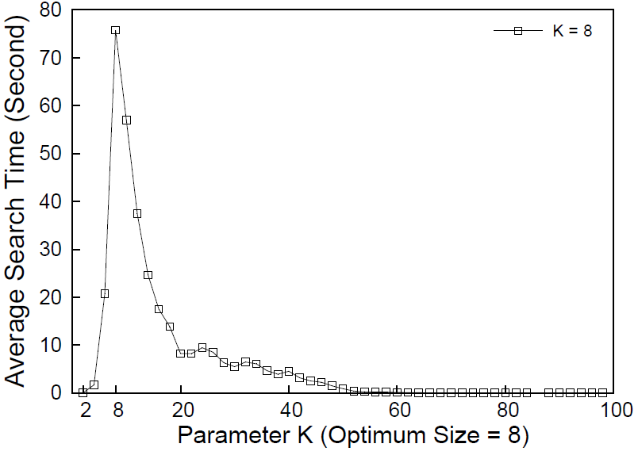
FPT search with different parameter k

Slide 36
Backup Slides

Slide 37


Skew Separator
G - F: Acyclic
Find (k-|F’|) vertices to block back edges go from vi to vj (i>j)
u
(F-F’) is acyclic.
Guess a toporder.
Skew separator problem. FPT algorithm using branching
v₁
v₂
v₃
v_{n}
…

Slide 38
Example of Applying Reductions
K = 2. FVS:
1
2
Delete Parallel Edges
3
Delete Self Loops
7
1
K = 1
Delete Dummy
2
6
Find a Flower
K = 0 and Acyclic
9
Done
4
8
5

Slide 39
Generation Strategy
Generation strategy
  The edges of connected DAG are ¼ of the total edge bound
  Each cycle has at most ¼ of nodes
  Generate cycles until reaching the edge bound

