Slide 1
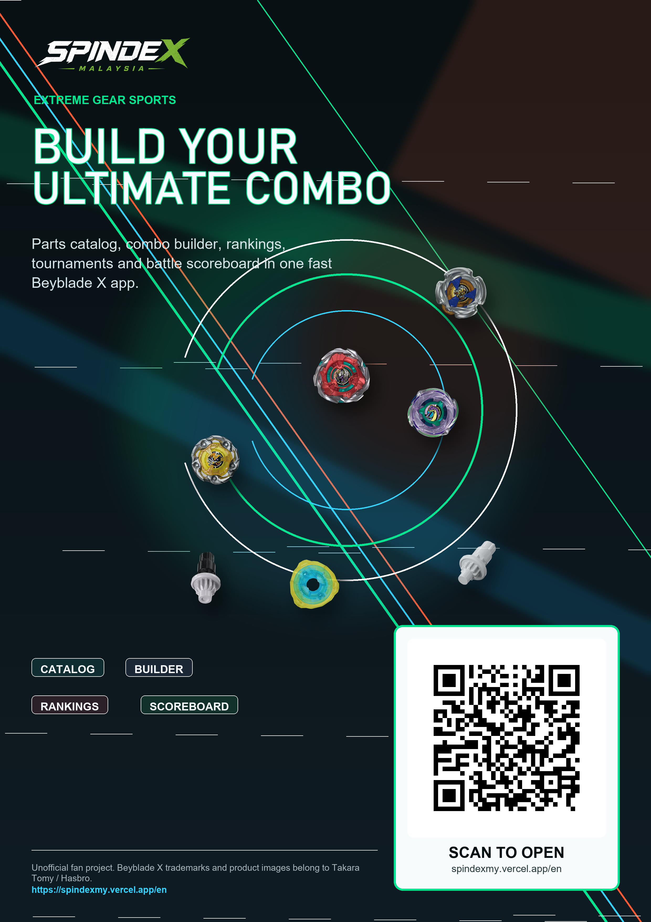

A community app for Beyblade X gatherings and tournaments
Built to run local meetups, structured events, live scoring, and player identity in one place.
Malaysia pilot deck
July 2026

Slide 2
POSITIONING
Social sports apps prove the behavior; Spindex owns the Beyblade X version.
Reclub's public positioning centers on running clubs, meets, competitions, and community in one product. Spindex applies that same operating model to a tighter, underserved niche: bladers who need recurring gatherings and credible tournaments.
Discover
Gather
Compete
Remember
Find nearby bladers, events, shops, and club activity.
Post meetups with place, time, fee, capacity, RSVP, and waitlist.
Run brackets, partner leagues, scoring, IDs, and BEYLIVE displays.
Turn results into rankings, profiles, stars, and shareable community history.
Sources: Reclub official site and Apple App Store listing; Spindex repo and local screenshots.
SPINDEX Malaysia
02

Slide 3
PROBLEM
The gap is not interest; it is coordination.
Beyblade X communities already gather in stores, malls, and local groups. What breaks down is the operating layer around the play.
Discovery is scattered
Hosting is manual
Tournaments feel fragile
Results disappear
Players rely on chat groups, word of mouth, and store posts to know where play is happening.
Hosts juggle RSVPs, waitlists, payments, formats, and lineup changes across multiple tools.
Brackets, scores, judges, and streams can become spreadsheets and screenshots under pressure.
The event ends, but rankings, player history, and meta learning rarely compound.
SPINDEX Malaysia
03

Slide 4
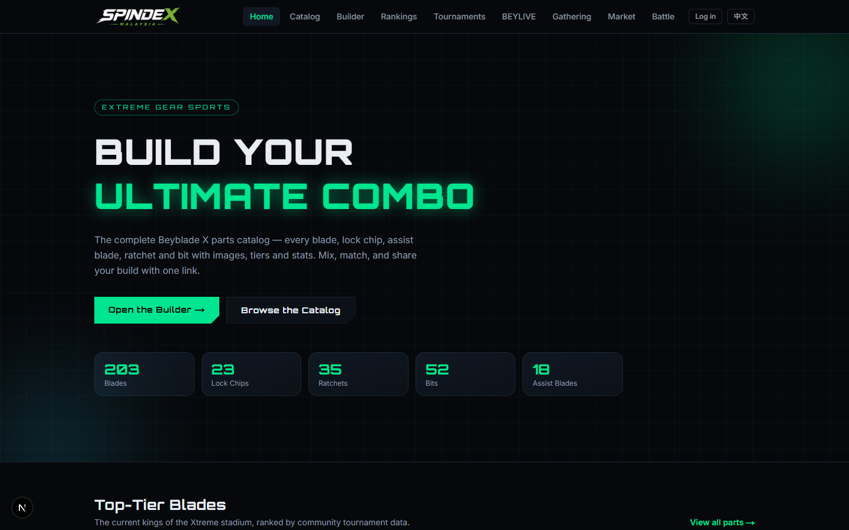
PRODUCT
Spindex turns casual play into a repeatable community loop.
The product should not start as a broad social network. It starts with real-world play, then uses every event to create the next one.
1
Create a gathering
State, venue, time, capacity, fee, notes, join/waitlist.
2
Convert interest into lineup
Joined players become tournament and partner battle rosters.
3
Run the event live
Judges score; public displays and BEYLIVE update.
Existing app surface: catalog, builder, rankings, tournaments, BEYLIVE, gatherings, market, battle.
4
Feed the community graph
Profiles, stars, rankings, combos, and content carry forward.
SPINDEX Malaysia
04

Slide 5
GATHERINGS
Gatherings are the recurring top of the funnel.
For a Reclub-style launch, gatherings should become the weekly habit: low-friction meetups that identify active players and seed future tournaments.
Host setup
Attendance control
Tournament bridge
Create a public meetup with state, venue, date/time, free or paid fee, capacity, and host notes.
Players join, waitlist, leave, and share the gathering page. Hosts can cancel or edit event details.
A strong gathering becomes a lineup source for brackets, partner battles, and BEYLIVE events.
Launch motion: weekly casual gatherings first, monthly flagship tournaments second.
SPINDEX Malaysia
05

Slide 6
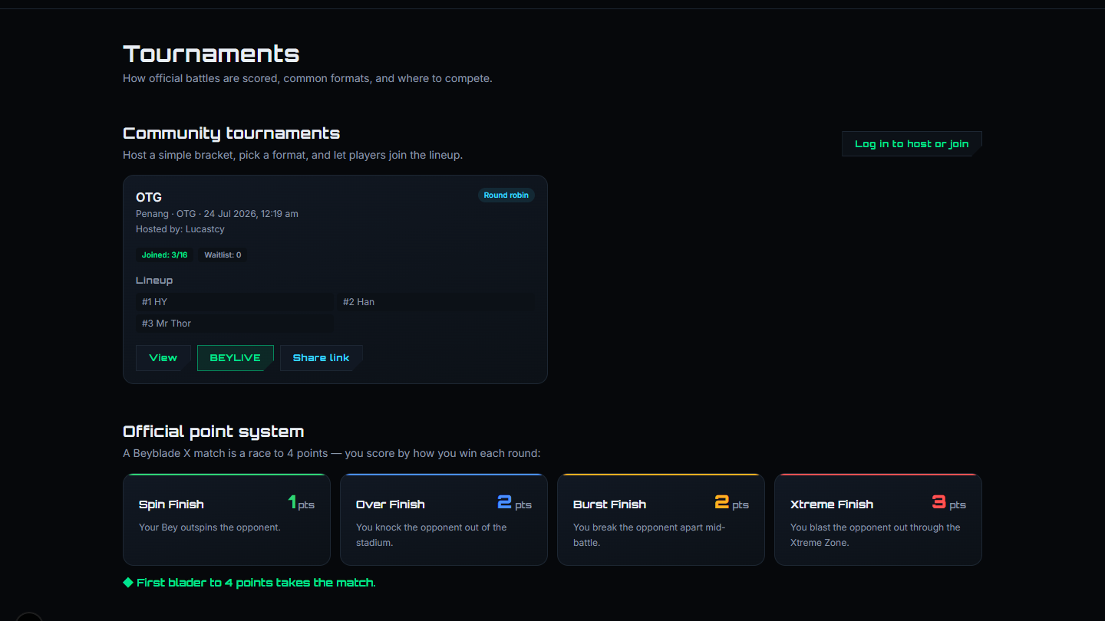
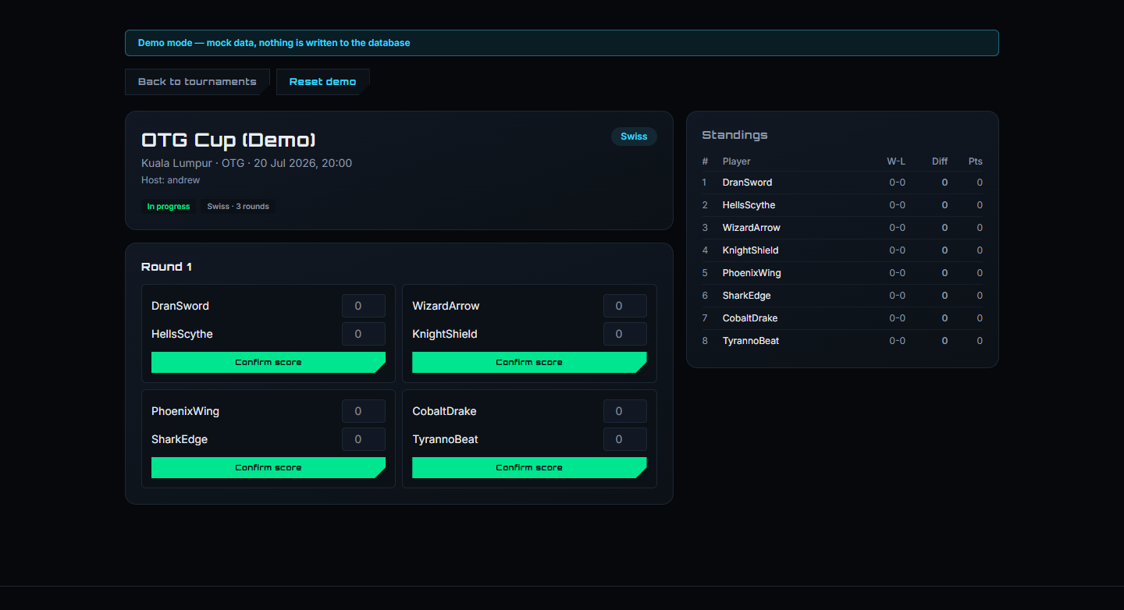
TOURNAMENTS
The tournament engine is the wedge.
Formats already represented in the app
Why it matters: events need credible structure before they need heavy social features.
Single elim
Double elim
Round robin
Swiss
Free-for-all
Leaderboard
Partner battle
SPINDEX Malaysia
06

Slide 7
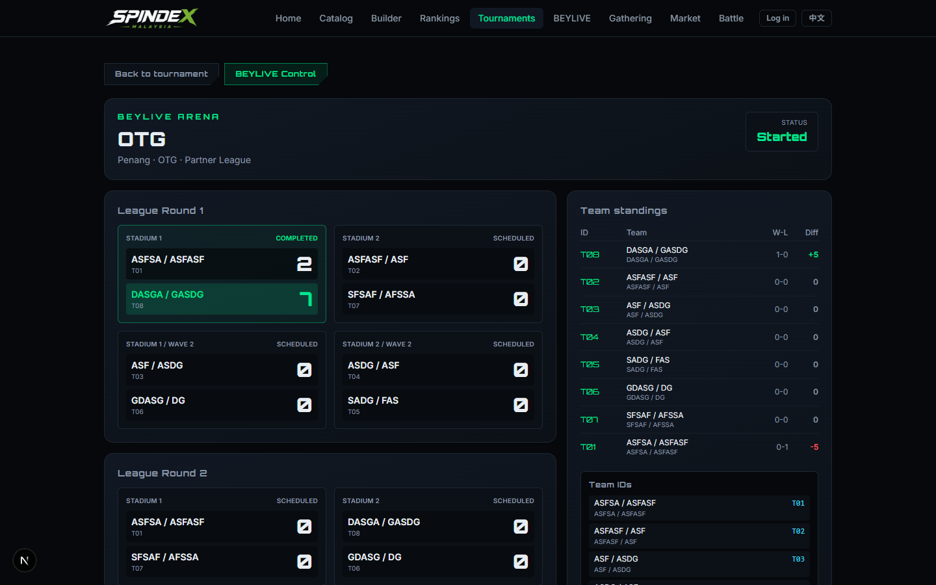
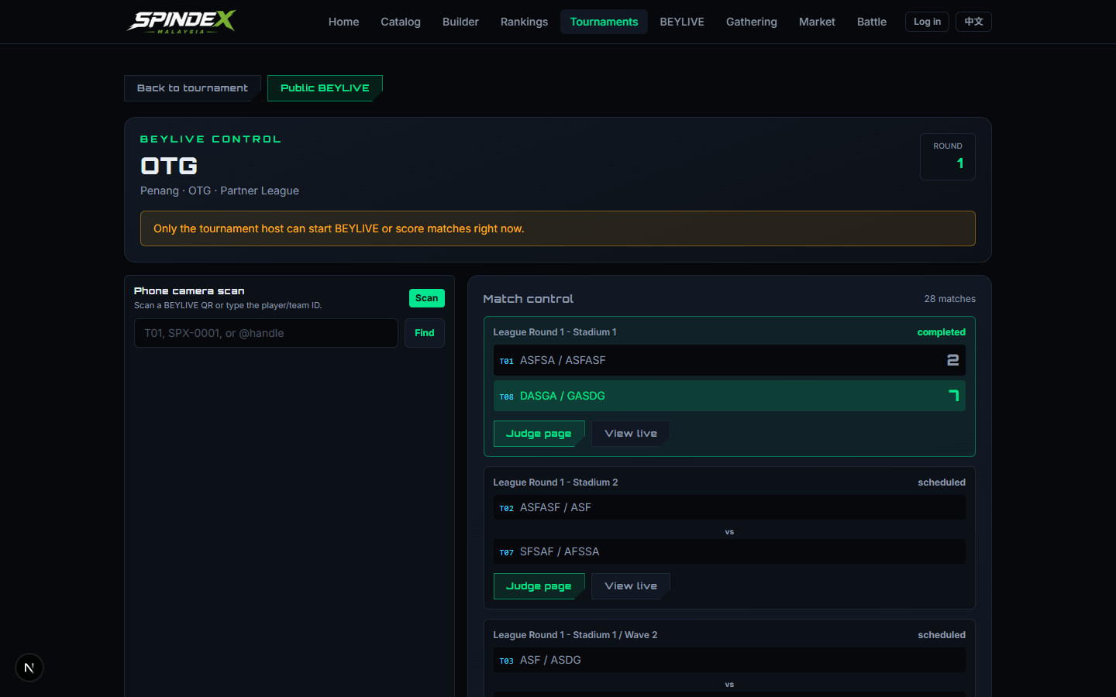
LIVE EVENT OS
BEYLIVE makes a local event feel official.
Public arena
Judge control
Player IDs
Stream-ready
Matches, standings, champions, team IDs.
Score, undo, advance, and finalize.
QR badges and phone camera scan.
Event and stadium video feeds.
SPINDEX Malaysia
07

Slide 8
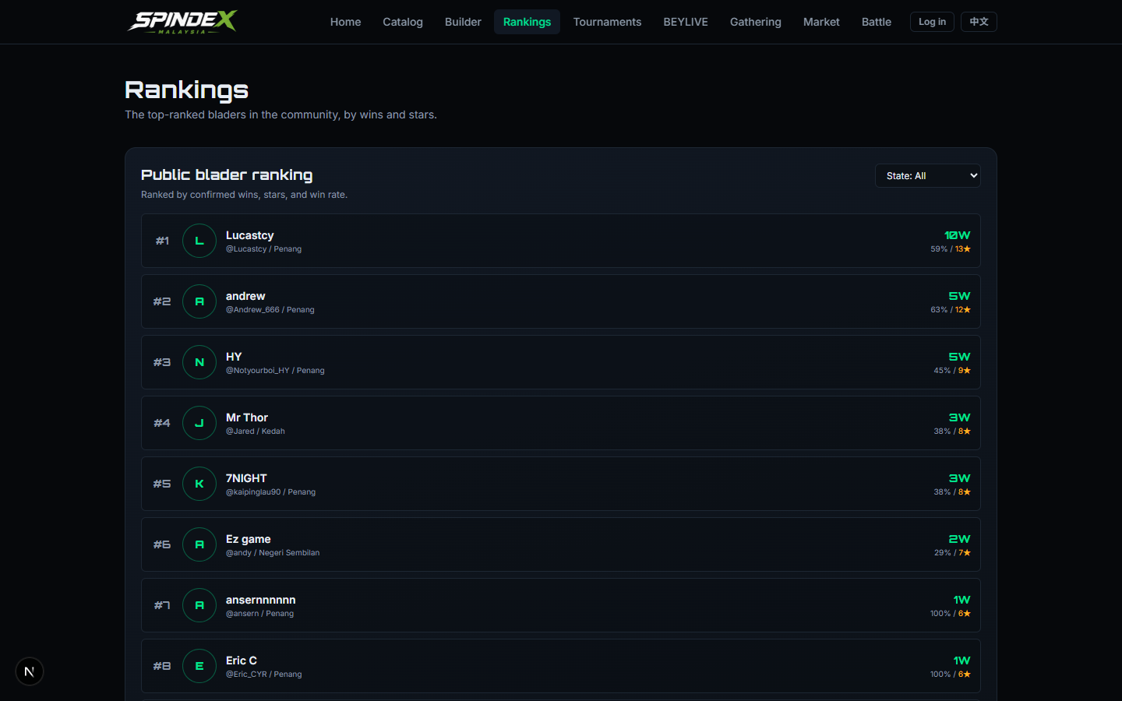
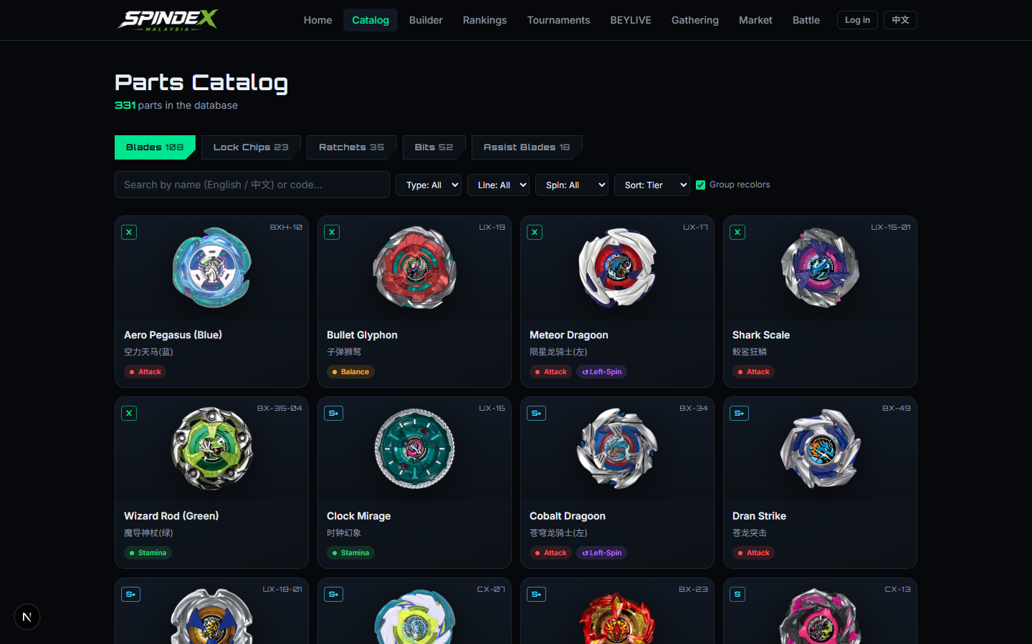
COMMUNITY FLYWHEEL
Every event compounds into community data.
331
203
SPX
Stars
parts in the database
blade records
persistent player IDs
wins and battle history
SPINDEX Malaysia
08

Slide 9
BUSINESS MODEL
The first revenue lanes follow the event workflow.
Revenue lane
What it sells
Primary signal
Organizer tools
Subscription for hosts, shops, and clubs that run recurring gatherings and tournaments.
Host retention
Tournament registration
Entry collection, platform fee, paid brackets, and premium event pages.
GMV + fee
Sponsorship packages
Sponsored cups, prize pools, store promotions, featured leaderboards, and media assets.
Brand budget
Marketplace commission
Buy/sell/pre-order parts once transactions move beyond preview.
Take rate
Start monetization after the pilot proves repeat hosts, recurring event attendance, and sponsor-ready event media.
SPINDEX Malaysia
09

Slide 10
Pilot Spindex as Malaysia's Beyblade X event layer.
0-30 days
30-60 days
60-90 days
Recruit host partners
Run monthly Cup
Launch season
Lock 3-5 shop or club hosts, publish the first gathering calendar, and convert community lists into profiles.
Use BEYLIVE, partner battle, standings, and event pages to make one flagship tournament repeatable.
City leaderboards, sponsor placements, prize pools, and marketplace waitlist tests.
Ask: approve the pilot, secure venue/store partners, and package sponsors around monthly tournaments.
SPINDEX Malaysia
10

