Slide 1
Quantum Fourier Transfer Learning
Leo Moon, Yuyi He, Zoey Hu, Yirui Li, Andrew Yates
Cornell University

Slide 2
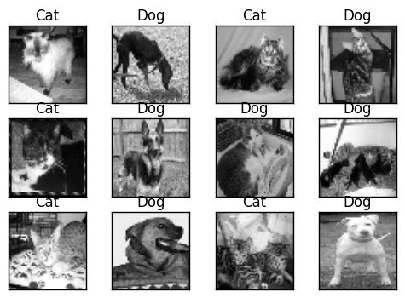

Supervised Learning
Given a labeled dataset ${\left\{\left(x^{\left(i\right)},y^{(i)} \right)\right\}}_{i}$, can we predict the label of a new data point $x$?
We’ll be looking at binary classification tasks: $y^{(i)}∈[−1, +1]$
E.g. -1 is “cat” and +1 is “dog”
To do this, we’ll use the quantum analogue of a classical neural network: a parametrized unitary, AKA quantum neural network.
Ref: https://pythonprogramming.net/convolutional-neural-network-kats-vs-dogs-machine-learning-tutorial/

Slide 3
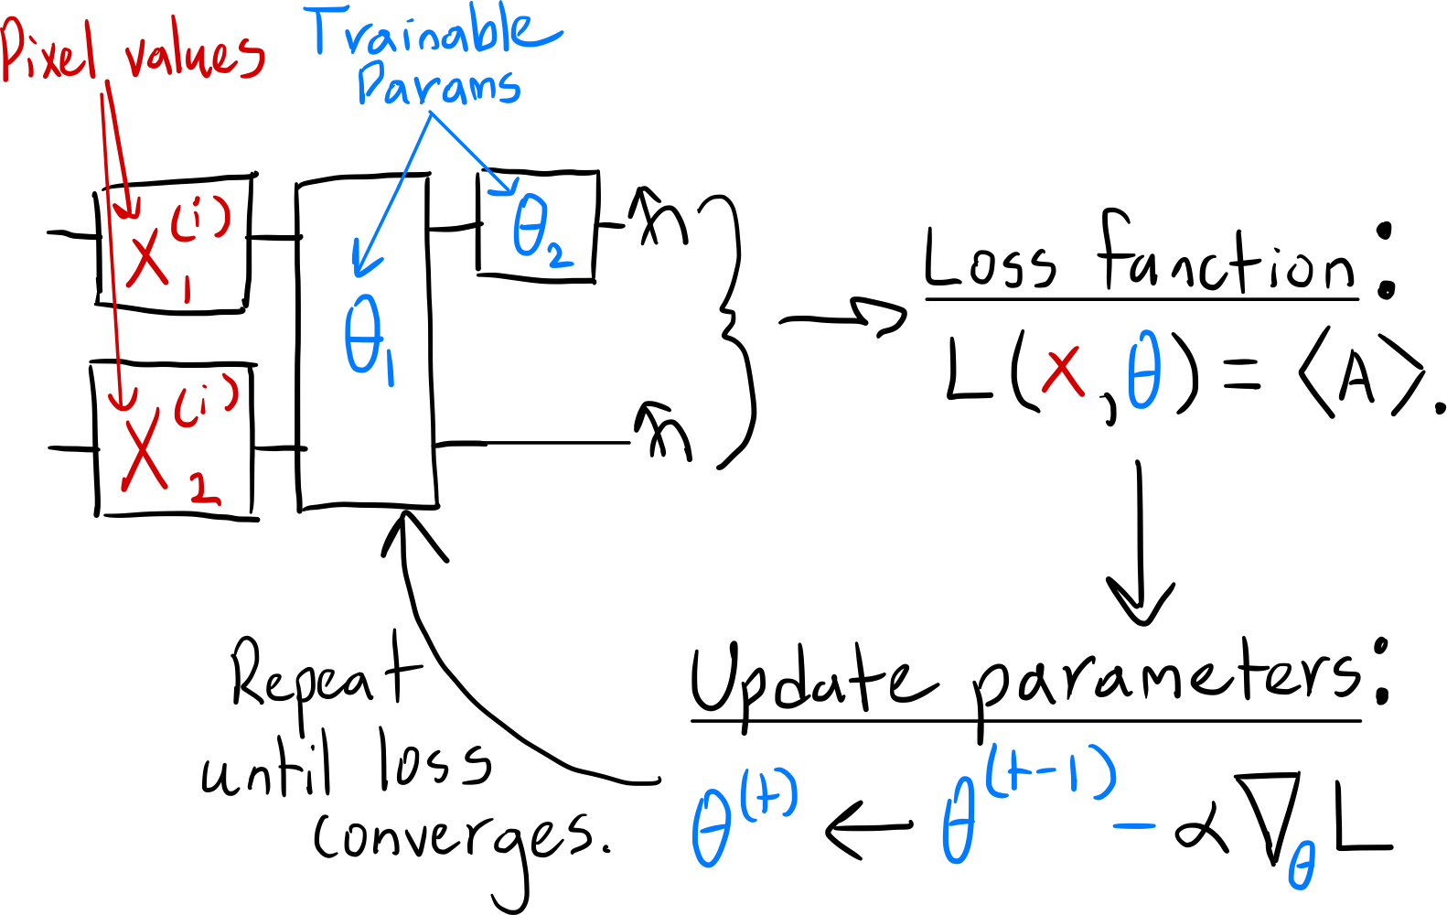
The Quantum Neural Network
AKA: Parametrized unitaries, variational circuits, etc.
Loss function: A function that penalizes misclassified images.
Find the minimum value of the loss function by running gradient descent on a classical processor.
Update the parameters of the circuit until the loss function converges to a low value.
Most images should be correctly classified!

Slide 4
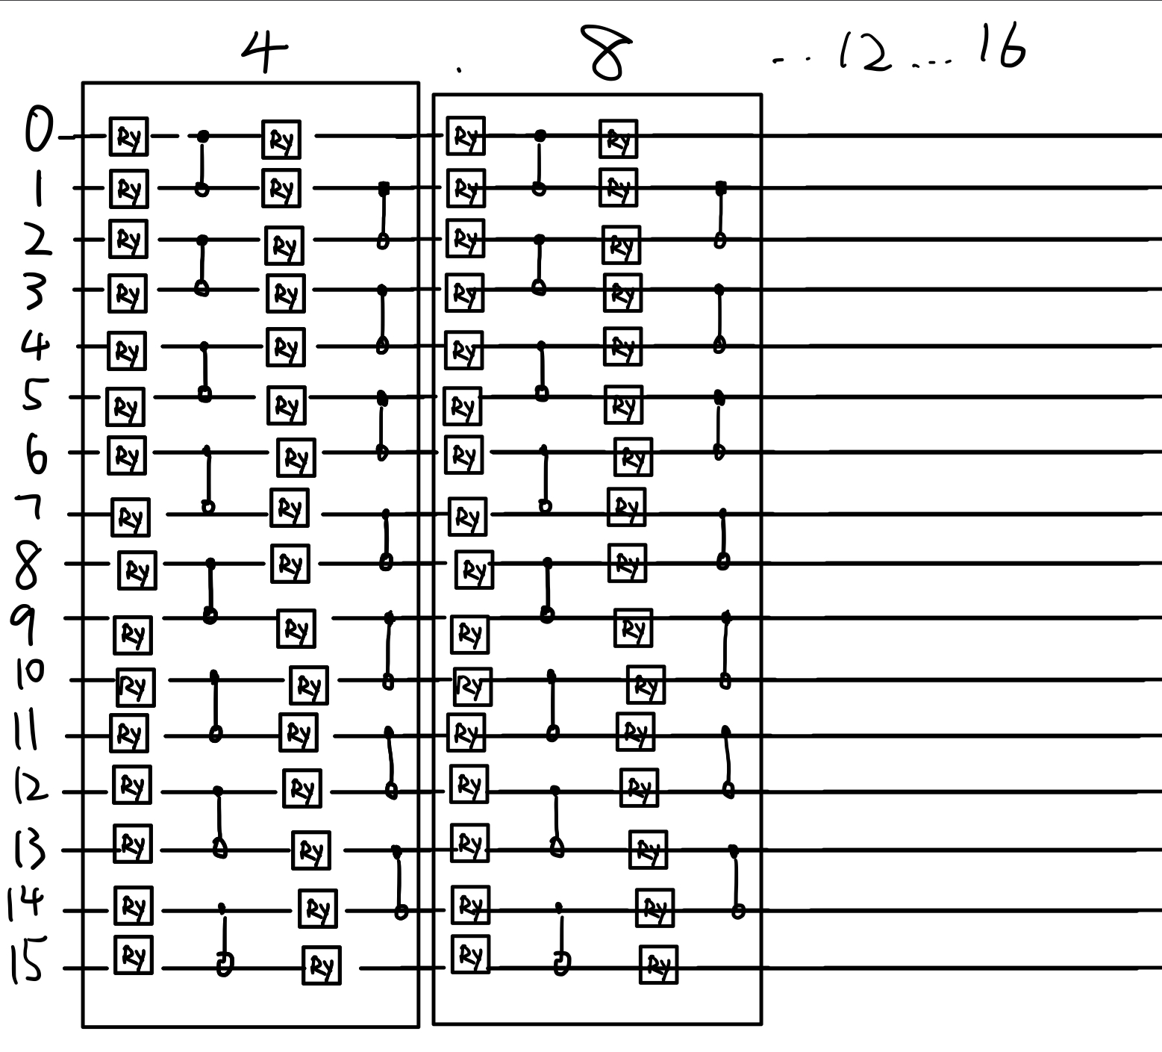
Trainable layer circuit design
We basically created a SimplifiedTwoDesign from PennyLane for our circuit design. The reason is that we are doing image processing and to image processing, spatial locality is important. In other words, it is important for qubits that are located ear each other to be connected.
After the first iteration (first box in the image), the nearest 4 qubits are being connected. After the second iteration (second box in the image), the nearest 8 qubits are being connected.
We want to find just the right amount of iterations so that it connects all the qubits that are related to each other but not overshot so it doesn’t cost too much unnecessary calculations.

Slide 5
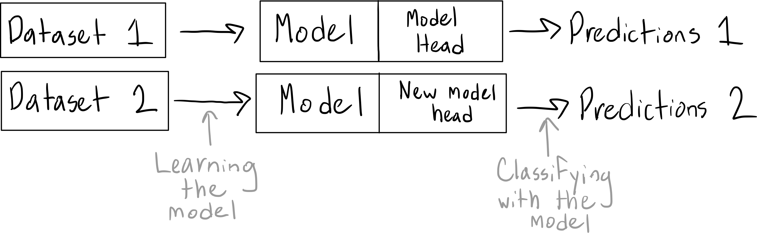
Transfer Learning
Use one neural network to “store knowledge” while solving one problem.
Use this knowledge in a different neural network to solve a different problem.
This problem should now be solved faster!
E.g. Use knowledge about recognizing cars to recognize trucks!

Slide 6
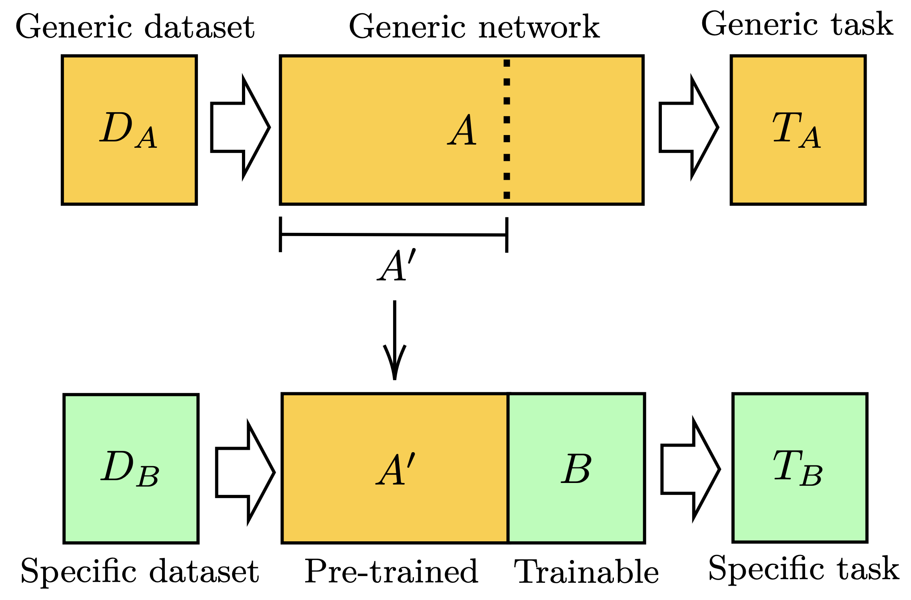
Quantum-to-quantum transfer learning
Ref: https://arxiv.org/abs/1912.08278

Slide 7
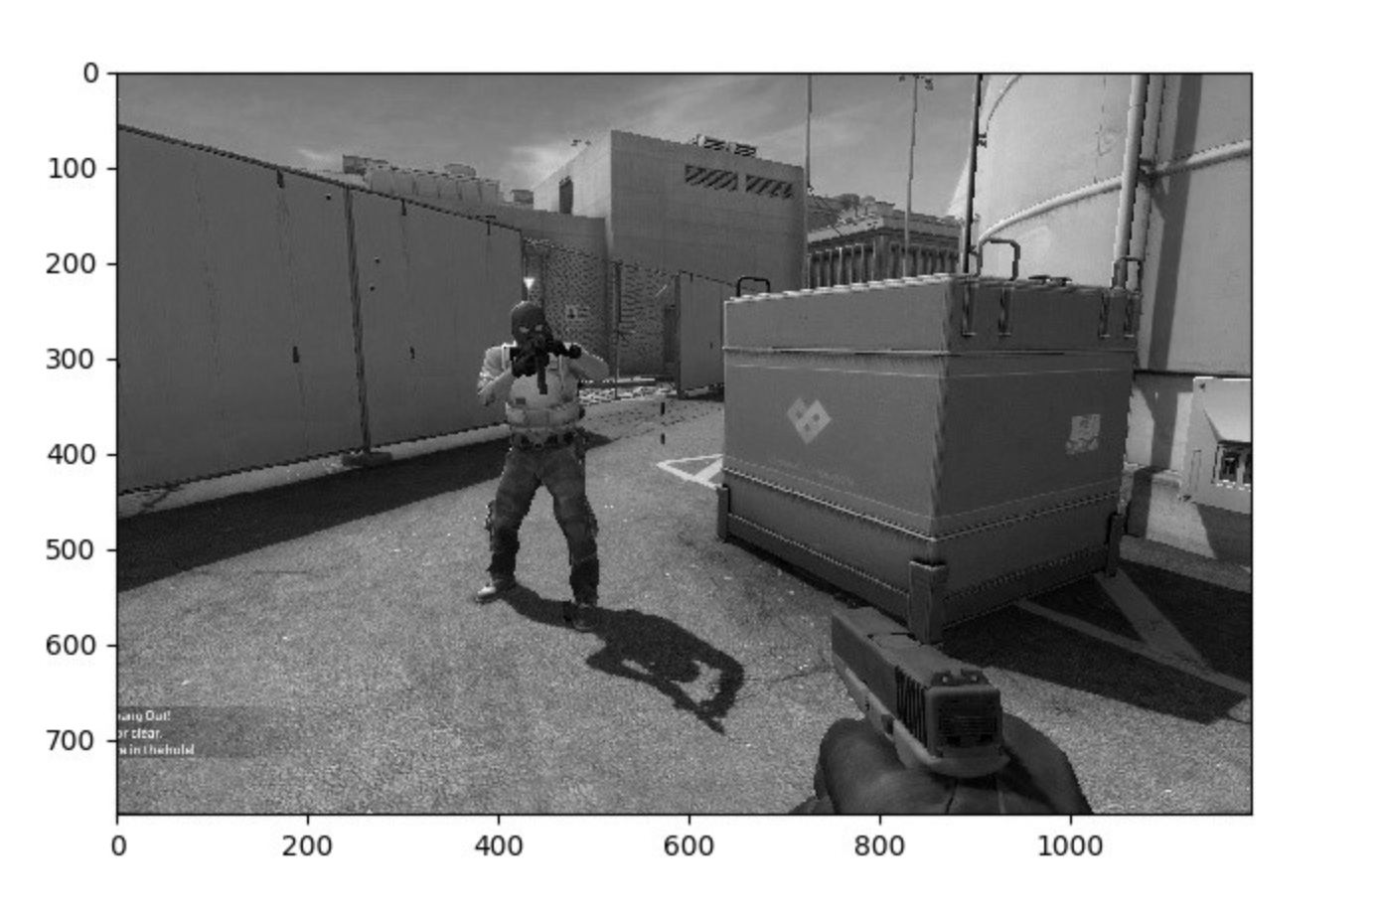
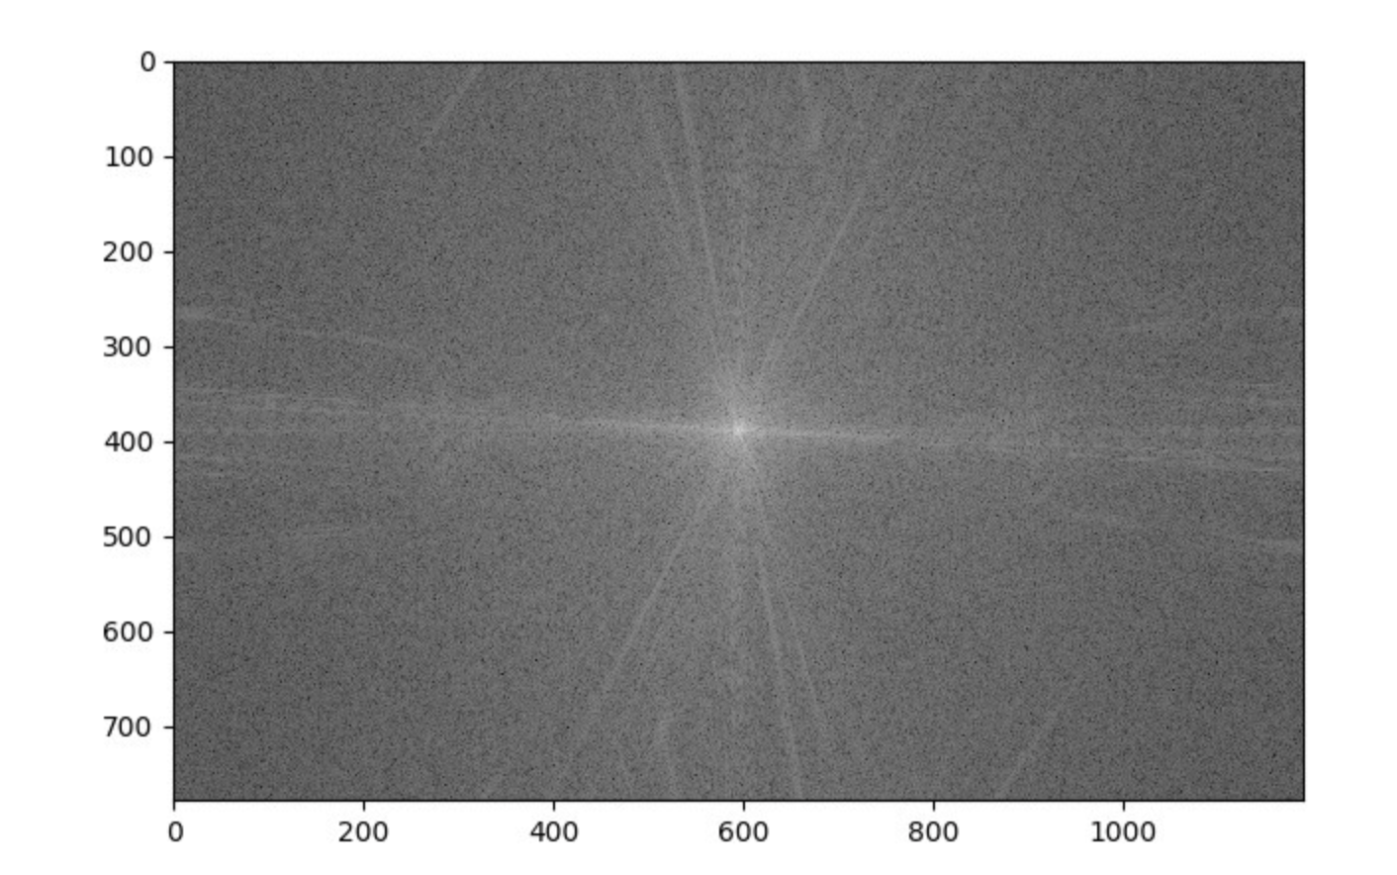
Image to Frequency Space
The middle part of the right image is the lower frequency and the outside part is the higher frequency. So for image processing we can extract the middle 25 percent for image classification tasks (less quibits).

Slide 8
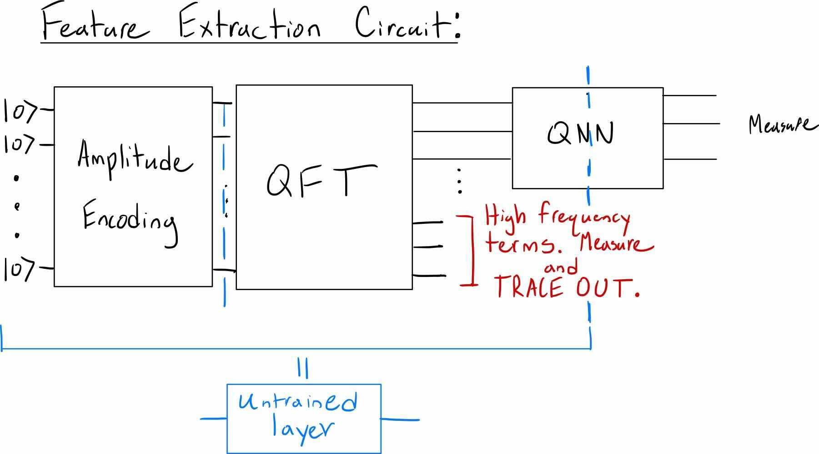
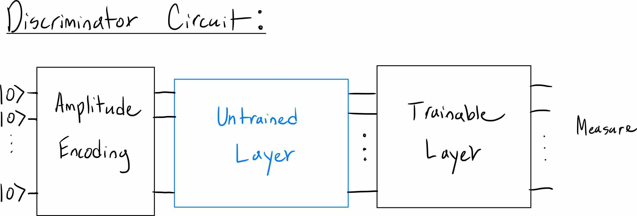
Quantum Fourier Transfer Learning

Slide 9
References
https://arxiv.org/pdf/1912.08278.pdf
https://arxiv.org/abs/1804.00633

