Slide 1
Transmorphing drawings

Slide 2
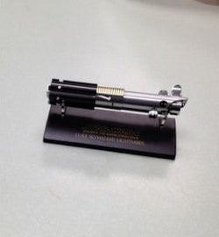
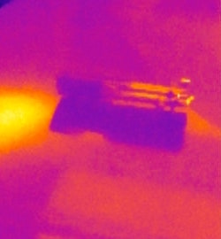

Visible image
Transmorphed
thermal image
Reconstructed visible image
JPEG Transmorphing
Inverse JPEG Transmorphing
Thermal image
Visible image is embedded

Slide 3
Transmorphing in the Camera
Inverse Transmorphing in the Server
Visible image
Transmorphed
thermal image
Reconstructed visible image
JPEG Transmorphing
Inverse JPEG Transmorphing
Thermal image
Visible image is embedded

Slide 4
Transmorphing in the Camera
Visible image
Inverse Transmorphing in the Server
Transmorphed
thermal image
Transmorphed
thermal image
Reconstructed visible image
JPEG Transmorphing
Inverse JPEG Transmorphing
Thermal image
Visible image is embedded
Visible image is embedded

