Slide 1

IEEE seminar paper presentation
Industrial Network Security
Image Source: RockWell Automation
Andrey Sysoev • Sadim Rahman Badhan • Md Mamun Hossain • Umut Karakaya
Hamm-Lippstadt University of Applied Sciences (HSHL)
1

Slide 2
Introduction
Industrial communication systems connect PLCs, HMIs, SCADA systems, sensors and actuators to exchange process data and control commands.
These networks are becoming more connected to enterprise IT and IIoT applications. This improves monitoring and flexibility, with the cost of increasing exposure to cyber threats.
Goals: keep communication
Available
Correct
Predictable
Consequences of an incident: delayed commands, lost monitoring, stopped production, safety risk.
Office IT downtime usually disrupts digital services, while downtime in industrial networks can directly affect machines, production processes and safety.
Responsible: Umut Karakaya
2

Slide 3
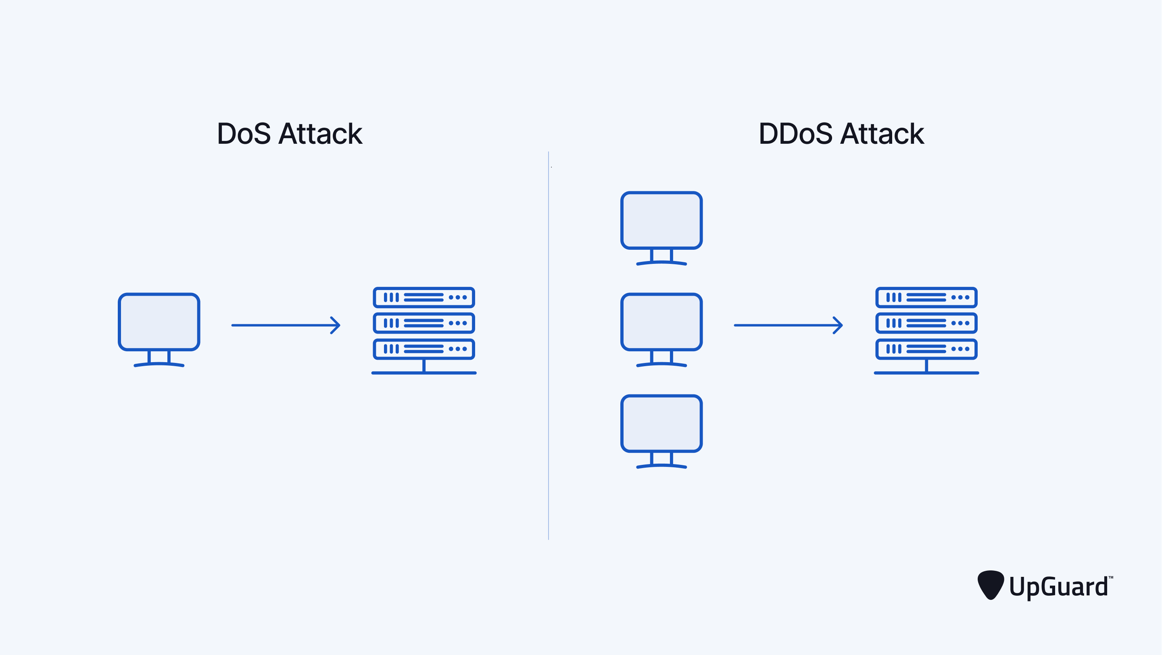
Denial-of-Service (DoS)
What is DoS?: A Denial-of-Service attack aims to make a network service or communication path unavailable for legitimate devices. This causes delays, blocked communication and complete service interruption between industrial devices.
The attacker's goals are:
Stopping production
Disturbing monitoring
Delaying control commands
Forcing the system into an unstable state
Image Source: UpGuard, “What is a DDoS Attack? How they Work + Protection Strategies,” 2025.
Responsible: Umut Karakaya
3

Slide 4
Denial-of-Service (DoS) Attacks
How It Happens
Impact on Industrial Operation
Rogue nodes or compromised devices flood the network
Occupies bandwidth, switches, processing capacity
Legitimate PLC / HMI / SCADA traffic is delayed or blocked
Time-critical control messages arrive too late
Monitoring data becomes unavailable
Production may be interrupted
Avoidance
Detection & Recovery
Network segmentation & security zones
Access control for PLCs / HMIs / SCADA
Traffic filtering & rate limiting
Monitor traffic patterns & delays
Isolate the suspicious device
Restore communication or switch to safe state
Responsible: Umut Karakaya
4

Slide 5
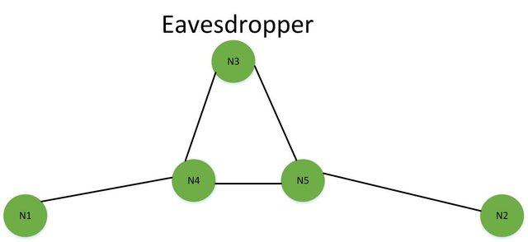
Eavesdropping
Types of Eavesdropping:
Passive
Active
Common Attack Methods:
VoIP interception
Bluetooth interception
Packet sniffing
Impact:
Leakage of data
Financial losses
Loss of customer trust
[2]
Responsible: Md Mamun Hossain
4

Slide 6
Man-in-the-Middle (MITM)
Attacker listens and takes control of the communication between two endpoints.
Endpoints are unaware of the attacker's presence.
Compromises CIA triad: Confidentiality, Integrity, Availability.
Two types: Passive and Active.
Responsible: Sadim Rahman Badhan
5

Slide 7
Network Segmentation
Divides the network into smaller isolated segments.
Core principle: limits attacker's lateral movement.
Micro-segmentation isolates individual devices.
Zero-trust micro-segmentation reduced network exposure by up to 90%.
Responsible: Sadim Rahman Badhan
6

Slide 8
Encryption and Secure Protocols
98% of industrial/IoT traffic is unencrypted, making it vulnerable to MITM
Lightweight cryptography addresses resource constraints in industrial devices
TLS/DTLS encrypts data transmission between devices, edge nodes and cloud platforms
OPC-UA offers reliable communication with built-in role-based access control
VPN paired with MFA prevents eavesdropping and MITM attacks on industrial networks
Responsible: Sadim Rahman Badhan
7

Slide 9
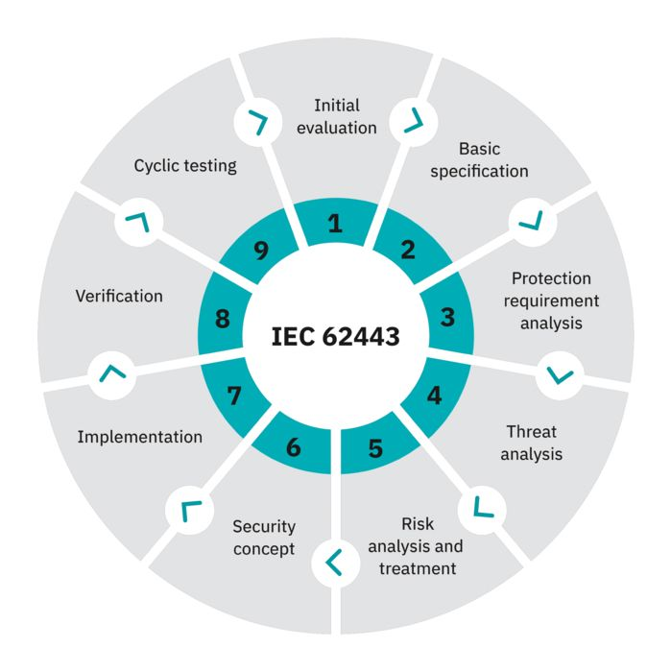
IEC 62443
Standard for securing Industrial Automation and Control Systems (IACS)
identify the System under Consideration (SuC)
perform cybersecurity risk assessment
divide the system into zones and conduits
Image source: Phoenixcontact - die Norm für industrielle Cyber Security
Responsible: Andrey Sysoev
8

Slide 10

Cyber Resilience Act
European regulation for products with digital elements
secure design and development
vulnerability handling
security updates during support period
response to exploited vulnerabilities and incidents
Image source: Triovega-new challenges in the development of connected products
Responsible: Andrey Sysoev
9

Slide 11
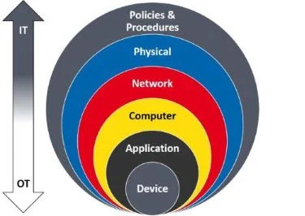
PROFINET Security
Security Challenges:
Limited built-in security
Vulnerable to eavesdropping, DoS etc.
Connectivity to IT networks expands attack surface
Security Mechanisms:
Encryption & authentication
Secure Application Relations (ARs)
Certificate-based device authentication
Security Classes:
Class 1: Improved configuration (SNMP, DCP)
Class 2 : cryptographic protection
Class 3: Full encryption
[3]
Best Practices:
Defense-in-Depth approach (IEC 62443)
Network segmentation, access control, monitoring
Secure device identity
Responsible: Md Mamun Hossain
9

Slide 12

Conclusion
Industrial network security is a continuous process of design, protection, and maintenance.
Design
Protect
Maintain
Risk-based design
Zones and conduits
IEC 62443
Patch management
Vulnerability handling
Continuous monitoring
Segmentation
Encryption
Secure protocols
Image source: - Cryptography and Network Security – TU Darmstadt
Responsible: Andrey Sysoev
11

Slide 13
Image and Text Sources
https://www.rockwellautomation.com/en-gb/capabilities/industrial-cybersecurity/products-services/network-security.html
https://www.researchgate.net/publication/282856952_Towards_Secure_Network_Coding-Enabled_Wireless_Sensor_Networks_in_Cyber-Physical_Systems/figures?lo=1
https://www.phoenixcontact.com/de-de/industrien/industrial-security/iec-62443-norm-industrielle-cyber-security
https://triovega.com/en/blog/cyber-resilience-act-new-challenges-in-the-development-of-connected-products/
https://profinews.com/wp-content/uploads/2023/01/Onion-Diagram.jpg
https://www.informatik.tu-darmstadt.de/cns/
K. Stouffer et al., “Guide to Operational Technology (OT) Security,” NIST SP 800-82 Rev. 3, 2023.
T. Cruz et al., “Improving Network Security Monitoring for Industrial Control Systems,” IFIP/IEEE IM, 2015.
M. Conti, N. Dragoni, and V. Lesyk, “A Survey of Man in the Middle Attacks,” IEEE Communications Surveys & Tutorials, 2016.
Z. T. Almulla and H. Rahman, “The Role of Network Segmentation and Micro-Segmentation in Operational Technology Security,” ICAIIC, 2025.
S. Khan et al., “A Comprehensive Review on Lightweight Cryptographic Mechanisms for Industrial Internet of Things Systems,” ACM Computing Surveys, 2025.
M. Kern et al., “An Architecture-Based Modeling Approach Using Data Flows for Zone Concepts in Industry 4.0,” IEEE ISSE, 2020.
G. B. Gaggero et al., “An IEC 62443-Based Framework for Secure-by-Design Energy Communities,” IEEE Access, 2024.
European Commission, “Cyber Resilience Act,” Shaping Europe’s Digital Future.
J. Akerberg and M. Bjorkman, “Exploring Security in PROFINET IO,” IEEE COMPSAC, 2009.
A. Walz et al., “PROFINET Security: A Look on Selected Concepts for Secure Communication in the Automation Domain,” IEEE INDIN, 2023.
Responsible: Andrey Sysoev
12

