Slide 1
Learning from Examples
Basic principle of AI

Slide 2
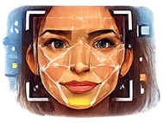




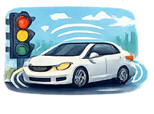
Artificial Intelligence – Everywhere Today
Face recognition
Audio, video, and image generation
Translation
Keyboard autocomplete
Chatbots, coding assistants
Image filters (Snapchat / IG)
Recommender systems (music, films, etc.)
Spam filters
Autonomous driving
and many more
Notes:
Immediatelz do not conflate machine learning and AI in general. Otherwise they will mention game AI, and I will get sidetracked.

Slide 3
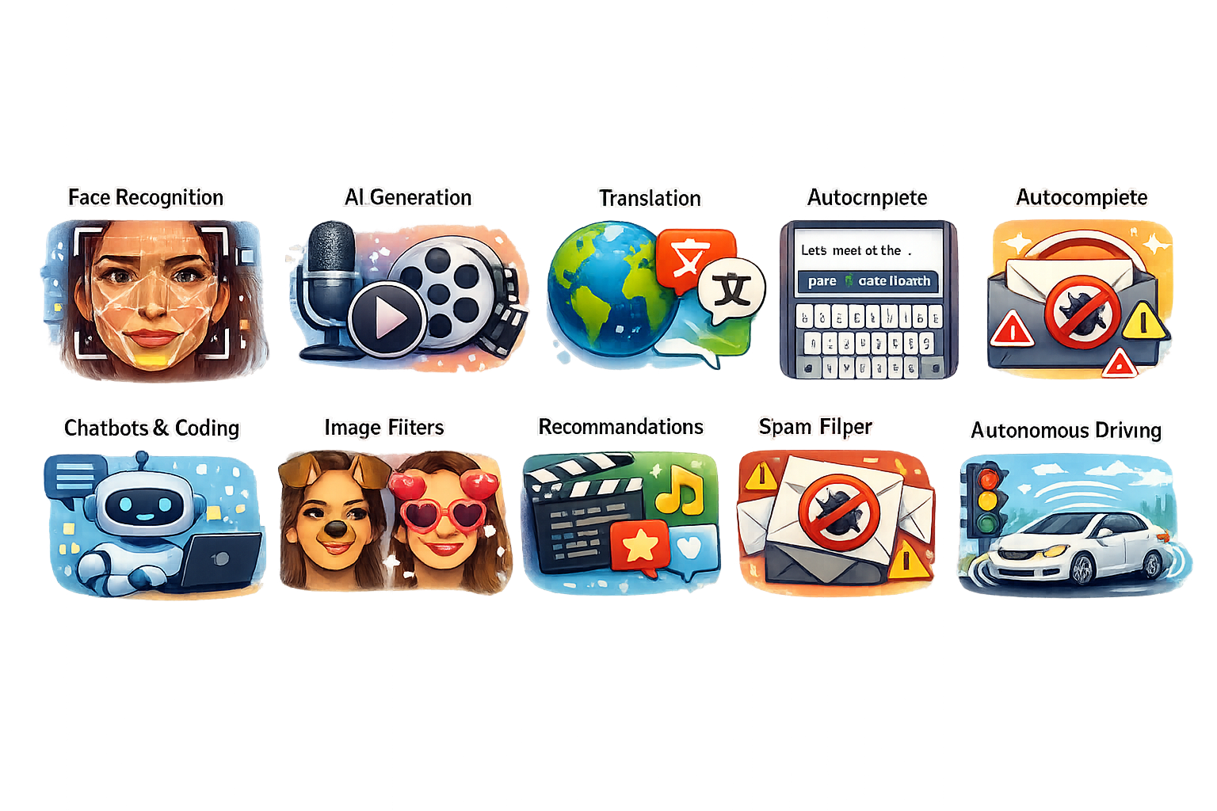
Even the Illustrations

Slide 4
Machine Learning
How do AI applications work?
What separates AI apps from other apps?
Machine learning is a major part of AI field
Those apps were not merely programmed
At the core they were trained
But why did we have to train them?
And how did we do that?

Slide 5
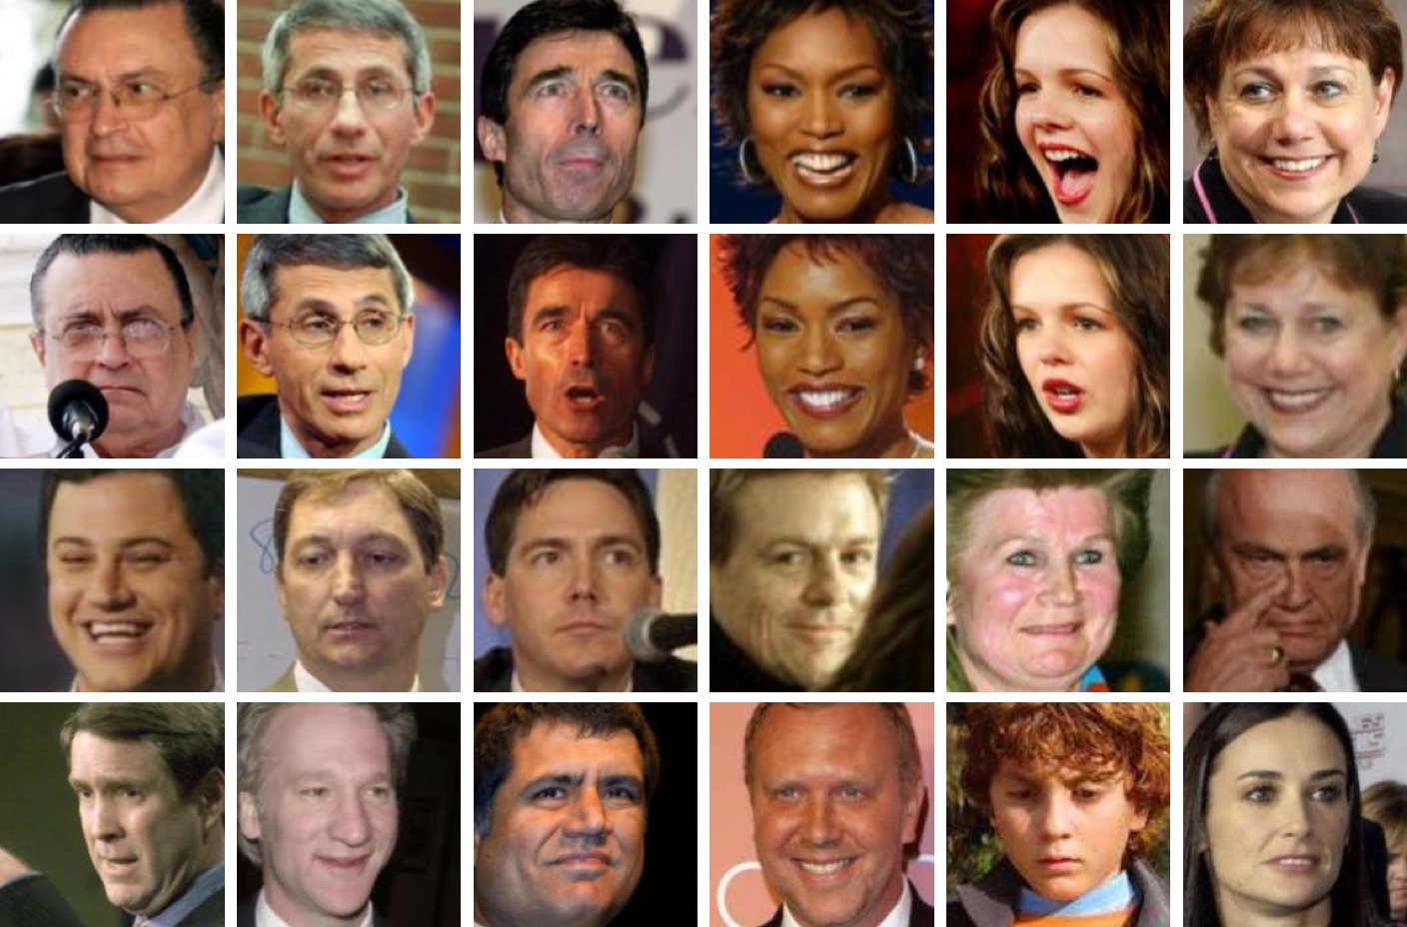
Memorize All Combinations?
Find a value for each combination of pixels?
250x250, 3 bytes per pixel = ~10^56443 combinations
For comparison: there are ~10^82 atoms in the observable universe

Slide 6
Define some rules?
«If the eye color is different, then those are different people on the photos»
But how to tell computer how to detect eye color on the image?
And how to do it for all possible applications?
And how to program all those rules?
And what about audio? Video?

Slide 7
One More Problem: Perception Difference
What we see
https://ar5iv.labs.arxiv.org/html/1801.05678

Slide 8
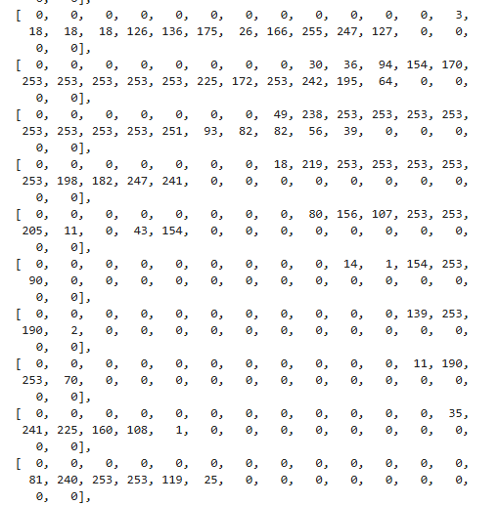
One More Problem: Perception Difference
What computer sees

Slide 9
Solution – Learn from Examples
We can’t provide full set of rules of “how to get to the correct answer”
But often we can provide a lot of examples
What we start with
“Correct answer” that we expect
… and then just say “figure it out on your own”
I.e. learn from those examples

Slide 10
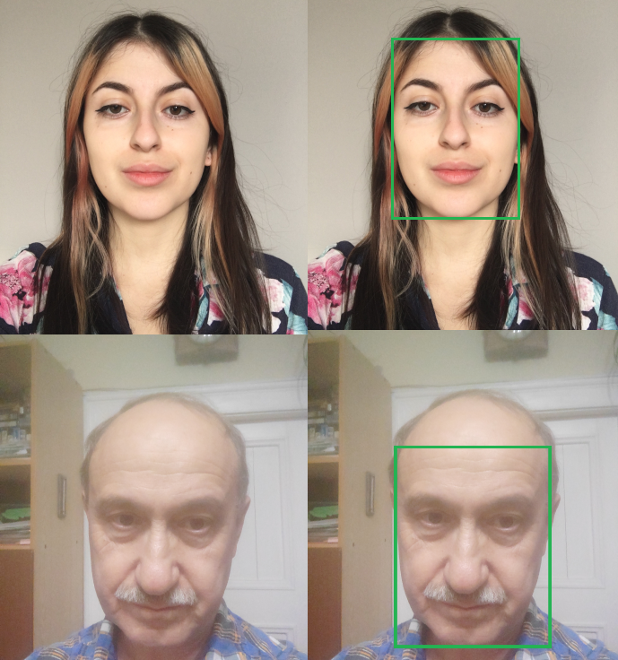
Examples – Face Detection
https://www.kaggle.com/datasets/trainingdatapro/face-detection-photos-and-labels

Slide 11
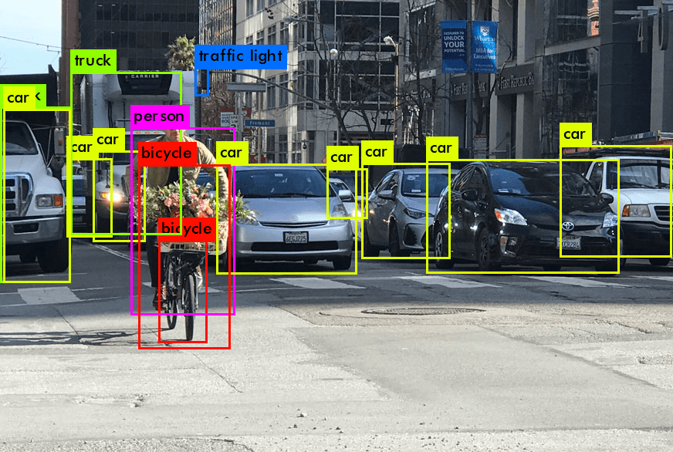
Examples – Object Detection
https://visionplatform.ai/object-detection/

Slide 12
Examples – Face Recognition
Same pairs
Different pairs
https://ar5iv.labs.arxiv.org/html/1801.05678

Slide 13
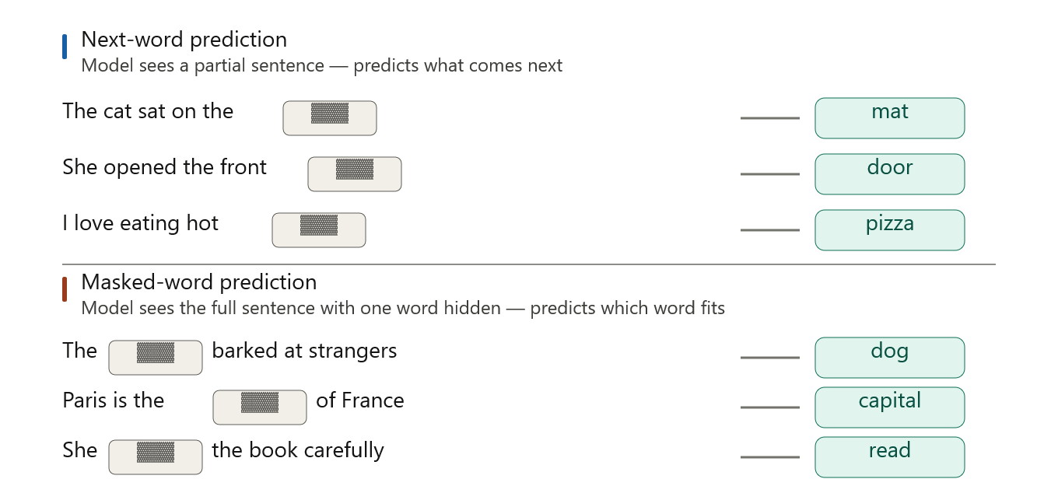
Examples - Chatbot

Slide 14
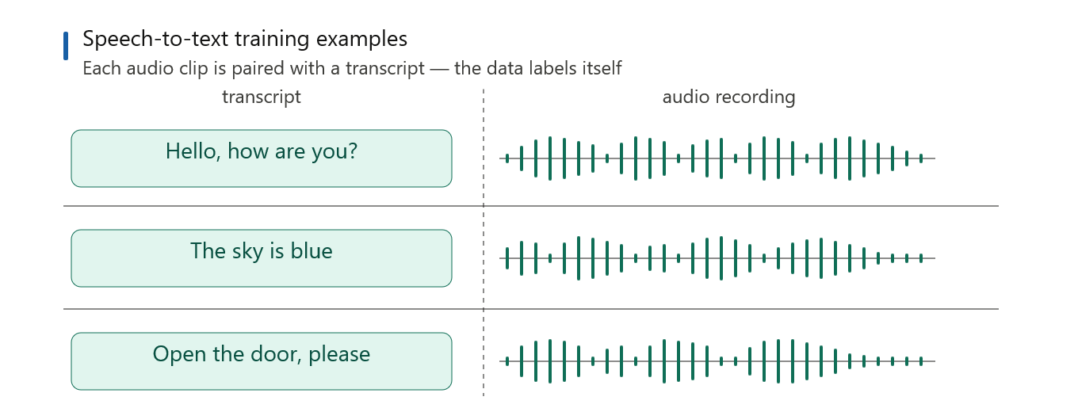
Examples – Speech to Text

Slide 15
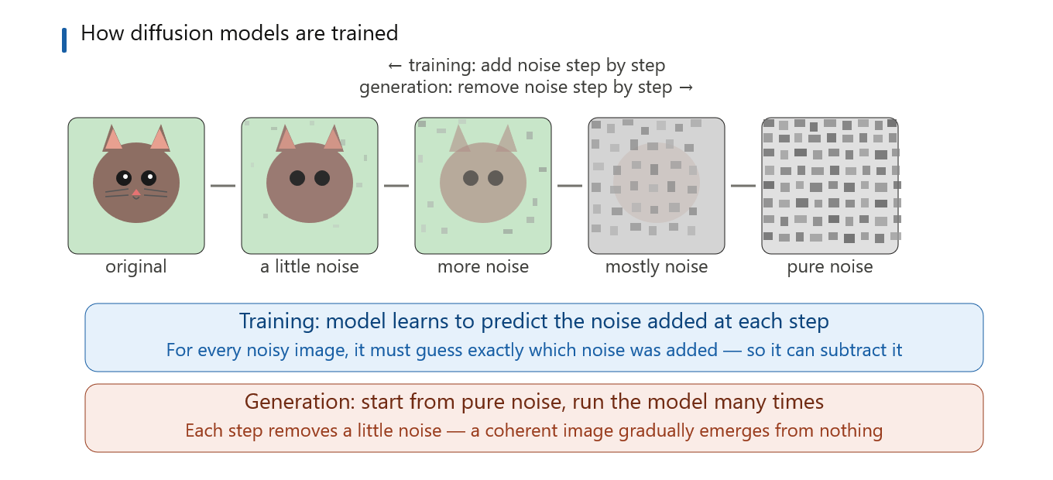
Examples – Image Generation

Slide 16
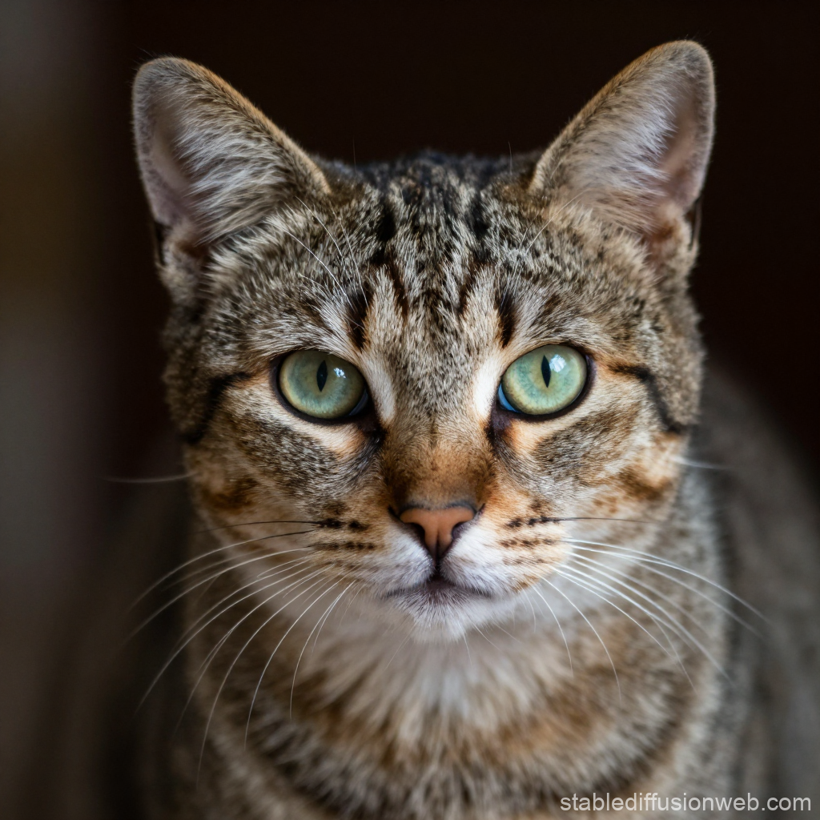

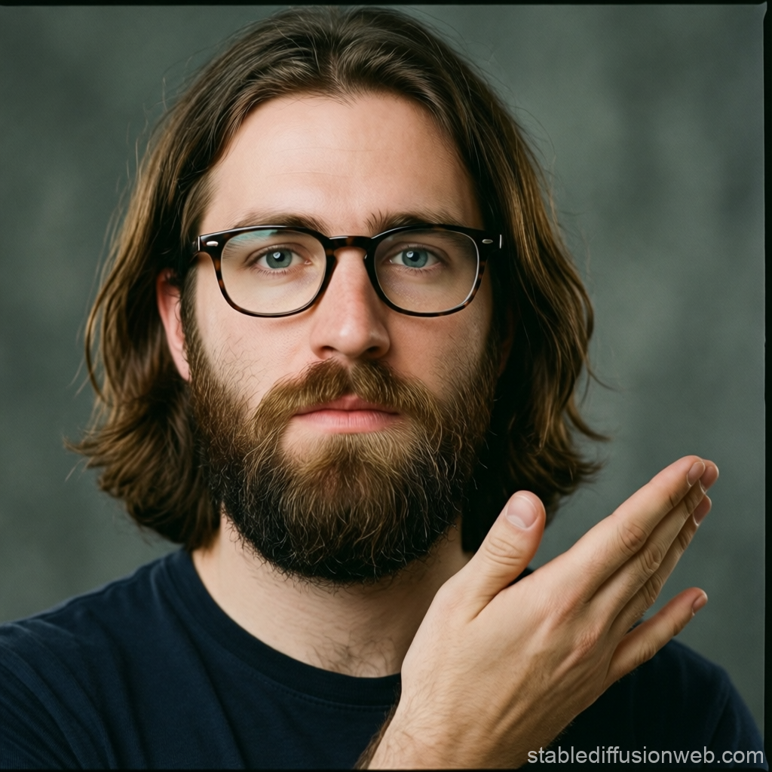
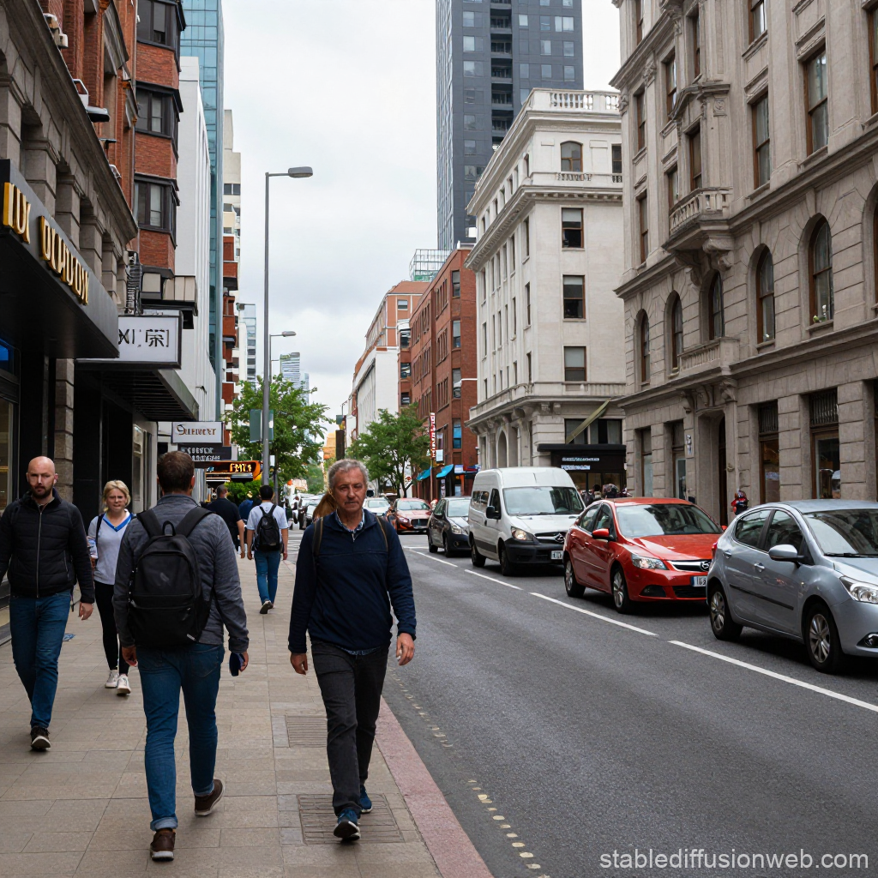
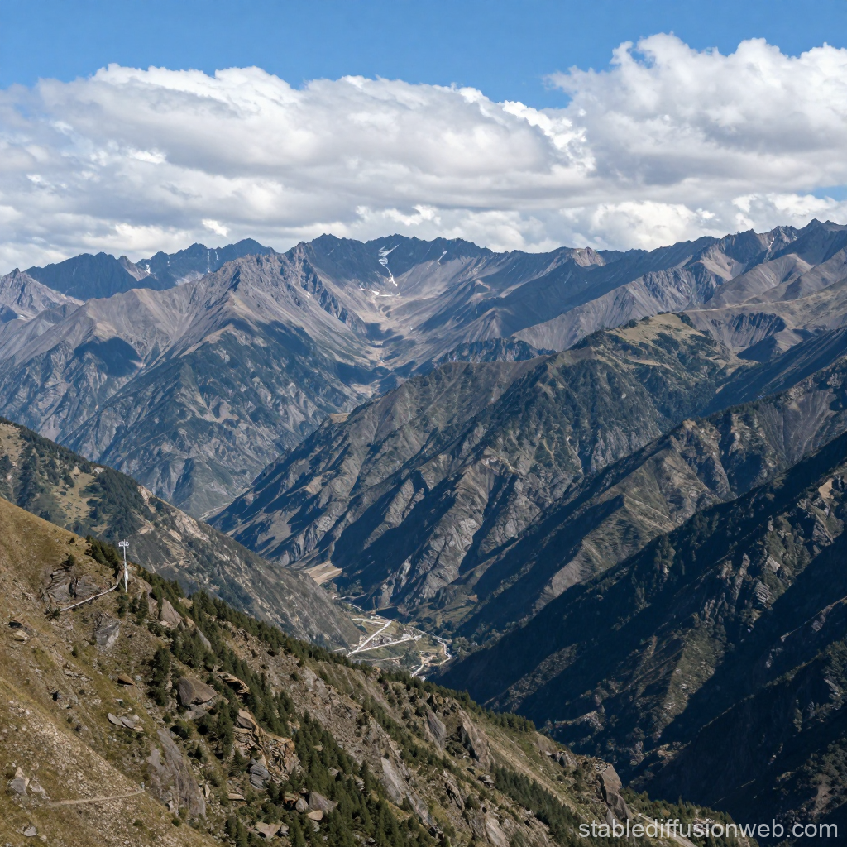
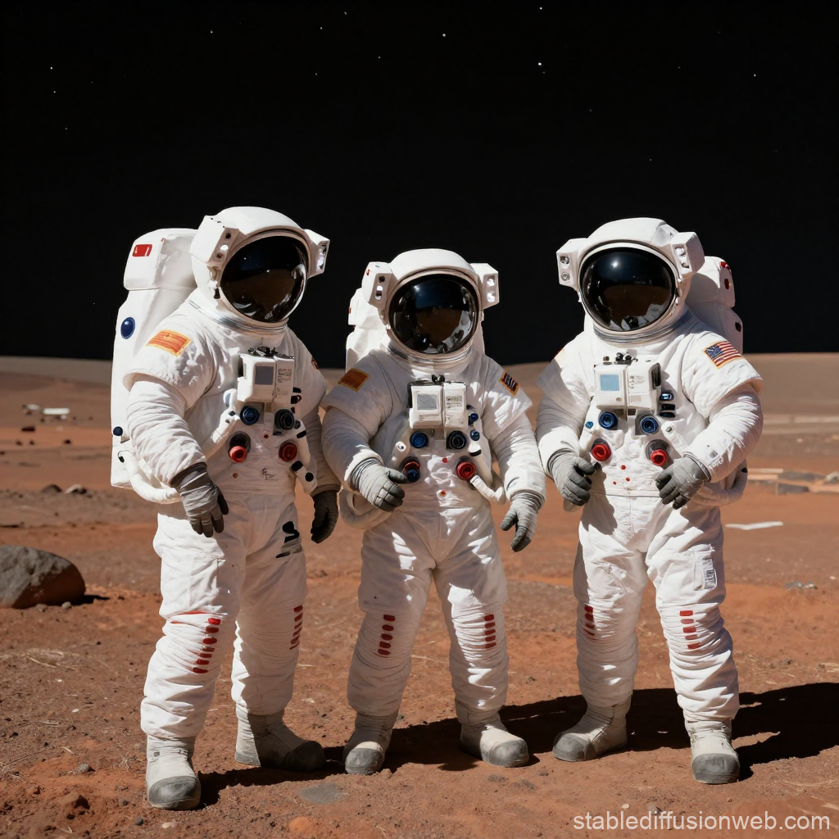
Diffusion-Generated Pictures

Slide 17
Learning from Examples
If we can make the app learn from examples, it can do A LOT of things
What do we need:
Examples to learn from
Something that learns, i.e. the model
The learning process itself
But how to automate the learning?
And what exactly do we even mean by “learning”?
Let’s answer a few simpler questions first

Slide 18
Success Metrics
How to understand whether our AI is doing well or not?
How to compare two AIs doing the same task? Which one is doing better?
Loss – how wrong the model is
Details depends on what the model does
Define per example
Aim to minimize the average across examples

Slide 19
Loss – Face Detection
https://www.kaggle.com/datasets/trainingdatapro/face-detection-photos-and-labels

Slide 20
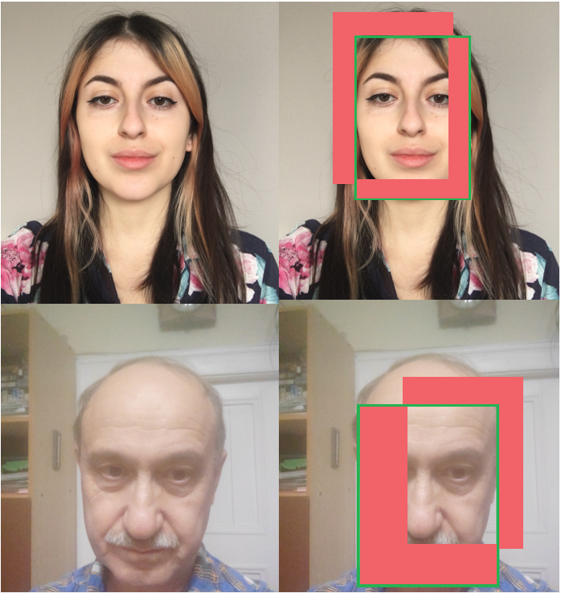
Loss – Face Detection
https://www.kaggle.com/datasets/trainingdatapro/face-detection-photos-and-labels

Slide 21
Loss – Face Recognition
Crude option:
- Correct answer: loss = 0
- Wrong answer: loss = 1
Better option:
Loss as 1 –minus confidence in the correct answer
There are even better options.
https://ar5iv.labs.arxiv.org/html/1801.05678

Slide 22

Loss – Chatbot
V
X
V
X
V
V
Crude option: correct answer - loss = 0, wrong answer - loss = 1
Better option: loss as 1 – minus confidence in the correct answer
And there are even better options.

Slide 23
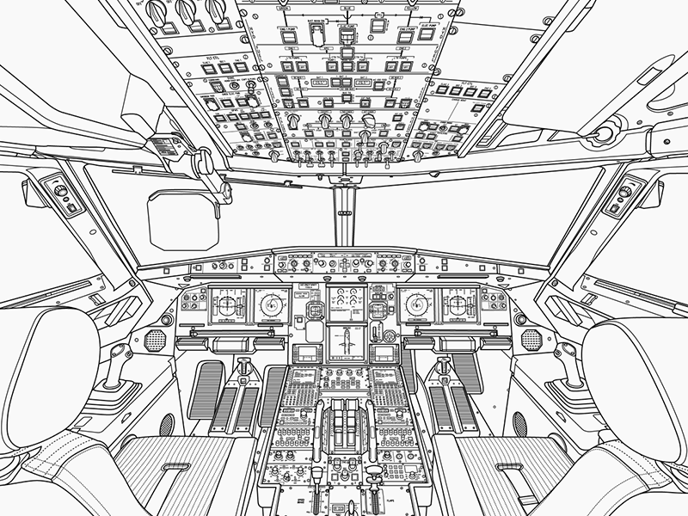
Knobs to Tweak: Parameters
Find the configuration to minimize loss
https://cdn.dribbble.com/userupload/23411945/file/original-70bcc02537911963499332df0b36b2e3.png

Slide 24
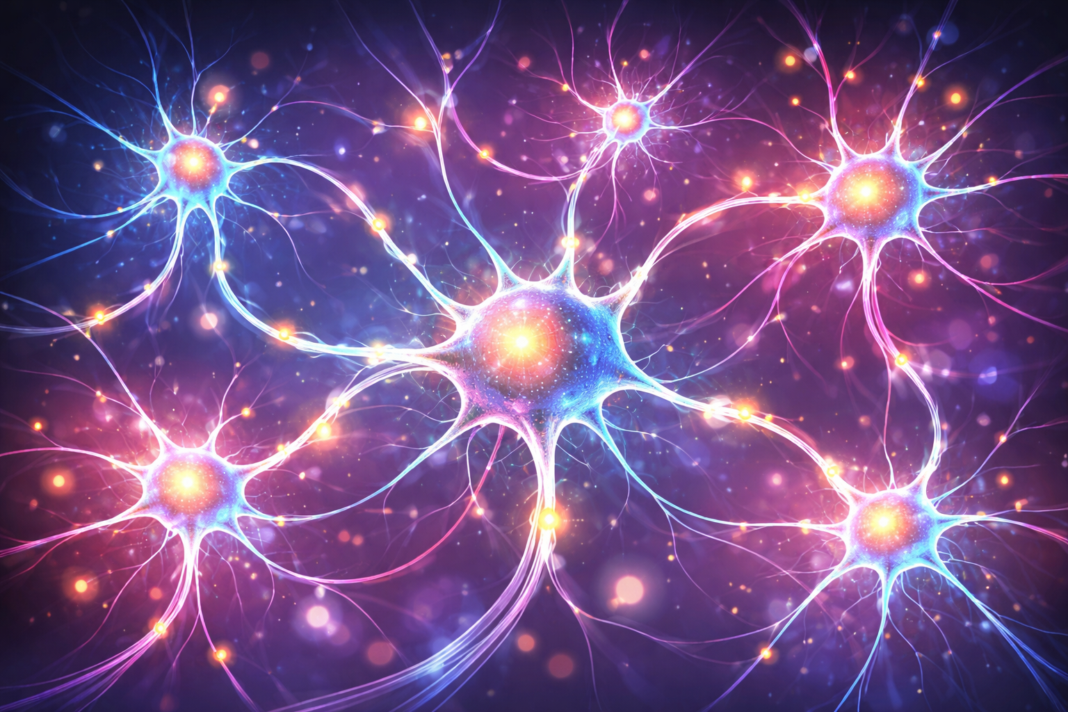
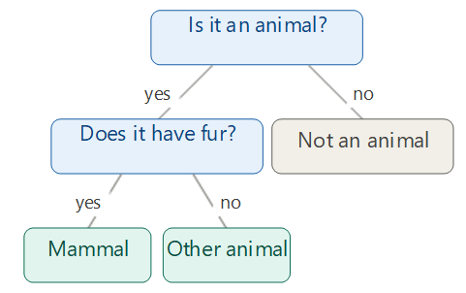
Parameters in Practice
From common sense decision-making to imitation of human neurons

Slide 25
Loss vs Model Parameters
What parameters do we have?
Can we find the best combination of parameters?
Best - resulting in a minimal loss
How to find the best combination?
We can’t just tweak the knobs randomly
Is it good enough?
If not, we made a mistake choosing the model
Start with random knobs and improve
But how?

Slide 26
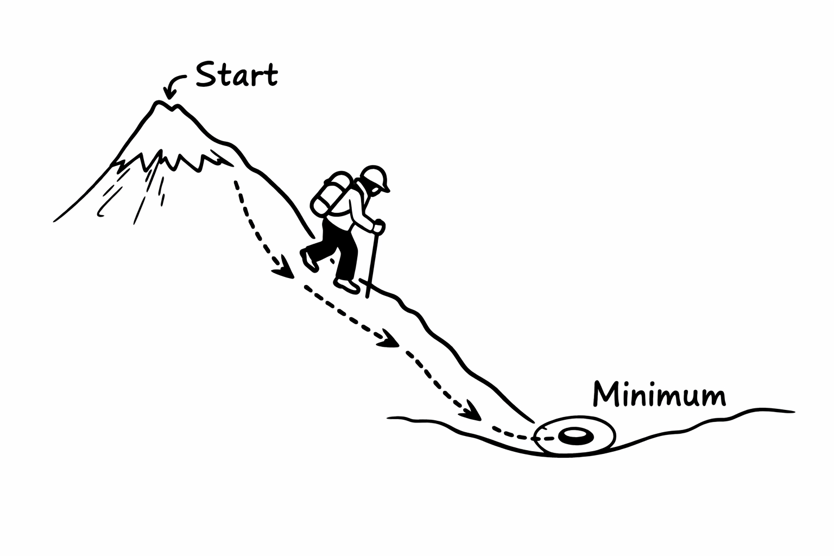
Common Sense of Gradient Descent

Slide 27
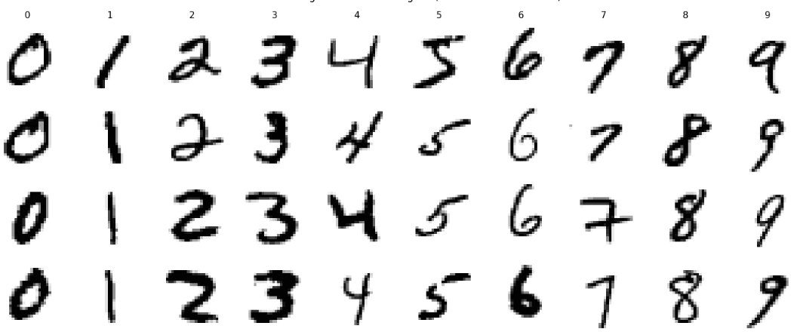
Let’s Train the Model
Input: 28x28 grayscale pictures
Expected answer: the digit
70000 examples
https://web.archive.org/web/20200430193701/http://yann.lecun.com/exdb/mnist/

Slide 28
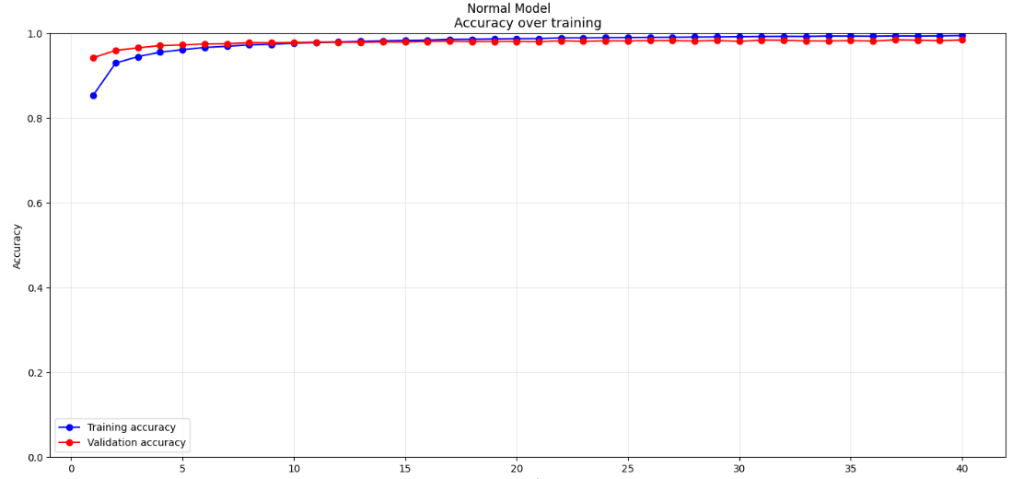
How Are We Doing?
Let’s hold out some data for later independent verification

Slide 29
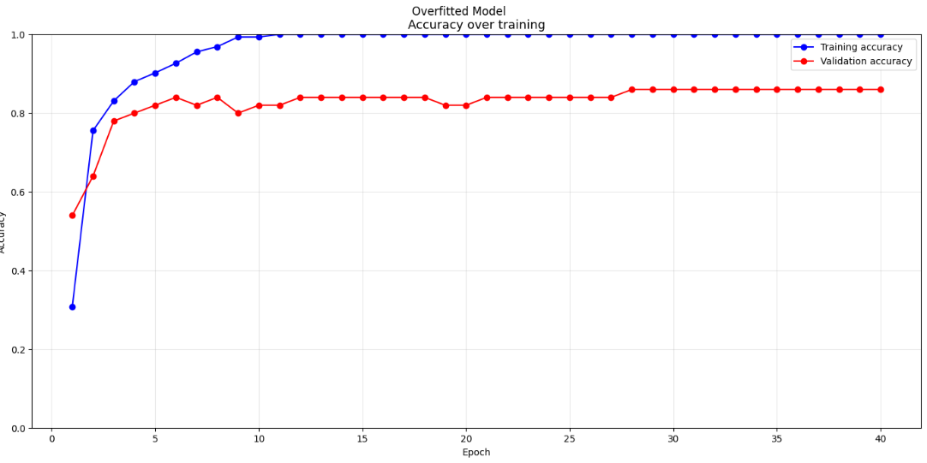
Let’s Add More Knobs to Turn
Complex model, less data. What can go wrong?

Slide 30

Overfit
Works on training examples but fails independent tests
It did not learn, it memorized
The digits just happened to look that way…
But the model thought they can look ONLY that way
Unless the digits are very close to examples, it will fail
Need more data or/and simpler model

Slide 31
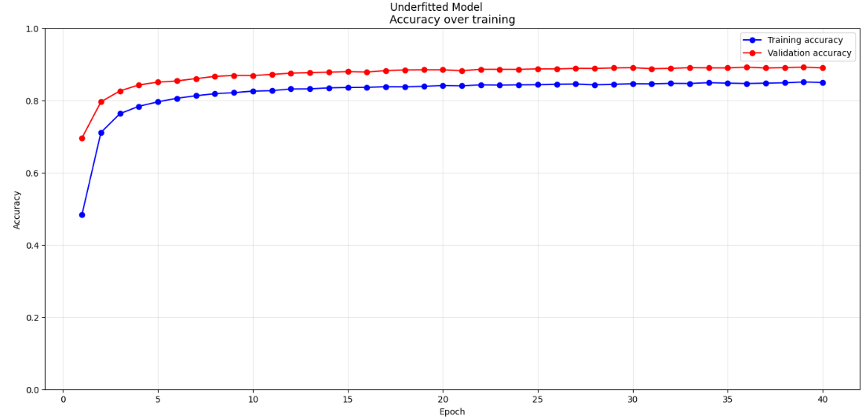
Let’s Make It Simpler…

Slide 32
Underfit
The model just does not work
It fails on training samples
It fails on independent tests
More data will not help
Not enough capacity to learn
Model cannot learn what it cannot even imagine
Too few parameters – can imagine only a few things

Slide 33
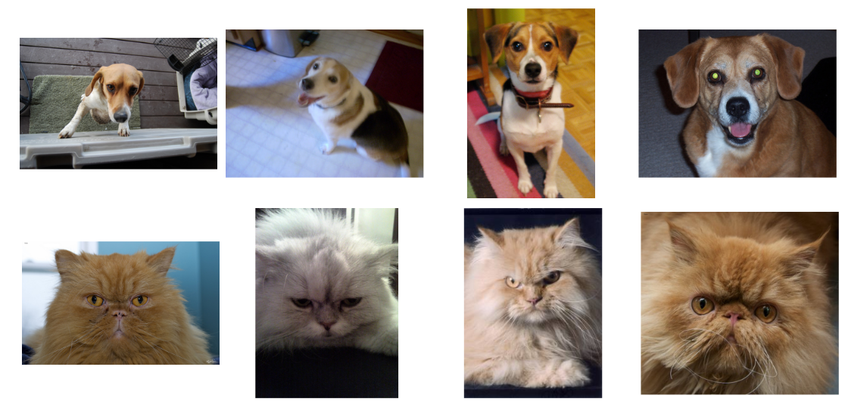
Cats Vs Dogs

Slide 34
Explainability
Why did the model make any particular decision?
Need to understand?
Need to investigate any particular example?
Need to explain the decision to the user?
Might be very unclear
But extremely important for practice
The whole area of research

Slide 35
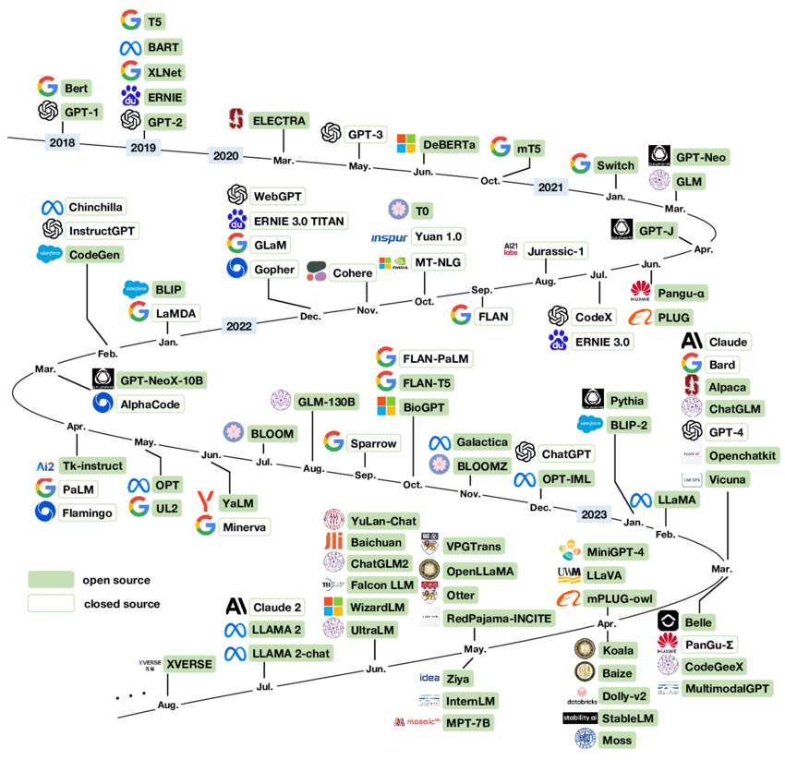
Learning From Examples
Plenty of models
Billions of parameters
Different “why”s
Different purpose
Different architecture
But the same main principles
https://www.researchgate.net/figure/A-chronological-overview-of-large-language-models-LLMs-multimodal-and-scientific_fig2_373451304

Slide 36
Thanks for your attention!

