Slide 1
Technicolor

Slide 2
Idea
We want to make objects more cherished by adding a music flavor to it.
Identify the most prominent color in an object
Map the color, emotion in the picture to note, volume and type of instrument
In future we want to be able to generate more melodies

Slide 3
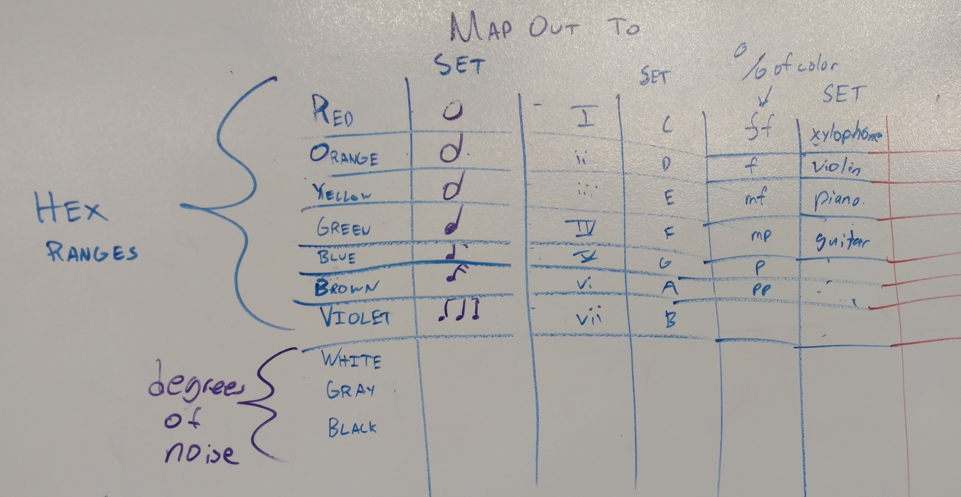
Algorithm

Slide 4
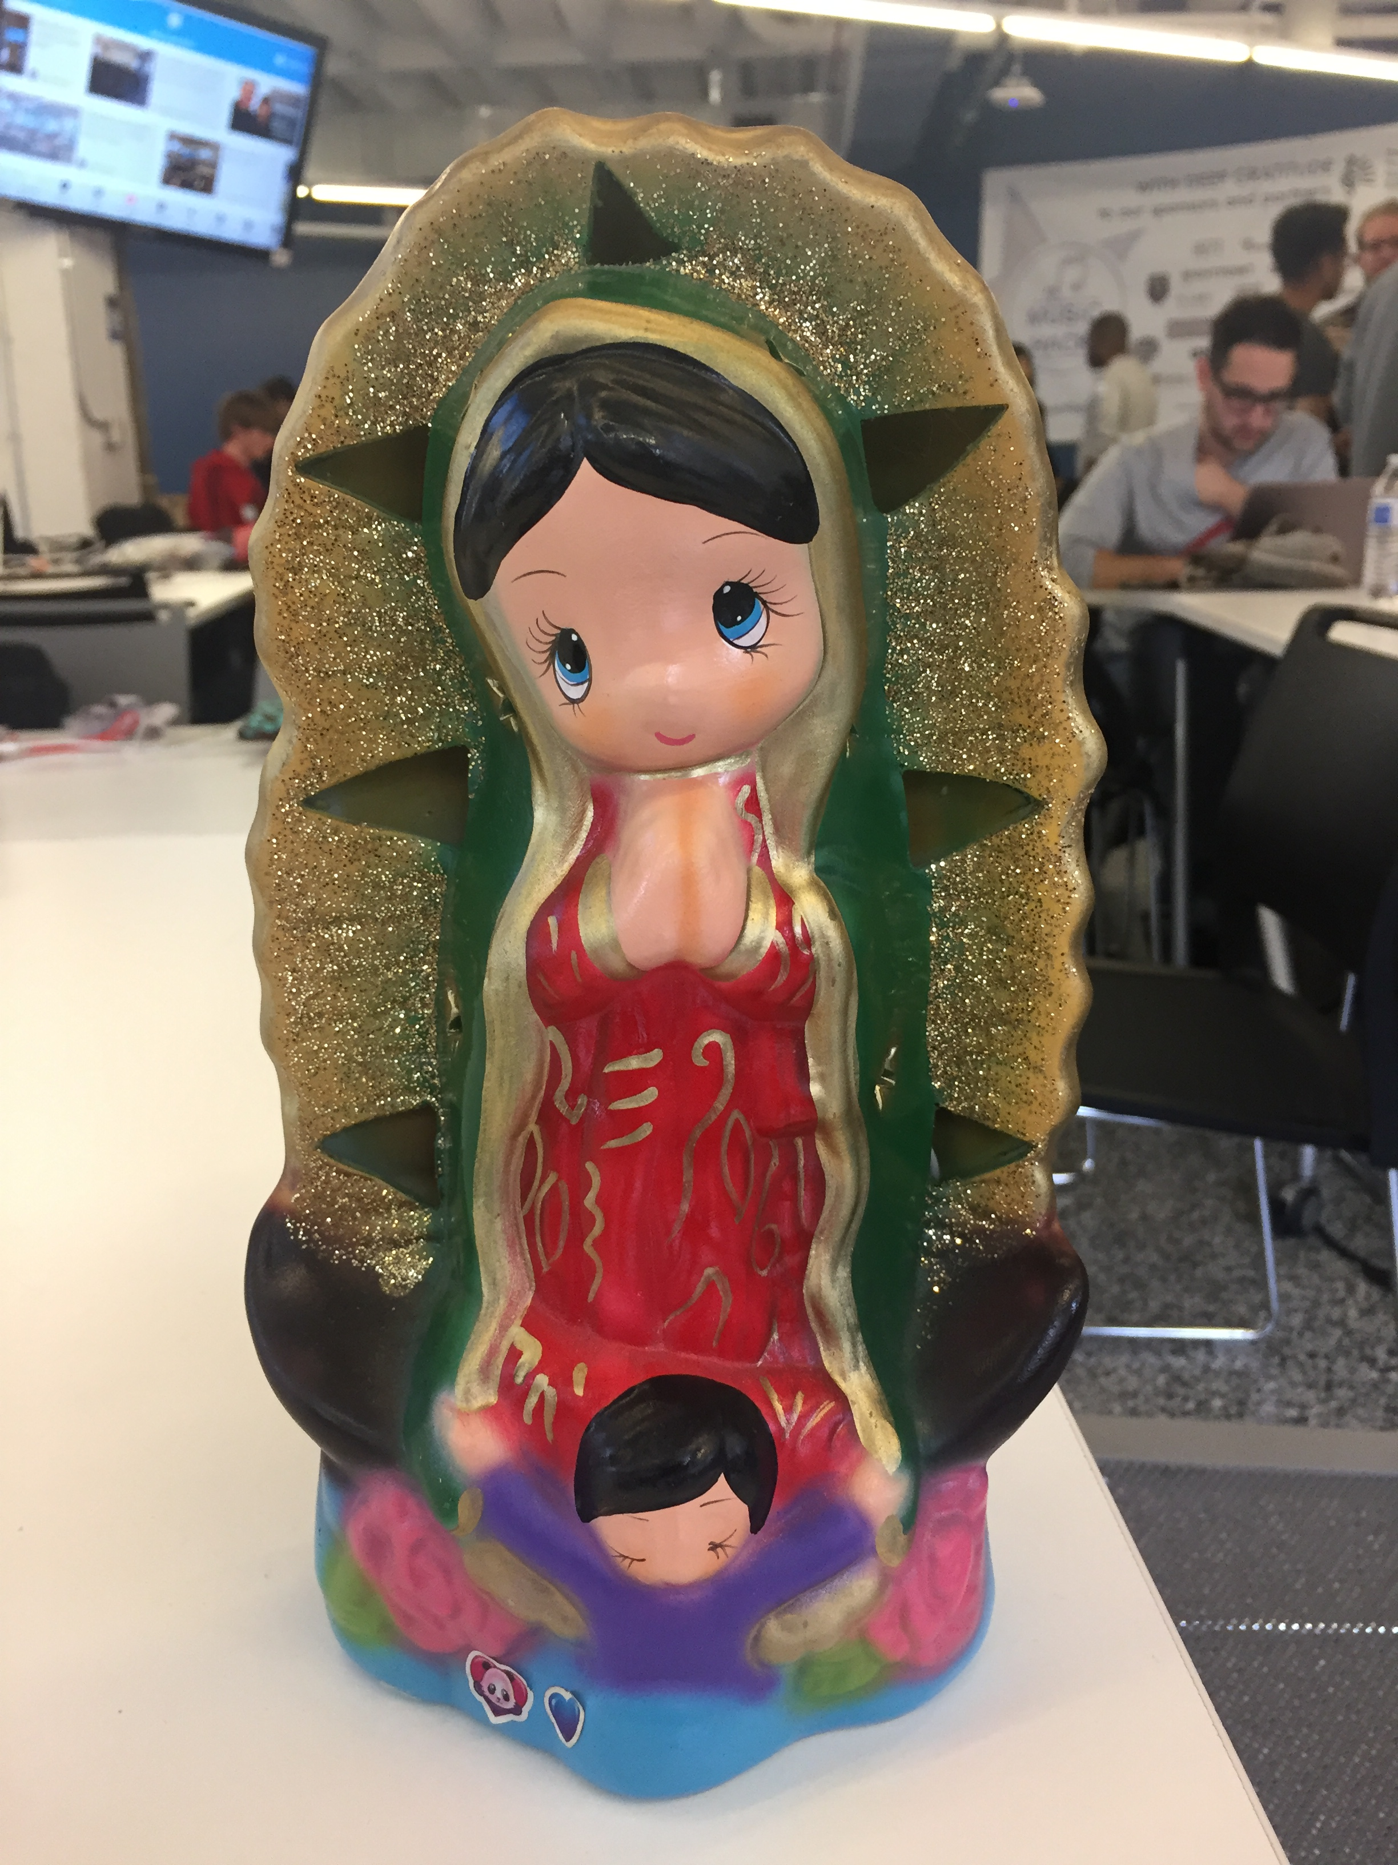
Sample Object

