Slide 1
Objective-C: Foundation Framework
Vyacheslav Kormushkin
Acquire Foundational Programming Skills

Slide 2
AGENDA
1. The Role of Foundation
2. The Root Class and Objective-C Objects
3. Object Creation
4. Memory Management
5. Value Classes
6. Collections
7. Object Introspection

Slide 3
About Foundation
The Foundation framework is the foundational toolkit for all programming for both iOS and OS X. You need to become familiar with this toolkit to be a successful developer for these platforms.
Foundation defines dozens of classes and protocols for a variety of purposes, but three categories of classes and protocols stand out as particularly fundamental:
The root class and related protocols
Value classes
Collection classes

Slide 4
NSObject
The Root Class and Objective-C Objects
NSObject is the root class of Objective-C class hierarchies
NSObject instance cannot do anything useful beyond being a simple object
NSObject adopts the NSObject protocol, which declares additional methods common to the interfaces of all objects.
NSObject adopts the NSCopying, NSMutableCopying, and NSCoding protocols
The NSObject class and related protocols define methods for:
creating objects
navigating the inheritance chain
interrogating objects about their characteristics and capabilities
comparing objects
copying obcjets
encoding objects

Slide 5
Objects
The Root Class and Objective-C Objects
Think in terms of objects
Strongly coupled objects
Loosely coupled objects

Slide 6
Allocation and initialization
Object Creation
Object creation consist of two steps:
Memory allocation
Object initialization
- (instancetype)initFileURLWithPath:(NSString *)path isDirectory:(BOOL)isDir
NSURL *aURL = [[NSURL alloc] initFileURLWithPath:NSTemporaryDirectory()
isDirectory:YES];
NSObject* object = [[NSObject alloc] init];

Slide 7
Default Initializer
Object Creation
-(instancetype)init
{
if (self=[super init])
{
_iVar = 1;
}
return self;
}

Slide 8
Parameterized Initializer
Object Creation
-(instancetype)initWithIVar:(NSInteger) iVar
{
if (self=[super init])
{
_iVar= iVar;
}
return self;
}

Slide 9
Class Factory
Object Creation
Class factory methods are class methods (+) that intended to create an object. They should be of the following form:
+ (type)className... (where className excludes any prefix)
Example:
- (instancetype)initWithFormat:(NSString *)format, ... ;
+ (instancetype)stringWithFormat:(NSString *)format, ...
NSString *myString = [NSString stringWithFormat:@"Customer: %@", self.record.customerName];

Slide 10
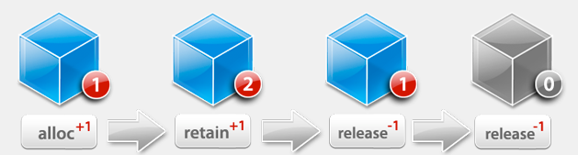
Manual Memory Management
Memory Management
Objective-C uses reference counting system:
alloc, retain, copy – increment reference count
release – decrements reference count

Slide 11
Dealloc
Memory Management
Once referenceCount=0 dealloc method is called
In dealloc all instance variable should be released
-(void)dealloc
{
[self.iVar1 release];
[self.iVar2 release];
[self.iVar3 release];
[super dealloc];
}

Slide 12
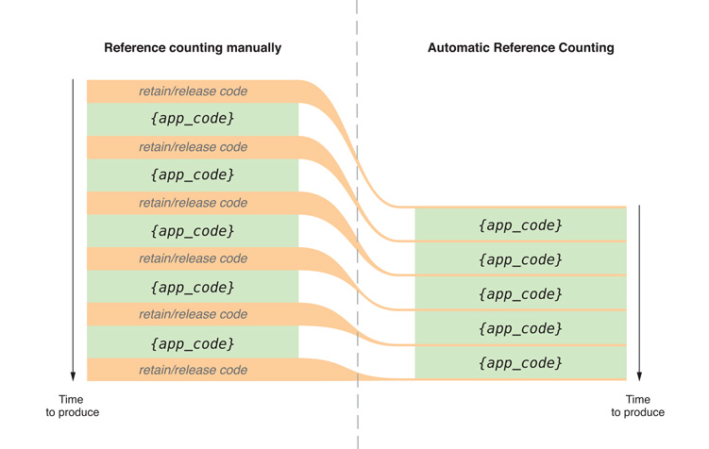
ARC
Memory Management
Never call dealloc directly using ARC!!!

Slide 13
Retain Cycles
Memory Management
Objects in retain cycle are never released

Slide 14
ARC
Memory Management
Use weak references to break retain cycles
@property (weak) NSString* name;
- (void)setTarget:(id __weak)target
__block typeof(self) tmpSelf = self;
[self methodThatTakesABlock:^ {
[tmpSelf doSomething];
}];

Slide 15
Mutable Objects
Foundation Classes
Mutable objects – object which state you can change
Most Framework classes are mutable
However there are few immutable classes
Immutable classes proivide the following benefits:
Immutable object wont change in runtime
App performance is improved if the object is immutable

Slide 16
Value Objects
Foundation Classes
A value object is an object that encapsulates a primitive value (of a C data type) and provides services related to that value
The Foundation framework provides you with the following classes:
NSString and NSMutableString
NSData and NSMutableData
NSDate
NSNumber
NSValue

Slide 17
NSString and String literals
Foundation Classes
NSString is a wrapper for C strings
// Create the string "My String" plus carriage return.
NSString *myString = @"My String\n";
// Create the formatted string "1 String".
NSString *anotherString = [NSString stringWithFormat:@"%d %@", 1, @"String"];
// Create an Objective-C string from a C string.
NSString *fromCString = [NSString stringWithCString:"A C string" encoding:NSASCIIStringEncoding];

Slide 18
NSNumber and Literals
Foundation Classes
NSNumber wraps primitive C types
int n = 5; // Value assigned to primitive type
NSNumber *numberObject = [NSNumber numberWithInt:n]; // Value object created from primitive type
int y = [numberObject intValue]; // Encapsulated value obtained from value object (y == n)
NSNumber *myIntValue = @32;
NSNumber *myDoubleValue = @3.22346432;
NSNumber *myBoolValue = @YES;
NSNumber *myCharValue = @'V';
NSNumber *myFloatValue = @3.2F

Slide 19
Dates and Times
Foundation Classes
NSDate represents a moment in time
NSDate *now = [NSDate date]; // 1
NSCalendar *calendar = [[NSCalendar alloc] initWithCalendarIdentifier:NSGregorianCalendar]; // 2
[calendar setTimeZone:[NSTimeZone systemTimeZone]]; // 3
NSDateComponents *dc = [calendar components:(NSHourCalendarUnit|NSMinuteCalendarUnit|
NSSecondCalendarUnit) fromDate:now]; // 4
NSLog(@"The time is %d:%d:%d", [dc hour], [dc minute], [dc second]); // 5

Slide 20
Collections
Foundation Classes
A collection is an object that stores other objects in a certain way and allows clients to access those objects

Slide 21
Arrays
Foundation Classes
Creating Arrays:
// Compose a static array of string objects
NSString *objs[3] = {@"One", @"Two", @"Three"};
// Create an array object with the static array
NSArray *arrayOne = [NSArray arrayWithObjects:&(*objs) count:3];
// Create an array with a nil-terminated list of objects
NSArray *arrayTwo = [[NSArray alloc] initWithObjects:@"One", @"Two", @"Three", nil];
NSArray *myArray = @[ @"Hello World", @67, [NSDate date] ];
Accessing objects:
NSString *theString = [arrayTwo objectAtIndex:1];
id theObject = myArray[1];

Slide 22
Fast Enumeration
Foundation Classes
NSArray *myArray = // get array
for (NSString *cityName in myArray) {
if ([cityName isEqualToString:@"Cupertino"]) {
NSLog(@"We're near the mothership!");
break;
}
}
NSArray *myArray = // get array
[myArray enumerateObjectsUsingBlock:^(id obj, NSUInteger idx, BOOL *stop) {
if ([obj isEqual:@"Cupertino"]) {
NSLog(@"We're near the mothership!");
*stop = YES;
}
}];

Slide 23
Dictionary
Foundation Classes
Dictionary creation:
// First create an array of keys and a complementary array of values
NSArray *keyArray = [NSArray arrayWithObjects:@"IssueDate", @"IssueName", @"IssueIcon", nil];
NSArray *valueArray = [NSArray arrayWithObjects:[NSDate date], @"Numerology Today", self.currentIssueIcon, nil];
// Create a dictionary, passing in the key array and value array
NSDictionary *dictionaryOne = [NSDictionary dictionaryWithObjects:valueArray forKeys:keyArray];
// Create a dictionary by alternating value and key and terminating with nil
NSDictionary *dictionaryTwo = [[NSDictionary alloc] initWithObjectsAndKeys:[NSDate date],@"IssueDate", @"Numerology Today", @"IssueName", self.currentIssueIcon, @"IssueIcon", nil];

Slide 24
Dictionary
Foundation Classes
Literal:
NSDictionary*myDictionary=@{
@"name" : NSUserName(),
@"date" : [NSDate date],
@"processInfo" : [NSProcessInfo processInfo]
};
Accessing Objects:
NSDate *date = [dictionaryTwo objectForKey:@"IssueDate"];
NSString *theName = myDictionary[@"name"];

Slide 25
Sets
Foundation Classes
Sets Are Unordered Collections
NSSet *simpleSet = [NSSet setWithObjects:@"Hello, World!", @42, aValue, anObject, nil];
Sets only store one reference to an individual object, even if you try and add an object more than once:
NSNumber *number = @42;
NSSet *numberSet =
[NSSet setWithObjects:number, number, number, number, nil];
// numberSet only contains one object

Slide 26
Mutable Collection
Foundation Classes
Mutable Array
NSMutableArray *myMutableArray = [NSMutableArray arrayWithCapacity:1];
NSDate *today = [NSDate date];
myMutableArray[0] = today;
Mutable Dictionary
NSMutableDictionary *mutableDict = [[NSMutableDictionary alloc] init];
mutableDict[@"name"] = @"John Doe";
Mutable Set
NSMutableSet* mutableSet = [[NSMutableSet alloc] init];
[mutableSet addObject:@"John Doe"];

Slide 27
Object Introspection
There are three important types of information that an object can divulge about itself at runtime:
Whether it’s an instance of a particular class or subclass
Whether it responds to a message
Whether it conforms to a protocol
Checking for being an instance of a particular class
static int sum = 0;
for (id item in myArray) {
if ([item isKindOfClass:[NSNumber class]]) {
int i = (int)[item intValue];
sum += i;
}
}

Slide 28
Object Introspection
Discover whether an object responds to selector:
if ([item respondsToSelector:@selector(setState:)])
{
[item setState: NSOnState];
}
Discover Whether an Object Conforms to a Protocol
(void) setDelegate:(id __weak) obj
{
NSParameterAssert([obj conformsToProtocol:
@protocol(SubviewTableViewControllerDataSourceProtocol)]);
delegate = obj;
}

Slide 29
Compare Objects
You can compare two objects by using the isEqual: method. The object receiving the message is compared to the passed-in object; if they’re the same, the method returns YES. For example:
BOOL objectsAreEqual = [obj1 isEqual:obj2];
if (objectsAreEqual) {
// do something...
}

Slide 30
Copy Object
You make a copy of an object by sending a copy message to it:
NSArray *myArray = [yourArray copy];
To be copied, the class of the receiving object must conform to the NSCopying protocol. If you want your objects to be copyable, you must adopt and implement the copy method of this protocol.

