Slide 1
Objective-C: Fundamentals
Vyacheslav Kormushkin
Write Objective-C Code

Slide 2
AGENDA
1. About Objective-C
2. Classes and objects
3. Methods and Messaging
4. Properties
5. Blocks
6. Protocols and Categories
7. Defined Types

Slide 3
History
About Objective-C
Developed in early 1980s by Brad Cox and Tom Love at Stepstone
Was inspired by Smalltalk
Was selected as the main language used by NeXT for its NeXTSTEP operating system
NeXT developed the AppKit and Foundation Kit
After acquiring NeXT in 1996, Apple Computer used OpenStep in its new operating system, Mac OS X.
At WWDC 2014, Apple introduced the new Swift language, which is being characterized as "Objective-C without the C".

Slide 4
Summary
About Objective-C
Objective-C is a Superset of the C Language
Objective-C adds the following syntax and features to ANSI C:
Definition of new classes
Class and instance methods
Method invocation (called messaging)
Declaration of properties (and automatic synthesizing of accessor methods from them)
Static and dynamic typing
Blocks—encapsulated segments of code that can be executed at any time
Extensions to the base language such as protocols and categories
Objective-C always uses dynamic binding

Slide 5
Interface and Implementation
Classes and Objects
Objective-C code consist of the following files:
.h - Header files. Header files contain class, type, function, and constant declarations.
.m - Implementation files. A source file with this extension can contain both Objective-C and C code. It is sometimes called an source file.
.mm - Implementation files. A source file with this extension can contain C++ code in addition to Objective-C and C code. Use this extension only if you actually refer to C++ classes or features from your Objective-C code.
When you want to include header files in your source code, specify a pound import (#import) directive as one of the first lines in a header or source file; a #import directive is like C’s #include directive, except that it makes sure that the same file is never included more than once.
#import “HeaderFile.h”
#import <Gizmo/Gizmo.h>

Slide 6
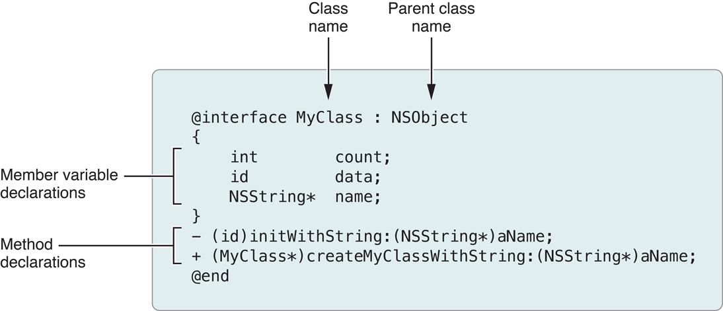
Class declaration
Classes and Objects

Slide 7
Class Implementation
Classes and Objects
#import "MyClass.h"
@implementation MyClass
- (id)initWithString:(NSString *)aName
{
// code goes here
}
+ (MyClass *)myClassWithString:(NSString *)aName
{
// code goes here
}
@end

Slide 8
Object declaration
Classes and Objects
Statically typed variables include the class name in the variable type declaration.
Dynamically typed variables use the type id for the object instead.
MyClass *myObject1; // Static typing
id myObject2; // Dynamic typing

Slide 9
Methods
Methods and Messaging
An instance method is a method whose execution is scoped to a particular instance of the class. In other words, before you call an instance method, you must first create an instance of the class. Instance methods are the most common type of method.
A class method is a method whose execution is scoped to the method’s class. It does not require an instance of an object to be the receiver of a message.

Slide 10
Messages
Methods and Messaging
To call a method, you do so by sending a message to the object that implements the method—or, in other words, by messaging that object.
[myArray insertObject:anObject atIndex:0];
[[myAppObject theArray] insertObject:anObject atIndex:0];
[myAppObject.theArray insertObject:anObject atIndex:0];
myAppObject.theArray = aNewArray;

Slide 11
Class methods
Methods and Messaging
It is also possible to send messages to the class itself
NSMutableArray *myArray = nil; // nil is essentially the same as NULL
// Create a new array and assign it to the myArray variable.
myArray = [NSMutableArray array];

Slide 12
Property declaration
Properties
Property in the general sense is some data encapsulated or stored by an object.
@property (assign) float volume;
@property (copy) MyModelObject *theObject; // Copy the object during assignment.
@property (readonly) NSView *rootView; // Declare only a getter method.
@property (weak) id delegate; // Declare delegate as a weak reference

Slide 13
Property declaration
Properties
Use the @synthesize compiler directive in the class implementation to ask the compiler to generate the accessor methods along with the specially named instance variable.
@synthesize enabled = _isEnabled;
Incidentally, when you declare a property you can specify custom names for the accessor methods, typically to make the getter methods of Boolean properties follow a conventional form, as shown here:
@property (assign, getter=isEnabled) BOOL enabled;

Slide 14
Block declaration and usage
Blocks
int result = myBlock(4);

Slide 15
Protocols
Protocols and Categories
A protocol declares methods that can be implemented by any class
@interface TrackMixAppDelegate : NSObject <NSApplicationDelegate>
The declaration of a protocol looks similar to that of a class interface
@protocol MyProtocol
(void)myProtocolMethod;
@end

Slide 16
Categories
Protocols and Categories
A category is a feature of the Objective-C language that enables you to extend the interface of a class without having to subclass it.
@interface NSDate (NSDateCreation)
You can also use an anonymous category known as a class extension to declare private properties and private methods in the implementation (.m) file.
@interface TrackMixAppDelegate ()
@property (weak) IBOutlet NSWindow *window;
@property (assign) IBOutlet NSTextField *nameField;
@property (strong) MyDataObject *data;
@end

Slide 17
Defined Types
Type | Description
id | The dynamic object type. The negative literal for both dynamically and statically typed objects is nil.
Class | The dynamic class type. Its negative literal is Nil.
SEL | The data type (typedef) of a selector; this data type represents a method signature at runtime. Its negative literal is NULL.
BOOL | A Boolean type. The literal values are YES and NO.

Slide 18

Questions?

