Slide 1

iOS Application Development
Harman Internship
Vyacheslav Kormushkin

Slide 2
Course Prerequisites
Any Computer Science course.
Experience with any programming language.
Basic OOP understanding. You should be familiar with the following terms:
Class
Instance
Instance variable
Method
Superclass/subclass
Environment setup.

Slide 3
Course Syllabus
Course Introduction
Introduction to Swift
Xcode and tools
iOS Application Development Fundamentals
Views, View Controllers, Navigation

Slide 4
Why should I learn iOS?

Slide 5
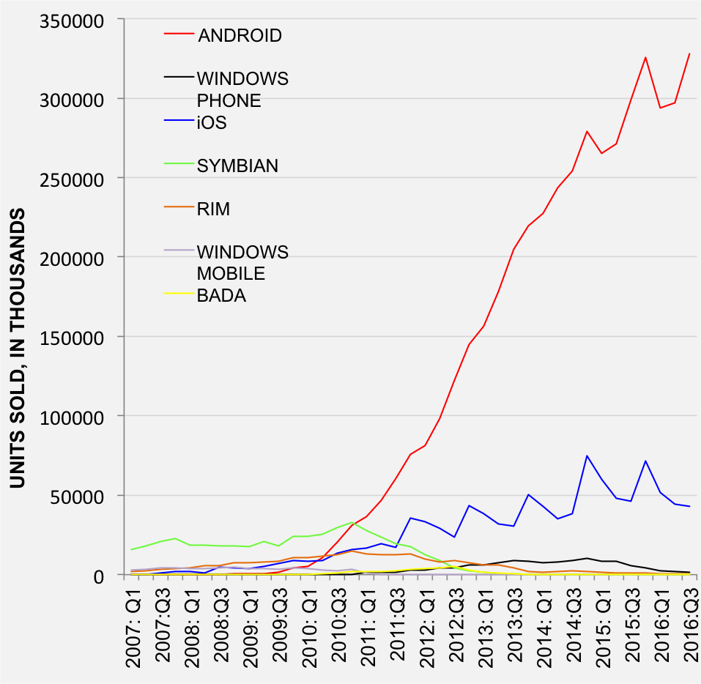
Mobile device market share

Slide 6
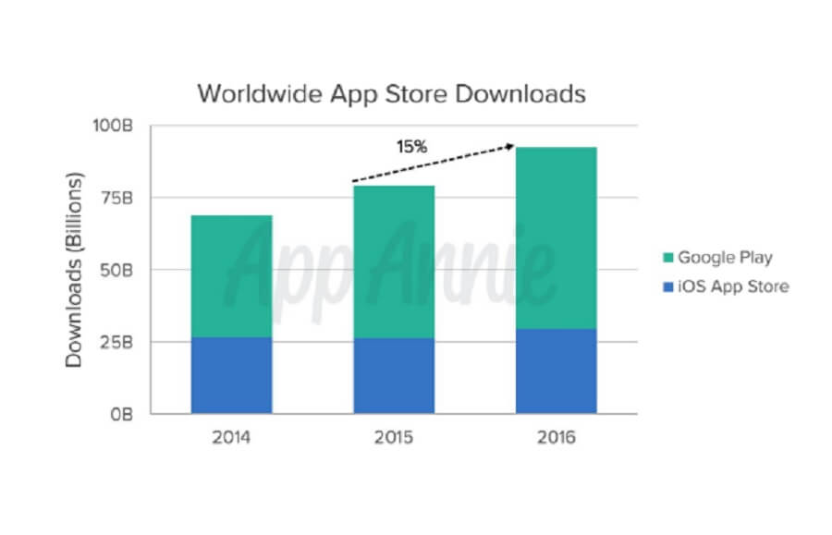
App market share

Slide 7
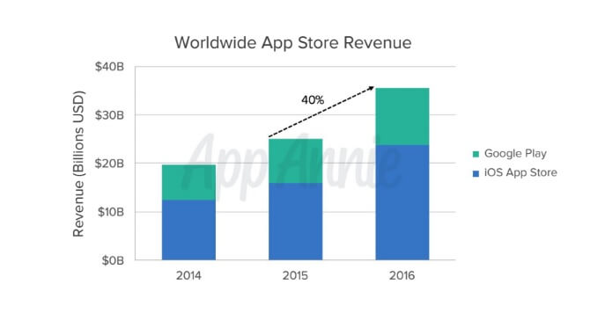
Store revenue share

Slide 8
History Facts
June 2007 - Initially introduced as iPhone OS
October 2007 – iPhone OS 2.0 and SDK are announced
June 2010 – renamed to iOS along with iPad introduction
September 2016 – current version of iOS was released – iOS10

Slide 9
Devices
iPhone
iPad
iPod Touch
Apple watch (watchOS)
Apple TV (tvOS)

Slide 10
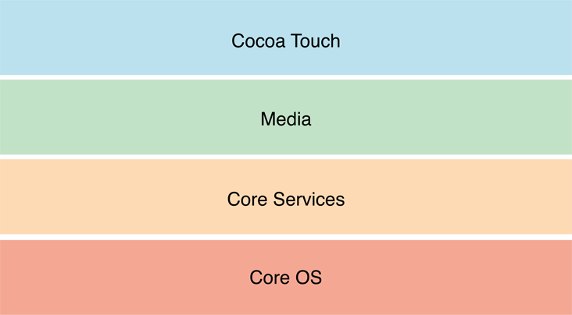
iOS architecture overview
Notes:
https://developer.apple.com/library/prerelease/content/documentation/Miscellaneous/Conceptual/iPhoneOSTechOverview/Introduction/Introduction.html#//apple_ref/doc/uid/TP40007898
CoreOS: Accelerate, CoreBluetooth, ExternalAccessory, Security, Authentication(TouchId), NetworkExtension(VPN)
CoreServices: Foundation, Core Foundation, Data Protection, File Sharing, GCD, CloudKit, AdKit, CoreData, Sqlite, Core Location, CoreTlephony, EventKit, HelthKit, HomeKit, PassKit
Media: UIKit graphics, Core Animation, Core Image, Metal, TextKit, OpenGL, AVFoundation, OpenAl, CoreAudio, MediaPlayer
CocoaTouch: UIKit, Storyboards, Address book UI, Message UI, Notification center

Slide 11
Development approaches
Native SDK
Web application
Cross-platform framework

Slide 12
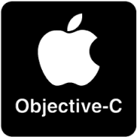

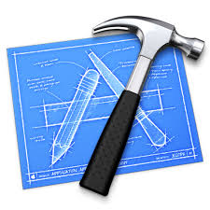

Native
Language:
Objective-C
Swift
IDE:
Xcode
Appcode (Jetbrains)

Slide 13






Web
Apache Cordova
JavaScript + HTML5
Cross-platform
Frameworks:
jQery mobile
Ionic
Sencha touch

Slide 14


Cross-platform
Xamarin (Microsoft)
C#
Visual Studio
Supports iOS, Android, and Windows10
React Native (Facebook)
JavaScript
React
Supports iOS and Android

Slide 15
Environment setup
Hardware:
Mac
Mac mini
MacBook Air
MacBook Pro
iMac
MacPro
Hackintosh
Virtual Machine
VMWare
VirtualBox
OS:
Mac OS X 10.11 El Capitan, macOS 10.12 Sierra
IDE:
Xcode 8

Slide 16
Resources
developer.apple.com
swift.org
iTunes U
Lynda.com

Slide 17
Questions?

