Slide 1

iOS Application Development Fundamentals
Harman Internship
Vyacheslav Kormushkin

Slide 2
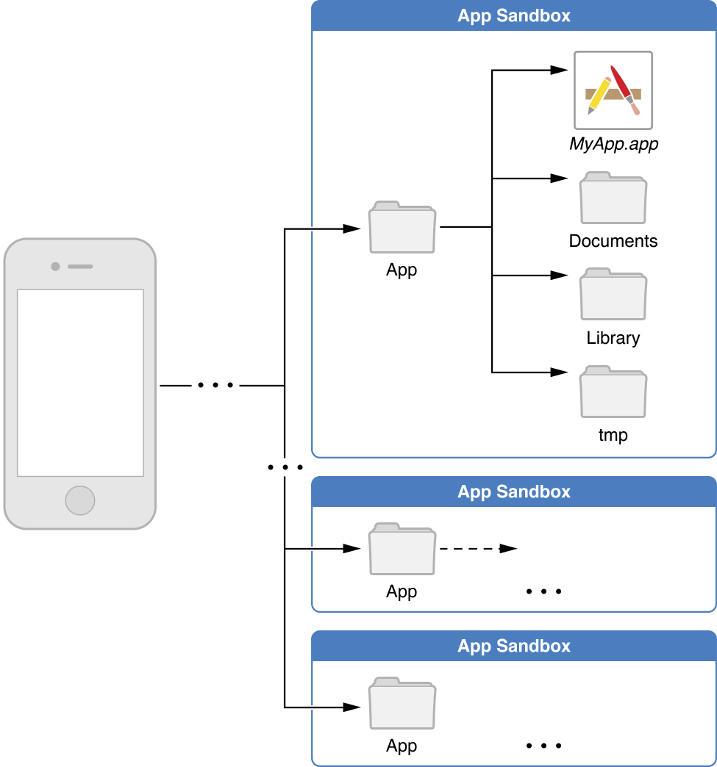
Application Bundle and Sandbox
Notes:
For security purposes, an iOS app’s interactions with the file system are limited to the directories inside the app’s sandbox directory. During installation of a new app, the installer creates a number of container directories for the app inside the sandbox directory. Each container directory has a specific role. The bundle container directory holds the app’s bundle, whereas the data container directory holds data for both the app and the user. The data container directory is further divided into a number of subdirectories that the app can use to sort and organize its data. The app may also request access to additional container directories—for example, the iCloud container—at runtime.

Slide 3
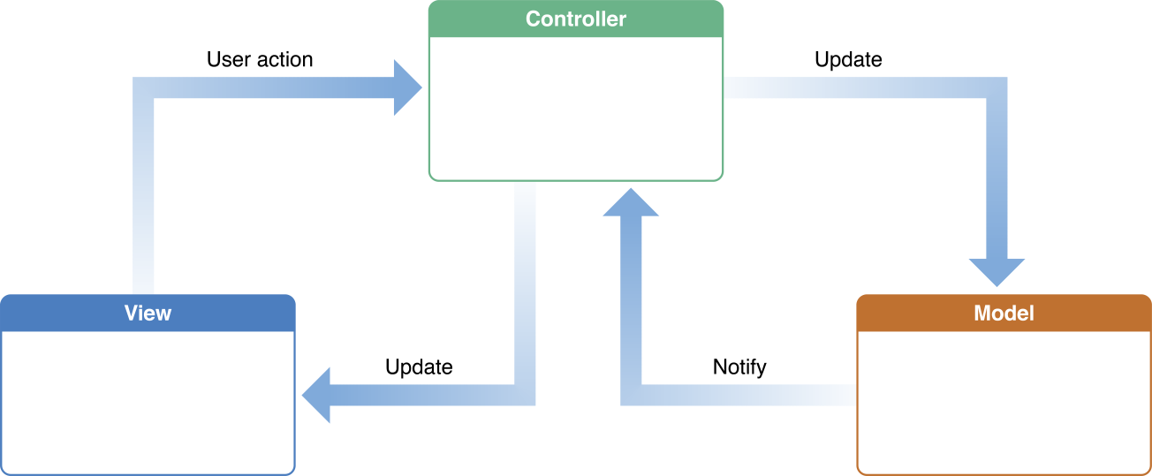
MVC

Slide 4
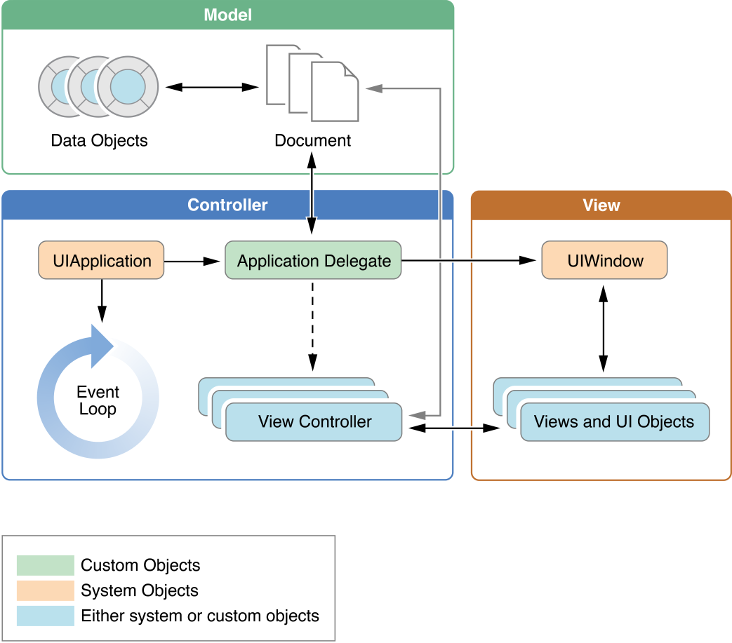
Structure of an app

Slide 5
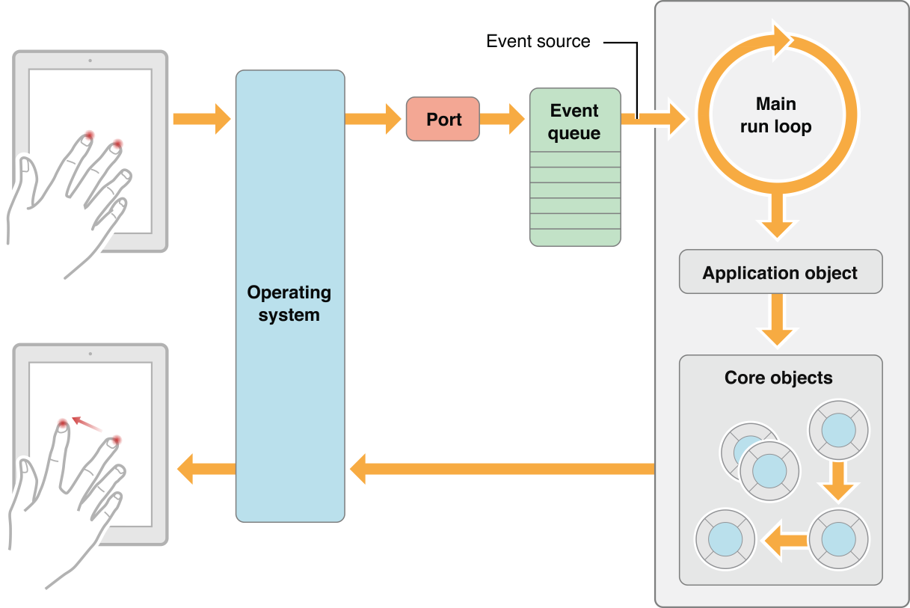
Main Run Loop

Slide 6
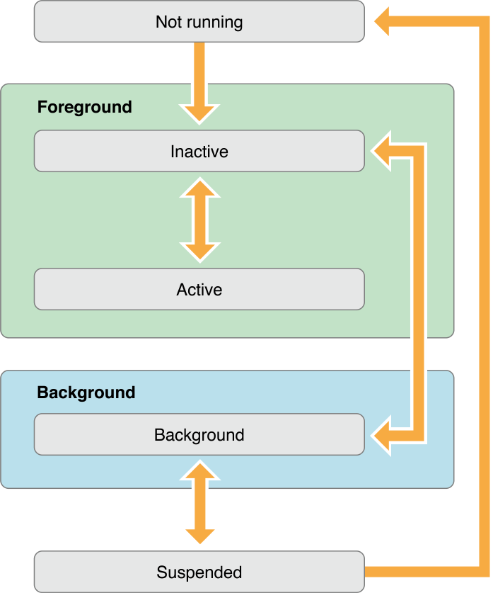
Execution states for apps

Slide 7
Background execution
Finite-Length Tasks
Downloading Sessions
Long-Running Tasks
Audio & VOIP
Location
Newsstand downloads
BLE and External Accessories
Background fetch
Remote notifications
Background App Refresh
Can be opted out
Notes:
Can be opted out

Slide 8
Inter-App Communication
UIPasteboard
URL scheme
AirDrop
App Extensions

Slide 9
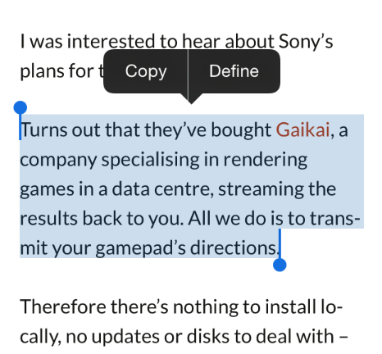
UIPasteboard
let lastString = UIPasteboard.general.string

Slide 10
URL Scheme
Apps should register URL scheme they support with the system
Apps can use custom URL schemes
If more than one third-party app registers to handle the same URL scheme, there is currently no process for determining which app will be given that scheme
let phoneUrl = URL(string: "tel://1234567890")
UIApplication.shared.open(phoneUrl!)

Slide 11
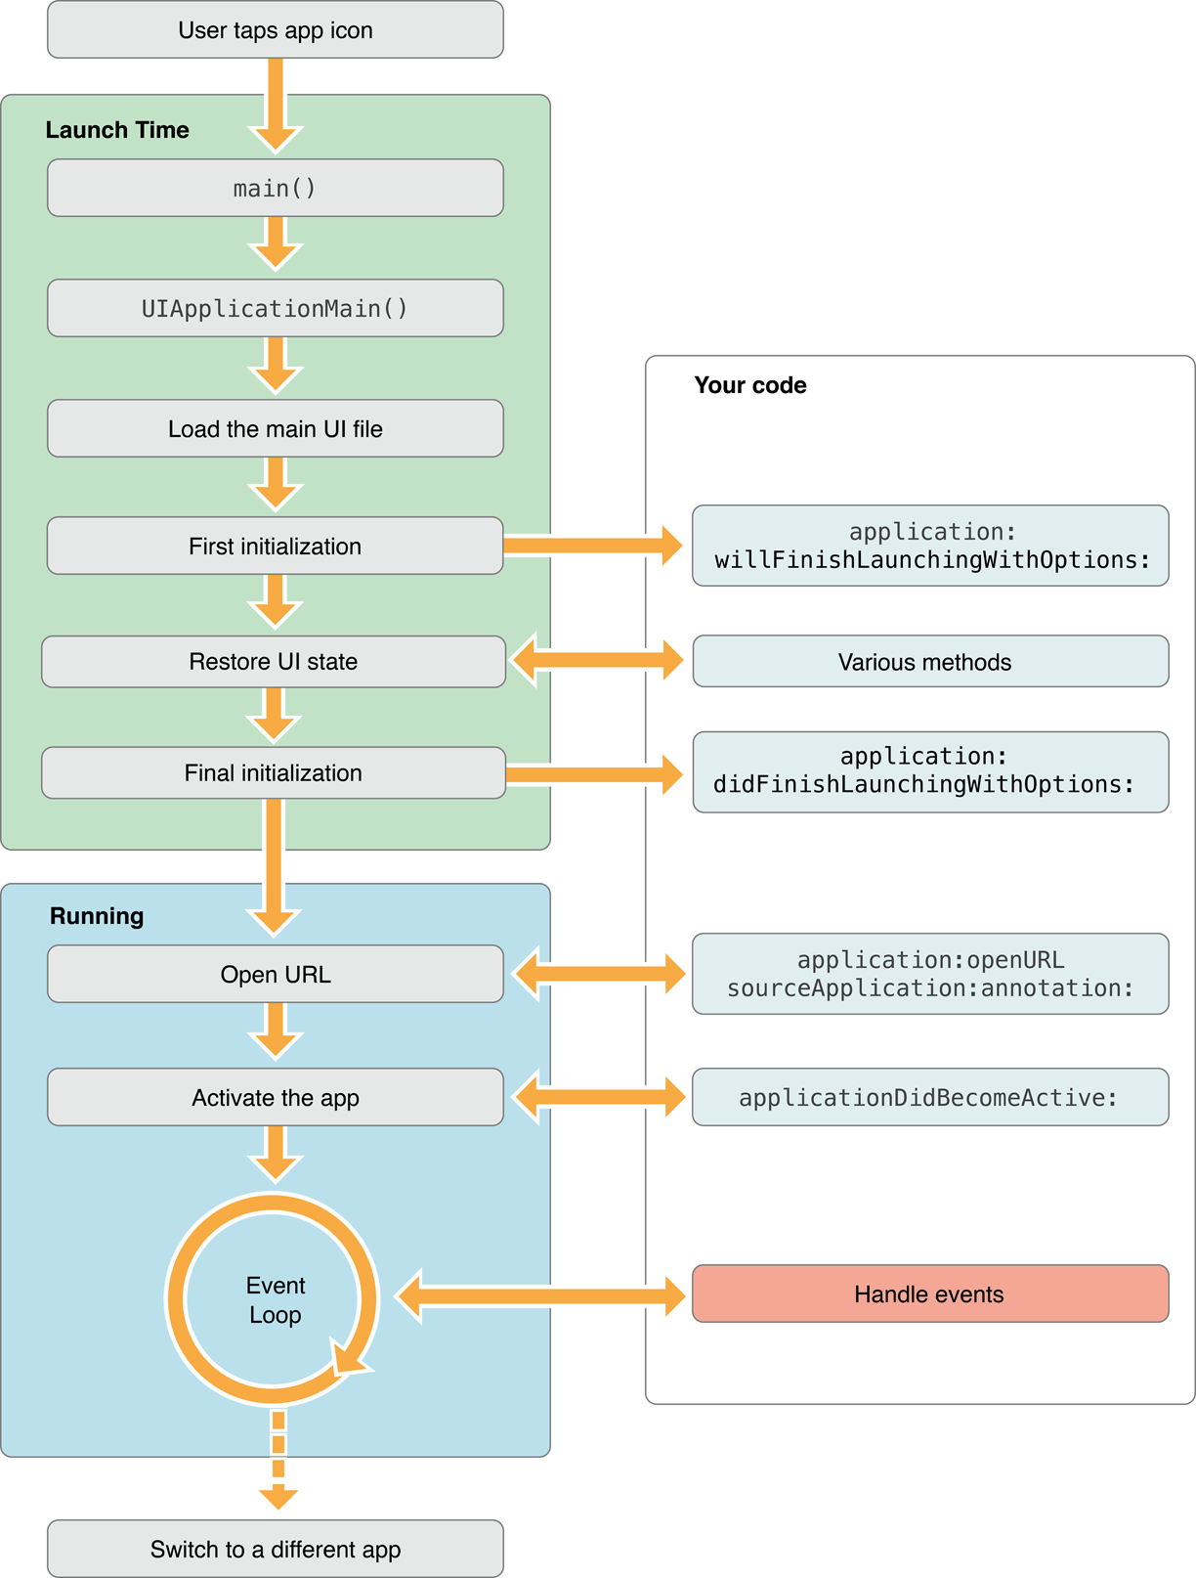
Launching an app to open URL

Slide 12
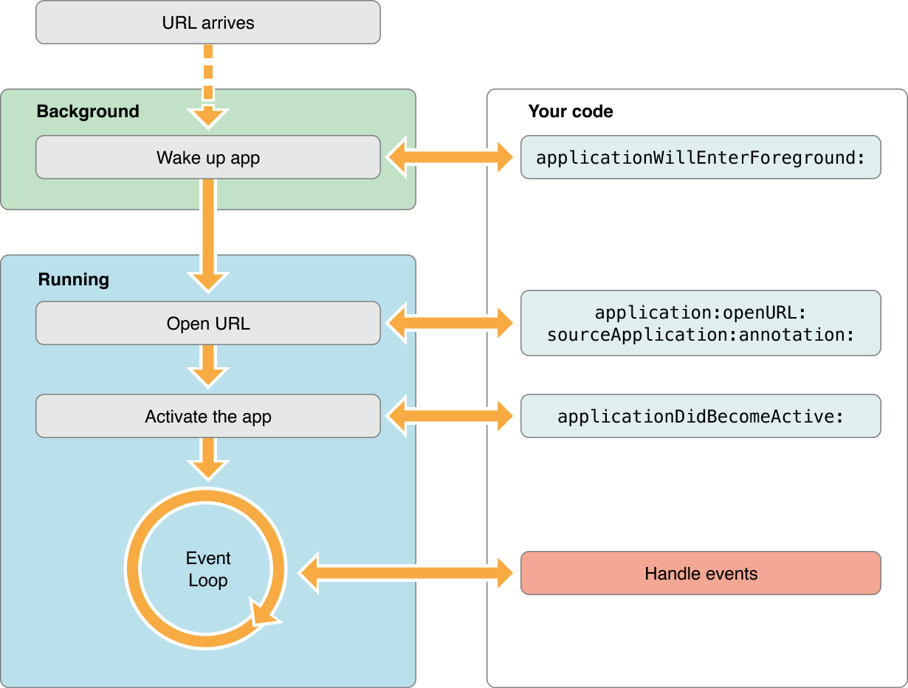
Waking a background app to open URL
let phoneUrl = URL(string: "tel://1234567890")
UIApplication.shared.open(phoneUrl!)

Slide 13
AirDrop
Use UIActivityViewController to send
Use application(_:open:options:) of UIApplicationDelegate to handle
Be prepared to look for files in your app’s Documents/Inbox directory and move them out of that directory as needed.

Slide 14
Application Extensions
Action
Audio Unit
Content Blocker
Custom Keyboard
Document Provider
Photo Editing
Share
Today
Intent
iMessage

Slide 15
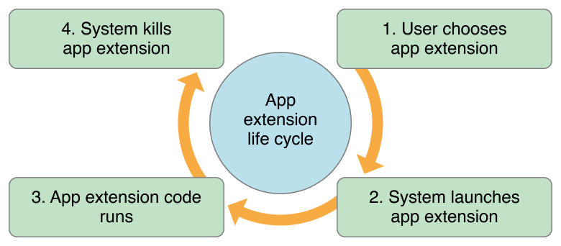
App Extension Lifecycle

Slide 16
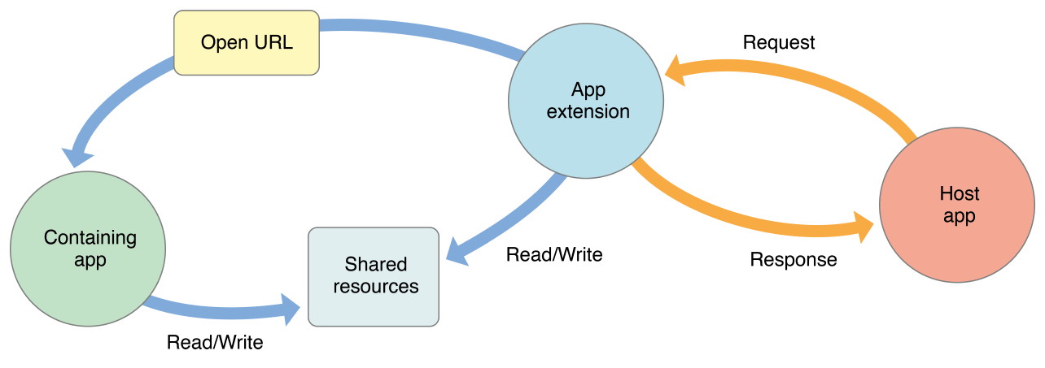
App Extension Communication

Slide 17
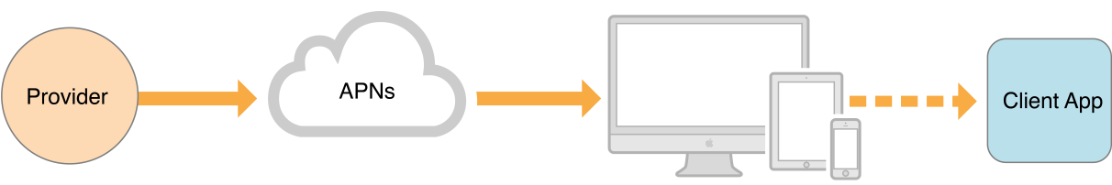
Notifications
Local Notifications - your app configures the notification details locally and passes those details to the system, which then handles the delivery of the notification when your app is not in the foreground.
Remote Notifications - you use one of your company’s servers to push data to user devices via the Apple Push Notification service.

Slide 18
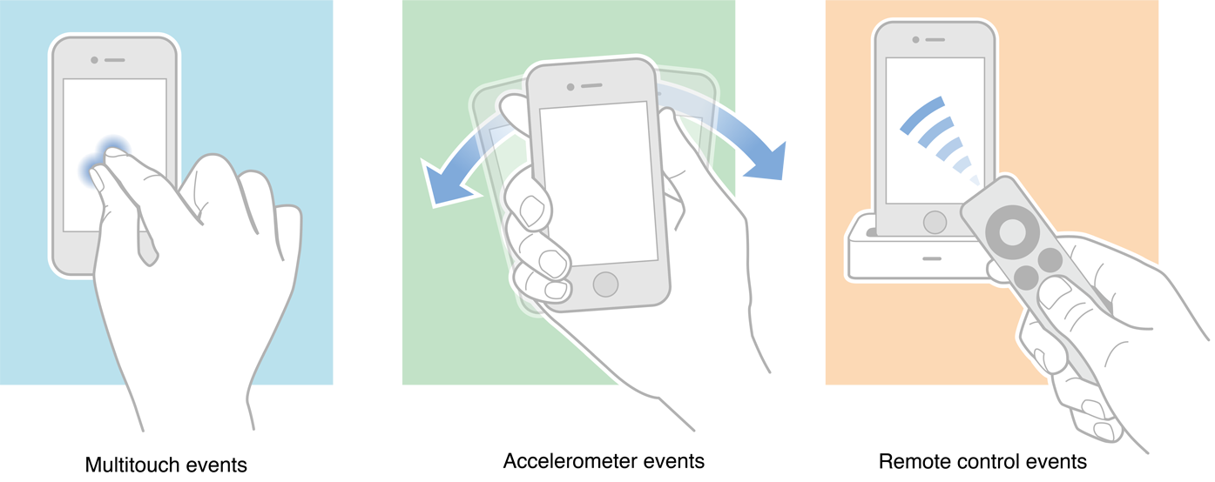
Event Handling

Slide 19
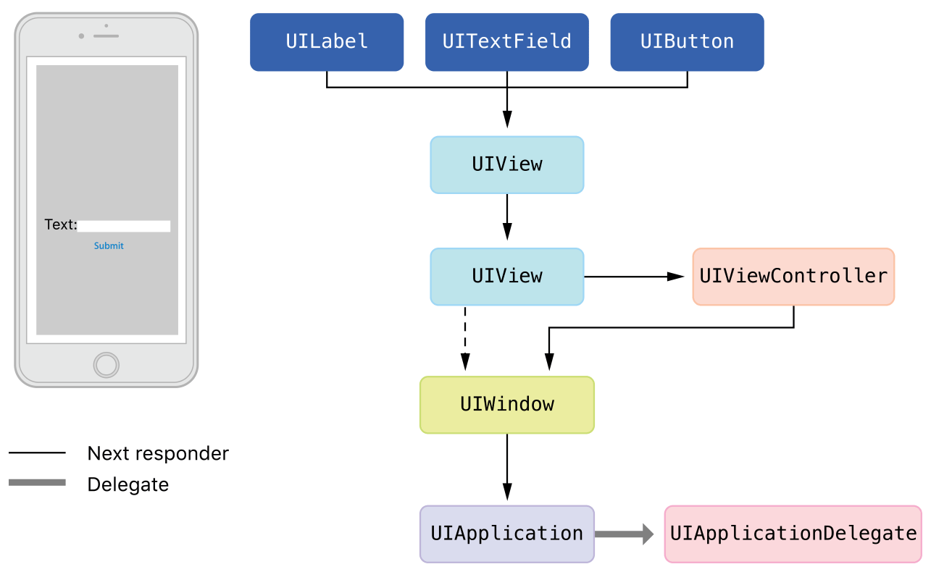
Responder Chain

Slide 20
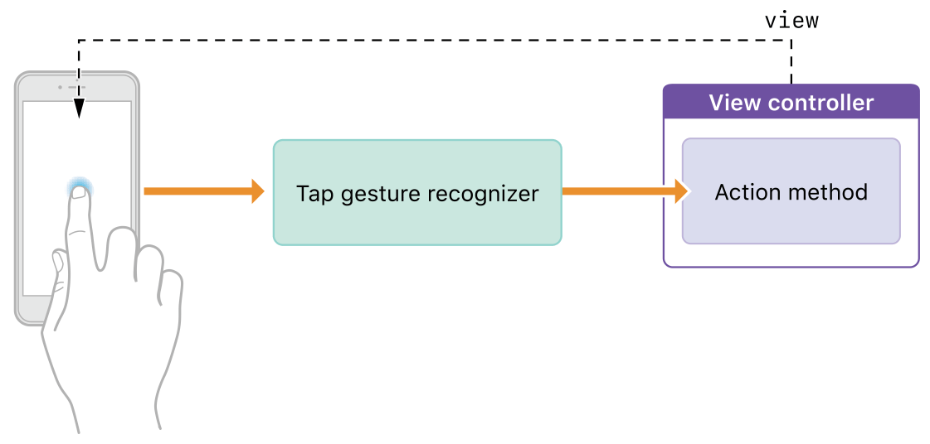
Gestures
Handled by gesture recognizers (UIGesture​Recognizer)
Some gestures are supported out of the box: Tap, Long-Press, Pan, Swipe, Pinch, Rotation
Custom recognizers can be introduced

Slide 21
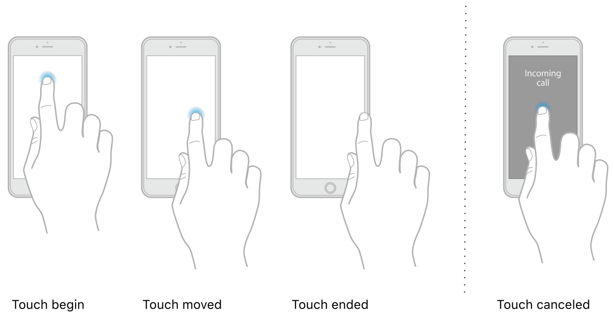
Touches
func touchesBegan(_ touches: Set<UITouch>, with event: UIEvent?)
func touchesEnded(_ touches: Set<UITouch>, with event: UIEvent?)
func touchesMoved(_ touches: Set<UITouch>, with event: UIEvent?)

Slide 22
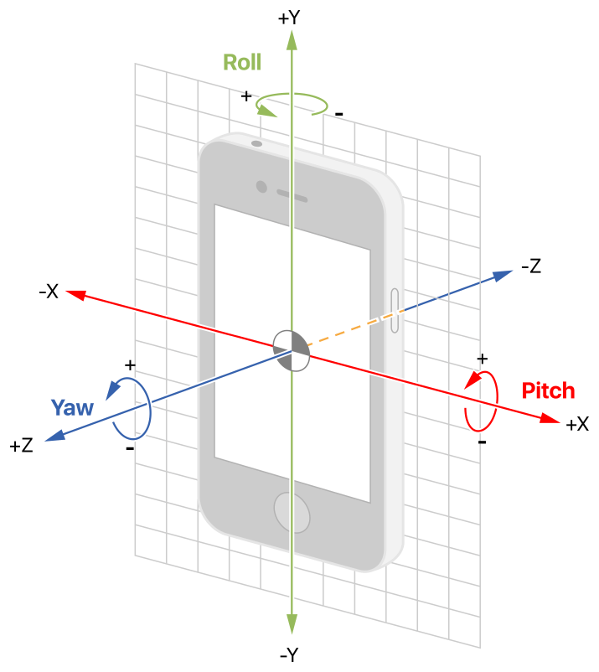
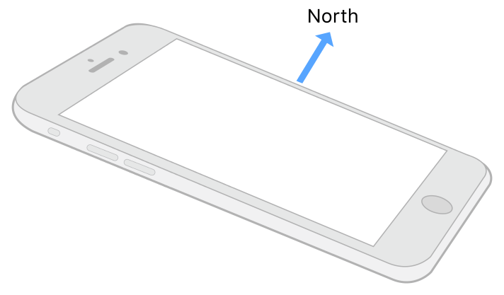
Motion events

Slide 23
Performance Tips
Reduce power consumption
Use memory efficiently
Tune your network code
Improve File Management
Make app backups more efficient
Move work off the main thread

Slide 24
Questions?

