Slide 3
Exposure Category B
Need to be true for area around the site w/ R <= max (20 H, 2.6k ft (0.5 mile, 0.8 km)) in all directions.
R

Slide 4
Exposure Category B
area
Areas
Exposure Category D
area
> 2 miles
< 20*H
true
true
Exposure
Category C

Slide 5
Exposure
Category B
Area
true
Exposure Category D
area
Exception:
Exposure C
>= 2 miles
(3.2 km)

Slide 6
Exposure Category D
Need to be true for area around the site w/ R >= 1 mile (16. km) in all directions.
R

Slide 7
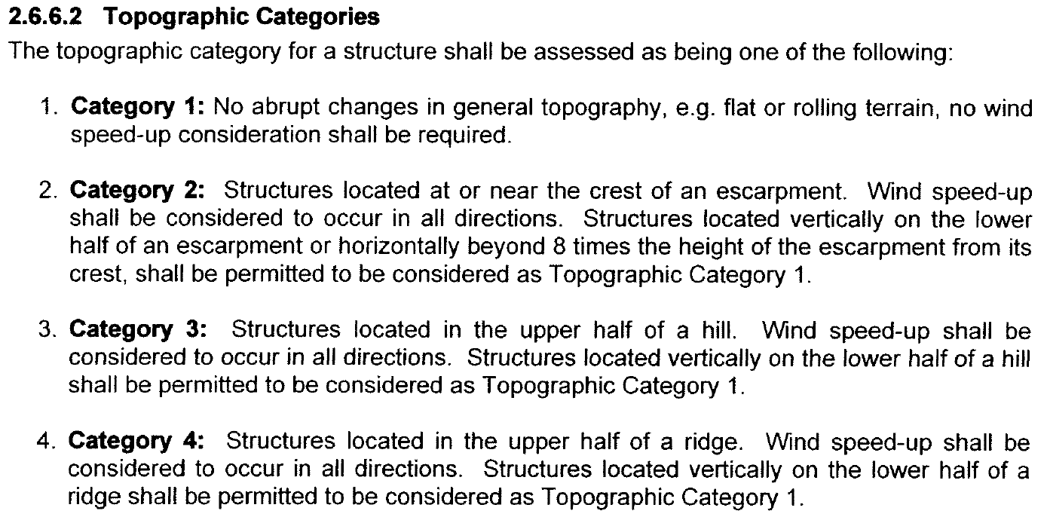

Slide 9

Cat. 1: flat and rolling terrain

Slide 10

Cat. 2: escarpment: gently sloping terrain
H/2
H
>= 8*H, ➔Cat. 1
Lower half
➔Cat. 1
H/2
8 * H

Slide 11

Cat. 3: hill: natural elevation smaller than a mountain
Upper half
Cat. 3
H/2
H
Lower half
➔Cat. 1
H/2

Slide 12

Cat. 4: ridge: a long, narrow chain of hills or mountains
If HoH <= 3*AH (H <= 2*AH):
➔Cat. 1 , else, ➔Cat. 4
H
Height of Hill (HoH)
Average Height (AH) of surrounding hills
2 miles (radius) for AH calculation of surrounding hills

Slide 13
Cat. 4: ridge: a long, narrow chain of hills or mountains
120’
220’
440’
Average Height (AH) of surrounding hills
= 660’ / 3 = 330’
2 miles
320’

Slide 14
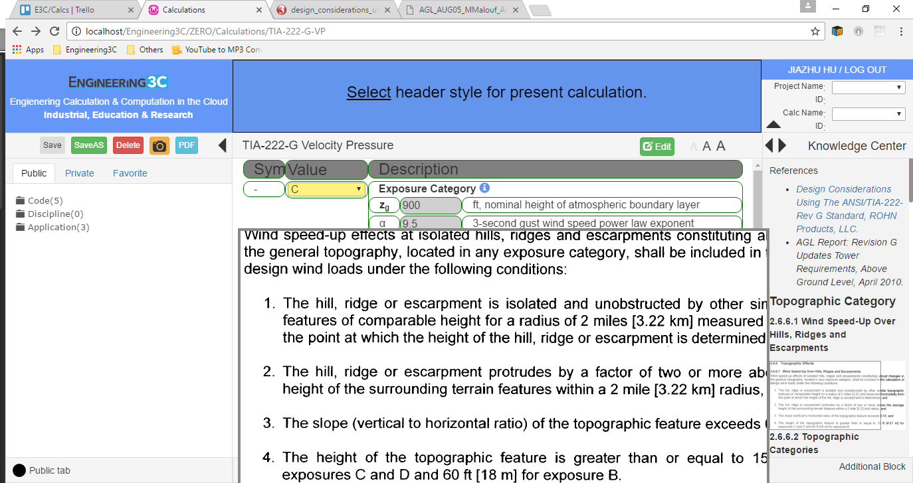

Slide 15
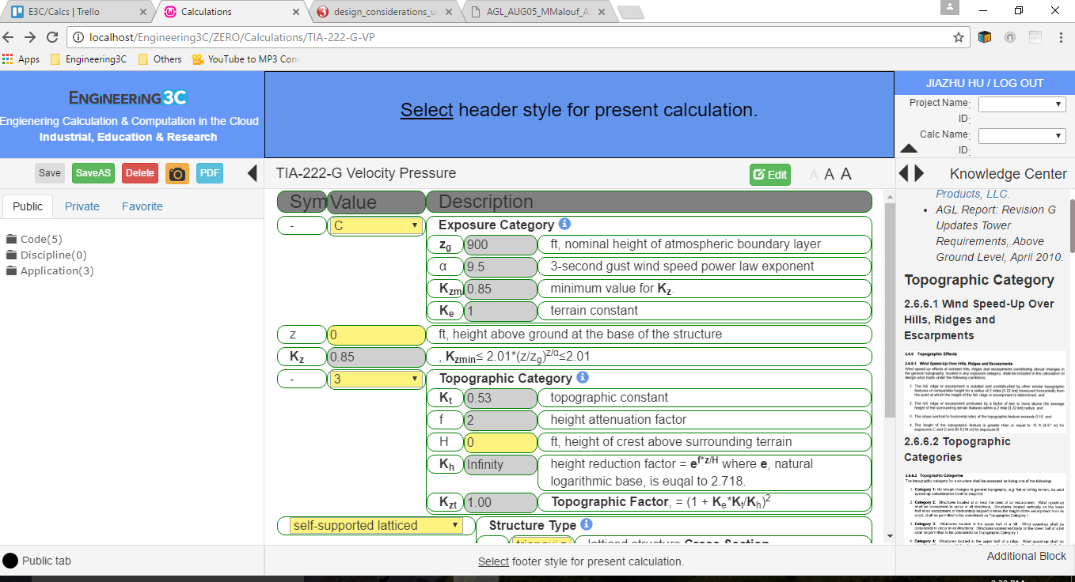
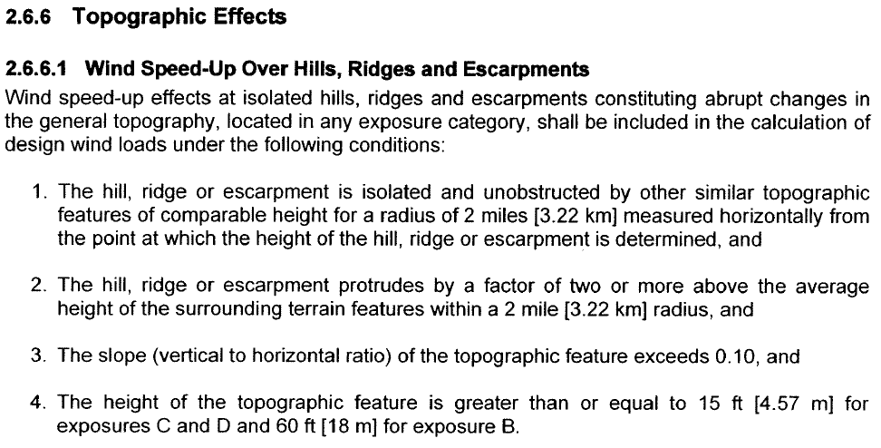
The entire image, not part of it defined by window
Fixed region on the page for displaying the entire image, no matter the original size of the image.

Slide 16
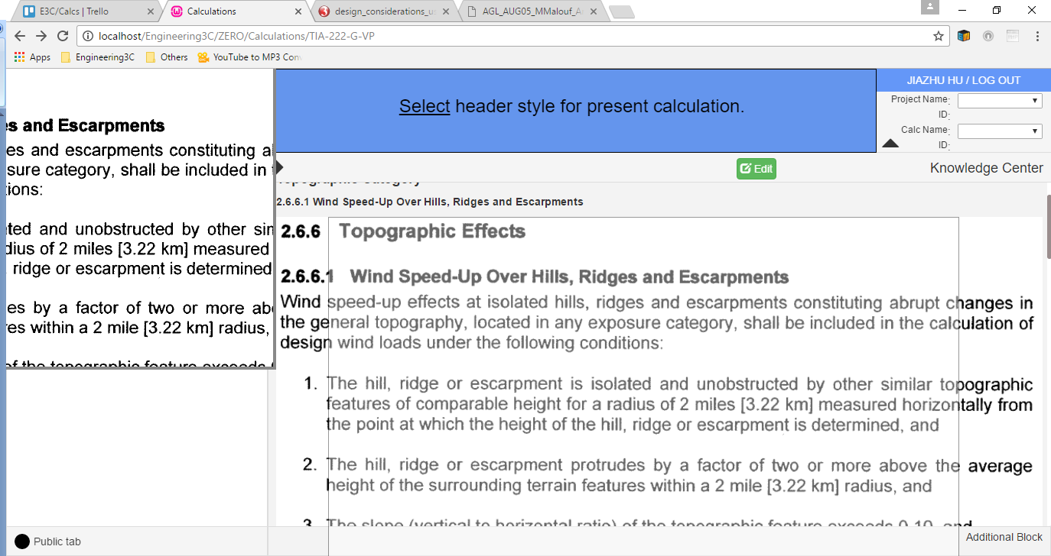
Disable the mouse-over to zoom image feature when the KC area is in extended display mode. The Edit button should be hidden as well.

