Slide 1

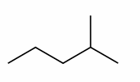
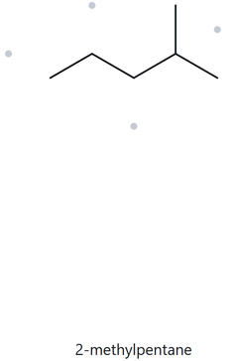


A01 FOUNDATION - C₆H₁₄
PART A - STRUCTURE → NAME
  NUMBERED PARENT
  NAMING TRAIL
Parent: longest chain = 5 C → pentane. Several 5-C paths exist, but each carries one methyl group, so they just lead to the same name.
Numbering: left → right gives 4; right → left gives 2. First point of difference: 2 < 4, so number from the right.
Substituents: methyl on C2 → 2-methyl.
4
2
5
3
1
  MY NAME
  THE ALKANE CHECK
2-methylpentane
MATCH
VERIFICATION STRIP
LONGEST CHAIN CONFIRMED
LOWEST LOCANTS
ALPHABETICAL ORDER
PUNCTUATIONS
FORMULA COUNTED

Slide 2
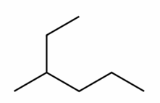
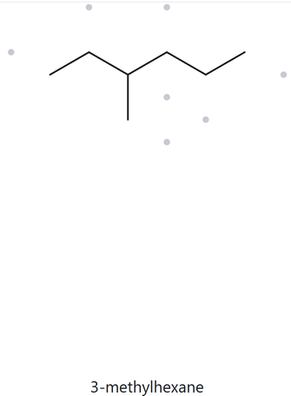
A02 FOUNDATION - C₇H₁₆
PART A - STRUCTURE → NAME
  NUMBERED PARENT
  NAMING TRAIL
1
2
Parent: longest chain = 6 C → hexane. Only one 6-C path exists.
Numbering: left → right gives 3; right → left gives 4. First point of difference: 3 < 4, so number from the left.
Substituents: methyl on C3 → 3-methyl.
3
5
4
6
  MY NAME
  THE ALKANE CHECK
3-methylhexane
MATCH
VERIFICATION STRIP
LONGEST CHAIN CONFIRMED
LOWEST LOCANTS
ALPHABETICAL ORDER
PUNCTUATIONS
FORMULA COUNTED

Slide 3
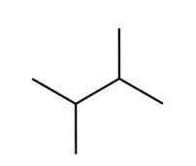
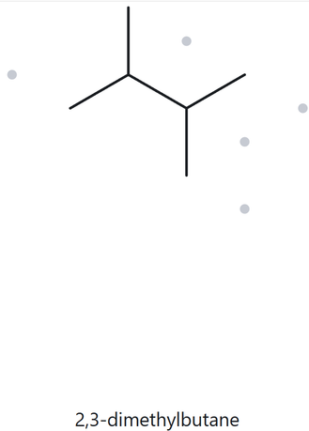
A03 FOUNDATION - C₆H₁₄
PART A - STRUCTURE → NAME
  NUMBERED PARENT
  NAMING TRAIL
Parent: longest chain = 4 C → butane. Several 4-C paths exist, but each carries two methyl groups, so they lead to the same name.
Numbering: left → right gives 2,3; right → left gives 2,3. The locant sets are identical, so either direction works. Substituents: methyl on C2 and C3 → 2,3-dimethyl.
1
2
3
4
  MY NAME
  THE ALKANE CHECK
2,3-dimethylbutane
MATCH
VERIFICATION STRIP
LONGEST CHAIN CONFIRMED
LOWEST LOCANTS
ALPHABETICAL ORDER
PUNCTUATIONS
FORMULA COUNTED

Slide 4
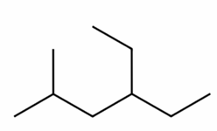
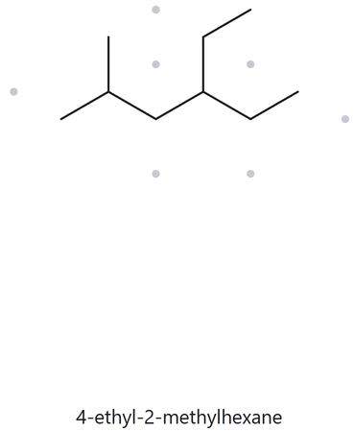
A04 DEVELOPING - C₉H₂₀
PART A - STRUCTURE → NAME
  NUMBERED PARENT
  NAMING TRAIL
Parent: longest chain = 6 C → hexane. Several 6-C paths exist, but each carries one methyl and one ethyl, so they lead to the same name. Numbering: left → right gives 2,4; right → left gives 3,5. First point of difference: 2 < 3, so number from the left.
Substituents: methyl on C2, ethyl on C4 (listed alphabetically) → 4-ethyl-2-methyl.
6
2
3
4
5
1
  MY NAME
  THE ALKANE CHECK
4-ethyl-2-methylhexane
MATCH
VERIFICATION STRIP
LONGEST CHAIN CONFIRMED
LOWEST LOCANTS
ALPHABETICAL ORDER
PUNCTUATIONS
FORMULA COUNTED

Slide 5
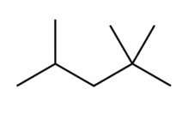
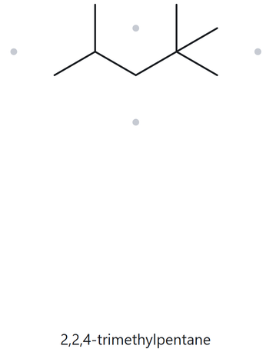
AO5 DEVELOPING - C₈H₁₈
PART A - STRUCTURE → NAME
  NUMBERED PARENT
  NAMING TRAIL
Parent: longest chain = 5 C → pentane. Several 5-C paths exist, but each carries three methyl groups, so they lead to the same name.
Numbering: left → right gives 2,4,4; right → left gives 2,2,4. First point of difference: at the second locant, 2 < 4, so number from the right (the end with the two methyls).
Substituents: methyl on C2 (2) and C4 → 2,2,4-trimethyl.
4
2
5
3
1
  MY NAME
  THE ALKANE CHECK
2,2,4-trimethylpentane
MATCH
VERIFICATION STRIP
LONGEST CHAIN CONFIRMED
LOWEST LOCANTS
ALPHABETICAL ORDER
PUNCTUATIONS
FORMULA COUNTED

Slide 6
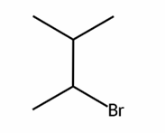
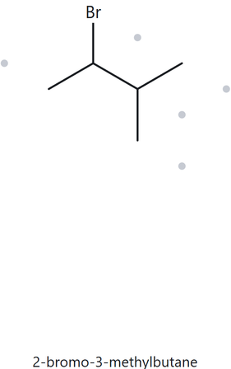
AO6 DEVELOPING - C₅H₁₁Br
PART A - STRUCTURE → NAME
  NUMBERED PARENT
  NAMING TRAIL
4
Parent: longest chain = 4 C → butane. Several 4-C paths exist, but each carries one bromo and one methyl, so they lead to the same name.
Numbering: both directions give 2,3. The locant sets are identical, so the lower number goes to the substituent that comes first alphabetically (bromo before methyl). Number from the bromo end.
Substituents: bromo on C2, methyl on C3 (listed alphabetically) → 2-bromo-3-methyl.
3
2
1
  MY NAME
  THE ALKANE CHECK
2-bromo-3-methylbutane
MATCH
VERIFICATION STRIP
LONGEST CHAIN CONFIRMED
LOWEST LOCANTS
ALPHABETICAL ORDER
PUNCTUATIONS
FORMULA COUNTED

Slide 7
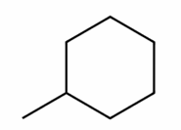
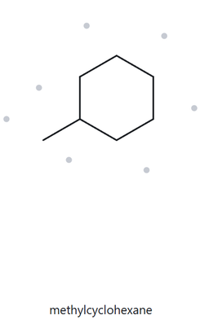
AO7 DEVELOPING - C₇H₁₄
PART A - STRUCTURE → NAME
  NUMBERED PARENT
  NAMING TRAIL
3
Parent: ring size = 6 C vs substituent = 1 C. The ring is larger → cyclohexane. Numbering: the single substituent takes position 1, and the direction doesn’t matter because there is nothing else to compare.
Substituents: methyl on C1 (locant 1 is omitted for a single ring substituent) → methyl.
2
4
1
5
6
  MY NAME
  THE ALKANE CHECK
methylcyclohexane
MATCH
VERIFICATION STRIP
LONGEST CHAIN CONFIRMED
LOWEST LOCANTS
ALPHABETICAL ORDER
PUNCTUATIONS
FORMULA COUNTED

Slide 8
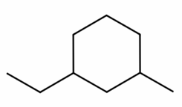
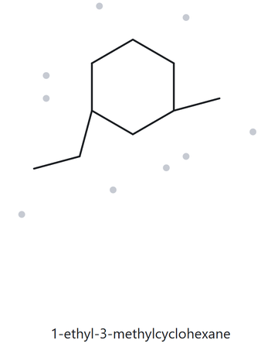
AO8 CHALLENGE - C₉H₁₈
PART A - STRUCTURE → NAME
  NUMBERED PARENT
  NAMING TRAIL
Parent: ring size = 6 C vs largest substituent = 2 C. The ring is larger → cyclohexane.
Numbering: going the short way around between the two substituents gives 1,3; the long way gives 1,5. Lowest locant set: 1,3. The locant sets tie from either substituent, so C1 goes to the first one alphabetically (ethyl before methyl). Substituents: ethyl on C1, methyl on C3 (listed alphabetically) → 1-ethyl-3-methyl.
5
6
4
1
3
2
  MY NAME
  THE ALKANE CHECK
1-ethyl-3-methylcyclohexane
MATCH
VERIFICATION STRIP
LONGEST CHAIN CONFIRMED
LOWEST LOCANTS
ALPHABETICAL ORDER
PUNCTUATIONS
FORMULA COUNTED

Slide 9
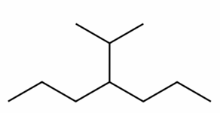
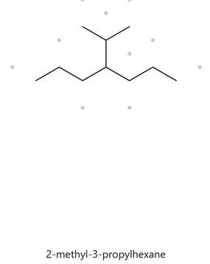

AO9 CHALLENGE - C₁₀H₂₂
PART A - STRUCTURE → NAME
  NUMBERED PARENT
  NAMING TRAIL
Parent: longest chain = 7 C → heptane. The chain runs through both propyl arms. The path through the isopropyl group is only 6 C.
Numbering: left → right gives 4; right → left gives 4. The chain is symmetrical about C4, so either direction works. Substituents: isopropyl on C4 → 4-isopropyl
2
3
4
5
6
1
7
  MY NAME
  THE ALKANE CHECK
4-isopropylheptane
MISMATCH
The name must be based on the longest continuous carbon chain, which is 7 for hepta. This makes the site’s six-carbon path incorrect.
VERIFICATION STRIP
LONGEST CHAIN CONFIRMED
LOWEST LOCANTS
ALPHABETICAL ORDER
PUNCTUATIONS
FORMULA COUNTED

Slide 10
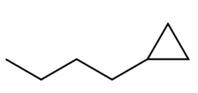
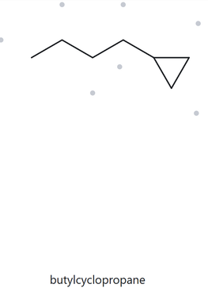
A10 CHALLENGE - C₇H₁₄
PART A - STRUCTURE → NAME
  NUMBERED PARENT
  NAMING TRAIL
Parent: open chain vs ring = 4 C vs 3 C. Since 4 > 3, the chain is the parent → butane.
Numbering: right → left gives 1; left → right gives 4. First point of difference: 1 < 4, so number from the end attached to the ring.
Substituents: cyclopropyl on C1 → 1-cyclopropyl.
4
3
2
1
  MY NAME
  THE ALKANE CHECK
1-cyclopropylbutane
MISMATCH
The four-carbon chain will take priority as the parent rather than the enclosed ring that only comprises of 3 carbons.
VERIFICATION STRIP
LONGEST CHAIN CONFIRMED
LOWEST LOCANTS
ALPHABETICAL ORDER
PUNCTUATIONS
FORMULA COUNTED

Slide 11
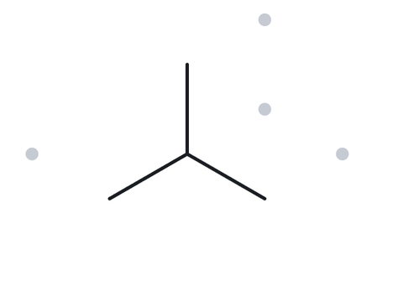
B01 FOUNDATION -
2-methylpropane
PART B - NAME → STRUCTURE
  NAME DECODED
  BOND-LINE STRUCTURE (THE ALKANE)
Parent: propane → a 3-carbon chain.
Substituents: methyl on C2.
Expected Formula: 3 + 1 = 4 C; open chain → C₄H₁₀
  FORMULA CHECK
  BACK-CHECK
Counted from the drawing: C₄H₁₀.
Open chain: CₙH₂ₙ₊₂ = C₄H₁₀ ✓
Returned by The Alkane: 2-methylpropane.
Same as the given name
VERIFICATION STRIP
PARENT LENGTH MATCHES
SUBSTITUENT POSITIONS MATCH
FORMULA AGREES
BACK-CHECK RECORDED

Slide 12
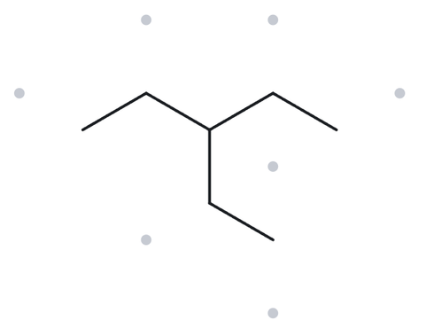
B02 FOUNDATION -
3-ethylpentane
PART B - NAME → STRUCTURE
  NAME DECODED
  BOND-LINE STRUCTURE (THE ALKANE)
Parent: pentane → a 5-carbon chain.
Substituents: ethyl on C3.
Expected formula: 5 + 2 = 7 C; open chain → C₇H₁₆
  FORMULA CHECK
  BACK-CHECK
Counted from the drawing: C₇H₁₆.
Open chain: CₙH₂ₙ₊₂ = C₇H₁₆ ✓
Returned by The Alkane: 3-ethylpentane.
Same as the given name
VERIFICATION STRIP
PARENT LENGTH MATCHES
SUBSTITUENT POSITIONS MATCH
FORMULA AGREES
BACK-CHECK RECORDED

Slide 13
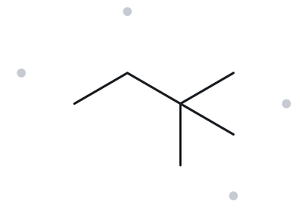
B03 FOUNDATION -
2,2-dimethylbutane
PART B - NAME → STRUCTURE
  NAME DECODED
  BOND-LINE STRUCTURE (THE ALKANE)
Parent: butane → a 4-carbon chain. Substituents: methyl on C2 (×2). Expected formula: 4 + 2 = 6 C; open chain → C₆H₁₄
  FORMULA CHECK
  BACK-CHECK
Counted from the drawing: C₆H₁₄. Open chain: CₙH₂ₙ₊₂ = C₆H₁₄ ✓
Returned by The Alkane: 2,2-dimethylbutane.
Same as the given name
VERIFICATION STRIP
PARENT LENGTH MATCHES
SUBSTITUENT POSITIONS MATCH
FORMULA AGREES
BACK-CHECK RECORDED

Slide 14
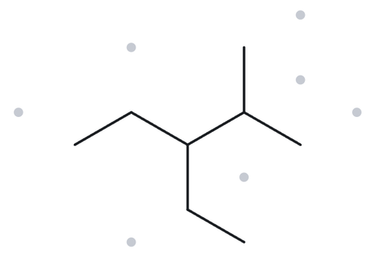
B04 DEVELOPING -
3-ethyl-2 methylpentane
PART B - NAME → STRUCTURE
  NAME DECODED
  BOND-LINE STRUCTURE (THE ALKANE)
Parent: pentane → a 5-carbon chain.
Substituents: ethyl on C3; methyl on C2.
Expected formula: 5 + 2 + 1 = 8 C; open chain → C₈H₁₈
  FORMULA CHECK
  BACK-CHECK
Counted from the drawing: C₈H₁₈. Open chain: CₙH₂ₙ₊₂ = C₈H₁₈ ✓
Returned by The Alkane: 3-ethyl-2-methylpentane.
Same as the given name
VERIFICATION STRIP
PARENT LENGTH MATCHES
SUBSTITUENT POSITIONS MATCH
FORMULA AGREES
BACK-CHECK RECORDED

Slide 15
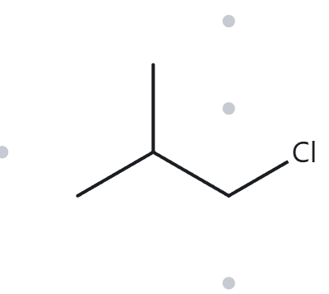
B05 DEVELOPING -
1-chloro-2 methylpropane
PART B - NAME → STRUCTURE
  NAME DECODED
  BOND-LINE STRUCTURE (THE ALKANE)
Parent: propane → a 3-carbon chain.
Substituents: chloro on C1; methyl on C2.
Expected formula: 3 + 1 = 4 C; open chain → C₄H₁₀; Cl replaces one H → C₄H₉Cl
  FORMULA CHECK
  BACK-CHECK
Counted from the drawing: C₄H₉Cl. Open chain: CₙH₂ₙ₊₂ = C₄H₁₀;
minus one H for Cl = C₄H₉Cl ✓
Returned by The Alkane: 1-chloro-2-methylpropane.
Same as the given name
VERIFICATION STRIP
PARENT LENGTH MATCHES
SUBSTITUENT POSITIONS MATCH
FORMULA AGREES
BACK-CHECK RECORDED

Slide 16
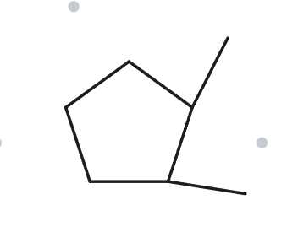
B06 DEVELOPING -
1,2 dimethylcyclopentane
PART B - NAME → STRUCTURE
  NAME DECODED
  BOND-LINE STRUCTURE (THE ALKANE)
Parent: cyclopentane → a 5-carbon ring. Substituents: methyl on C1; methyl on C2.
Expected formula: 5 + 1 + 1 = 7 C; one ring → C₇H₁₄
  FORMULA CHECK
  BACK-CHECK
Counted from the drawing: C₇H₁₄.
One ring: CₙH₂ₙ = C₇H₁₄ ✓
Returned by The Alkane: 1,2-dimethylcyclopentane.
Same as the given name
VERIFICATION STRIP
PARENT LENGTH MATCHES
SUBSTITUENT POSITIONS MATCH
FORMULA AGREES
BACK-CHECK RECORDED

Slide 17
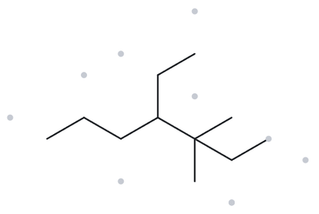
B07 DEVELOPING -
4-ethyl-3,3 dimethylheptane
PART B - NAME → STRUCTURE
  NAME DECODED
  BOND-LINE STRUCTURE (THE ALKANE)
Parent: heptane → a 7-carbon chain.
Substituents: ethyl on C4; methyl on C3 (×2).
Expected formula: 7 + 2 + 1 + 1 = 11 C; open chain → C₁₁H₂₄
  FORMULA CHECK
  BACK-CHECK
Counted from the drawing: C₁₁H₂₄.
Open chain: CₙH₂ₙ₊₂ = C₁₁H₂₄ ✓
Returned by The Alkane: 4-ethyl-3,3-dimethylheptane.
Same as the given name
VERIFICATION STRIP
PARENT LENGTH MATCHES
SUBSTITUENT POSITIONS MATCH
FORMULA AGREES
BACK-CHECK RECORDED

Slide 18
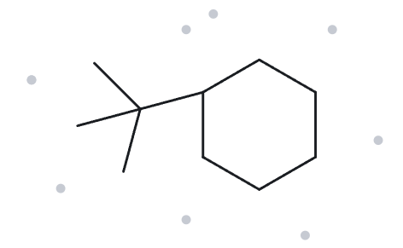
B08 CHALLENGE-
tert-butylcyclohexane
PART B - NAME → STRUCTURE
  NAME DECODED
  BOND-LINE STRUCTURE (THE ALKANE)
Parent: cyclohexane → a 6-carbon ring. Substituents: tert-butyl on C1.
Expected formula: 6 + 4 = 10 C; one ring → C₁₀H₂₀
  FORMULA CHECK
  BACK-CHECK
Returned by The Alkane: (1,1-dimethylethyl)cyclohexane.
Counted from the drawing: C₁₀H₂₀.
One ring: CₙH₂ₙ = C₁₀H₂₀ ✓
NOT THE SAME AS THE GIVEN NAME
According to the IUPAC naming reference (Table B.3 on appendix B), naming must prioritize systematic over the common. In this case, (1,1-dimethylethyl)cyclohexane should be the name rather than the given tert-butylcyclohexane.
VERIFICATION STRIP
PARENT LENGTH MATCHES
SUBSTITUENT POSITIONS MATCH
FORMULA AGREES
BACK-CHECK RECORDED

Slide 19
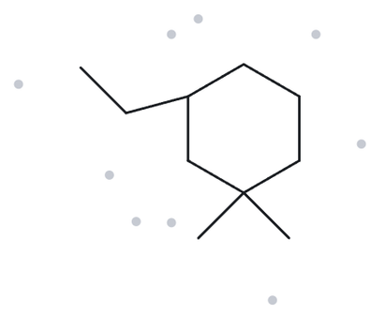
B09 CHALLENGE -
3-ethyl-1,1-dimethylcyclohexane
PART B - NAME → STRUCTURE
  NAME DECODED
  BOND-LINE STRUCTURE (THE ALKANE)
Parent: cyclohexane → a 6-carbon ring.
Substituents: ethyl on C3; methyl on C1 (2).
Expected formula: 6 + 2 + 1 + 1 = 10 C; one ring → C₁₀H₂₀
  FORMULA CHECK
  BACK-CHECK
Counted from the drawing: C₁₀H₂₀.
One ring: CₙH₂ₙ = C₁₀H₂₀ ✓
Returned by The Alkane: 3-ethyl-1,1-dimethylcyclohexane.
Same as the given name
VERIFICATION STRIP
PARENT LENGTH MATCHES
SUBSTITUENT POSITIONS MATCH
FORMULA AGREES
BACK-CHECK RECORDED

Slide 20
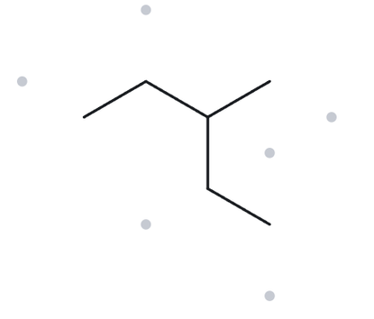
B10 CHALLENGE -
2-ethylbutane
PART B - NAME → STRUCTURE
  NAME DECODED
  BOND-LINE STRUCTURE (THE ALKANE)
Parent: butane → a 4-carbon chain. Substituents: ethyl on C2.
Expected formula: 4 + 2 = 6 C; open chain → C₆H₁₄
  FORMULA CHECK
  BACK-CHECK
Returned by The Alkane: 3-methylpentane. .
Counted from the drawing: C₆H₁₄.
Open chain: CₙH₂ₙ₊₂ = C₆H₁₄ ✓
NOT THE SAME AS THE GIVEN NAME
The chain through the ethyl group gives 5 carbons (pentane) with a methyl on C3, so the longest-chain rule makes 3-methylpentane the correct name.
VERIFICATION STRIP
PARENT LENGTH MATCHES
SUBSTITUENT POSITIONS MATCH
FORMULA AGREES
BACK-CHECK RECORDED

