Slide 1
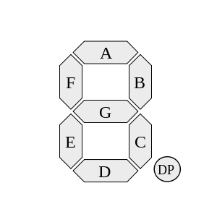
GND
A
GND
F
GND
B
VCC
VCC
VCC
GND
E
GND
D
GND
DP
GND
C
GND
G
VCC

