Slide 1
What is a Supercomputer?
Shelley Knuth
shelley.knuth@colorado.edu
www.rc.colorado.edu Questions? #RC_BasicSC
Link to survey on this topic: http://tinyurl.com/rcpresurvey
Slides: https://github.com/ResearchComputing/Final_Tutorials/tree/master/Basics_Supercomputing

Slide 2
Outline
About RC and the workshop
General information about supercomputers
Supercomputer detail
Running jobs
Accessing RC resources

Slide 3
Survey!
http://tinyurl.com/rcpresurvey

Slide 4
What does Research Computing do?
We manage
Shared large scale compute resources
Large scale storage
High-speed network without firewalls – ScienceDMZ
Software and tools
We provide
Consulting support for building scientific workflows on the RC platform
Training
Data management support in collaboration with the Libraries
Notes:
700 users across 30 institutes and departments on campus

Slide 5
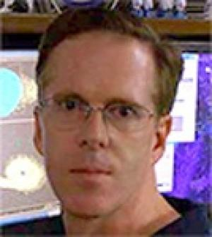
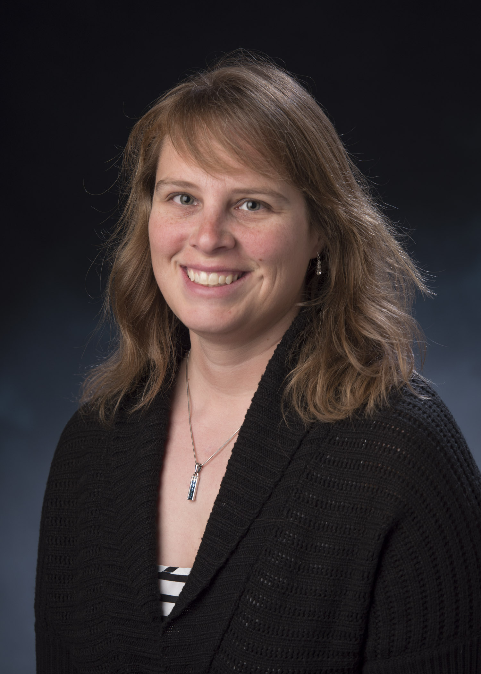
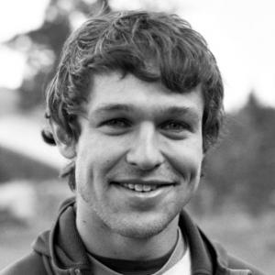

Who Are We?
Meet your instructors!
Shelley Knuth
Max Joseph
Tim Dunn
Pete Ruprecht
Aaron Holt
Meet your assistants!
Sarah Papich
Matt Oakley
Zach Schira
Tim Dunn
Shelley Knuth
Max Joseph
Pete Ruprecht

Slide 6
Agenda – Day 1
09:00-10:15 What is a Supercomputer? Shelley Knuth
10:15-10:30 Break
10:30-11:45 Getting to Know Max Joseph
the Command Line
11:45-13:00 Lunch
13:00-14:15 Submitting Jobs Shelley Knuth
to the Supercomputer
14:15-14:30 Break
14:30-15:45 Installing and Building Tim Dunn
Software
15:45-16:00 Break
16:00-17:15 How Can I Move and Max Joseph
Store All that Data?

Slide 7
Agenda – Day 2
09:00-10:15 What's Different About Pete Ruprecht
Summit?
10:15-10:30 Break
10:30-11:45 Using the Supercomputer Tim Dunn
from a Website
11:45-13:00 Lunch
13:00-14:15 What is this Parallel Shelley Knuth
Computing Thing?
14:15-14:30 Break
14:30-15:45 Efficient Submission of Aaron Holt
Serial Jobs
15:45-16:00 Break
16:00-17:15 How to Parallel Program Shelley Knuth

Slide 8
General Information

Slide 9
What Is a Supercomputer?
A supercomputer is one large computer made up of many smaller computers and processors
Each different computer is called a node
Each node has processors/cores
Carry out the instructions of the computer
With a supercomputer, all these different computers talk to each other through a communications network
Example - InfiniBand

Slide 10

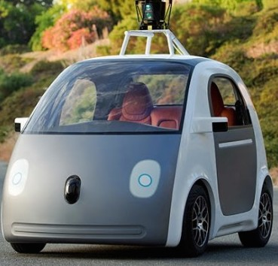
Computers and Cars - Analogy
≈

Slide 11


Computers and Cars - Analogy
≈

Slide 12
Why Use a Supercomputer?
Supercomputers give you the opportunity to solve problems that are too complex for the desktop
Might take hours, days, weeks, months, years
If you use a supercomputer, might only take minutes, hours, days, or weeks
Useful for problems that require large amounts of memory

Slide 13
World’s Fastest Supercomputers
www.top500.org June 2016
Rank | Site | Name | TeraFlops
1 | National Supercomputing Center (Wuxi, China) | Sunway | 125435.9
2 | National Super Computer Center (Guangzhou, China) | Tianhe-2 | 54902.4
3 | Oak Ridge National Laboratory (United States) | Titan | 27112.5
4 | DOE/NNSA/LLNL (United States) | Sequoia | 20132.7
5 | RIKEN Advanced Institute for Computational Science (Japan) | K | 11280.4
6 | DOE/Argonne National Lab (United States) | Mira | 10066.3
7 | DOE/NNSA/LANL/SNL (United States) | Trinity | 11078.9
8 | Swiss National Supercomputing Centre (Switzerland) | Piz Daint | 7788.9
9 | HLRS - Höchstleistungsrechenzentrum Stuttgart (Germany) | Hazel Hen | 7403.5
10 | King Abdullah University of Science and Technology (Saudi Arabia) | Shaheen II | 7235.2
Notes:
TeraFlops are an appropriate measure of speed for some applications, but not all!

Slide 14
What Does It Mean to Be Fast?
Titan can do 27 trillion calculations per second
A regular PC can perform 17 billion per second
Researchers can get access to some of these systems through XSEDE (The Extreme Science and Engineering Discovery Environment)

Slide 15
Supercomputer Details

Slide 16
Hardware - Janus Supercomputer
1368 compute nodes (Dell C6100)
16,428 total cores
No battery backup of the compute nodes
Fully non-blocking QDR Infiniband network
960 TB of usable Lustre based scratch storage
16-20 GB/s max throughput
Notes:
Main design consideration was running large parallel jobs really fast. Stability was a tradeoff.

Slide 17
Additional Compute Resources
2 Graphics Processing Unit (GPU) Nodes
Visualization of data
Exploring GPUs for computing
4 High Memory Nodes
1 TB of memory, 60-80 cores per node
16 Blades for long running jobs
2-week walltimes allowed
96 GB of memory (4 times more compared to a Janus node)

Slide 18
Different Node Types
Login nodes
This is where you are when you log in
No heavy computation, interactive jobs, or long running processes
Script or code editing, minor compiling
Job submission
Compile nodes
Compute/batch nodes
This is where jobs that are submitted through the scheduler run
Intended for heavy computation

Slide 19
Storage Spaces
System variations
Home Directories
Store source code
Not for direct computation
Small quota (2 GB)
Backed up
$PROJECT Space
Mid level quota (250 GB)
Large file storage
Not backed up
Scratch Directory
Much larger – depends on system
Output from running jobs should go here
Files generally purged at some point
Notes:
Different spaces are appropriate for different kinds of data and I/O

Slide 20
Jobs

Slide 21
What is Job Scheduling
Supercomputers usually consist of many nodes
Users submit jobs that may run on one or multiple nodes
Sometimes these jobs are very large; sometimes there are many small jobs
Need software that will distribute the jobs appropriately
Make sure the job requirements are met
Reserve nodes until enough are available to run a job
Account for offline nodes
Also need software to manage the resources
Integrated with scheduler

Slide 22
Job Scheduling
On a supercomputer, jobs are scheduled rather than just run instantly at the command line
People “buy” time to use the resources (allocation)
Shared system
Request the amount of resources needed and for how long
Jobs are put in a queue until resources are available
Once the job is run they are “charged” for the time they used

Slide 23
Job Scheduling - Priority
What jobs receive priority?
Can depend on the center
Can arrange for certain people who “pay more” receive priority
Generally though based on job size and time of entry
Might have different queues based on different job needs
Can receive priority on a job by creating a reservation

Slide 24
Wall Times
The maximum amount of time your job will be allowed to run
How do I know how much time that will be?
What happens if I select too much time?
What happens if I select too little time?

Slide 25
Job Schedulers - Slurm
Jobs on supercomputers are managed and run by different software
Simple Linux Utility for Resource Management (Slurm)
Open source software package
Slurm is a resource manager
Keeps track of what nodes are busy/available, and what jobs are queued or running
Slurm is a scheduler
Tells the resource manager when to run which job on the available resources

Slide 26
Running Jobs
What is a “job”?
Interactive jobs
Work interactively at the command line of a compute node
Batch jobs
Submit job that will be executed when resources are available
Create a text file containing information about the job
Submit the job file to a queue
Load the Slurm module!

Slide 27
Useful Slurm Commands
sbatch: submit a batch script to slurm
Standard input (keyboard)
File name
Options preceded with #SBATCH
sbatch exits immediately after receiving a slurm job ID
By default, standard output and errors go to file named slurm-%j.out (job allocation number)
Slurm runs a single copy of the script on the first node in the set of allocated nodes
http://slurm.schedmd.com/sbatch.html

Slide 28
SBATCH Options
http://slurm.schedmd.com/sbatch.html
In batch script put:
#SBATCH <options> OR sbatch <options>
Allocation: --A=<account_no>
Checkpoints: --checkpoint=<interval>
Sending emails: --mail-type=<type>
Email address: --mail-user=<user>
Number of nodes: -N <nodes> or --nodes=<nodes>
Queues: --qos=<qos>
Reservation: --reservation=<name>
Wall time: --time=<wall time>
Job Name: -J <jobname> or –job-name=<jobname>

Slide 29
Queues
There are several ways to define a “queue”
Clusters may have different queues set up to run different types of jobs
Certain queues might exist on certain clusters/resources
Other queues might be limited by maximum wall time
Slurm can use a “quality of service” for each queue
aka “QOS”
Also can use a “partition” (or set of nodes) that corresponds to a queue

Slide 30
Quality of Service = Queues
janus-debug
Only debugging – no production work
Maximum wall time 1 hour, 2 jobs per user
(The maximum amount of time your job is allowed to run)
janus
Default
Maximum wall time of 24 hours, 480 nodes/job
janus-long
Maximum wall time of 7 days; 40 nodes/user
himem
crestone
gpu

Slide 31
Software
Common software is available to everyone on the systems
To find out what software is available, you can type ml avail
To set up your environment to use a software package, type ml <package>/<version>
Can install your own software
But you are responsible for support
We are happy to assist

Slide 32
Initial Steps to Use RC Systems
Apply for an RC account
https://portals.rc.colorado.edu/account/request
Get registered with Duo
Duo invitation
Smart phone app
Push notifications
Apply for a computing allocation
Startup allocation of 50K SU granted immediately
Additional SU require a proposal

Slide 33
Janus/Summit Access
To access RC’s computing, in general:
ssh login.rc.colorado.edu –l <username>
Password: duo:<identikey>
Need the Duo application

Slide 34
What’s Next?
So far we’ve introduced you to the basics of supercomputing
Next, learn to:
Use the command line
Submit jobs!
Transfer data!
Load up some software!

Slide 35
Questions?
Email rc-help@colorado.edu
Twitter: CUBoulderRC
Link to survey on this topic:
http://tinyurl.com/curc-survey16
Slides: https://github.com/ResearchComputing/Final_Tutorials/tree/master/Basics_Supercomputing

