Slide 1
Beginner Parallel Computing
Shelley Knuth, Research Computing, University of Colorado-Boulder
shelley.knuth@colorado.edu
Questions? #RC_Meetups
Link to survey on this topic: http://goo.gl/forms/8VidcwOhRT
Slides: https://github.com/ResearchComputing/Final_Tutorials

Slide 2
Outline
Serial vs. Parallel processing
Shared vs. Distributed Memory
OpenMP vs. MPI
Matlab
Overhead

Slide 3
What Is Parallelism?
What is parallelism?
Idea where many instructions are carried out simultaneously across a computing system
Can divide a large problem up into many smaller problems
The idea of splitting up mowing the lawn with your spouse
Or of you and your spouse mowing your lawn and your neighbor’s lawn
Potentially faster, more efficient

Slide 4
Why Parallelize?
Single core too slow for solving the problem in a “reasonable” time
“Reasonable” time: overnight, over lunch, duration of a PhD thesis
Memory requirements
Larger problem
More physics
More particles

Slide 5
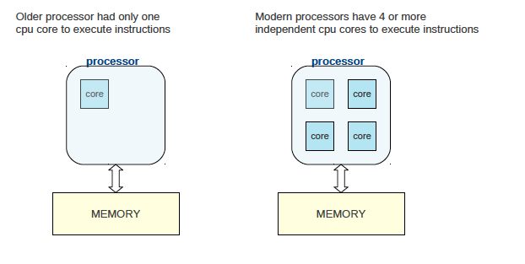
Basic Architecture
Source: http://people.math.umass.edu/~johnston/PHI_WG_2014/OpenMPSlides_tamu_sc.pdf

Slide 6
Serial Processing – Thought Experiment
Jigsaw puzzle analogy**
Have a 1000 piece jigsaw puzzle
You can do it yourself, maybe it will take 1 hour to do
Serial processing
Maybe you have three friends sitting nearby willing to help, but you won’t let them
Wasted resources
**from Henry Neeman, OSCER, “Supercomputing in Plain English”

Slide 7
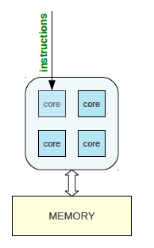
Serial Processing
Instructions are executed on one core
The other cores sit idle
If a task is running, Task 2 waits for Task 1 to complete, etc.
Wasting resources
Want to instead parallelize and use all cores
Source: http://people.math.umass.edu/~johnston/PHI_WG_2014/OpenMPSlides_tamu_sc.pdf

Slide 8
Shared Memory Parallel Processing – Thought Experiment
Jigsaw puzzle analogy**
Let’s say you decide to let one of your friends, Stacey, join you
Stacey and you sit at a table and each work on half the puzzle
In theory you reduce the puzzle time completion by half
However, other time sinks
Reaching for the same puzzle pieces
Resource contention
Communicating about puzzle interfaces
Might take 35 minutes instead of 30
**from Henry Neeman, OSCER, “Supercomputing in Plain English”

Slide 9
Shared Memory Parallel Processing – Thought Experiment
Jigsaw puzzle analogy**
Now you let your other two friends, Fred and Jim, join in
Now conceivably could finish in ¼ the time (15 minutes)
But there’s even more contention for resources
More communication
Slows down the process even more (maybe takes 23 minutes to complete instead)
Too many people slows down the process too much to make it worthwhile
Eventually have a “diminishing return”
**from Henry Neeman, OSCER, “Supercomputing in Plain English”

Slide 10
Shared-memory Model
The concept is that all processors can access all memory available
Multiple processors can perform tasks on their own but share the same memory
Source: https://computing.llnl.gov/tutorials/parallel_comp/#ModelsShared

Slide 11
Shared-memory Model
Advantage: data sharing is fast and uniform
Disadvantage: adding more processors can cause performance issues when accessing the same shared memory resource
Source: https://computing.llnl.gov/tutorials/parallel_comp/#ModelsShared

Slide 12
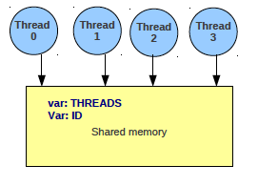
Shared-memory Model
A thread is a block of code with one entry and one exit that is abstract and is mapped onto a physical core. Multiple threads can be mapped onto one core.
Threads communicate by depositing contents in shared memory area
Source: http://people.math.umass.edu/~johnston/PHI_WG_2014/OpenMPSlides_tamu_sc.pdf

Slide 13
Distributed Memory Parallel Processing – Thought Experiment
Jigsaw puzzle analogy**
Now we have two tables with one person at each table doing the puzzle
We split the puzzle equally between tables
Each person works completely independently
But to communicate costs more
How do you work out connecting the puzzle?
Can you really divide up the puzzle evenly?
**from Henry Neeman, OSCER, “Supercomputing in Plain English”

Slide 14
Distributed-memory Model
Distributed memory requires a communication network to connect memory
Processors have own memory and don’t map globally
Source: https://computing.llnl.gov/tutorials/parallel_comp/#ModelsShared

Slide 15
Distributed-memory Model
Programmers explicitly define how processors access other processor’s memory
Advantage: scalable memory
Disadvantage: need to know parallel programming!
Source: https://computing.llnl.gov/tutorials/parallel_comp/#ModelsShared

Slide 16
Distributed-Shared Memory
Most large and fast computers now
Shared memory machines connected to other shared memory machines
Source: https://computing.llnl.gov/tutorials/parallel_comp/#ModelsShared

Slide 17
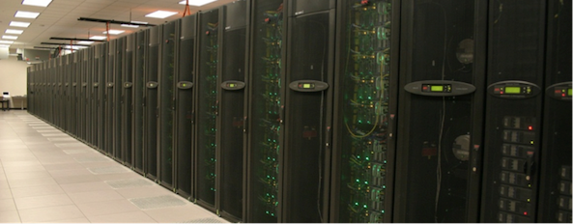
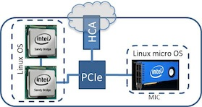
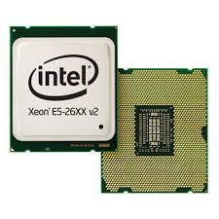
Programming to Use Parallelism
Parallelism across processors/threads - OpenMP
Parallelism across multiple nodes - MPI
www.scan.co.uk

Slide 18
OpenMP
OpenMP: An application programming interface (API) for parallel programming on multiprocessors
Uses shared memory
OpenMP is used through compiler directives embedded in Fortran, C, or C++ code
Directs multi-threaded, shared memory parallelism
Can do a lot with only a handful of commands
Intended to be easy to use
Source: https://computing.llnl.gov/tutorials/openMP/#Introduction

Slide 19
Multi-Threaded, Shared Memory Parallelism
Have a main program that loads all needed resources
Main program does many things, including run subroutines
Threads that can be run concurrently
Share the same resources from the main program, but also has local data
Threads communicate through global memory
Must ensure multiple threads don’t update concurrently
Where OpenMP and programmers come in
Source: https://computing.llnl.gov/tutorials/parallel_comp/#ModelsShared

Slide 20
OpenMP – Fork/Join
OpenMP programs start with a single thread (master)
Then Master creates a team of parallel “worker” threads (FORK)
Statements in block are executed in parallel by every thread
At end, all threads synchronize and join master thread
Source: https://computing.llnl.gov/tutorials/openMP/#Introduction

Slide 21
Distributed Memory
Tasks use own local memory when computing
Can reside on one or many machines
Communicate by sending and receiving messages
Have an inter-connect, such as Infiniband
http://www.ee.ryerson.ca/~courses/ee8218/mpi_openmp.pdf

Slide 22
MPI
MPI is a library specification for message passing Based on consensus of many organizations
Provides widely used standard for writing message passing programs
Operates on a distributed model
Exchange data through communication between tasks – send and receive data
MPI can get complicated
Programmers must explicitly implement parallelism using MPI constructs
https://computing.llnl.gov/tutorials/mpi/

Slide 23
MPI or OpenMP?
OpenMP
Don’t understand parallel programming
Only need to run on one node
Just want to speed up application
Program is not complicated
MPI
Multiple nodes
Running out of memory and need to use more nodes

Slide 24
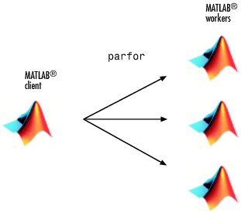
Running Matlab in Parallel
Mimics OpenMP or MPI
Depends on toolbox you have
Easiest to get the Parallel Computing Toolbox
Mimics OpenMP
Easy to convert code from serial to parallel
parfor
spmd
Workers: copies of the original client created to assist in computation

Slide 25
Parallel Overhead
Should you convert your serial code to parallel?
Usually do it to speed up
But need to consider things like overhead
Overhead because of
Startup time
Synchronizations
Communication
Overhead by libraries, compilers
Termination time
https://computing.llnl.gov/tutorials/parallel_comp/#ModelsShared

Slide 26
Questions?
Email rc-help@colorado.edu
Twitter: @CUBoulderRC
Link to survey on this topic: http://goo.gl/forms/8VidcwOhRT
Slides: https://github.com/ResearchComputing/Final_Tutorials

