Slide 1

The Level of Reading Fondness in Indonesia 2021

Slide 2

Explanation on your Project background
What is the problem you’re trying to solve through the projects?
The problem that we want to solve is we want to make a dashboard and also make some recommendations that can be used to determine what kind of policies can be done to increase the level of reading fondness in Indonesia, especially in several provinces where the level fondness of reading was still low
How your project can solve the problem?
We made a product dashboard that would display easy to read and comprehensive data which will be useful for other teams in determining policies and further actions. The features that we want to build in this project are reading frequency charts, the total of reading material, reading duration, internet access frequency, internet access duration, reading fondness level, and rating category for each province in Indonesia
Notes:
Note: Feel free to add more slides.

Slide 3
Explanation on your Project background
What’s scope of the projects?
The scope of our project are the graphs that are based on islands and provinces in Indonesia. Those graphs include the data of reading fondness in Indonesia 2021, the data of village office with internet access 2021, and the data number of village in Indonesia 2021.
The limiting limitation is the data owned and the available data sources are very limited..
Notes:
Note: Feel free to add more slides.

Slide 4

Problem Formulation on your Project background
What are the formulations of the problem that you raise in this project?
The formulations of the problem: how do we increase the level of reading fondness in Indonesia from 59,52% in 2021 to 65% in 2022 within 1 years
Notes:
Note: Feel free to add more slides.

Slide 5


Tech Use & Impact
What are the technology stack use in the project?
Ms Excel, Google Data Studio and RStudio
How is this project (your app/data) gives impact or benefits to you and your users?
Our product dashboard would display easy to read and comprehensive data which will be useful for other teams in determining policies and further actions. This dashboard can be used by the Ministry of Education and Culture to find out which areas should receive special attention to increase the literacy rate so as to reduce the gap with the province with the highest literacy rate, increase the literacy rate nationally and generalize the literacy rate in Indonesia.
Notes:
Note: Feel free to add more slides.

Slide 6
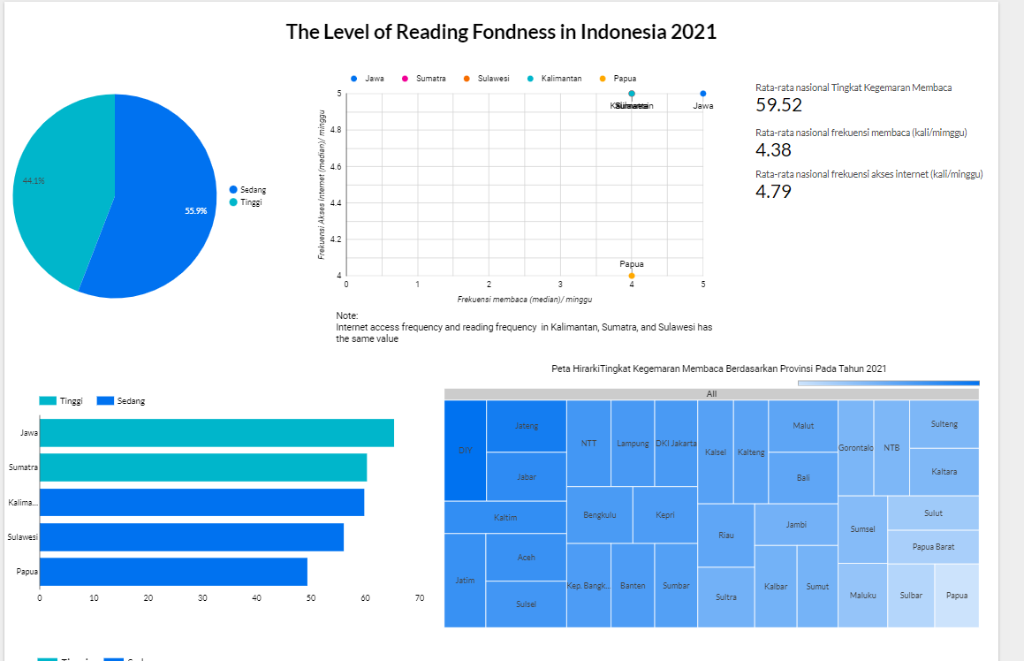
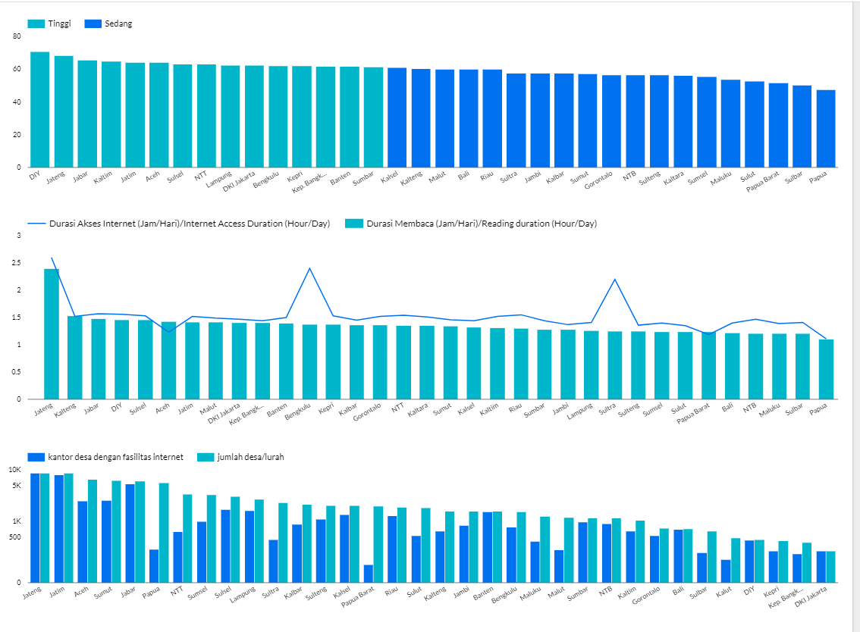
Our Product Dashboard
Click the link below for further information and insight: https://datastudio.google.com/u/0/reporting/d537ec45-7bd1-47b3-97e6-a70cf49d2741/page/niDwC

Slide 7

What learning do you get from working on this project?
from this project we learn how to search data and process it to make it easier to visualize on the dashboard and how to analyze the data to get recommendation and conclusion. We also learn about the AB testing that would be the tool to proved our hypothesis. Besides that, we also learn about Gestalt principle because it would be useful to make a better visualization.
What other learning do you feel throughout your journey in #GenerasiGIGIH?
We get how to plan, manage, brainstorm and delegation. We also learn how to work with a team and collaboration.
Learning Takeaways
Notes:
Note: Feel free to add more slides.

Slide 8
Data Source:
1. Tingkat Kegemaran Membaca 2021: https://katalog.data.go.id/dataset/tingkat-kegemaran membaca/resource/adfdd729-1508-47bd-99f2-9288397571fc
2. Jumlah Desa/Kelurahan Menurut Provinsi, 2021: https://www.bps.go.id/indikator/indikator/view_data_pub/0000/api_pub/bEVXU252SU9hTjBxWEU3Z2NpS1ZPQT09/da_02/1
3. Banyaknya Desa/Kelurahan yang Memiliki Fasilitas Internet di Kantor Desa/Lurah menurut Provinsi dan Klasifikasi Daerah (Desa) 2018-2020:
https://www.bps.go.id/indicator/2/1692/1/banyaknya-desa-kelurahan-yang-memiliki-fasilitas-internet-di-kantor-desa-lurah-menurut-provinsi-dan-klasifikasi-daerah.html

Slide 9
Thank you!

