Slide 1
Project 3 Presentation - Abalone dataset
Andri Ólafsson
Matthías Dan Flemmingsson

Slide 2
The right dataset
Abalone dataset
4177 instances
8 attributes
Dataset documents attributes of abalones
None of the data is missing
Characteristics of the dataset:
Integer, Real and Categorial attributes
Goal of the study to create a classifier from clustering
Determining age of abalones from attributes presented in dataset

Slide 3
Pre-processing
Worked on the data purely in Python
Pandas
Seaborn
Scipy
Sklearn
Using standardzation over normalization to perserve outliers. Using z-score with filtering

Slide 4
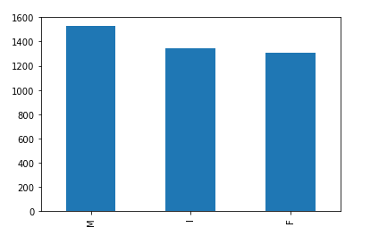
Pre-processing
Distribution of instances in the dataset where balanced

Slide 5
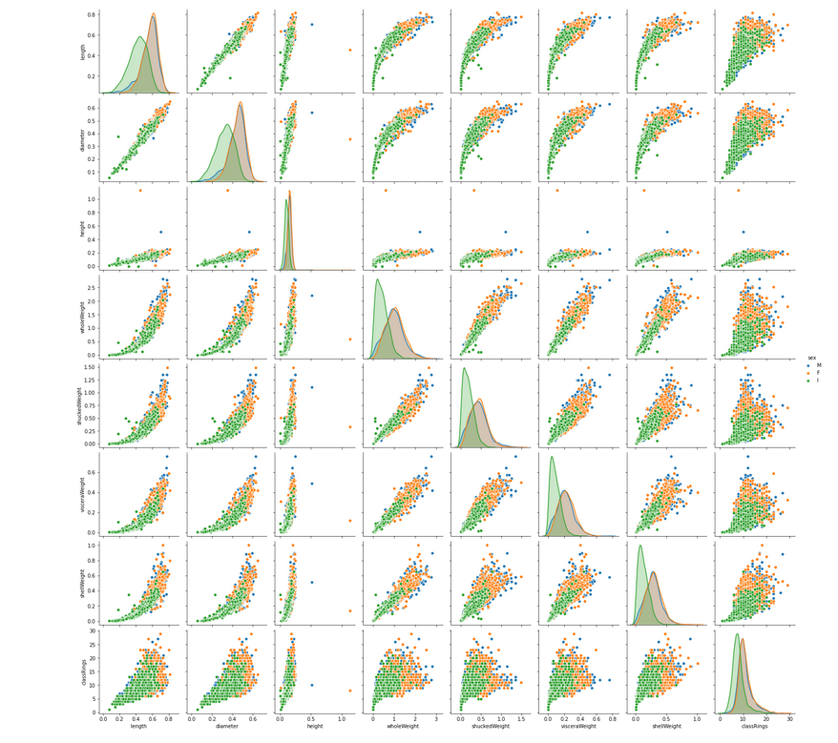
Pre-processing

Slide 6
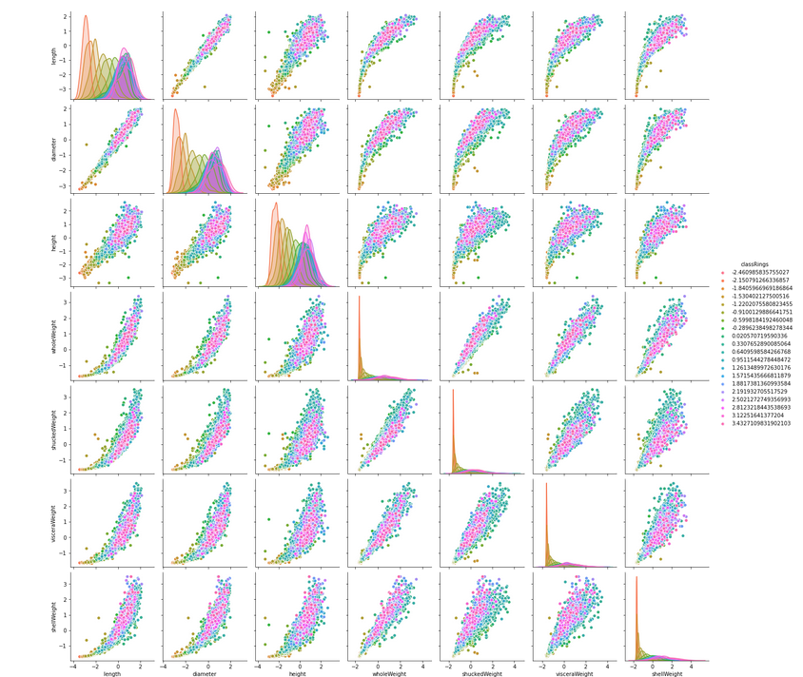
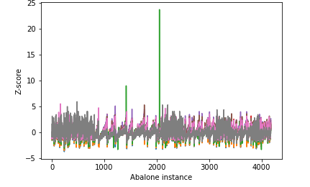
Pre-processing

Slide 7
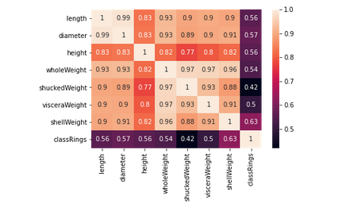
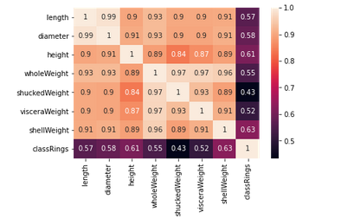
Pre-processing -Correlation
Weight of abalones is proportional to the size
By observing correlation of the target variable (rings) with other variables. The size and weight of the abalone varies accordingly to age until the adult age. After reaching adult stage the size and weight stops varying.
No significant differences in size/weight between m/f abalones
Infant abalone group has lower mean values of size/weight
Multicolinearity between weight attributes

Slide 8
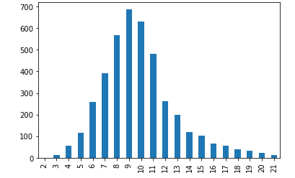
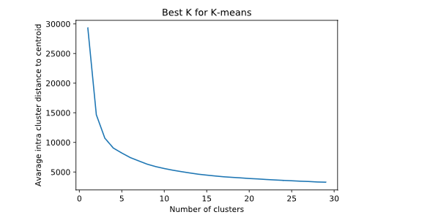
Clustering - Best K
Best K at 4-15 according to classRing Graph
Intertia stable at 5
Difference between 5 and 15 not ideal. 5 does not overfit data

Slide 9
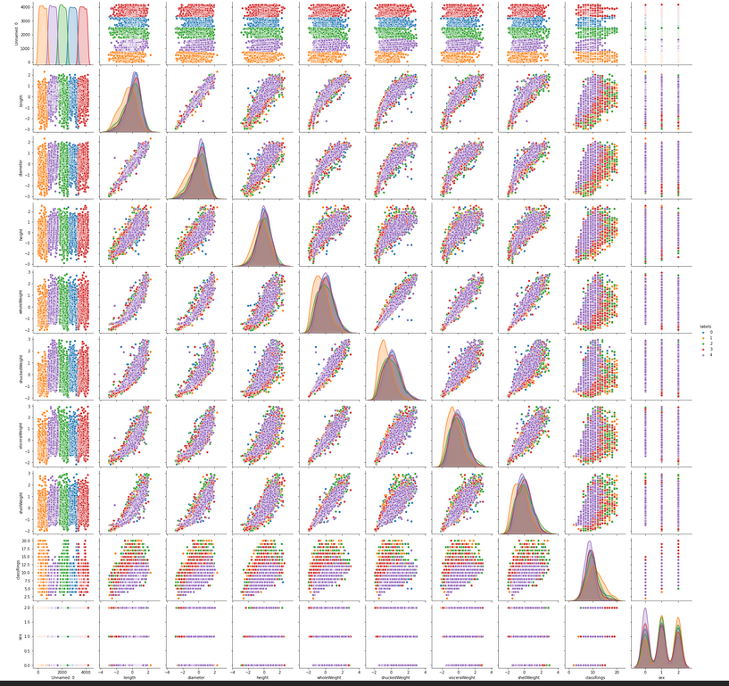
Cluster results
Centroid locations
2900.9516
407.9750
2056.5657
3754.0314
1232.5006
s
dfsafkm

Slide 10
Cluster results
s

Slide 11
Conclusions
s
Notes:
Correlations of symptoms might be weak in general

Slide 12

Questions?

