Slide 1

Physics-Informed Neural Networks for Futures Pricing and Signal-Generation Under Stochastic Volatility
Andria Gonzalez Lopez
Capstone Project
Wednesday, April 23rd, 2025

Slide 2
Agenda
Introduction
Mathematical Foundations
PINN Architecture
Asset Selection and Training
Signal-Generation
Future Improvements

Slide 3
Introduction
Importance of having our own pricing model
Understanding contract value
Identifying investment opportunities from mispricing
Problems with mathematical pricing models
Cost-of-Carry
Black-Scholes
Heston
Benefits of using the Physics-Informed Neural Network
Captures hidden relationships
Fast calculation

Slide 4

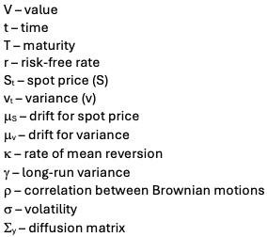


Mathematical Foundations
Heston SDE
Feynman-Kac PDE
Terminal Condition

Slide 5



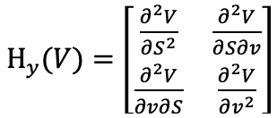
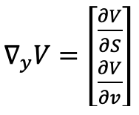
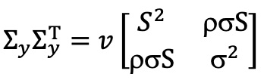


Mathematical Foundations
Matrix Operations
Drift
Trace

Slide 6
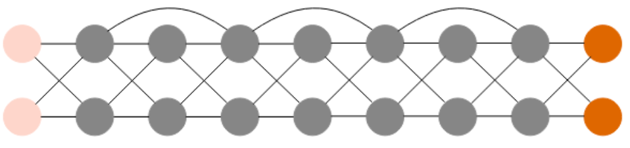
PINN Architecture
Input – FK variables
Type – Residual Neural Network
Activation Function – tanh
Loss – weighted physics loss + mean-squared error (MSE)
Output – futures price
Validation – train-test split

Slide 7
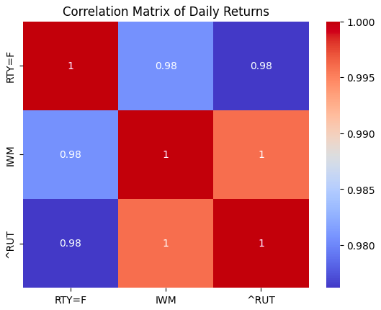
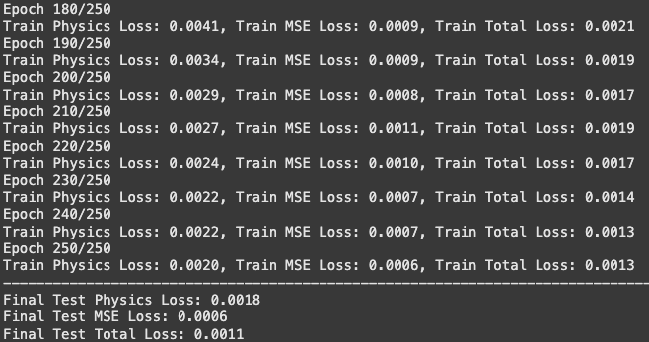
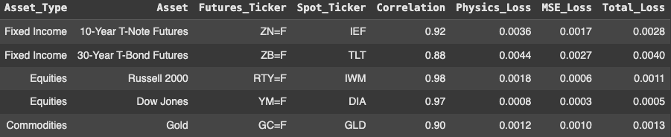
Asset Selection and Training

Slide 8
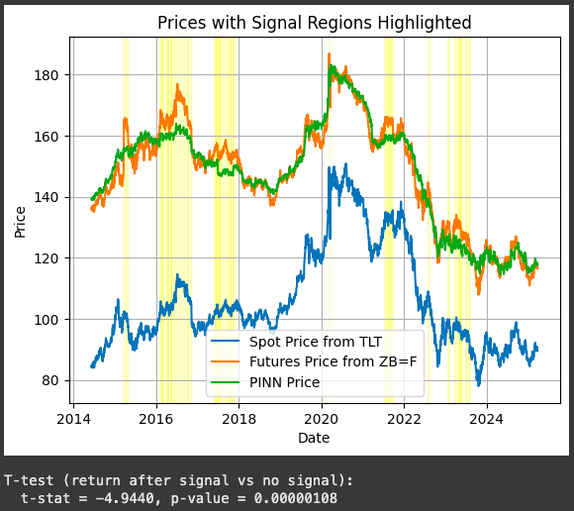
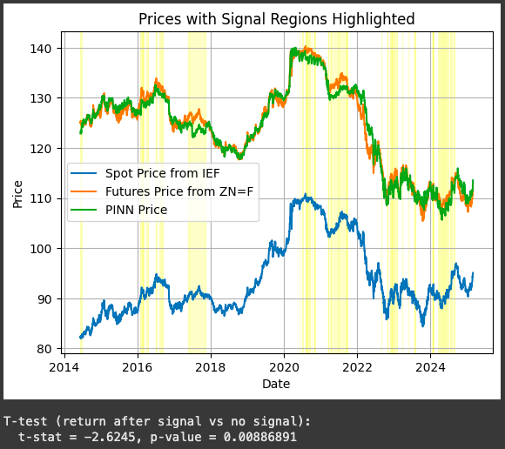
Signal-Generation

Slide 9
Future Improvements
Finding optimal weights for physics loss
Conducting additional statistical tests to evaluate causal relationships
Backtesting strategies based on price spread signals
Modifying model to train up to a target loss rather than target number of epochs

Slide 10
Q&A

