Slide 1

Event-Driven systems backed by MongoDB
bit.ly/2DUYXNF
Notes:
Talk intro:
- Event-Driven systems and challenges
- MongoDB replication internals
- Reference implementation with MongoDB and C#

Slide 2

About me
Andrii Litvinov
Platform engineer at Synergy Sports Technology
Notes:
Company creates analytics of sport events based on videos.

Slide 3
Challenges we face
• Large codebase
• Complex domain rules
• Request processing time
• Multiple subsystems to keep in-sync

Slide 4
What Event-Driven architecture is all about?
Notes:
Multiple components involved in business transaction

Slide 5
Message broker
PlaceOrder
Order Placed
Order Placed
Orders
Payments
Payment Accepted
Payment Accepted
Order
Payment
Notes:
State change notifications
Reactive
Can make decisions independently (in isolation)

Slide 6
Message broker
?
✕
Crash
Event
Event
Service 1
Service 2
✓
Entity
Notes:
Failure scenario

Slide 7
Key takeaway: persist state and publish event atomically
Notes:
TPC
Degraded performance
No support by message brokers
Write ahead logging
To complex for simple cases
Options?

Slide 8
Event Sourcing
Service 1
Service 2
Event 1
Event 1
Event 1
Event 1
Event 1
Event 1
Event 1
Event 1
Event
Event
Notes:
Best option where applicable
Kafka?

Slide 9
Application events (Outbox)
Message broker
Service
Event
Publisher
Entity
Local
transaction
Event
Notes:
All ACID SQL DB engines
Some No-SQL DB engines

Slide 10
Transaction log tailing
Message broker
Service
Entity
Event
Publisher
Transaction Log
Notes:
Work with most No-SQL
No explicit event publishing in the app code
Can be hard to revers-engineer the event

Slide 11
Write concern

Slide 12
Our considerations
• MongoDB 3.4, primary-secondary-arbiter (PSA), { w: 1 }
• Event sourcing requires major redesign
• No ACID transactions support so far
• We have to go with Oplog tailing
• MongoDB 3.6 with Change Streams just released and available for upgrade

Slide 13
Oplog tailing
Proc
• Proven, reliable, widely used in production
• Weak durability with { w: 1 }
Cons
• Undocumented low-level API
• Private API, can change with next releases of MongoDB
• Move efforts to implement stronger durability with { w: "majority" }
• Even more difficult with sharding
• Adviced against by MongoDB

Slide 14
Change Streams 3.6
Proc
• Fixated, well-documented API that guarantied to stay
• Way easier to implement PoC
• { w: "majority" } out of the box
• Recommended by MongoDB
Cons
• New API that is not yet widely used in production
• Only supports { w: "majority" }, no way to achieve { w: 1}
• Only subscribe to a single collection per connection
• Cannot resume subscription if latest observed operation is gone from oplog
Notes:
Went with Change Streams for PoC
Quickly implemented it

Slide 15

Notes:
Deployed to staging
Stale resume token issue
Failed to upgrade to MongoDB 3.6 on prod

Slide 16
Takeaway: for MongoDB 3.6 use Oplog tailing
Notes:
Stale resume token issue

Slide 17
Takeaway: for primary-secondary-arbiter (PSA) replica set use Oplog tailing
Notes:
3.4 to 3.6 upgrade issue

Slide 18
Change Streams 4.0
Proc
• Option to resume from a given Timestamp
• Subscribe to changes from database or entire deployment
• { w: "majority" } out of the box
• Recommended by MongoDB
Cos
• Only supports { w: "majority" }, no way to achieve { w: 1}

Slide 19
Takeaway: for MongoDB 4.0 replica set with 3+ data-bearing nodes use Change Streams

Slide 20
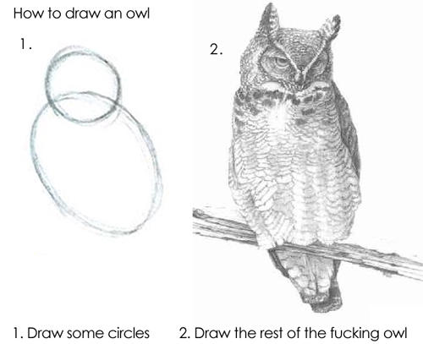
Demo
Notes:
Capped collection
50 GB size limit

Slide 21
Message broker
PlaceOrder
Order Placed
Order Placed
Orders
Payments
Payment Accepted
Payment Accepted
Order
Payment
Notes:
State change notifications
Reactive
Can make decisions independently (in isolation)

