Slide 1
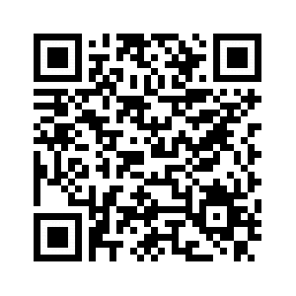
Event-Driven systems backed by MongoDB
bit.ly/2DUYXNF
Notes:
Talk intro:
- Event-Driven systems and challenges
- MongoDB replication internals
- Reference implementation with MongoDB and C#

Slide 2

Andrii Litvinov
Platform engineer at Synergy Sports Technology
Notes:
Company creates analytics of sport events based on videos.

Slide 3
Challenges
• Game statistics calculations
• Reports read model calculations
• Duplicate records matching

Slide 4
Message broker
Place Order
Order Placed
Order Placed
Orders
Payments
Payment Accepted
Payment Accepted
Order
Payment
Notes:
Multiple components involved in business transaction
State change notifications
Reactive
Can make decisions independently (in isolation)

Slide 5
Message broker
Place Order
?
✕
Order Placed
Order Placed
Crash
Orders
Payments
Order
✓

Slide 6
Key takeaway: persist state and publish event atomically
Notes:
TPC
Degraded performance
No support by message brokers
Write ahead logging
Too complex for simple cases
Options?

Slide 7
Event Sourcing
Service 1
Service 2
Event 1
Event 1
Event 1
Event 1
Event 1
Event 1
Event 1
Event 1
Event
Event
Notes:
Best option where applicable
No Kafka

Slide 8
Application events
Message broker
Service
Event
Publisher
Entity
Local
transaction
Event
Notes:
What to do with No-SQL?
Searching conferences/talking to people. Not right-away obvious.

Slide 9
Transaction log tailing
Message broker
Service
Entity
Event
Publisher
Transaction Log
Notes:
Work with most No-SQL
No explicit event publishing in the app code
Can be hard to revers-engineer the event

Slide 10
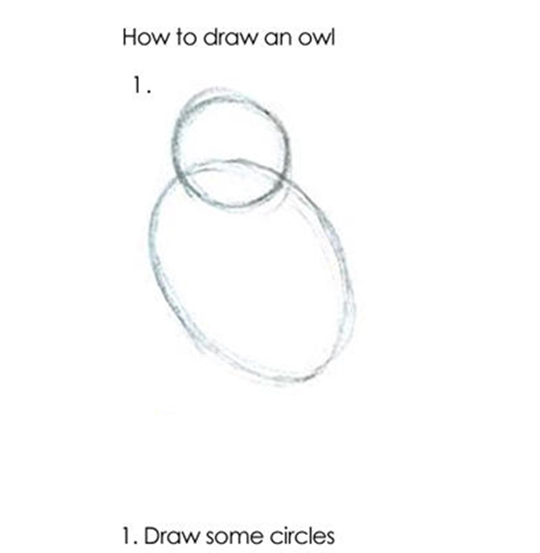
Demo 1

Slide 11
Our considerations
• MongoDB 3.4
• No ACID transactions support so far
• Event sourcing requires major redesign
• Go with Oplog tailing
• MongoDB 3.6 change Streams just released

Slide 12
Oplog tailing
Pros
• Proven, reliable, widely used in production
• Emit event from Primary { w: 1 }
Cons
• Private undocumented API
• More efforts to implement { w: "majority" }
• Advised against by MongoDB

Slide 13
Change Streams 3.6
Pros
• Stable, well-documented API
• { w: "majority" } out of the box
• Recommended by MongoDB
Cons
• Not yet widely used in production
• No way to emit from Primary { w: 1}
• Single collection per connection
Notes:
Went with Change Streams for PoC

Slide 14

Notes:
Stale resume token issue on staging
Failed to upgrade to MongoDB 3.6.2 on prod

Slide 15
Takeaway: for primary-secondary-arbiter (PSA) replica set use Oplog tailing
Notes:
3.4 to 3.6 upgrade issue

Slide 16
Change Streams 4.0
Pros
• Option to resume from a given Timestamp
• Subscribe to database or entire deployment
• { w: "majority" } out of the box
• Recommended by MongoDB
Cons
• Only supports { w: "majority" }, no { w: 1}

Slide 17
Takeaway: for MongoDB 4.0 replica set with 3+ data-bearing nodes use Change Streams

Slide 18
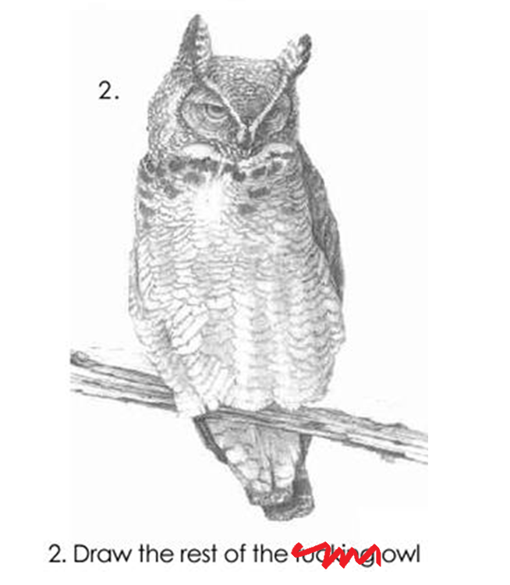
Demo 2

Slide 19
Summary
• Write state and publish event atomically
• Use oplog tailing prior MongoDB 4.0 or with 2 data-bearing nodes
• Use change streams with MongoDB 4.0 and 3+ data-bearing nodes

Slide 20
Resources
Replication
https://www.slideshare.net/Stripe_talks/mongo-db-oplog
https://www.compose.com/articles/the-mongodb-oplog-and-node-js/
https://stackoverflow.com/questions/17878835/what-does-the-h-in-oplog-rs-document-stand-for
https://stackoverflow.com/questions/26935419/what-do-the-oplog-fields-actually-mean
Event-Driven-Architecture
https://www.nginx.com/blog/event-driven-data-management-microservices/
https://microservices.io/
https://skillsmatter.com/skillscasts/12115-keynote-not-just-events-developing-asynchronous-microservices
Domain model
http://dddcommunity.org/library/vernon_2011/

Slide 21
Contacts
https://twitter.com/andriilitvinov
https://stackoverflow.com/users/2138959/andrii-litvinov
https://github.com/andrii-litvinov
https://dou.ua/users/andrii.litvinov/articles/
https://www.upwork.com/fl/andriilitvinov

Slide 22
Thank You!

Slide 23
Questions?

