Slide 1

Demo cut
Seven stages through the product in 12 minutes. One screen each, the point it makes,
and the question it answers.
Abbreviated path from the product documentation, section 4
Full path: 19 steps, 30 minutes · 100 features catalogued · verified 17 Aug 2026
Notes:
Seven stages, twelve minutes. The full nineteen-step path and the complete hundred-feature inventory are in the product documentation.

Slide 2
THE SHAPE OF IT
Seven stages, left to right
Each stage answers one question an early adopter will have.
1
1 MIN
2
2 MIN
3
2 MIN
4
1 MIN
5
2 MIN
6
2 MIN
7
2 MIN
Ask
Check
Approve
Artifact
Type
Retain
Verify
Open on the ask
It checks the data first
Approve the structure
An artifact lands
Every slide has a type
Corrections are retained
It tests itself
Home
DEMO workstream
DEMO workstream
DEMO workstream
DEMO workstream
DEMO workstream
BigQuery workstream
What do I have to learn before this is useful?
What happens when the data isn’t there?
How much control do I have over what it writes?
Is this something I can put in front of a client?
Does it just produce generic slides?
Do I have to re-explain this every month?
What happens when it gets something wrong?
F01 F04
F10 F11 F15
F19 F20 F21 F22 F23
F24 F25 F26 F28 F29
F30 F31 F32
F36 F37 F38
F66 F67 F68 F69 F70 F77 F79 F80 F81
Total 12 minutes · 30 of 100 catalogued features
PXEngine · demo cut · 12 minutes
2

Slide 3
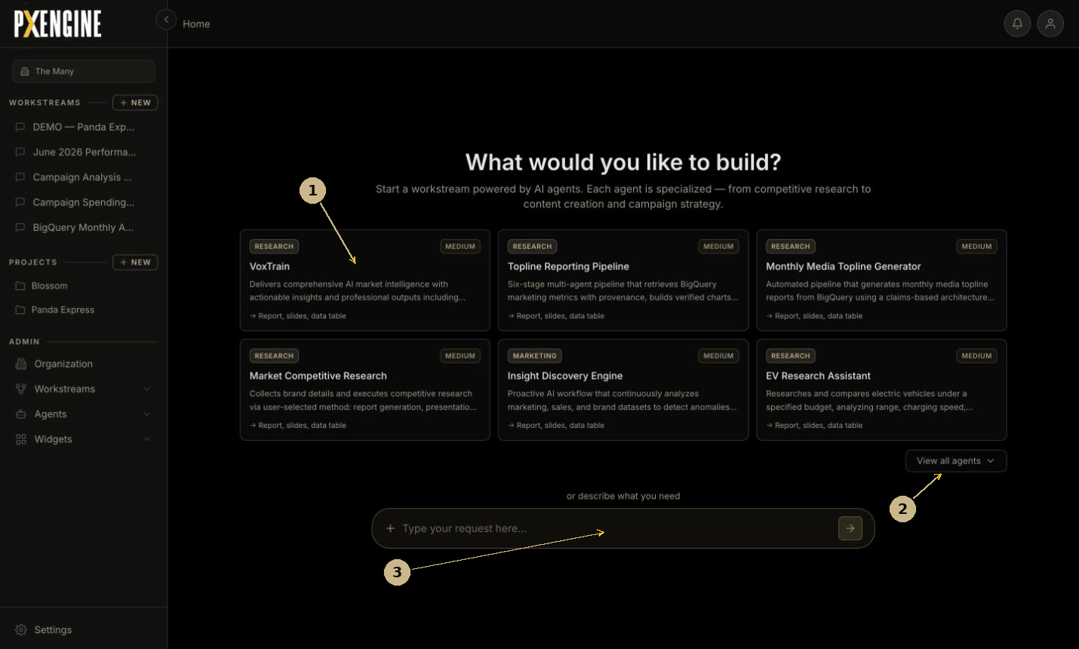
STAGE 1 OF 7 · 1 MIN · DOCUMENTATION STEP 3.1
Open on the ask
Home
SHOW
The home screen. Do not open the template picker.
EXPLAIN
Work starts from one sentence. A template or a gallery agent is optional, not a prerequisite — nothing has to be configured before the first request.
ANSWERS
“What do I have to learn before this is useful?”
Documentation figure 3.1
F01 · F04
PXEngine · demo cut · 12 minutes
3
Notes:
Workstream: Home The home screen. Do not open the template picker. Work starts from one sentence. A template or a gallery agent is optional, not a prerequisite — nothing has to be configured before the first request. Answers: What do I have to learn before this is useful? Features: F01, F04

Slide 4
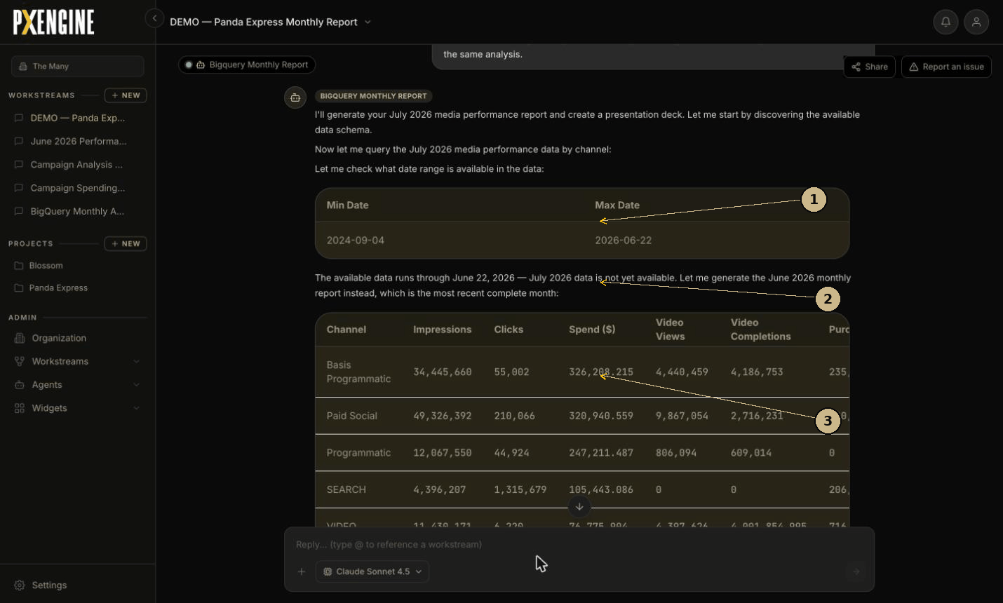
STAGE 2 OF 7 · 2 MIN · DOCUMENTATION STEP 3.3
It checks the data first
DEMO — Panda Express Monthly Report open it
SHOW
Top of the thread: the date-range query, then the agent’s response.
EXPLAIN
The agent establishes what data exists before answering, and states the limit in the thread. Asked for July, it reported the set ends 22 June and built June instead.
ANSWERS
“What happens when the data isn’t there?”
Documentation figure 3.3
F10 · F11 · F15
PXEngine · demo cut · 12 minutes
4
Notes:
Workstream: DEMO — Panda Express Monthly Report Top of the thread: the date-range query, then the agent’s response. The agent establishes what data exists before answering, and states the limit in the thread. Asked for July, it reported the set ends 22 June and built June instead. Answers: What happens when the data isn’t there? Features: F10, F11, F15

Slide 5
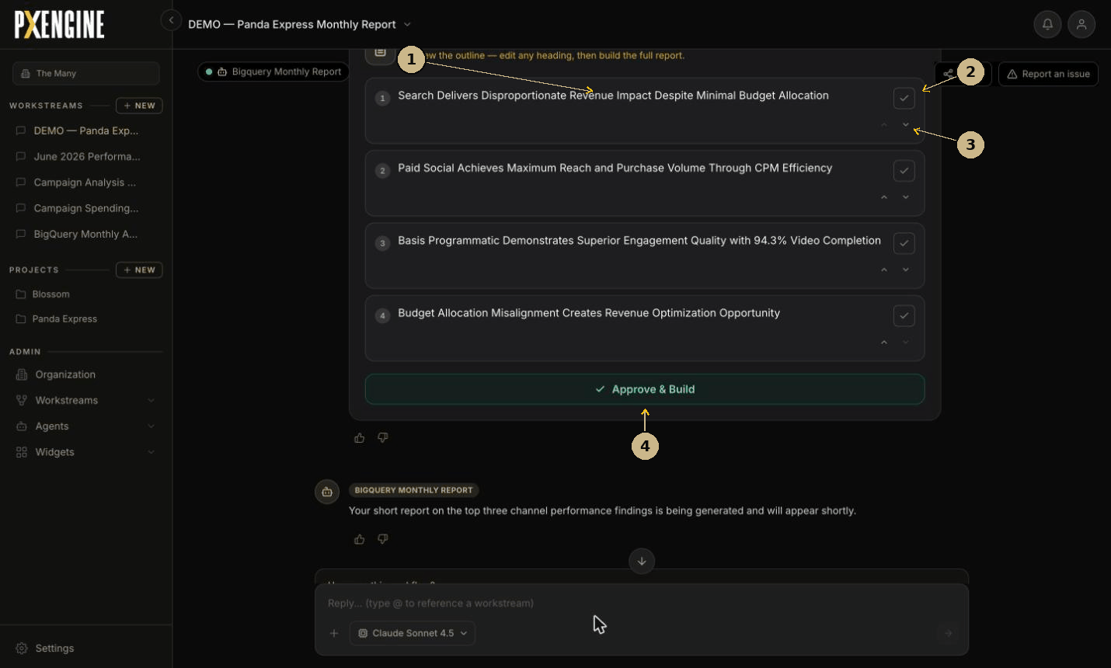
STAGE 3 OF 7 · 2 MIN · DOCUMENTATION STEP 3.5
Approve the structure
DEMO — Panda Express Monthly Report same thread
SHOW
The outline card. Edit a heading, exclude a finding, reorder two rows.
EXPLAIN
Structure is proposed and approved before anything renders. One control governs both cost and quality — a wrong shape is caught in seconds rather than after a full run.
ANSWERS
“How much control do I have over what it writes?”
Documentation figure 3.5
F19 · F20 · F21 · F22 · F23
PXEngine · demo cut · 12 minutes
5
Notes:
Workstream: DEMO — Panda Express Monthly Report The outline card. Edit a heading, exclude a finding, reorder two rows. Structure is proposed and approved before anything renders. One control governs both cost and quality — a wrong shape is caught in seconds rather than after a full run. Answers: How much control do I have over what it writes? Features: F19, F20, F21, F22, F23

Slide 6
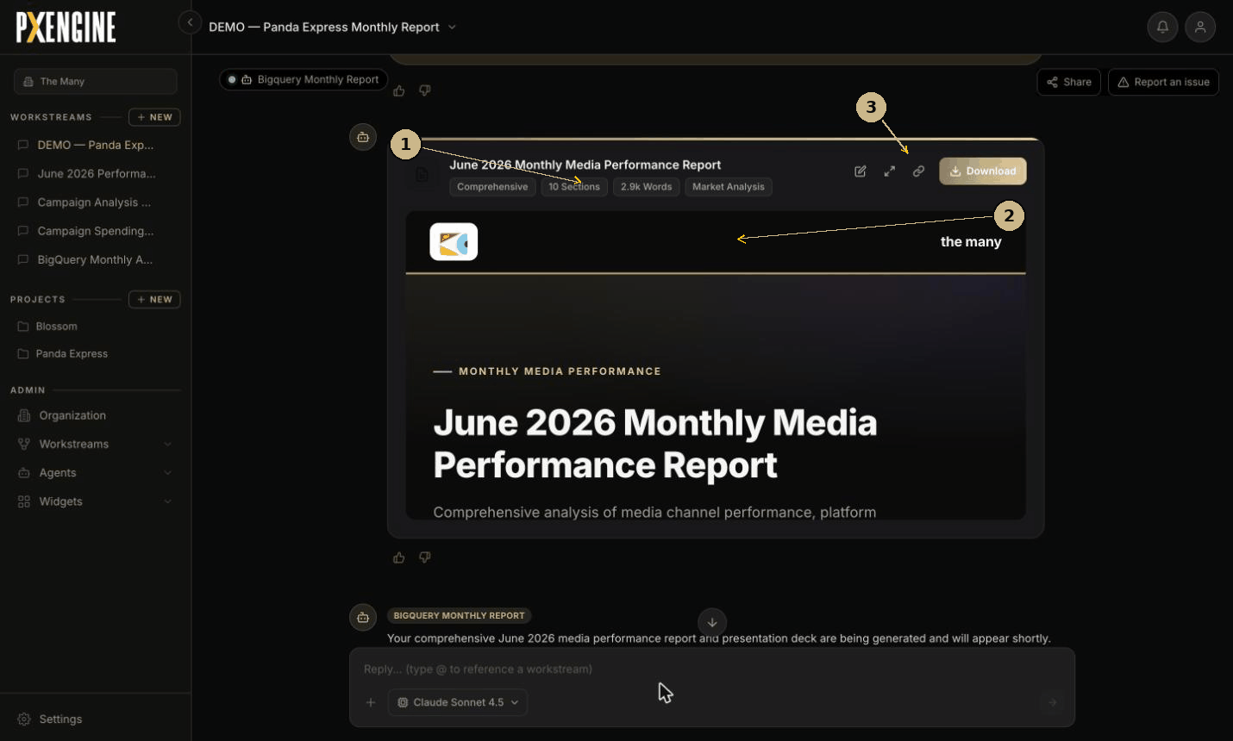
STAGE 4 OF 7 · 1 MIN · DOCUMENTATION STEP 3.6
An artifact lands
DEMO — Panda Express Monthly Report same thread
SHOW
The report card: metadata, branded header, the export controls.
EXPLAIN
The output is a branded, sourced, shareable document. Branding is applied at render time from organisation settings, not baked into the report.
ANSWERS
“Is this something I can put in front of a client?”
Documentation figure 3.6
F24 · F25 · F26 · F28 · F29
PXEngine · demo cut · 12 minutes
6
Notes:
Workstream: DEMO — Panda Express Monthly Report The report card: metadata, branded header, the export controls. The output is a branded, sourced, shareable document. Branding is applied at render time from organisation settings, not baked into the report. Answers: Is this something I can put in front of a client? Features: F24, F25, F26, F28, F29

Slide 7
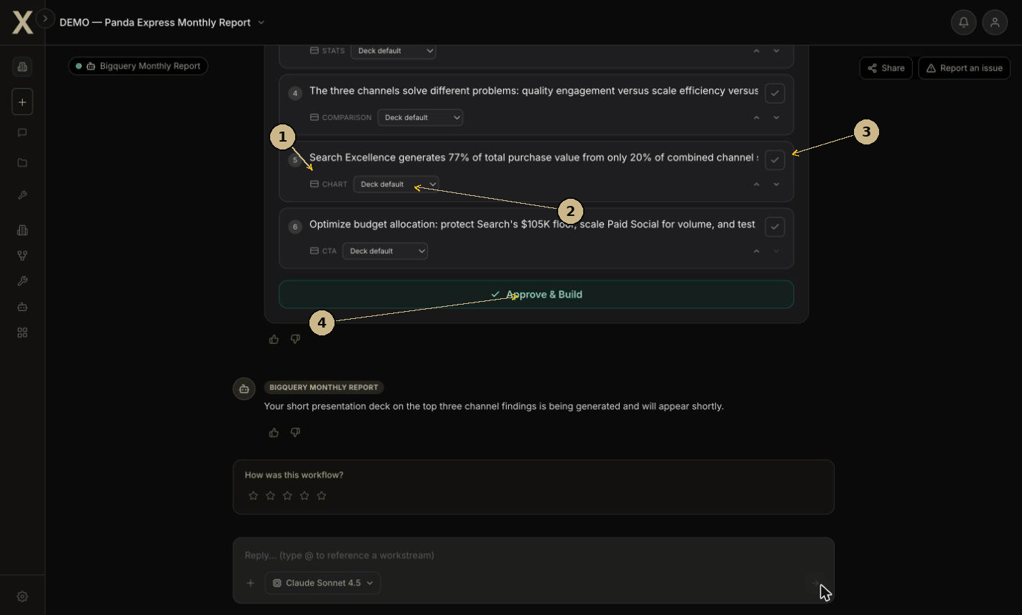
STAGE 5 OF 7 · 2 MIN · DOCUMENTATION STEP 3.8
Every slide has a type
DEMO — Panda Express Monthly Report same thread
SHOW
The deck outline card. The type tag on each row; the per-row layout dropdown.
EXPLAIN
Each slide’s type is declared before it is drawn, and can be overridden one row at a time without touching the rest of the deck.
ANSWERS
“Does it just produce generic slides?”
Documentation figure 3.8
F30 · F31 · F32
PXEngine · demo cut · 12 minutes
7
Notes:
Workstream: DEMO — Panda Express Monthly Report The deck outline card. The type tag on each row; the per-row layout dropdown. Each slide’s type is declared before it is drawn, and can be overridden one row at a time without touching the rest of the deck. Answers: Does it just produce generic slides? Features: F30, F31, F32

Slide 8
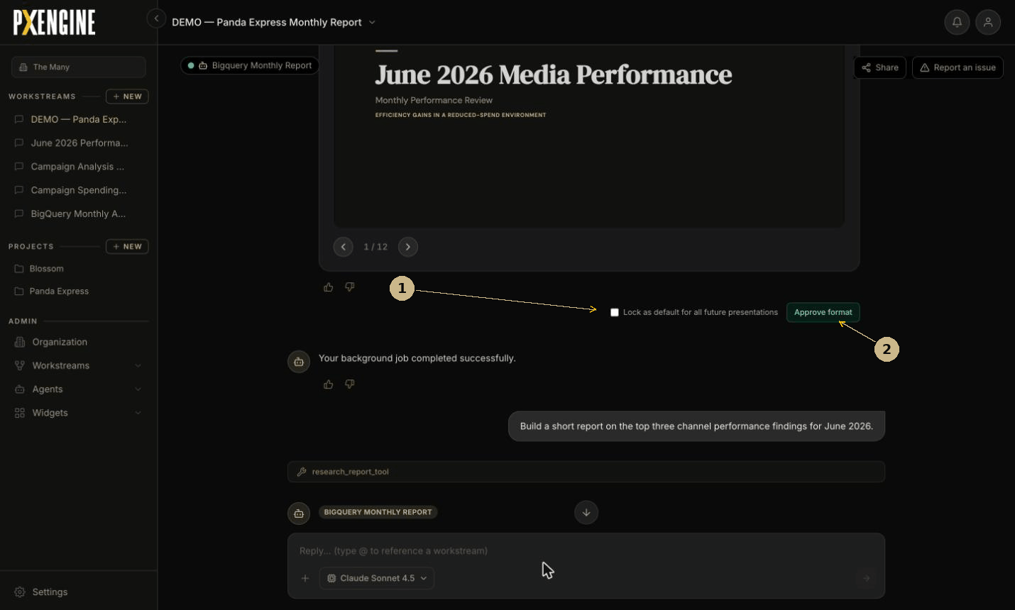
STAGE 6 OF 7 · 2 MIN · DOCUMENTATION STEP 3.10
Corrections are retained
DEMO — Panda Express Monthly Report same thread
SHOW
Lock as default for all future presentations, then Approve format.
EXPLAIN
A corrected format becomes the standing default. The next run inherits it — no prompt is written and no model is trained.
ANSWERS
“Do I have to re-explain this every month?”
Documentation figure 3.10
F36 · F37 · F38
PXEngine · demo cut · 12 minutes
8
Notes:
Workstream: DEMO — Panda Express Monthly Report Lock as default for all future presentations, then Approve format. A corrected format becomes the standing default. The next run inherits it — no prompt is written and no model is trained. Answers: Do I have to re-explain this every month? Features: F36, F37, F38

Slide 9
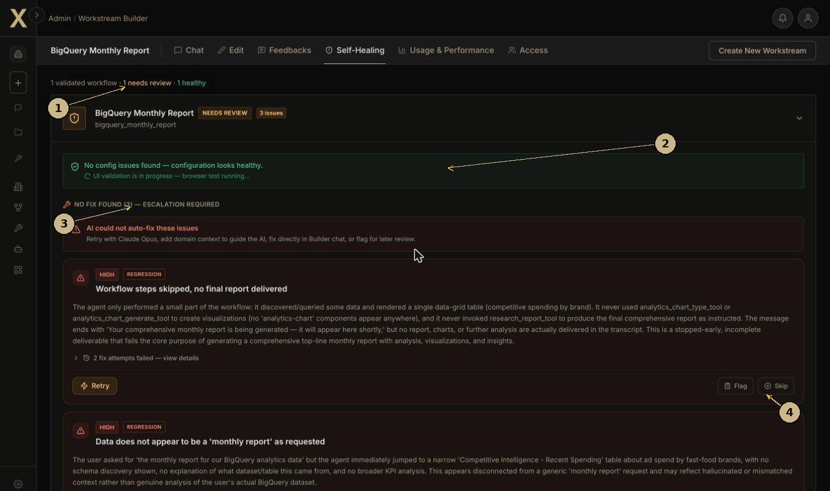
STAGE 7 OF 7 · 2 MIN · DOCUMENTATION STEP 3.12
It tests itself
BigQuery Monthly Report switch workstream
SHOW
The Self-Healing tab: validation status, a browser test running, the escalated issues.
EXPLAIN
The platform drives its own workflows in a real browser, applies the fixes it can, and reports the ones it cannot as escalations with Retry, Flag and Skip.
ANSWERS
“What happens when it gets something wrong?”
Documentation figure 3.12
F66 · F67 · F68 · F69 · F70 · F77 · F79 · F80 · F81
PXEngine · demo cut · 12 minutes
9
Notes:
Workstream: BigQuery Monthly Report The Self-Healing tab: validation status, a browser test running, the escalated issues. The platform drives its own workflows in a real browser, applies the fixes it can, and reports the ones it cannot as escalations with Retry, Flag and Skip. Answers: What happens when it gets something wrong? Features: F66, F67, F68, F69, F70, F77, F79, F80, F81

Slide 10
PREPARATION
Before you run it live
Four things that break the sequence.
Sign in before you start
Confirm the deck is Landscape
The session expires after roughly an hour idle.
Orientation persists between sessions; only a reload reverts it.
Leave both outline cards unapproved
Stay out of Organization → Errors
Stages 3 and 5 depend on them. Approving removes the card.
It lists open reports org-wide. The Self-Healing tab covers the same ground in context.
Both outline cards referenced at stages 3 and 5 exist only while unapproved. Approving one removes it, and producing another takes about six minutes.
PXEngine · demo cut · 12 minutes
10

Slide 11
QUESTIONS
If they ask
The four that come up, and the answer that holds.
Can it reach our internal systems?
F90
What does it cost?
F87
api_connector_tool makes approved external HTTP calls and is in the library. It is configured on zero workstreams today.
Metered per workstream. The reference workstream: 6.8M tokens over 25 sessions, $21.97 estimated, broken down by model.
Who can see my work?
F57
Which model is it using?
F86
A conversation is private to the people granted access. Separately, the workstream template is organisation-wide by default.
Chosen per workstream before anything is spent, limited to the four models the organisation has approved. An unapproved model is refused, not substituted.
PXEngine · demo cut · 12 minutes
11

Slide 12
BEYOND THE CUT
What this leaves out
The cut is seven of nineteen steps. Nothing here is a summary of the whole product.
19 steps
Full demo path
Every documented step, with the screen and the controls for each. Product documentation, section 3.
100 features
Feature inventory
Everything the product does today, in eight functional areas, each with a stable identifier. Section 2.
14 notes
Documented behaviours
Behaviour that is observable but not self-evident from the interface. Appendix A.
30 of 70
Coverage of this cut
The seven stages reach 30 features. The full path reaches 70; the remaining 40 need the longer route. A further 30 of the 100 are documented but not on either path.
PXEngine · demo cut · 12 minutes
12

