Slide 1
Routes in Ruby on Rails
Andrii Palchik
November 2021

Slide 2
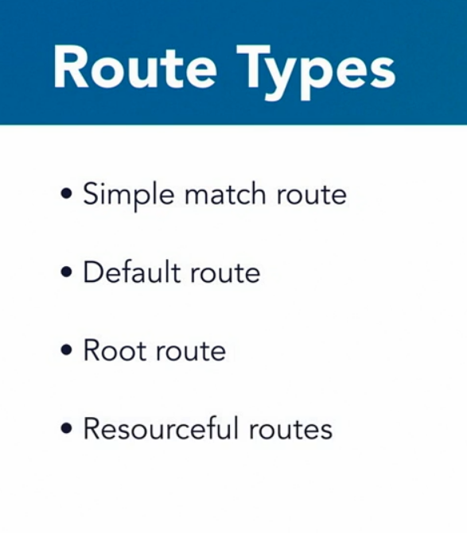
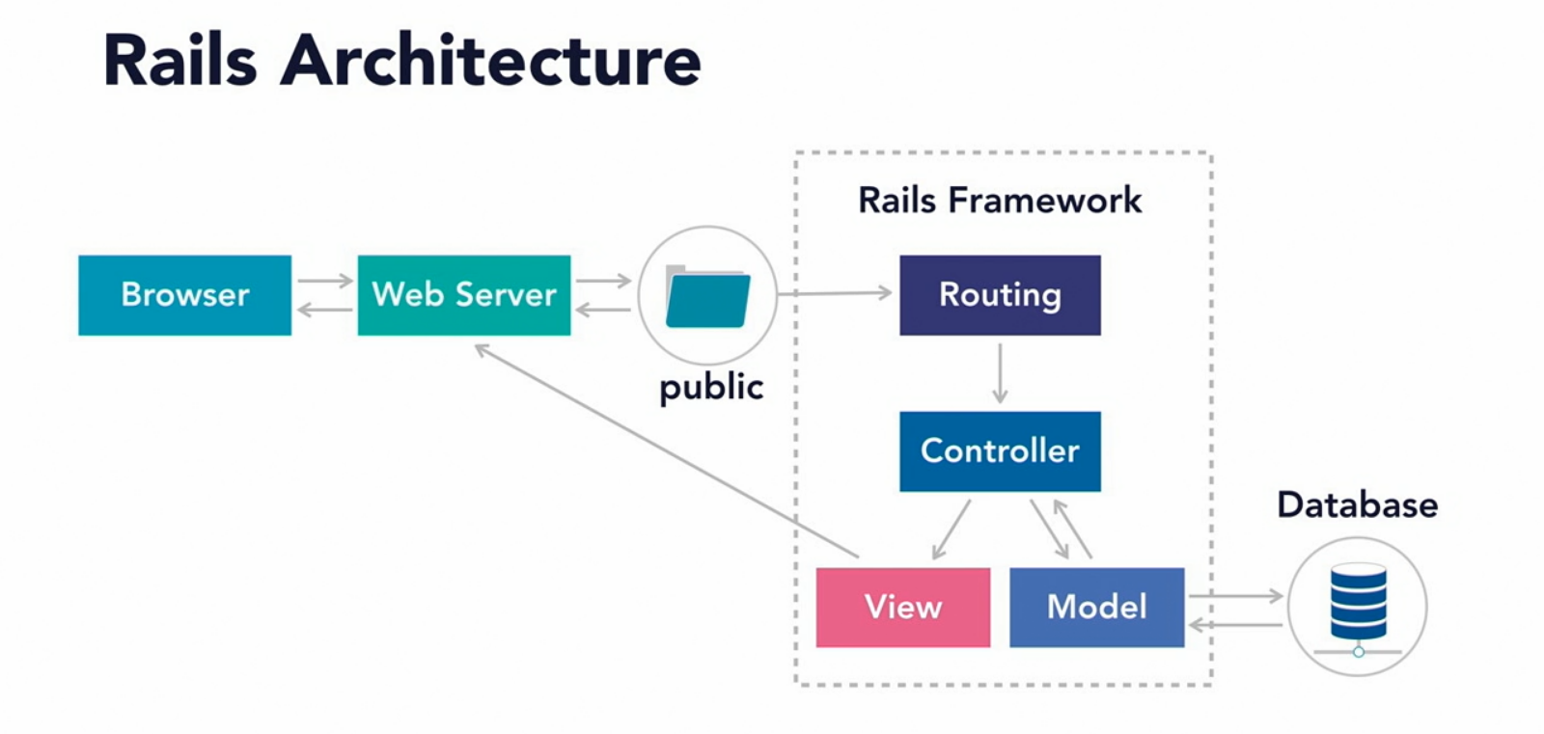
Routes in Ruby on Rails

Slide 3
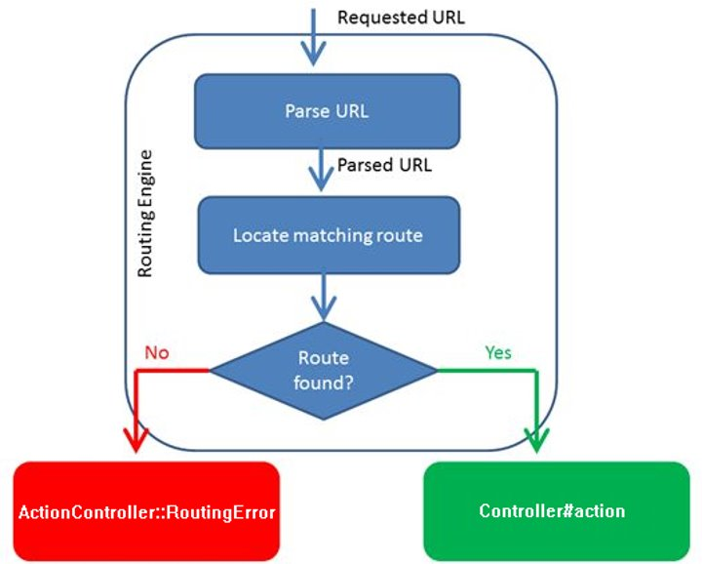
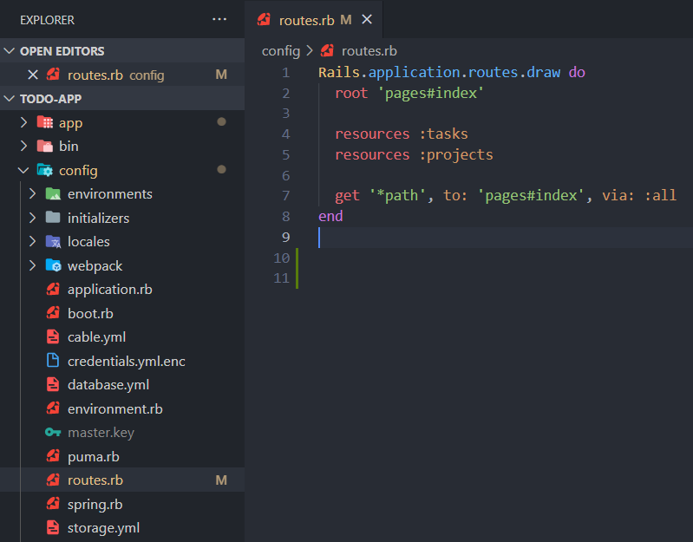
Router

Slide 4
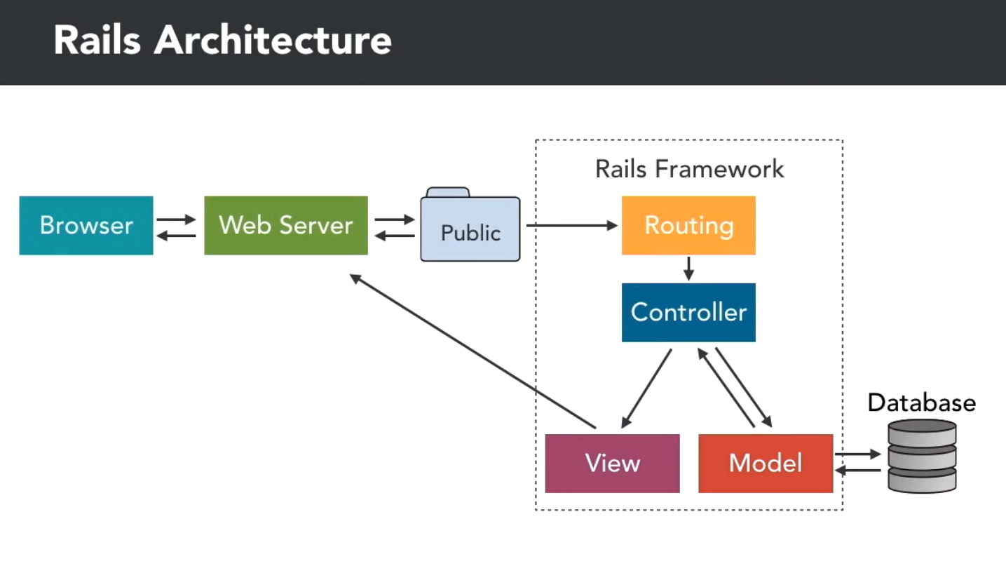
A little bit of Rails architecture

Slide 5
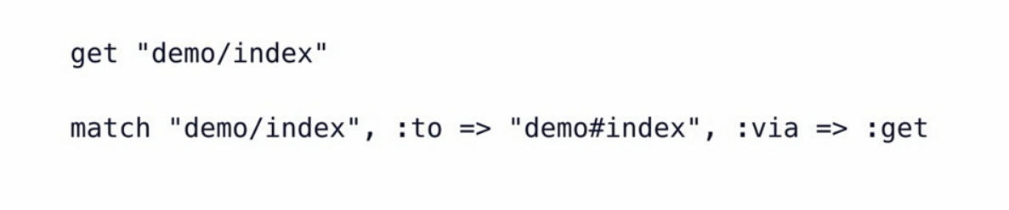
Simple match route

Slide 6

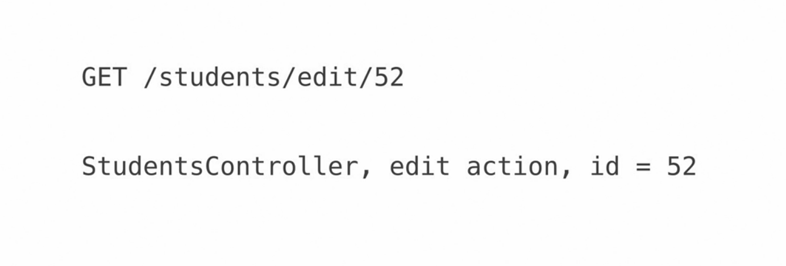
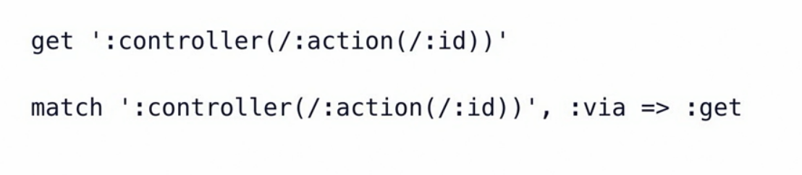
Default route (not that popular nowadays)

Slide 7
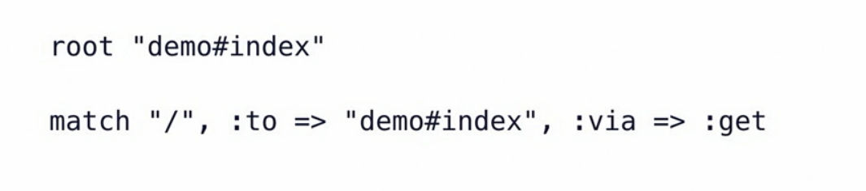
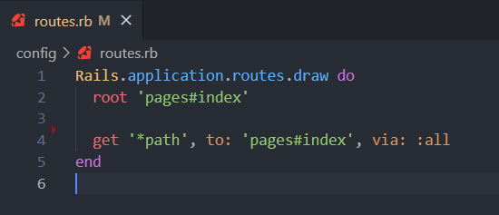
Root route (home page route)

Slide 8
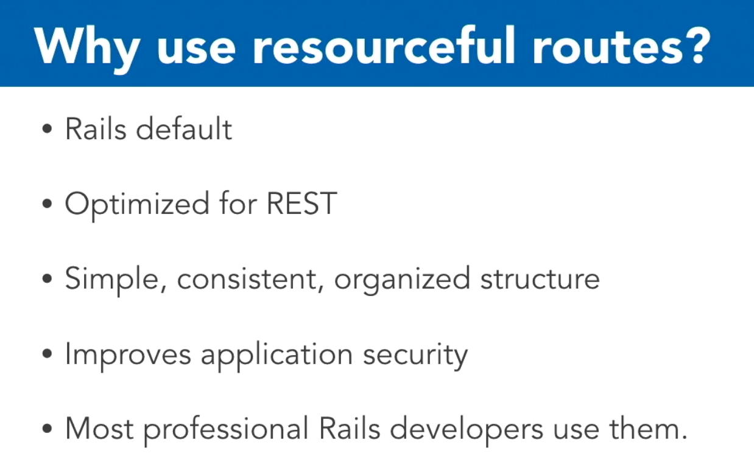
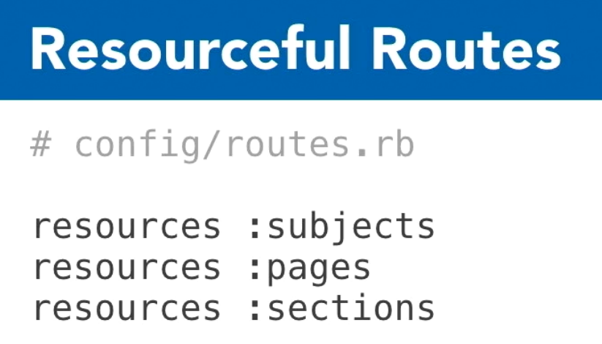
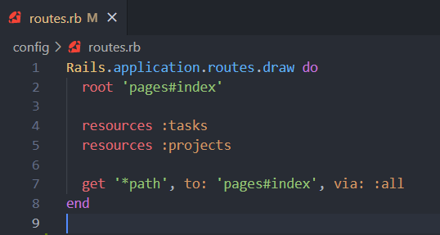
Resourceful routing (the standard)

Slide 9
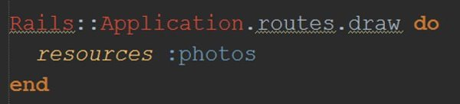
Resourceful routes
HTTP Verb​ | Path​ | Controller#Action​ | View helpers​
GET​ | /photos​ | photos#index​ | photos_path​
GET​ | /photos/new​ | photos#new​ | new_photo_path​
POST​ | /photos​ | photos#create​ | photos_path​
GET​ | /photos/:id​ | photos#show​ | photo_path(id:)​
GET​ | /photos/:id/edit​ | photos#edit​ | edit_photo_path(id:)​
PATCH/PUT​ | /photos/:id​ | photos#update​ | photo_path(id:)​
DELETE​ | /photos/:id​ | photos#destroy​ | photo_path(id:)​

Slide 10
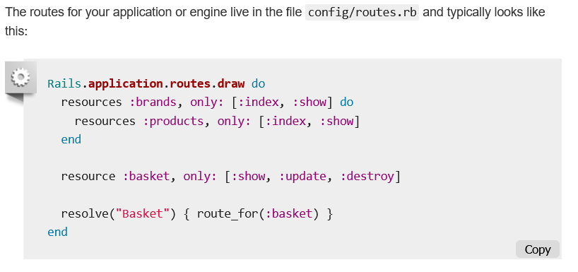
Resourceful routes

Slide 11
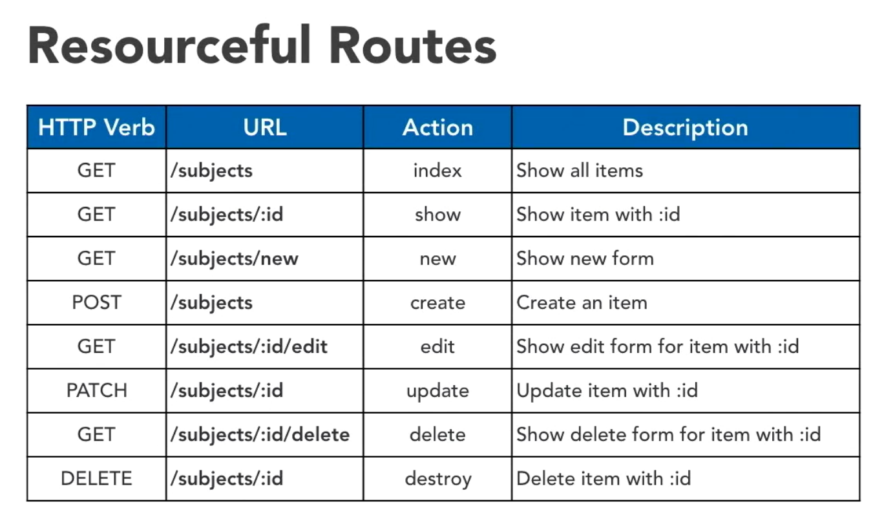
Resourceful routes

Slide 12


