Slide 1
JavaScript DOM
Andrii Palchik
December 2021

Slide 2
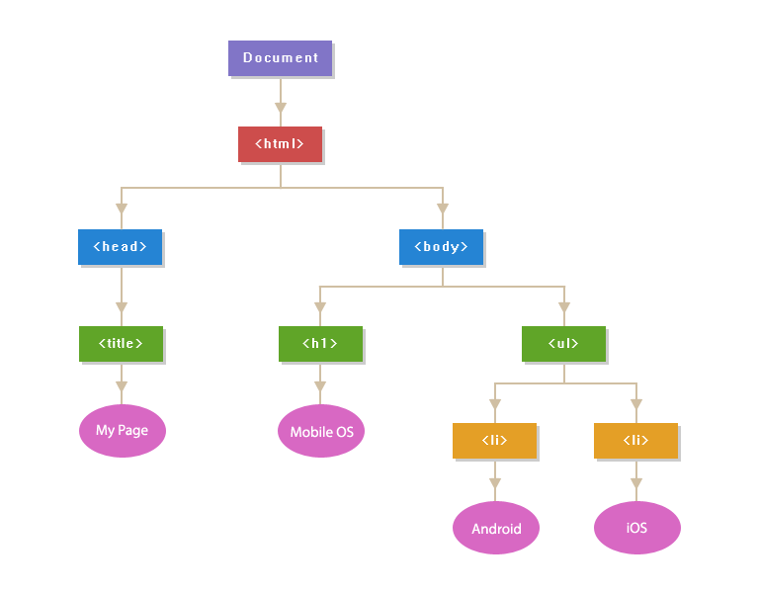
Introduction to the DOM
The Document Object Model (DOM) is the data representation of the objects that comprise the structure and content of a document on the web.
It's a programming interface for web documents. It represents the page so that programs can change the document structure, style, and content. The DOM represents the document as nodes and objects; that way, programming languages can interact with the page.

Slide 3
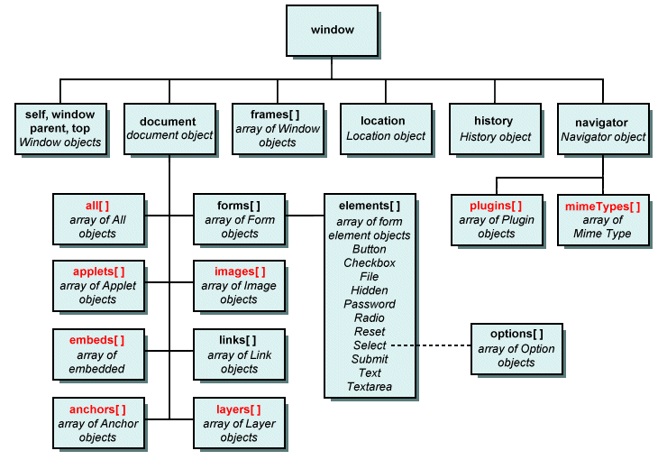
BOM (Browser Object Model)
The Document Object Model is the hierarchy of elements on a page that is accessed from the window.document object. The DOM is really just part of the wider Browser Object Model BOM.

Slide 4
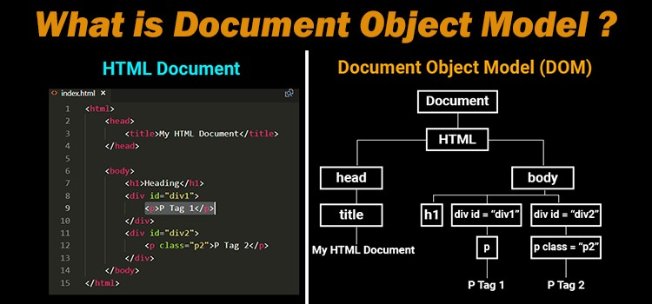
Document Object Model
Is at the core of DHTML
Represents the web page displayed in a window
Each element on a web page is represented in the DOM by its own object
This makes it possible for a JavaScript program to:
Access individual elements on a web page
Change elements individually, without having to reload the page from the server

Slide 5
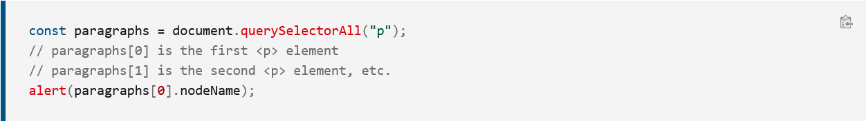
DOM and JavaScript
A web page is a document that can be either displayed in the browser window or as the HTML source. In both cases, it is the same document but the Document Object Model (DOM) representation allows it to be manipulated. As an object-oriented representation of the web page, it can be modified with a scripting language such as JavaScript.
For example, the DOM specifies that the querySelectorAll method in this code snippet must return a list of all the <p> elements in the document:

Slide 6
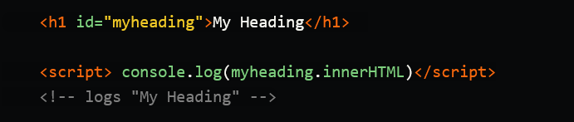
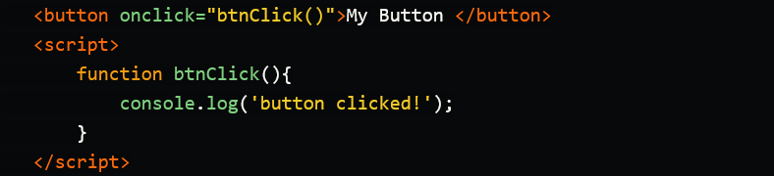

DOM nodes and ID. JS in html attributes
Any element with an ID will create a JavaScript object named after that ID. innerHTML is a very useful property that returns the contents of an HTML tab. Though it seems to behave quite differently across various browsers so you're probably better of using document.querySelector()

Slide 7
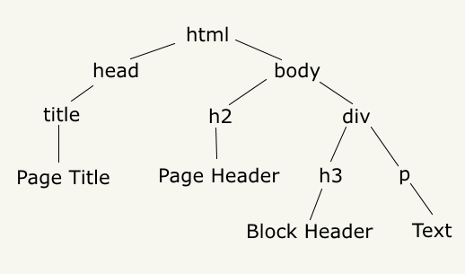
Objects
All of the properties, methods, and events available for manipulating and creating web pages are organized into objects. For example, the document object that represents the document itself, any table objects that implement the HTMLTableElement DOM interface for accessing HTML tables, and so forth, are all objects.
The DOM is not part of the JavaScript language, but is instead a Web API used to build websites. The DOM was designed to be independent of any particular programming language, making the structural representation of the document available from a single, consistent API. Even if most web developers will only use the DOM through JavaScript, implementations of the DOM can be built for any language

Slide 8
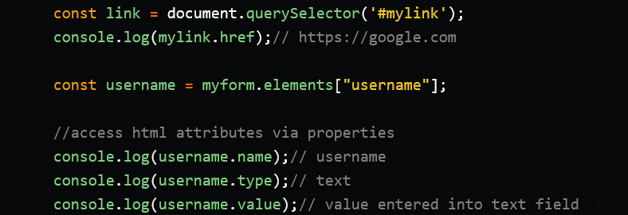
DOM Elements
Every other html element can be accessed in JavaScript by using document.querySelector(). The attributes of the HTML element can be accessed as a property of it's corresponding element object.

Slide 9
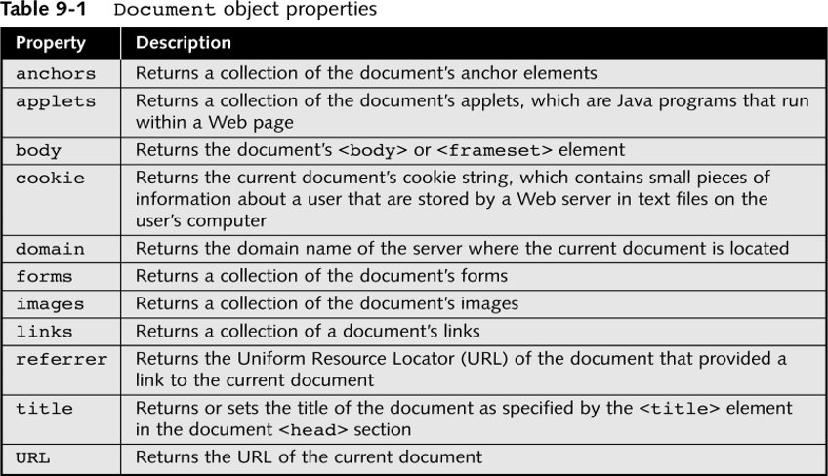
Document Object Properties

Slide 10
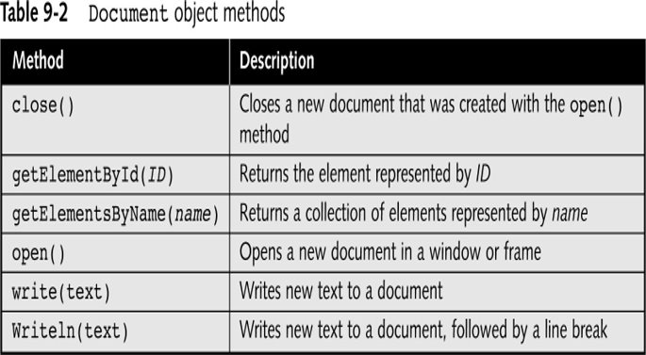
Document Object Methods

Slide 11
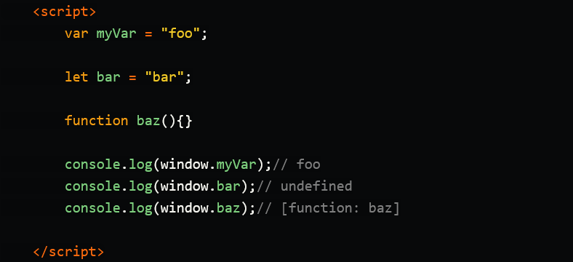
Window and Global Scope
Global functions and objects declared with var can be referenced via the window object. Note, that doesn't work with block scoped variables declared with let and const.

Slide 12
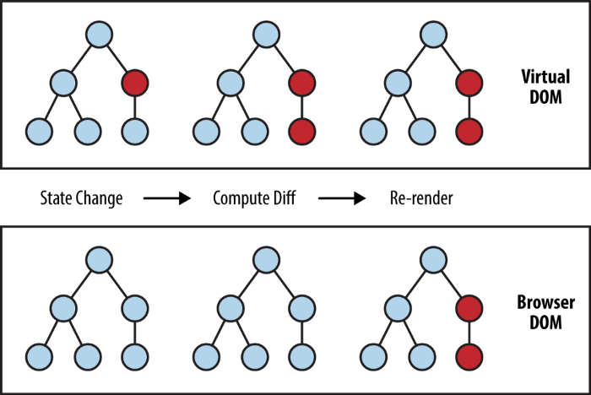
Virtual DOM
The main problem with the DOM is that it was never designed to create a dynamic user interface (UI). We can work with it using JavaScript and libraries like jQuery, but using them doesn't solve performance problems. Look at modern social media platforms like Twitter, Facebook, or Pinterest.
After a little scrolling, we will have tens of thousands of DOM nodes, effectively interacting with which is not an easy task. For example, try moving 1000 divs 5 pixels to the left. It can take more than a second - this is too much for the modern Internet. You can optimize the script and use some tricks, but in the end it will only cause headaches when working with huge pages and dynamic UI.
The solution: instead of interacting with the DOM directly, we work with a lightweight copy of it. We can make changes to the copy based on our needs, and then apply the changes to the real DOM. This compares the DOM tree with its virtual copy, determines the difference, and starts redrawing what has been changed. This approach is faster because it doesn't include all the heavyweight parts of the real DOM.

Slide 13


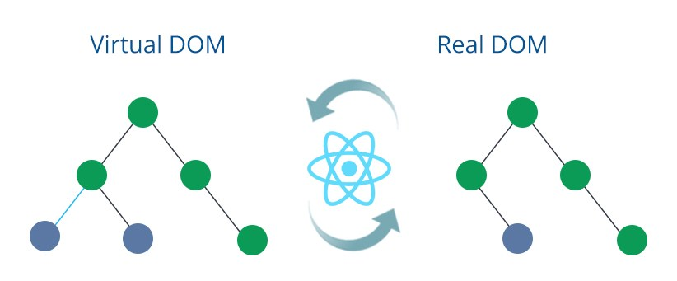

Virtual DOM
Virtual DOM is a technique and set of libraries / algorithms that allows us to improve client-side performance by avoiding direct DOM manipulation by working with a lightweight JavaScript object that mimics a DOM tree.
The idea of using the virtual DOM is great, although not new, we have known for a long time that working directly with the DOM is expensive. By using libraries like React, View and Angular we can improve application performance in a very simple way.

Slide 14


