Slide 1

Distributed Systems Project
Di Ienno Simone, Pirrotta Andrea, Sorrentino Lucrezia

Slide 2

Index
High-level overview
Coordinator
Set up
Runtime
Workers
Set up
Runtime
Failure model
Analytics
Conclusion

Slide 3
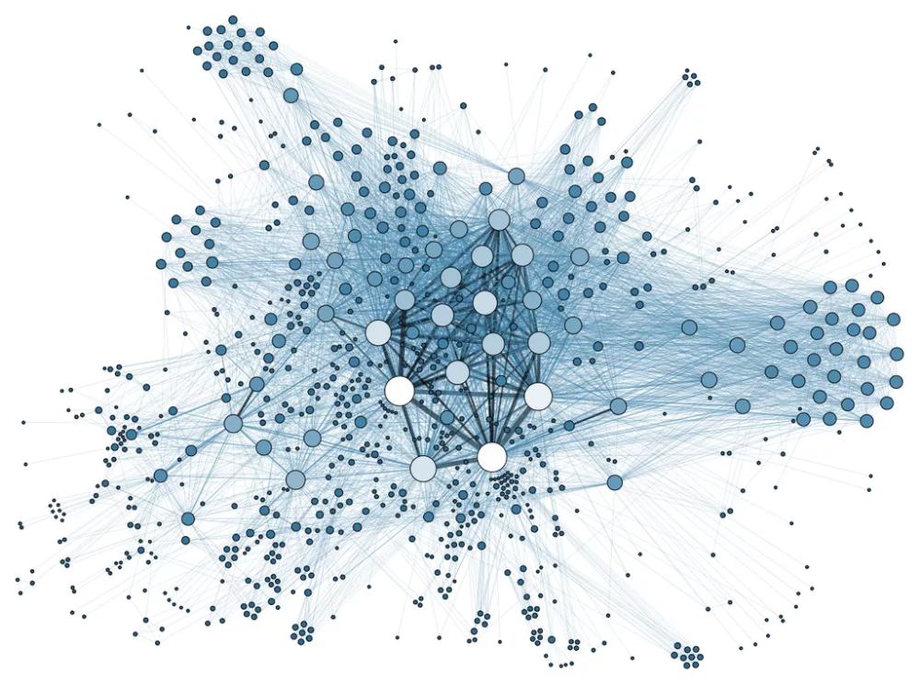
High-level overview
This system follows a distributed computing model where the coordinator assigns tasks to workers, monitors their progress, handles failures, and orchestrates the execution of map and reduce operations on the given input.
1
CSV file divided in chunks
2
Execute map operation on every chunk
3
4
Prepare «Reduce Data» (list of <key, result> so that #chunks = #different keys in CSV )
Execute Reduce

Slide 4


Coordinator
role and responibilities
Reads and validates the JSON and CSV files
Divides the input CSV into chunks
Keeps track of worker information such as worker ID, task in execution and state
Dispatches the operations to workers and keeps track of the progress
Sends a ping to all workers and schedules a pingTimeout to detect worker failures
Prepares the input for the Reduce operation
Saves the result on file

Slide 5

Coordinator: runtime
Assigns operations to free workers by sending an execute message, records which operation is assigned to which worker.
When a worker completes an operation it notifies the coordinator, who stores the result. A new operation is scheduled on that worker.
Map operations are completed sequentially, only when an operation is completed on every chunk the coordinator starts scheduling the following operation.
Periodically pings workers, and if no response is received before the pingTimeout, marks the worker as failed. When a worker executing an operation fails, the operation is re-scheduled on a free worker.
When all map operations are completed, the coordinator prepares the input for the reduce operation.
The reduce operation is scheduled on free workers and the final result is written to file.

Slide 6
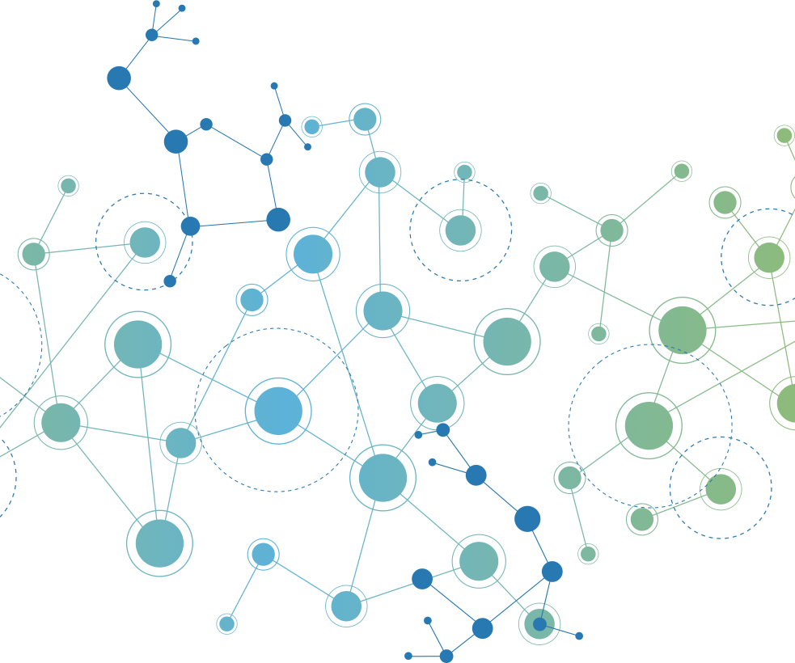
Worker
role and responibilities
Execute map and reduce operations
Respond to coordinator’s pings

Slide 7

Worker: runtime
Receives an execute message from the coordinator.
Parses the operation type, reads the corresponding data chunk, and executes the operation.
Computes the output and simulates execution time.
After the execution time, sends the result to the coordinator.
Responds to pings with a pong.
May fail with a certain probability after receiving an execute message, in which case it drops the task and after a certain amount of time, when it recovers, it notifies the coordinator.

Slide 8


Failure model
The coordinator will periodically ping all workers by sending a ping and scheduling a self ping Timeout message, if no pong is received before a ping Timeout for that worker then it is considered failed.
If a pong is received in time the ping Timeout for that worker is deleted and a new ping is sent. When a back online message is received the info about the worker is updated and a new task is scheduled.
When a worker that was executing a task fails, the task is rescheduled on a free worker.
The worker also responds to ping with a pong. The failure model is such that there is a probability to fail after each execute message is received, in this case the worker will drop the task and schedule a recovery self message, after which it will send a back online message to the coordinator.

Slide 9

Data structures
Input files:
JSON file contains: definition of a sequence of maps operation, changekey and one reduce operation
CSV file: a series of key-value pairs
workersData: contains information about each worker (its id, the operation it is executing and if it is online)
mapTaskQueue: tasks that have to be executed
globaldata: vector with the input data divided in chuncks (each represented by a vector of pairs)
currentTaskQueue: keeps track of the tasks to be executed, each item is a pair of integers (chunck index; task index)
chunkDone: vector of booleans that keeps track of the completion status of each chunk
reduceData: represents the sorted input data and it’s used for the reduce operation
timeoutId: stores Ids of the pingTimeout messages for each worker

Slide 10

Analytics
Reference configuration:
200 pairs
5 map operations
10 worker number
2% failure probability

Slide 11
Number of workers

Slide 12
Number of map operations

Slide 13
Number of input pairs

Slide 14
Failure Probability

Slide 15

Conclusion
Number of workers: greatly impacts the execution time, with a point of diminishing returns after a certain amount of workers. The number of messages also grows but with a less steep trend.
Number of map operations: impacts the execution time in a non-linear way, more operations leads to more computations but also higher probability of worker failure. The number of messages exchanged grows sub-linearly.
Input pairs: the platform scales reasonably well with the input pair size, with the execution time increasing 1.3x times when the input size is increased by 20x. The number of messages does not grow significantly w.r.t. the input size.
Failure probability: most impactful w.r.t. simulation time, doubling the rate roughly doubles the execution time, while the number of messages grows more gently.

