Slide 1
ExaThon India 2026 · Track 02: Customers, Channels & Demand
ShelfSense
Catch stock-outs before they happen.
Stock-out early warning for quick-commerce dark stores, computed entirely in SQL inside Exasol Personal.
Andrin Godson · Karthikeyan
shelfsense-exathon.vercel.app · github.com/andringodson/shelfsense
Notes:
ShelfSense predicts which shelves in which dark stores will run empty before the next truck, and tells the ops team what to do about each one.

Slide 2
An empty shelf is a lost customer
The customer doesn't wait. They open another app.
Store managers find out from complaints or a weekly report, hours too late.
Sales data can't show it: an empty shelf at 7 PM looks exactly like a quiet hour.
5.7%
of all demand goes unserved because the shelf was empty
₹15 lakh
revenue lost in 14 days across 25 stores (simulated network)
Notes:
Who has it: dark-store managers and city ops at quick-commerce chains. Why it matters: every miss is revenue plus a customer trained to use a competitor.

Slide 3
Stock-outs hide, then breed more stock-outs
1
2
3
Shelf runs empty
→
Forecast learns "low demand"
→
Next order is smaller
Sales record 0, not the 12 customers who wanted it.
Models trained on sales copy the stock-out zeros.
So the shelf empties earlier, and the loop tightens.
ShelfSense breaks the loop: it learns demand only from hours when the shelf was NOT empty.

Slide 4
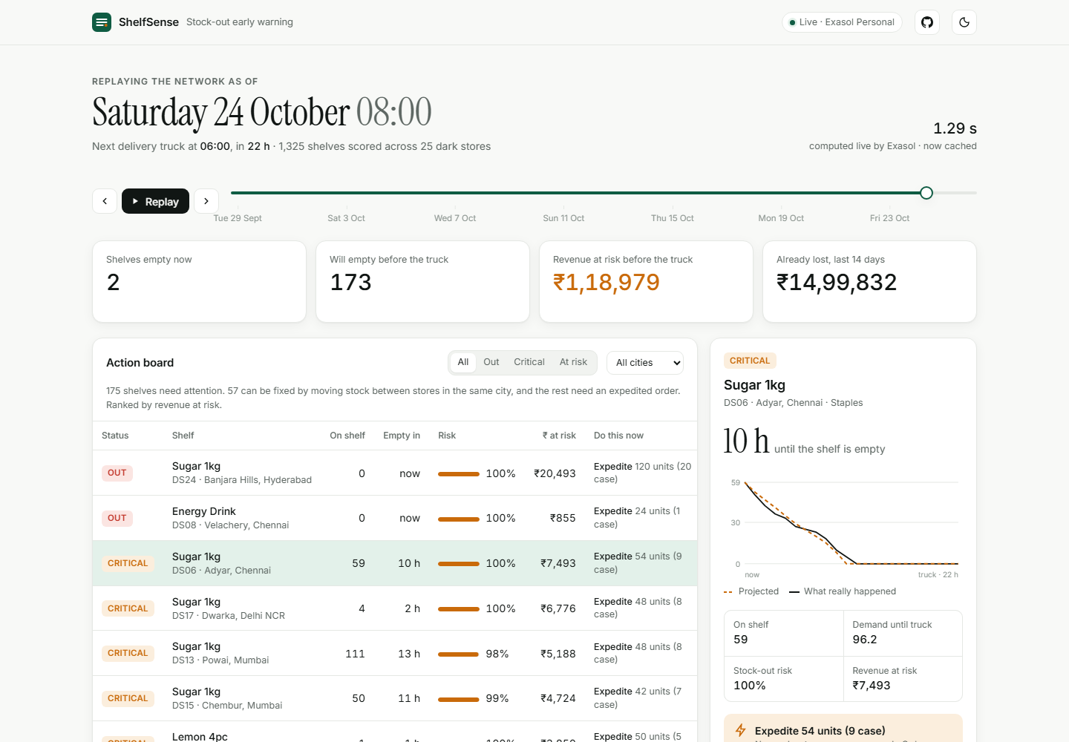
Will this shelf empty before the truck?
1
Action board
Risk of running empty before the 06:00 truck, revenue at stake, and the fix: transfer or expedite.
2
Lost sales
Demand hidden behind every empty-shelf hour, valued in ₹.
3
Backtest replay
Rewind to any hour, then score the calls against what really happened.

Slide 5
All the intelligence lives in Exasol as SQL views
V_SHAPE · V_RATE
V_FORECAST
V_RISK
V_ACTIONS
V_BACKTEST
Censoring-aware demand
48-hour forecast
Poisson risk, hours to empty
Same-city rebalancing
Scored against the future
1.3 M
1.2 s
20 ms
hourly rows bulk-loaded in 2.5 s
to score every shelf at any hour: 3 queries, on a laptop
to replay any hour once cached: the timeline scrubs live
Notes:
Window functions for running demand, ROW_NUMBER self-join for donor stores, a single APP_STATE row lets every view time-travel. Analysts can query V_ACTIONS from any SQL client.

Slide 6
The calls hold up against what really happened
72%
57%
of alerts were right (precision)
of real stock-outs caught in advance
96%
of shelves rated 85–100% risk really ran out. At 0–10% risk, only 4% did.
Notes:
Replay at Saturday 24 Oct 08:00: 218 shelves really went empty before the next truck. Lost-sales estimate is within 28% of simulator ground truth, deliberately conservative.

Slide 7
From alert to action in one screen
What the ops team gets
Saturday, 08:00 · 25 stores
173 shelves
57 shortfalls fixed by a same-city transfer: "Transfer 23 from DS07 (T Nagar)"
The rest get a case-pack-rounded expedite order
Ranked by ₹ at risk, so the first call is the most valuable one
Planners see true demand, so the next order stops shrinking
will empty before tomorrow's truck
₹1.19 lakh
at risk today, before anyone notices

Slide 8
Real-world next steps
1
2
3
Plug in real feeds
Smarter fixes
Push, not pull
POS and WMS exports load with the same IMPORT path. The schema is 4 tables.
Dark-store distance, rider capacity, and shelf life for perishables.
Alerts to store managers on WhatsApp or Slack the moment risk crosses 70%.
Live: shelfsense-exathon.vercel.app
Code: github.com/andringodson/shelfsense (MIT)
Andrin Godson: data model, Exasol SQL, dashboard
Karthikeyan: testing, reproducibility, demo review

