Slide 3
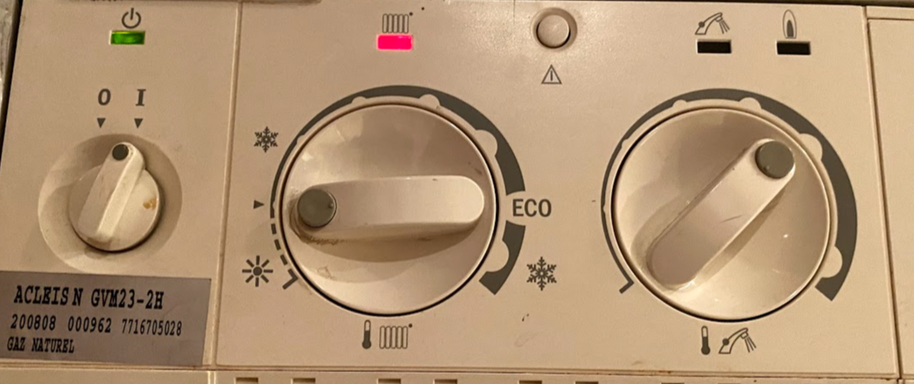
on/off
radiator heater
hot water
Heating 👍

Slide 4
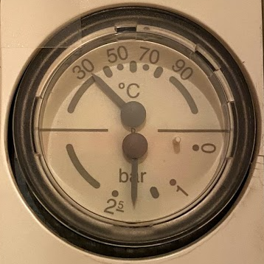
👍

Slide 5
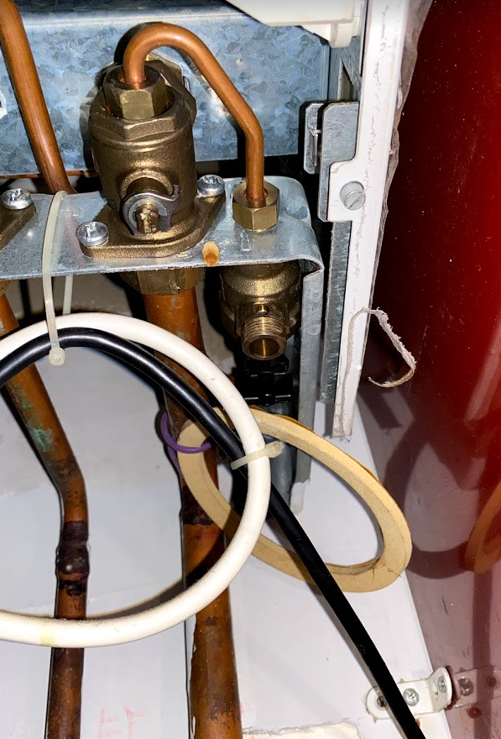
water pressure valve valve pression d'eau

Slide 6
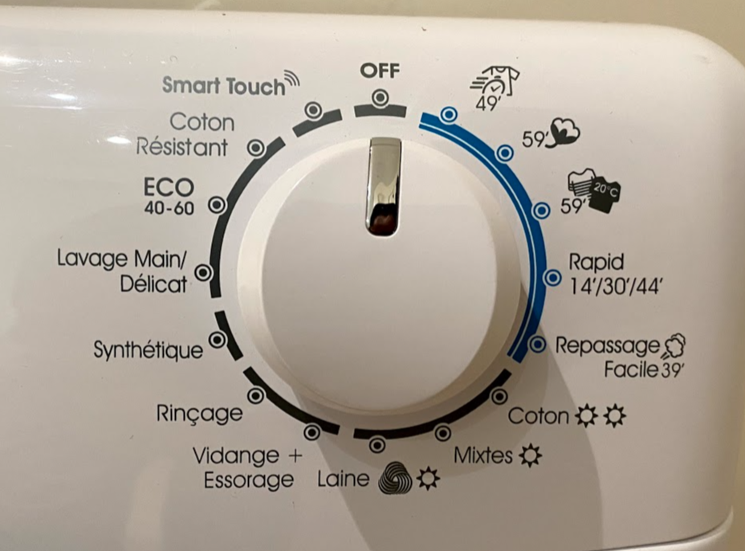
wash
wash
rinse
dry

