Slide 1
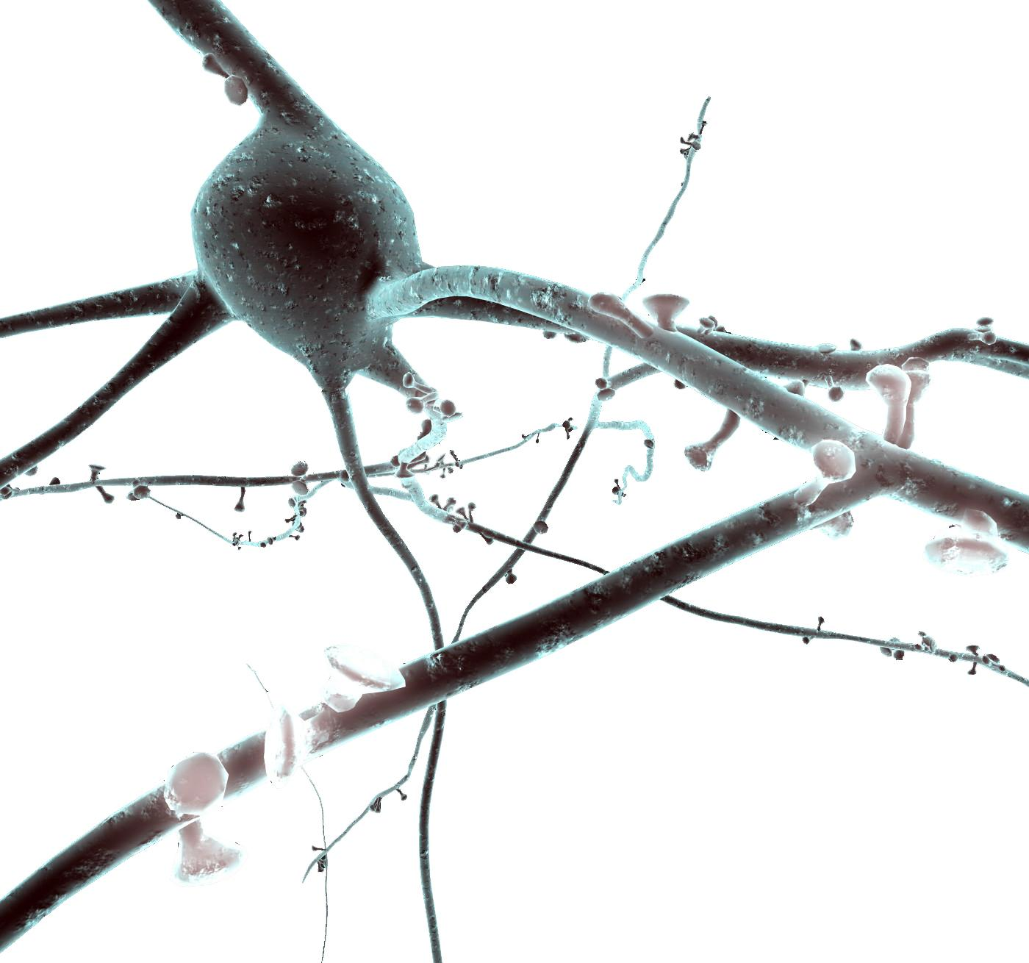
Using NEURON to model cells Tutorial
Oren Amsalem, Yoni Leibner, and András Ecker
oren.amsalem1@mail.huji.ac.il, yoni.leibner@mail.huji.ac.il
andras.ecker@epfl.ch
Idan Segev Lab and the Blue Brain Project

Slide 2
Introduction
The NEURON Simulation Environment is designed for modeling individual neurons and networks of neurons.
It is particularly well-suited to explore problems which are closely linked to experimental data.
NEURON was build and is maintained by Ted Carnevale and Michael Hines, lately the Blue Brain Project is becoming heavily involved with the development of the software
Neuron is written in C & C++, the interface with the simulator is with HOC, but a Python wrapper was build and now commonly used instead of HOC (NEURON as a python package). In addition User-defined mechanisms such as voltage- and ligand-gated ion channels are used in order to expand NEURON (NMODL files, need to be compiled).
In this presentation we will show the following examples:
Single compartment model
Ball and Stick model and the replication of a published result (Gidon et al.)
Multicompartmental L5 Pyramidal cell and two published results (Hay et al., Doron et al.)

Slide 3
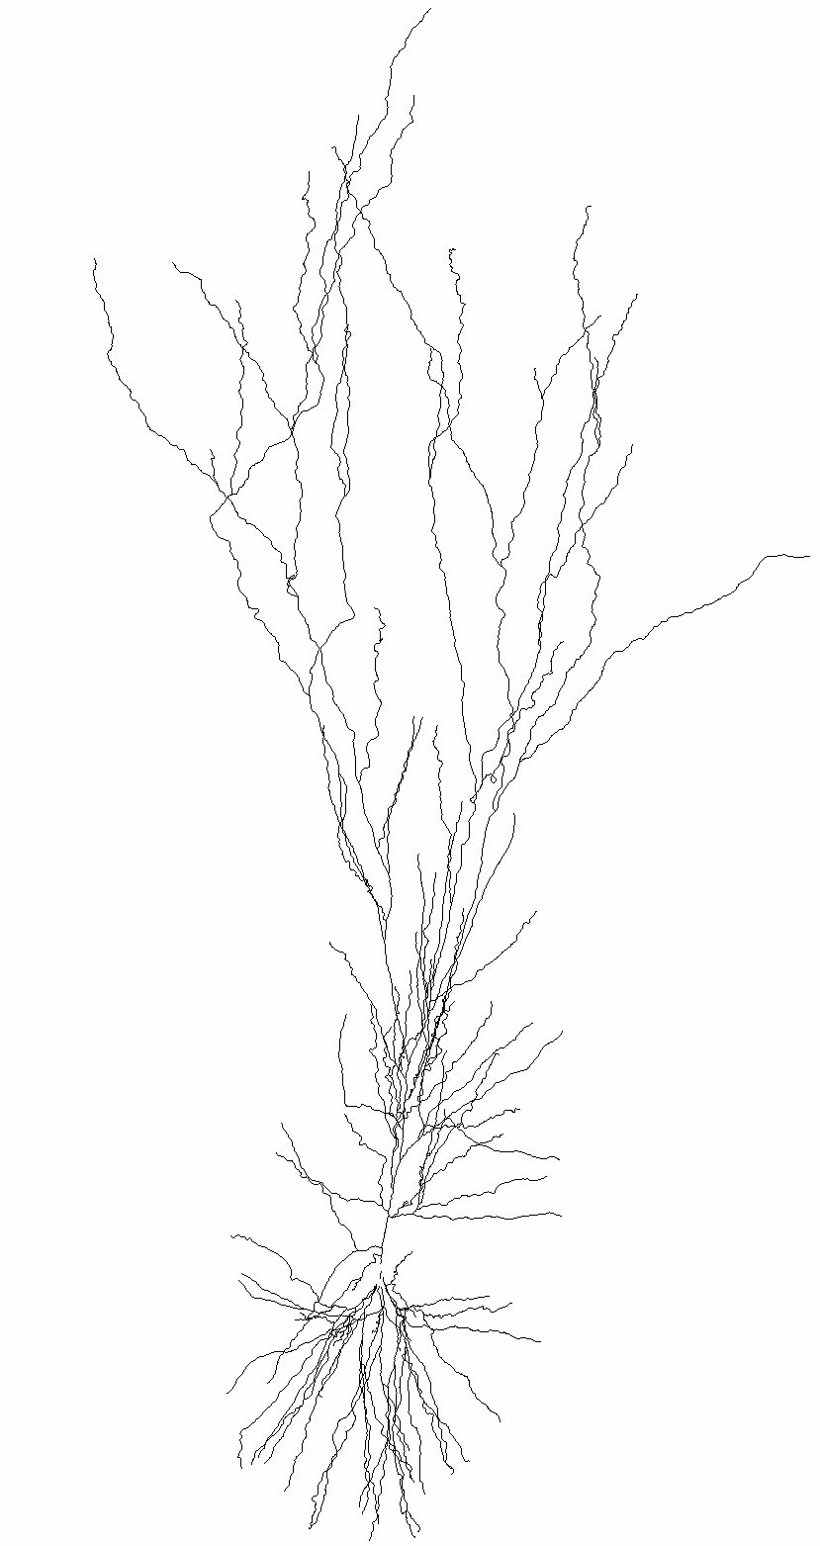
Introduction
Basic concepts of Neuron models:
Model - a Neuron object, it can have soma, basal dendrites (dend) and apical dendrite (apic).
Section - more of a morphological definition, a section is usually a dendrite between 2 bifurcation points.
Segment - one RC circuit that resemble (approximate) the computation in a piece of membrane.
Clamps - an object that represent an experimental electrode.
Synapses - object that resemble a single synapse (we will see it later, and how it’s activated in the simulation).
Point Process - a more general idea, it’s an object that seats on the segment (RC circuit), and simulate a channel or synapse.

Slide 4
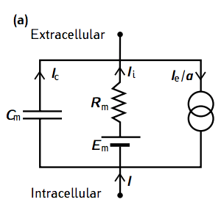
Single compartment neuron - single RC circuit
from neuron import h, gui
# create model
Soma = h.Section(name="soma")
soma.L = 10 # length µm
soma.diam = 10 # diameter µm
soma.insert('pas’). # add passive properties
soma.g_pas = 1/10000 # set the specific membrane
resistance to 10000 ohm*cm^2
# current current clamp
stim = h.IClamp(soma(0.5))
stim.delay = 20. # start of the current injection (ms)
stim.dur = 100 # duration (ms)
stim.amp = 0.01 # amplitude (nA)
0_soma_passive.ipynb

Slide 5
Single compartment neuron - recording
# record injected current soma voltage (and time)
soma_v = h.Vector()
soma_v.record(soma(0.5)._ref_v)
stim_current = h.Vector()
stim_current.record(stim._ref_i)
t = h.Vector()
t.record(h._ref_t)
# run simulation
h.tstop = 220 # simulation time (ms)
h.dt = 0.025.
h.v_init = -70. # initial voltage (mV)
h.run()

Slide 6
Single compartment neuron - synapse
# add a synapse
synapse = h.Exp2Syn(soma(0.5))
synapse.tau1 = 0.3 # rise time constant
synapse.tau2 = 1.8 # decay time constant
Stim = h.NetStim()
stim.number = 1
stim.noise = 0 # no noise
stim.interval = 1
net_con = h.NetCon(stim, synapse)
net_con.weight[0]= 0.0004 # the maximal conductance of the synapse

Slide 7
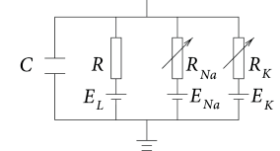
Single compartment neuron – active conductances
from neuron import h, gui
# create model
Soma = h.Section(name="soma")
soma.L = 10 # length µm
soma.diam = 10 # diameter µm
soma.insert("pas"). # add passive properties
soma.g_pas = 1/10000 # set the specific membrane
resistance to 10000 ohm*cm^2
soma.insert(”kv") # add potassium channel
(from a mod file)
soma.gbar_kv = 2000 # set the potassium conductance
soma.insert(”na") # add sodium channel (from a mod file)
soma.gbar_na = 8000 # set the sodium conductance
h.celsius = 30. # set temperature
1_soma_active.ipynb

Slide 8
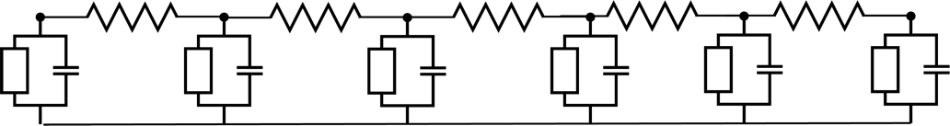
Moving towards the cable model
# create dendrite
dend = h.Section(name=”dend")
dend.L = 500 # um
dend.diam = 1 # um
dend.Ra = 100 # ohm*cm
dend.insert(”pas")
dend.g_pas = 1/10000
dend.connect(soma, 1, 0). # connect the end of
The dendrite to the beginning of the soma
h"forall { nseg = int((L/(0.1*lambda_f(100))+0.9)/2)*2 + 1 }")
# set the number of segments
Dendrite
dend(0.1).v
dend(0.4).v
Dendrite
synaptic input
2_soma_dend_step_current.ipynb
3_soma_dend_synapse.ipynb
Note: d_lambda rule – NEURON book p50

Slide 9
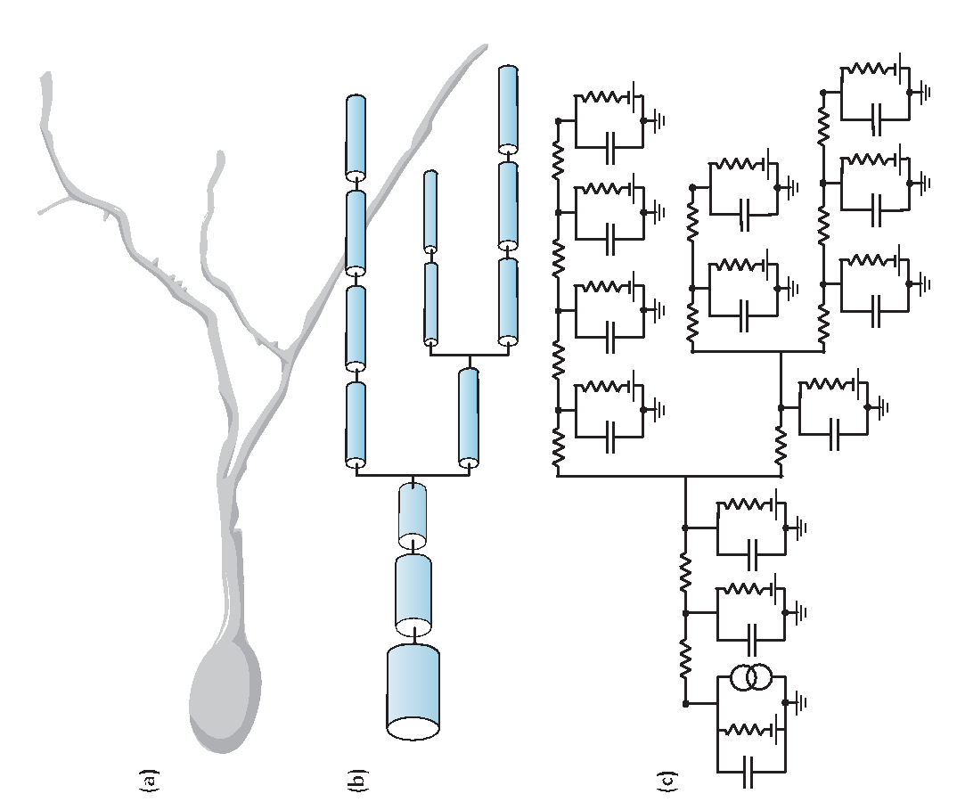
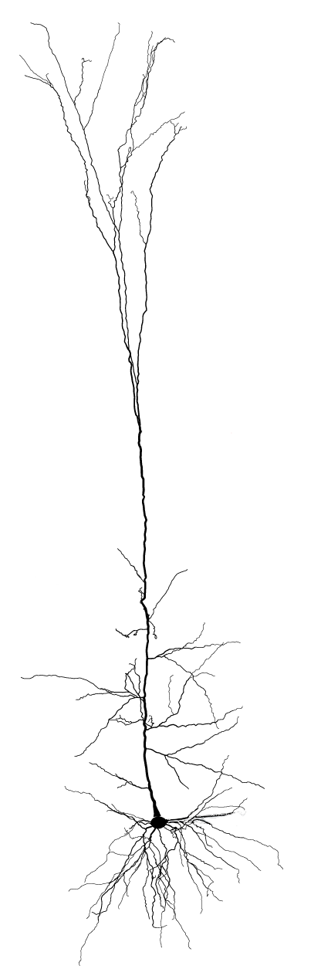
Layer 5b Pyramidal Cell
from neuron import h, gui
# instantiating cell
h.load_file("import3d.hoc")
h.load_file("models/L5PCbiophys3.hoc")
h.load_file("models/L5PCtemplate.hoc")
morph_fname = "morphologies/cell1.asc"
L5PC = h.L5PCtemplate(morph_fname )
4_L5_PC_Hay_et_al.ipynb
“Models of Neocortical Layer 5b Pyramidal Cells Capturing a Wide Range of Dendritic and Perisomatic Active Properties”, Etay Hay , Sean Hill, Felix Schürmann, Henry Markram, Idan Segev. PLOS Computational Biology, 2011

Slide 10
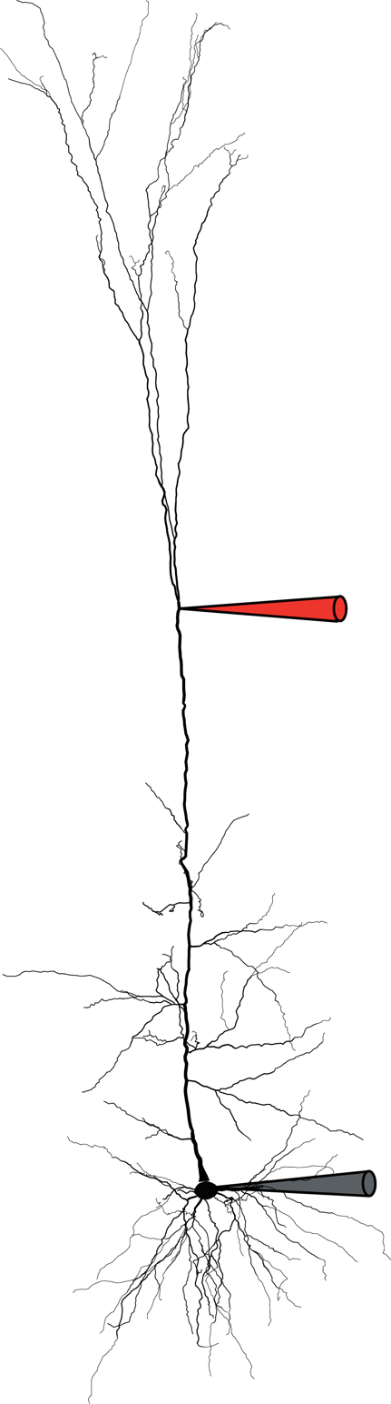
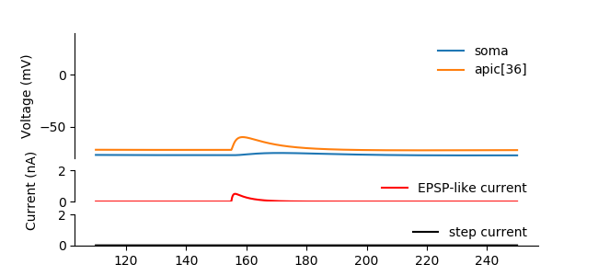
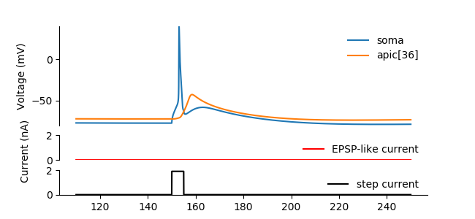

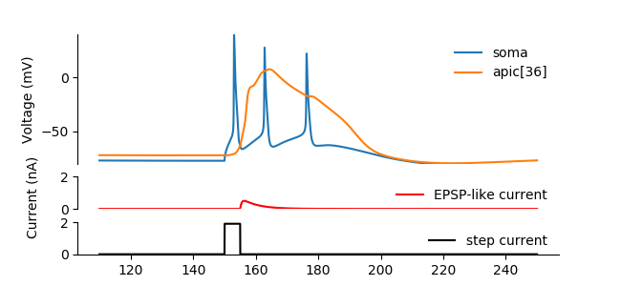

# Only EPSP-like current
syn.imax = 0.5
stim.amp = 0
h.run();
plot_result(...)
# Only small step current
syn.imax = 0
stim.amp = 1.9
h.run();
plot_result(...)
Recording
# both currents
syn.imax = 0.5
stim.amp = 1.9
h.run()
plot_result(...);
5_calcium_spike_Hay_et_al.ipynb
“Models of Neocortical Layer 5b Pyramidal Cells Capturing a Wide Range of Dendritic and Perisomatic Active Properties”, Etay Hay , Sean Hill, Felix Schürmann, Henry Markram, Idan Segev. PLOS Computational Biology, 2011

Slide 11
Layer 5b Pyramidal Cell
# place a single synapse
syn_loc = rng_pos.repick() apical_exc_syns.append(h.ProbAMPANMDA_EMS(sec(syn_loc)))
# create random stim. times
apical_exc_netstims.append(h.NetStim())
apical_exc_netstims[-1].number = t_stop / 1000 * exc_freq
apical_exc_netstims[-1].interval = 1000 / exc_freq # ms
apical_exc_netstims[-1].noise = 1 # make it Poisson like
# connect stimulator to the synapse
apical_exc_netconns.append(h.NetCon(apical_exc_netstims[-1], apical_exc_syns[-1]))
apical_exc_netconns[-1].weight[0] = gsyn_exc
6_random_synapses_Hay.ipynb

Slide 12
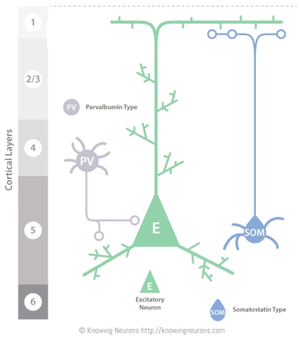
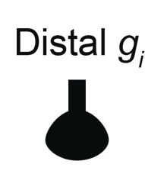

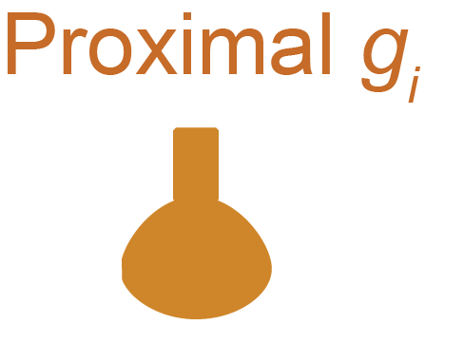

Inhibition location
+1_inhibition_location_Gidon_et_al.ipynb
“Principles Governing the Operation of Synaptic Inhibition in Dendrite” Albert Gidon, Idan Segev. Neuron, 2012

Slide 13
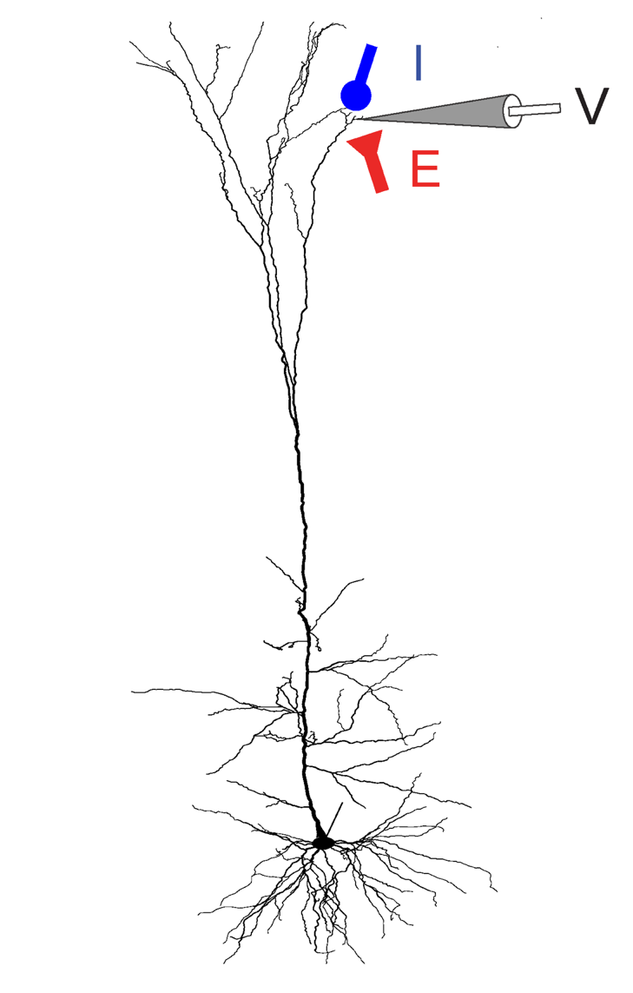
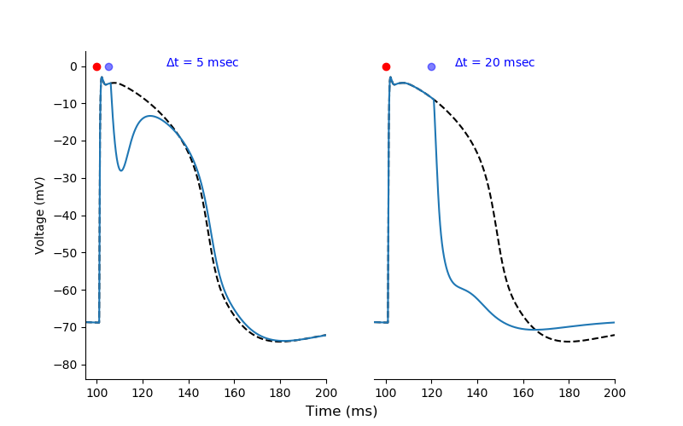
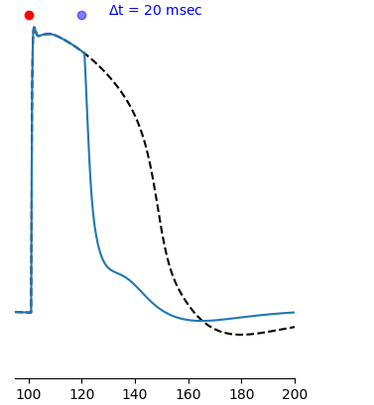
Timed inhibition
+2_timed_inhibition_Doron_et_al.ipynb
“Timed Synaptic Inhibition Shapes NMDA Spikes, Influencing Local Dendritic Processing and Global I/O Properties of Cortical Neurons” Michael Doron, Giuseppe Chindemi, Eilif Muller, Henry Markram, Idan Segev. Cell Reports, 2017

Slide 14
Useful links
NEURON documentation: https://www.neuron.yale.edu/neuron/static/new_doc/index.html
MOOC: https://www.edx.org/course/simulation-neuroscience#
ModelDB (repo of published models): https://senselab.med.yale.edu/ModelDB/
NeuroMoprho (morphologies): https://neuromorpho.org/
ChannelPedia (ion channels): https://channelpedia.epfl.ch/
NetPyNE (modelling networks of neurons): http://netpyne.org/
CoreNEURON (faster NEURON execution): https://github.com/BlueBrain/CoreNeuron

