Slide 1
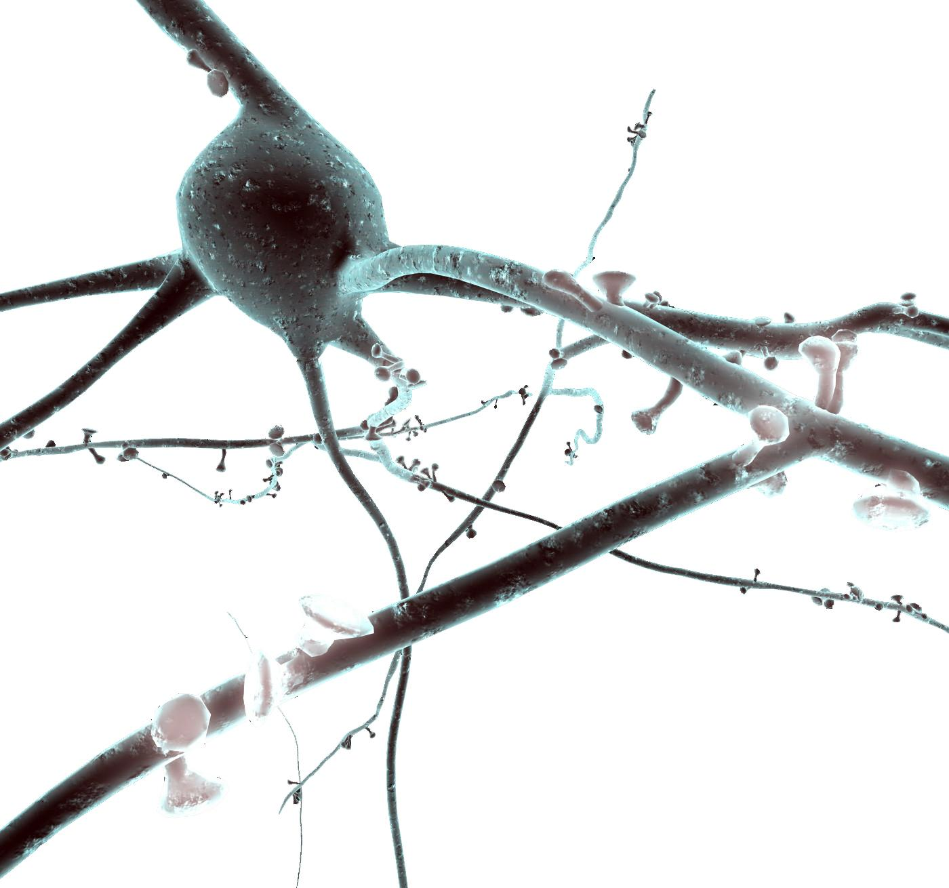
Using NEURON to model cells Tutorial
Oren Amsalem, Yoni Leibner, and András Ecker
oren.amsalem1@mail.huji.ac.il, yoni.leibner@mail.huji.ac.il
andras.ecker@epfl.ch
Idan Segev Lab and the Blue Brain Project

Slide 2
Introduction
The NEURON Simulation Environment is designed for modeling individual neurons and networks of neurons.
It is particularly well-suited to explore problems which are closely linked to experimental data.
NEURON was build and is maintained by Ted Carnevale and Michael Hines, lately the Blue Brain Project is becoming heavily involved with the development of the software
Neuron is written in C & C++, the interface with the simulator is with HOC, but a python wrapper was build and now commonly used instead of HOC (NEURON is used as a python package). In addition User-defined mechanisms such as voltage- and ligand-gated ion channels are used in order to expand NEURON (mod files, need to be compiled).
In this presentation we will show the following examples:
Single compartment model
Ball and Stick model and a replication of a published result (Gidon et al.)
Layer 5 Pyramidal cell and two replications of published results (Hay et al., Doron et al.)

Slide 3
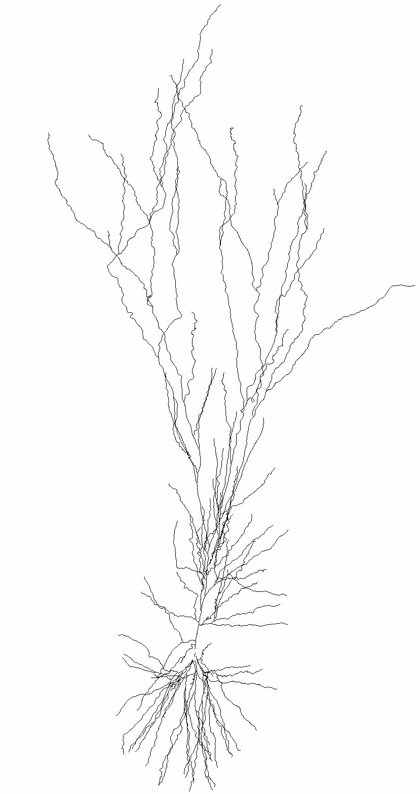
Introduction
Read More About NEURON
Basic concepts of Neuron models:
Model - a Neuron object, it can have soma, basal dendrites (dend) and apical dendrite (apic).
Section - more of a morphological definition, a section is usually a dendrite between 2 bifurcation points.
Segment - one RC circuit that resemble (approximate) the computation in a piece of membrane.
Clamps - an object that represent an experimental electrode.
Synapses - object that resemble a single synapse (we will see it later, and how it’s activated in the simulation).
Point Process - a more general idea, it’s an object that seats on the segment (RC circuit), and simulate a channel or synapse.

Slide 4
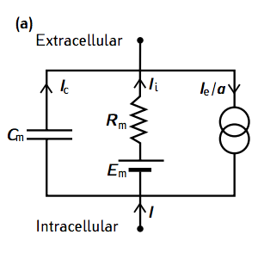
Single compartment neuron - single RC circuit
from neuron import h, gui
# create model
Soma = h.Section(name="soma")
soma.L = 10 # length µm
soma.diam = 10 # diameter µm
soma.insert('pas’). # add passive properties
soma.g_pas = 1/10000 # set the specific membrane
resistance to 10000 ohm*cm^2
# current current clamp
stim = h.IClamp(soma(0.5))
stim.delay = 20. # start of the current injection (ms)
stim.dur = 100 # duration (ms)
stim.amp = 0.01 # amplitude (nA)
0_soma_passive.ipynb

Slide 5
Single compartment neuron - recording
# record injected current soma voltage (and time)
soma_v = h.Vector()
soma_v.record(soma(0.5)._ref_v)
stim_current = h.Vector()
stim_current.record(stim._ref_i)
t = h.Vector()
t.record(h._ref_t)
# run simulation
h.tstop = 220 # simulation time (ms)
h.dt = 0.025.
h.v_init = -70. # initial voltage (mV)
h.run()
Notes:
Exercise: Inject different currents to the neuron and create a figure like this one: http://www.jneurosci.org/content/jneuro/21/3/1067/F8.large.jpg

Slide 6
Single compartment neuron - synapse
# add a synapse
synapse = h.Exp2Syn(soma(0.5))
synapse.tau1 = 0.3 # rise time constant
synapse.tau2 = 1.8 # decay time constant
Stim = h.NetStim()
stim.number = 1
stim.noise = 0 # no noise
stim.interval = 1
net_con = h.NetCon(stim, synapse)
net_con.weight[0]= 0.0004 # the maximal conductance of the synapse
Notes:
Exercise:
Inject different currents to the neuron and create a figure like this one: http://www.jneurosci.org/content/jneuro/21/3/1067/F8.large.jpg

Slide 7
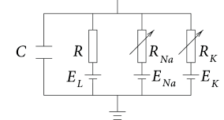
Single compartment neuron – active conductances
from neuron import h, gui
# create model
Soma = h.Section(name="soma")
soma.L = 10 # length µm
soma.diam = 10 # diameter µm
soma.insert("pas"). # add passive properties
soma.g_pas = 1/10000 # set the specific membrane
resistance to 10000 ohm*cm^2
soma.insert(”kv") # add potassium channel
(from a mod file)
soma.gbar_kv = 2000 # set the potassium conductance
soma.insert(”na") # add sodium channel (from a mod file)
soma.gbar_na = 8000 # set the sodium conductance
h.celsius = 30. # set temperature
1_soma_active.ipynb
Notes:
The goal here is to see how simple RC circuit is behaving

Slide 8
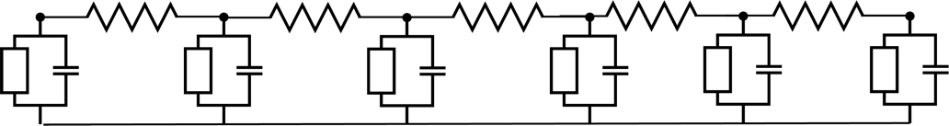
Moving towards the cable model
# create dendrite
dend = h.Section(name=”dend")
dend.L = 500 # um
dend.diam = 1 # um
dend.Ra = 100 # ohm*cm
dend.insert(”pas")
dend.g_pas = 1/10000
dend.connect(soma, 1, 0). # connect the end of
The dendrite to the beginning of the soma
h"forall { nseg = int((L/(0.1*lambda_f(100))+0.9)/2)*2 + 1 }")
# set the number of segments
Dendrite
dend(0.1).v
dend(0.4).v
Dendrite
synaptic input
2_soma_dend_step_current.ipynb
3_soma_dend_synapse.ipynb
Note: d_lambda rule – NEURON book p50

Slide 9
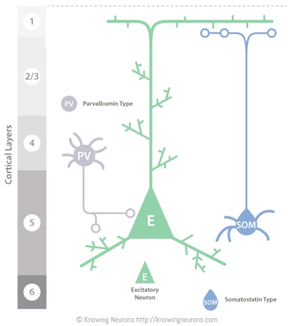
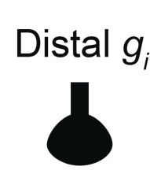

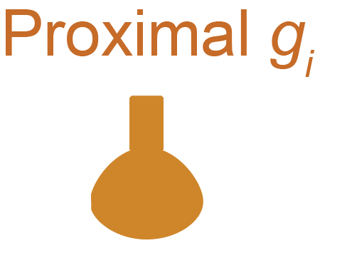

Inhibition location
4_inhibition_location_Gidon_et_al.ipynb
“Principles Governing the Operationof Synaptic Inhibition in Dendrite” Albert Gidon, Idan Segev. Neuron, 2012

Slide 10
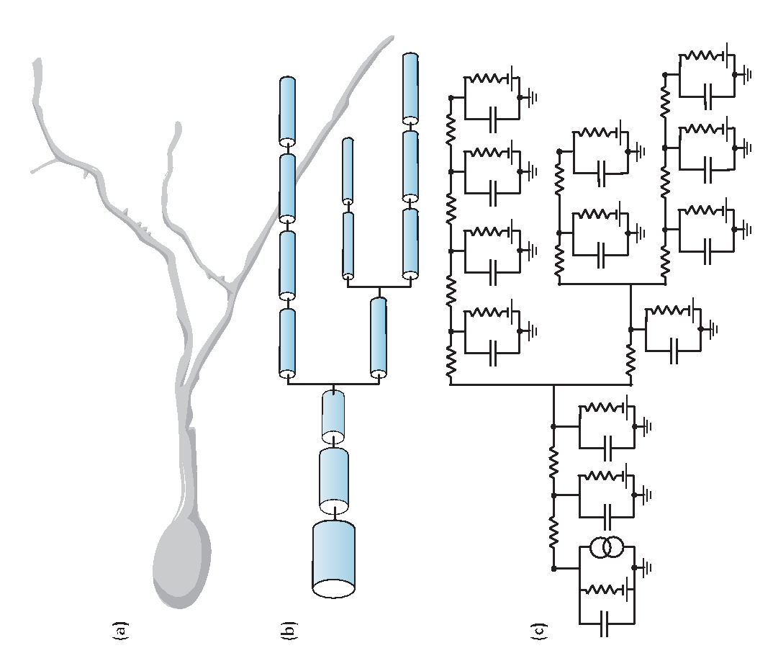
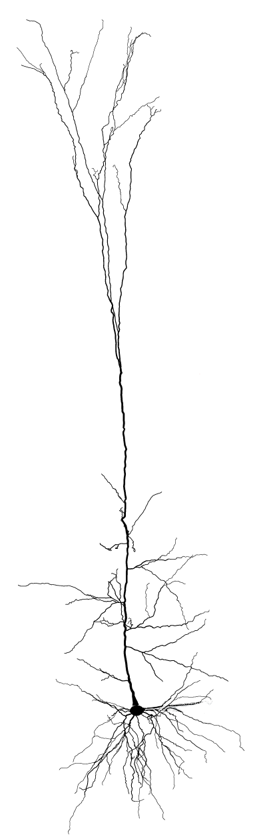
Layer 5b Pyramidal Cell
from neuron import h, gui
# instantiating cell
h.load_file("import3d.hoc")
h.load_file("models/L5PCbiophys3.hoc")
h.load_file("models/L5PCtemplate.hoc")
morph_fname = "morphologies/cell1.asc"
L5PC = h.L5PCtemplate(morph_fname )
6_L5_PC_Hay_et_al.ipynb
“Models of Neocortical Layer 5b Pyramidal Cells Capturing a Wide Range of Dendritic and Perisomatic Active Properties”, Etay Hay , Sean Hill, Felix Schürmann, Henry Markram, Idan Segev. PLOS Computational Biology, 2011
Notes:
how do we make our model to react in the same way realty does?

Slide 11
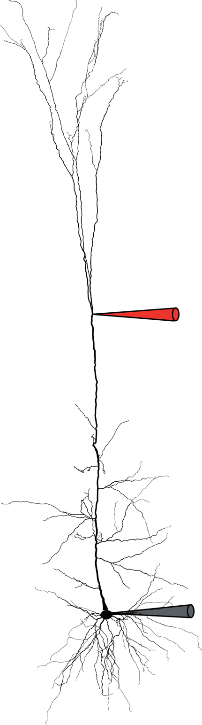
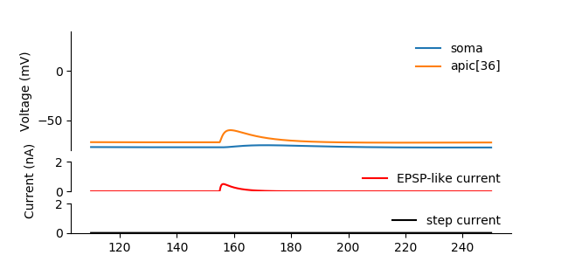
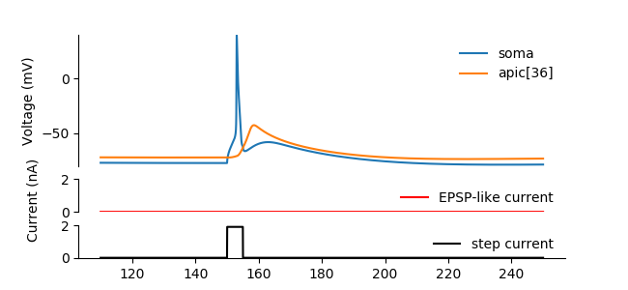

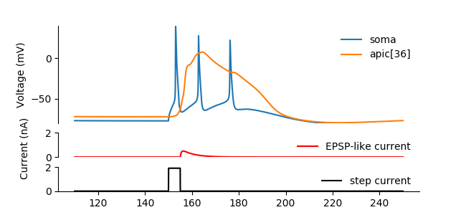

# Only EPSP-like current
syn.imax = 0.5
stim.amp = 0
h.run();
plot_result(...)
# Only small step current
syn.imax = 0
stim.amp = 1.9
h.run();
plot_result(...)
Recording
# both currents
syn.imax = 0.5
stim.amp = 1.9
h.run()
plot_result(...);
7_calcium_spike_Hay_et_al.ipynb
“Models of Neocortical Layer 5b Pyramidal Cells Capturing a Wide Range of Dendritic and Perisomatic Active Properties”, Etay Hay , Sean Hill, Felix Schürmann, Henry Markram, Idan Segev. PLOS Computational Biology, 2011
Notes:
Exercise:
Add a synapse to a random location on the neuron (use the GUI) and check what is the epsp that is creates.
Add more synapses to a random locations on the neuron (use the GUI) and check how many synapses are needed to make the neuron fire a spike

Slide 12
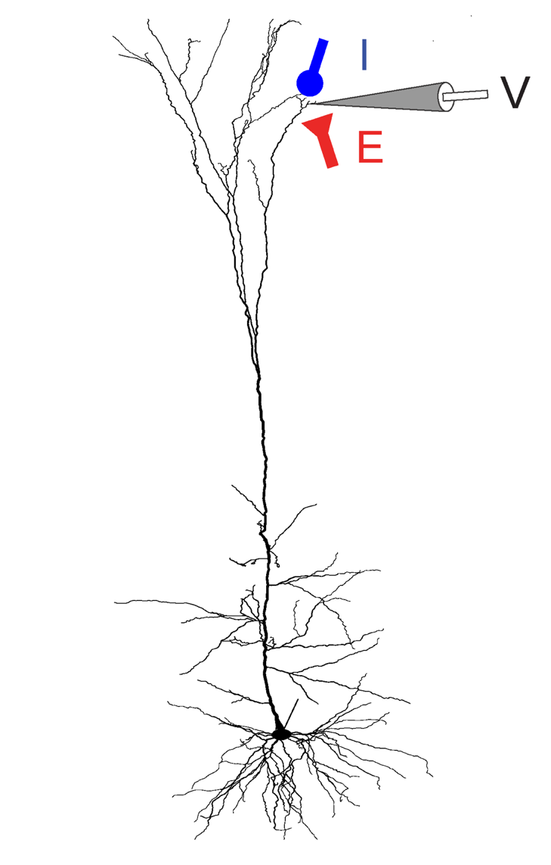
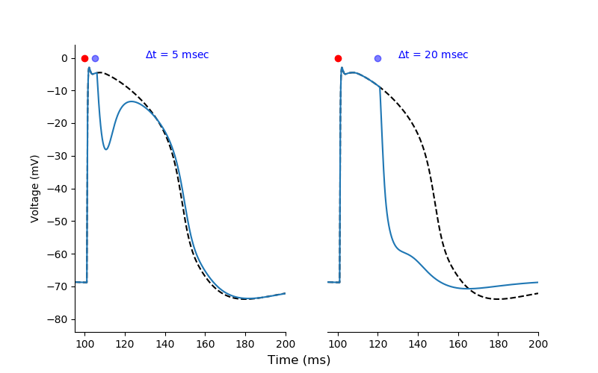
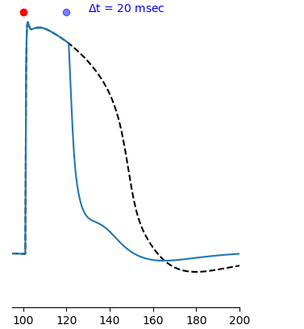
Timed inhibition
8_timed_inhibition_Doron_et_al.ipynb
“Timed Synaptic Inhibition Shapes NMDA Spikes, Influencing Local Dendritic Processing and Global I/O Properties of Cortical Neurons” Michael Doron, Giuseppe Chindemi, Eilif Muller, Henry Markram, Idan Segev. Cell Reports, 2017

