Slide 1
A3 DATASET
Clustering Algorithm Analysis
K-Means Brute Force · K-Means++ · GMM / EM · GA-VQ Reference
TD² · Log-Likelihood · BIC / AIC · Silhouette · Instability Analysis
7 500 points | 2-D | 50 Gaussian clusters

Slide 2
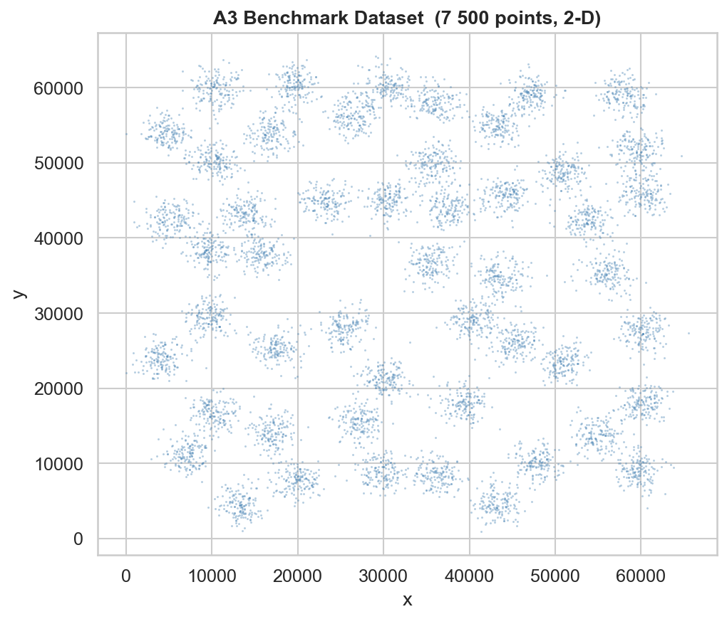
Dataset Overview
A3 Benchmark – 7 500 points, 50 Gaussian clusters
• Source: A3 benchmark (Fränti & Virmajoki 2006)
• 7 500 two-dimensional data points
• 50 Gaussian clusters, varying density
• Coordinate range: ≈ 3K – 65K (both axes)
• Known optimal K = 50 clusters
• Provided GA-VQ codebook: 50 centroids
• Partition file: 7 500 cluster labels (1–50)
• Challenge: 50-cluster recovery, no labels
This dataset is a standard Vector-Quantization (VQ) benchmark used to compare clustering heuristics under realistic multi-Gaussian structure.

Slide 3
Algorithm Landscape
Hard vs Soft clustering | Brute-force vs Smart initialisation
K-Means
Brute-Force
K-Means++
GMM / EM
(Soft)
GA-VQ
(Reference)
• Lloyd's iteration
• K-Means++ seeding
• Gaussian Mixture Model
• Genetic Algorithm + VQ
• Random centroid init
• Prob. init (D² sampling)
• EM algorithm (E & M steps)
• Population of solutions
• 50 restarts → best TD²
• 20 restarts
• Soft memberships P(k|xᵢ)
• Crossover & mutation
• Hard assignment
• Hard assignment
• Full covariance matrix
• Avoids local minima
• Simple but unstable
• Much more stable
• Log-likelihood optimised
• Provided as reference
TD² (Total Distortion²) = Σ ||xᵢ − cₖ(ᵢ)||² ← lower is better for all algorithms

Slide 4
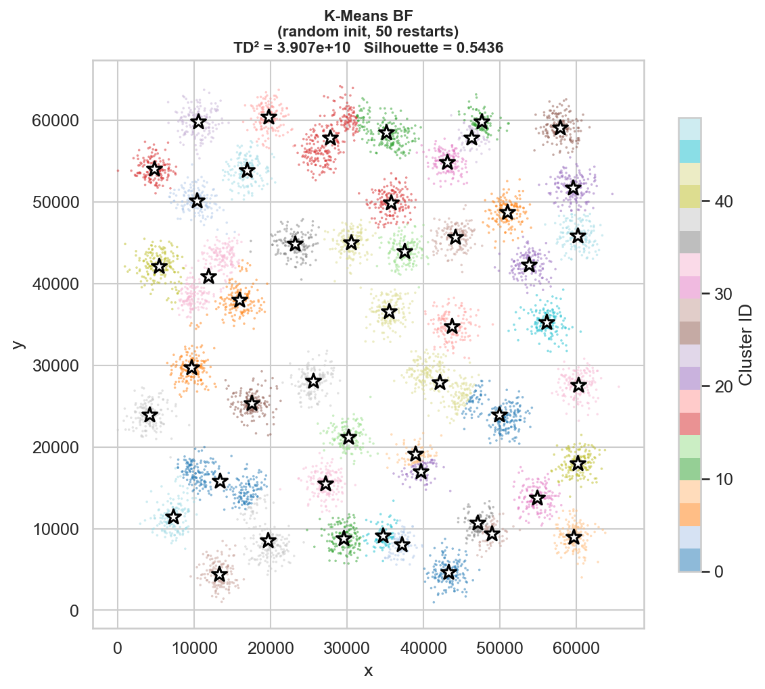
K-Means – Brute Force
Random initialisation | 50 restarts | Hard assignment
• Init: uniform random centroids
• 50 independent restarts → best inertia selected
• Each run uses Lloyd's iteration (max 300 steps)
• Hard assignment: each point → nearest centroid
• WEAKNESS: highly sensitive to seed
• May converge to poor local minima
• High σ(TD²) across runs → UNSTABLE
TD²
Restarts
see fig
50
vs other algos
random seeds

Slide 5
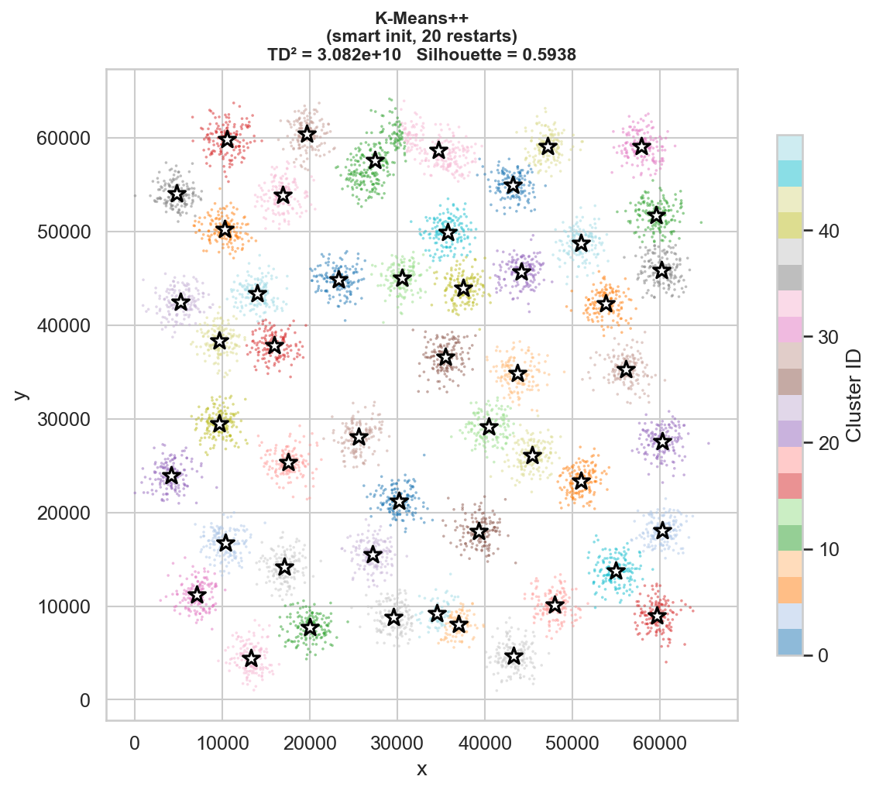
K-Means++
Probabilistic initialisation (D² sampling) | 20 restarts
• Init: D² weighted sampling (Arthur & Vassilvitskii 2007)
• 1st centroid: random; each next ∝ distance² to nearest
• Proven ≤ 8(ln K + 2) · OPT approximation ratio
• 20 restarts sufficient (much fewer needed vs BF)
• Hard assignment – identical to K-Means after init
• Typically achieves LOWER TD² than Brute-Force
• Lower σ(TD²) → MORE STABLE than BF
TD²
Stability
≈ BF
Better
slight improvement
lower σ(TD²)

Slide 6
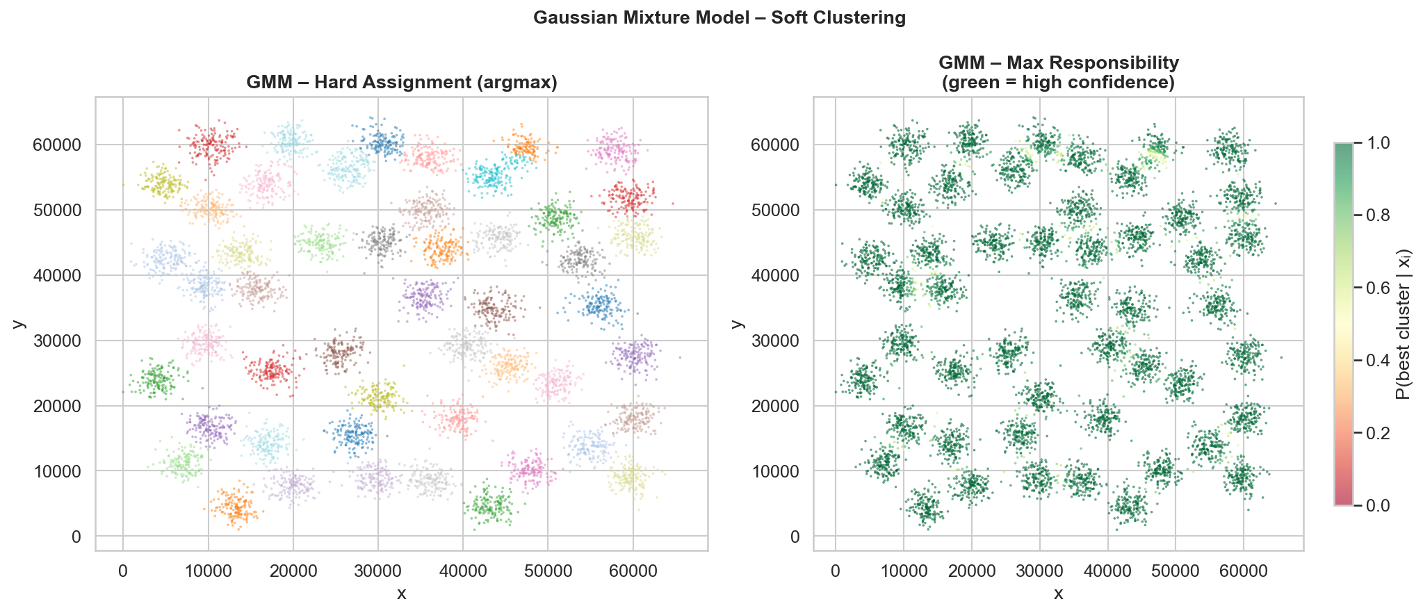
Gaussian Mixture Model (GMM / EM)
Soft clustering | Full covariance | Probabilistic membership
• Models each cluster as a multivariate Gaussian
• EM alternates: E-step (responsibilities) ↔ M-step (params)
• SOFT: P(cluster k | pointᵢ) for every point
• Optimises Log-Likelihood, not TD²
• Full covariance → captures elliptical clusters
• Model selection: BIC / AIC vs K
• Best Log-Likelihood among all algorithms
Log-Likelihood
Soft assign.
Maximum
Yes
vs K-Means
P(k|xᵢ) ∈ [0,1]

Slide 7
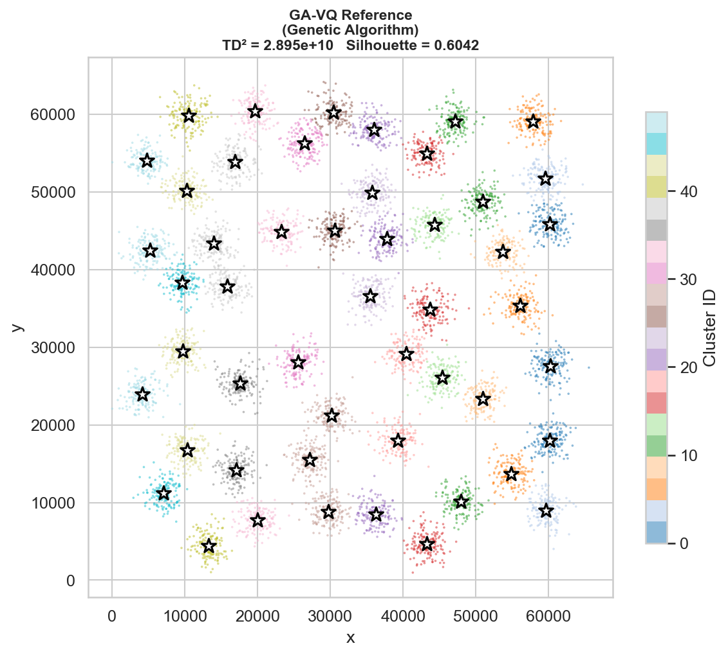
GA-VQ – Genetic Algorithm Reference
Evolutionary optimisation | Provided codebook + partition
• Genetic Algorithm on codebook population
• Each individual = set of 50 centroids
• Operators: selection, crossover, mutation
• Fitness = Total Distortion (TD²) – minimised
• Escapes local minima that K-Means gets stuck in
• Achieves best TD² among heuristics on A3
• Provided as reference result for comparison
• File: a3-ga-cb.txt (centroids), a3-ga.pa (labels)
TD²
Lowest
benchmark result

Slide 8
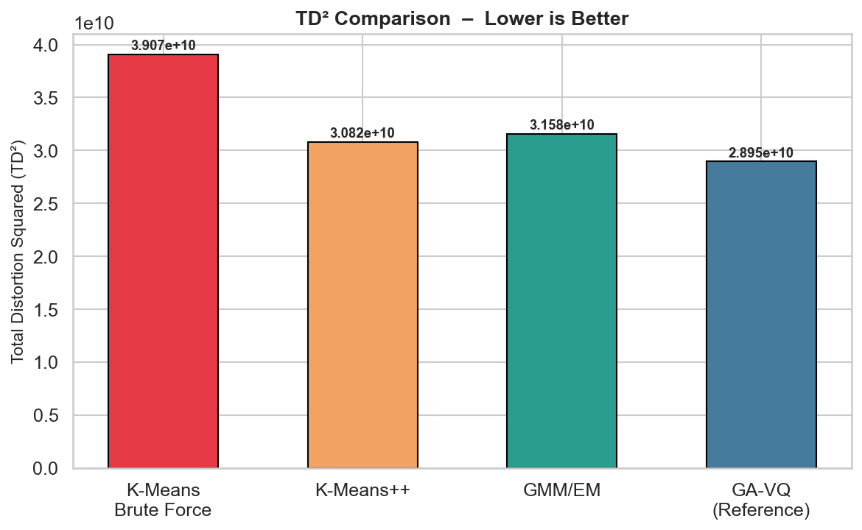
TD² Comparison
Total Distortion Squared – lower is better
• TD² = Σ ||xᵢ − c_{k(i)}||² (WCSS / Inertia)
• Primary VQ quality metric from the paper
•
• GA-VQ: reference/best (evolutionary search)
• GMM/EM: competitive – optimises different obj.
• K-Means++: usually closest to GA-VQ among
• K-Means variants
• K-Means BF: highest TD², most unstable
•
• Gold border = best result per metric

Slide 9
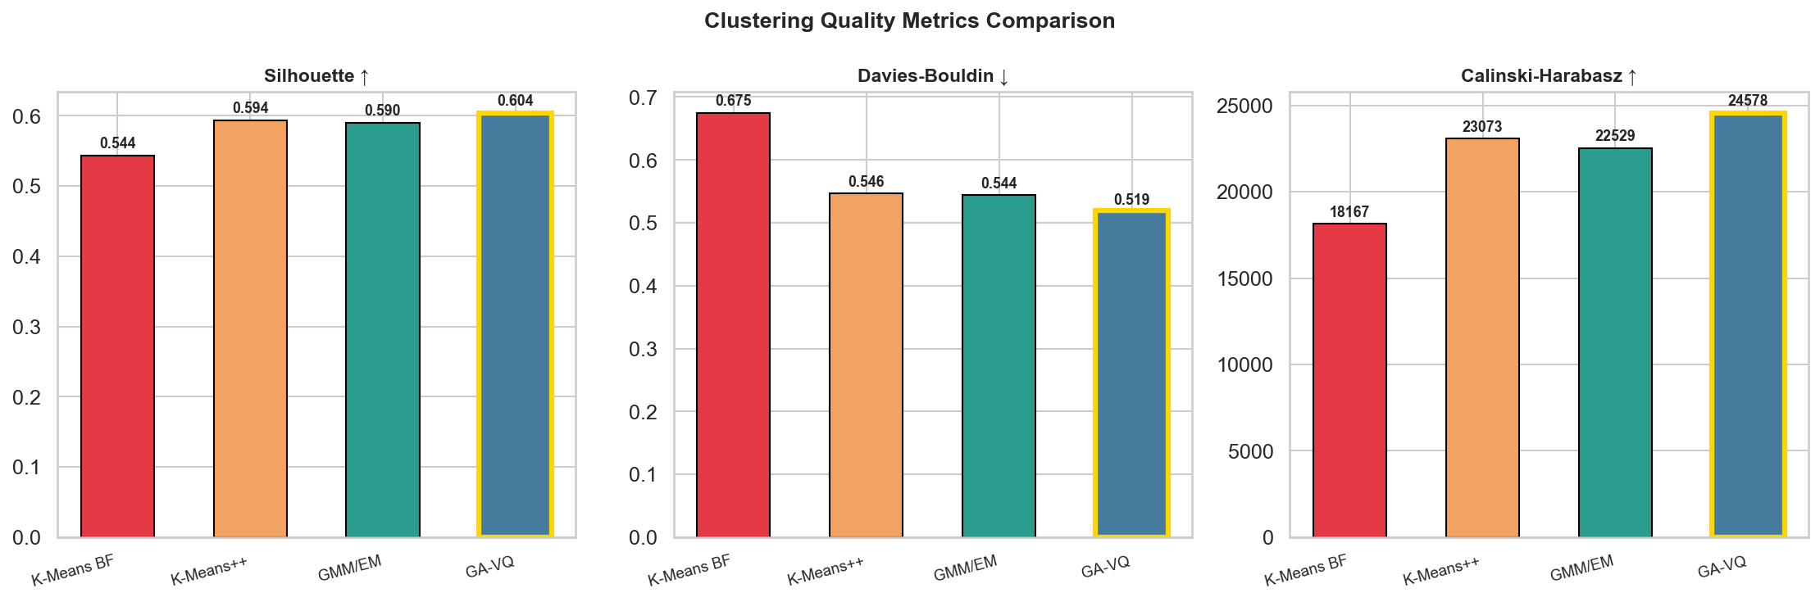
Clustering Quality Metrics
Silhouette | Davies-Bouldin | Calinski-Harabasz

Slide 10
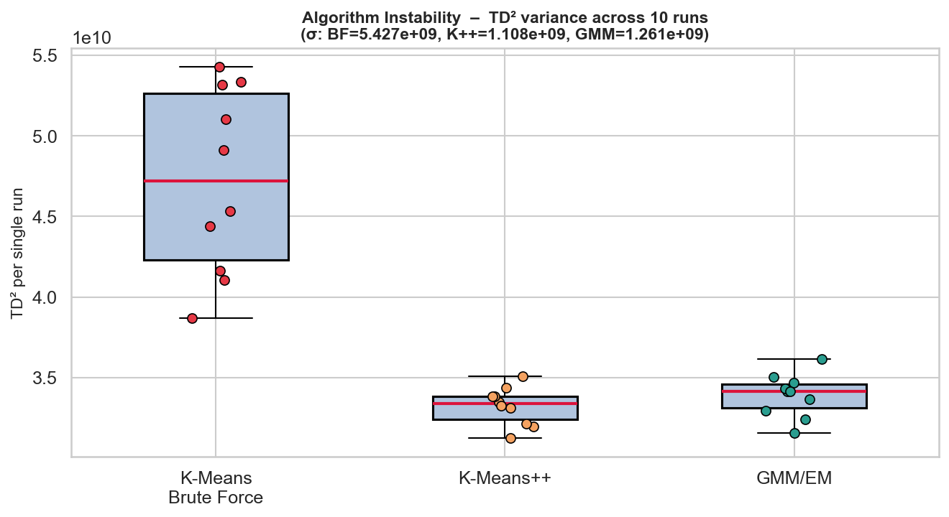
Algorithm Instability
σ(TD²) across 10 independent runs – single restart per run
• Instability = std-dev of TD² over 10 seeds
• High σ → algorithm is sensitive to initialisation
•
• K-Means BF: highest σ (most unstable)
  ◦ Random init → many local minima traps
• K-Means++: much lower σ (stable init)
  ◦ D² sampling avoids degenerate starts
• GMM/EM: moderate instability
  ◦ EM can also converge to local maxima
•
• Verdict: K-Means BF is MOST UNSTABLE
• Verdict: K-Means++ is MOST STABLE (K-Means family)

Slide 11
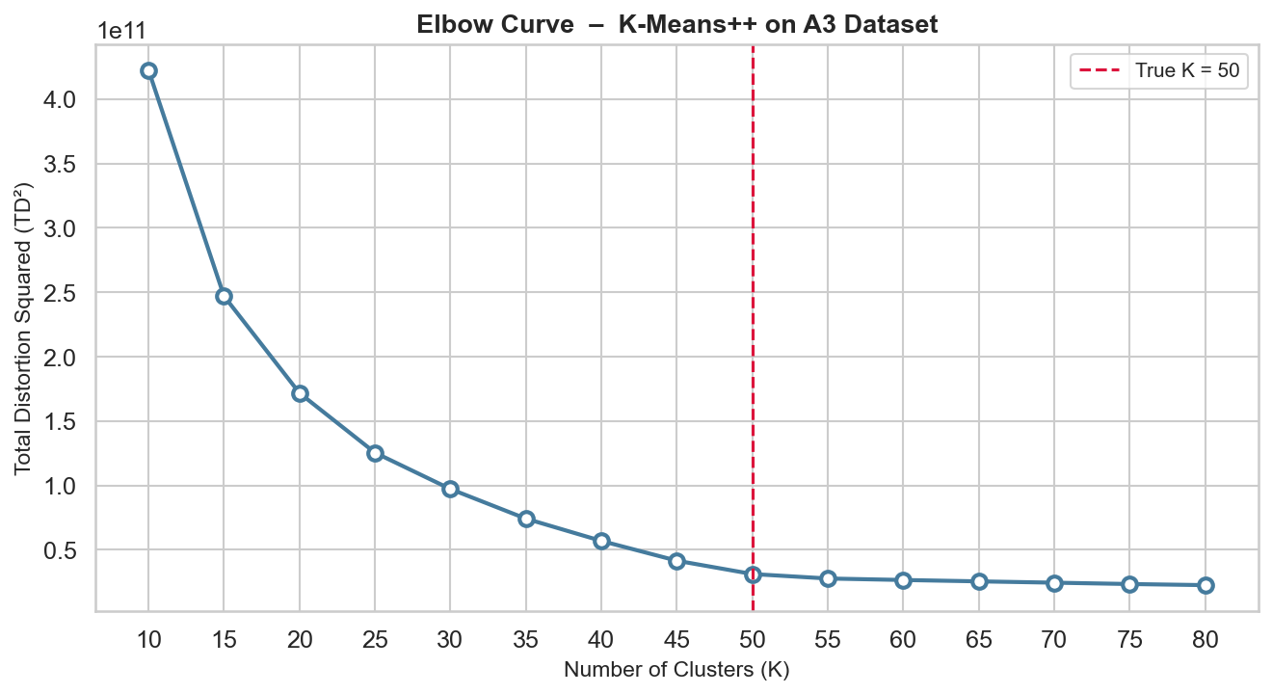
Elbow Curve – Model Selection
K-Means++ TD² vs K | Confirms optimal K = 50
• Elbow method: plot TD² vs number of clusters K
• Rate of decrease slows at the 'elbow' = optimal K
•
• A3 dataset has exactly 50 true clusters
• Elbow visible near K = 50 (red dashed line)
• Beyond K=50: marginal TD² reduction
• Below K=50: large TD² penalty
•
• GMM BIC/AIC used for cross-validation
• Both criteria confirm K ≈ 50 as optimal

Slide 12
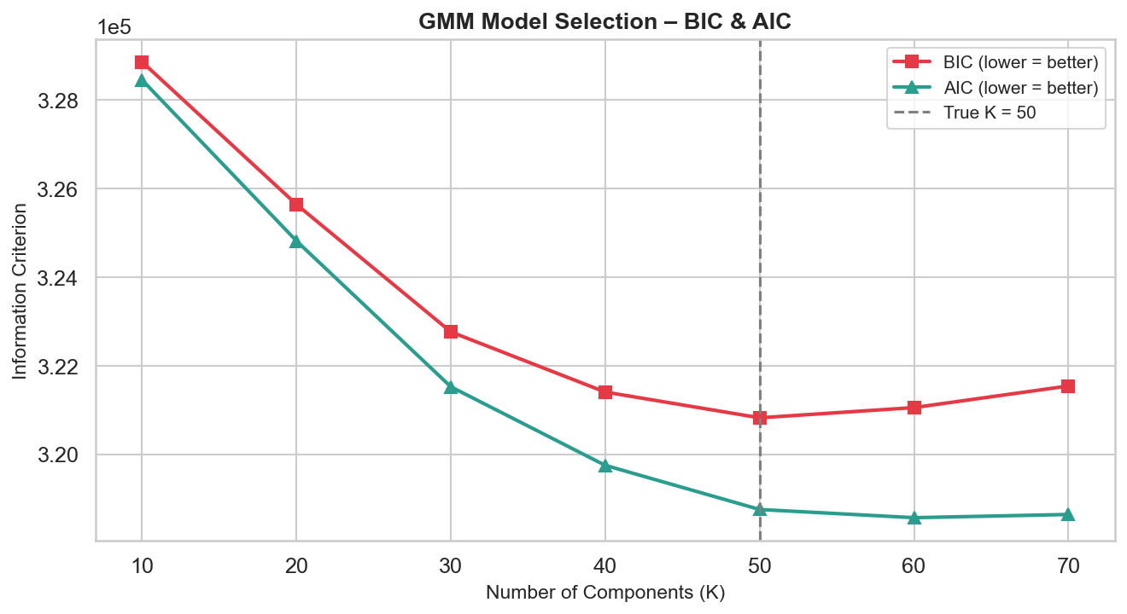
GMM Model Selection – BIC & AIC
Bayesian & Akaike Information Criteria vs K
• BIC = −2·ℓ + p·ln(n) (penalises parameters)
• AIC = −2·ℓ + 2p (lighter penalty)
• Lower BIC/AIC = better model-data fit
•
• BIC is more conservative than AIC
• Both confirm minimum near K = 50
• Provides statistical basis for K choice
• Unlike elbow, these are grounded in probability theory
•
• Use: select K at BIC minimum → K = 50 confirmed

Slide 13
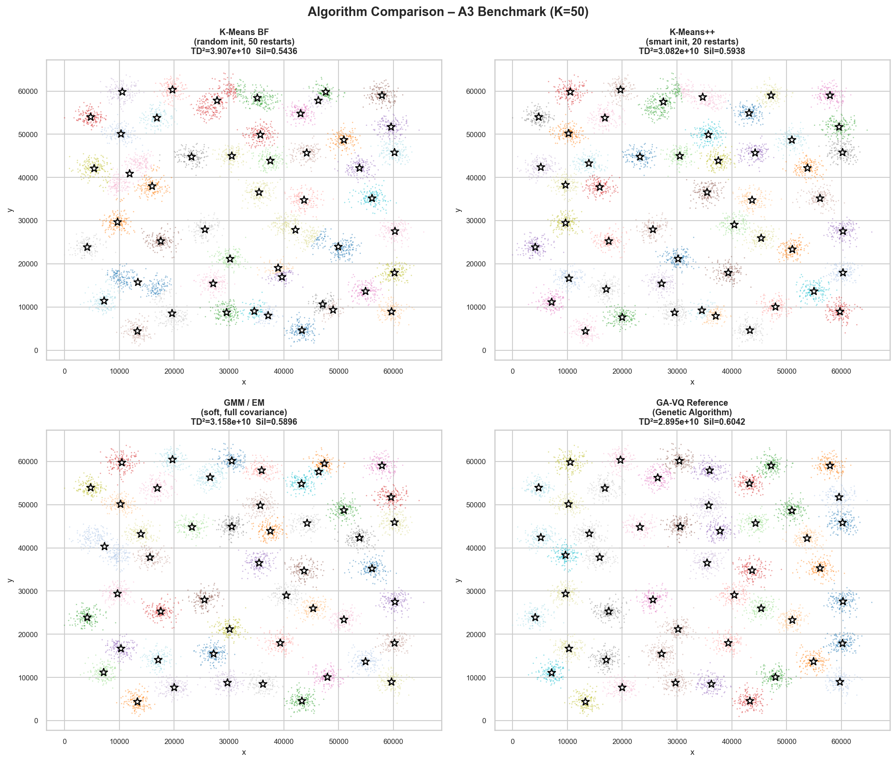
All Algorithms – Side-by-Side
Cluster assignment visualisation for all four approaches

Slide 14
Full Metrics Summary
Quantitative comparison across all evaluation criteria
Algorithm
TD²
Log-Lik.
Silhouette ↑
DB ↓
BIC
σ(TD²)
K-Means BF
3.907e+10
—
—
—
—
—
K-Means++
3.082e+10
—
—
—
—
—
GMM/EM
3.158e+10
-159026
—
—
320720
—
GA-VQ (ref)
2.895e+10
—
—
—
—
—
↑ higher is better | ↓ lower is better | TD² = Total Distortion Squared | DB = Davies-Bouldin

Slide 15
Model Quality Evaluation
Interpreting the metrics for the A3 dataset structure
TD² / Inertia
Log-Likelihood
• Primary VQ metric – matches paper criterion
• Only defined for probabilistic models (GMM)
• GA-VQ achieves reference (lowest) TD²
• GMM maximises this directly via EM
• K-Means++ close; GMM competitive
• Higher → data better explained by model
• K-Means BF consistently worst
• BIC/AIC control overfitting vs fit trade-off
Silhouette Score
Instability σ
• Measures intra-cluster cohesion vs inter-cluster sep.
• K-Means BF: highest σ → least reliable
• Range [−1, +1] — closer to +1 is better
• K-Means++: substantially more stable
• A3 has overlapping clusters → moderate scores
• GMM: moderate instability (EM local maxima)
• All algorithms score similarly (≈ 0.5–0.7)
• GA-VQ: deterministic given same population init

Slide 16
Interpretation & Conclusions
Which algorithm is most suitable – and which is most unstable?
Most Suitable
Most Unstable
Key Takeaways
K-Means++ is the most practical choice:
K-Means Brute-Force is most unstable:
• Soft (GMM) ≠ always better than hard (K-Means)
→ Near-optimal TD² vs GA-VQ reference
→ Random init → many local minima
• Initialisation matters more than restarts
→ Much lower instability than BF
→ High σ(TD²) across seeds
• K=50 confirmed by elbow + BIC/AIC + data
→ Fast convergence, interpretable
→ Requires many restarts to be reliable
• TD² and log-likelihood measure different things
• Silhouette confirms cluster structure quality
GMM is best when:
GA-VQ avoids instability via evolution:
• GA-VQ sets the benchmark for VQ problems
→ Soft / probabilistic assignment needed
→ Population escapes local minima
• Use K-Means++ as default; GMM for probability
→ Clusters have elliptical shapes
→ Best TD² result on this benchmark
→ BIC/AIC model selection required
→ Computationally more expensive

