Slide 1

MVA PROJECT: Banking
Andreja Andrejic, David Candela, Nayara Costa, Julie Oppedal, Alexandros Tremopoulos

Slide 2
1.Introduction

Slide 3

Data
The Bank Marketing dataset compiles call information from a Portuguese banking institution with the objective of predicting whether a client will subscribe to a term deposit.
- 4521 records in the sample (bank.csv)
- 17 total variables

Slide 4
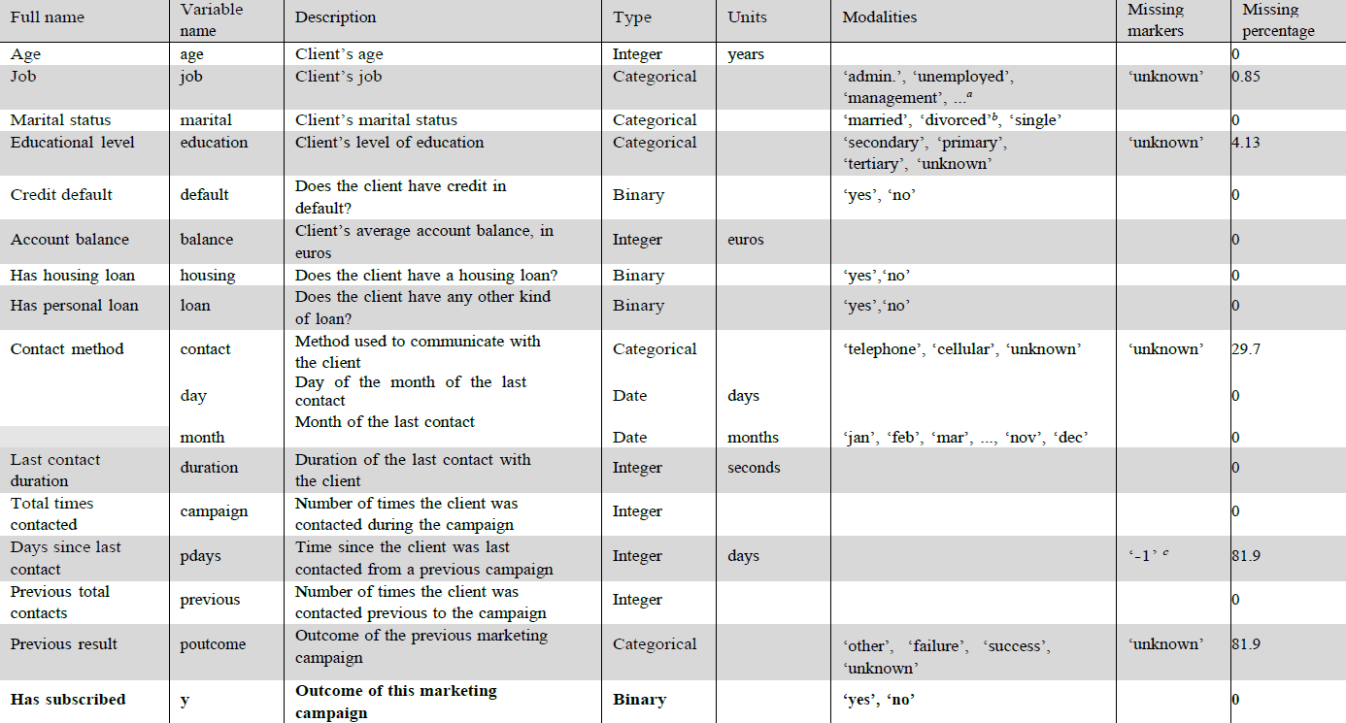

Slide 5
2.1 Preprocessing

Slide 6
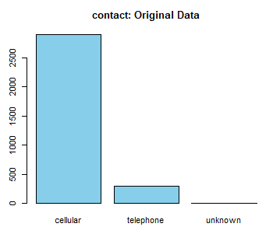
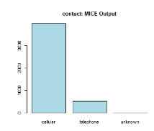
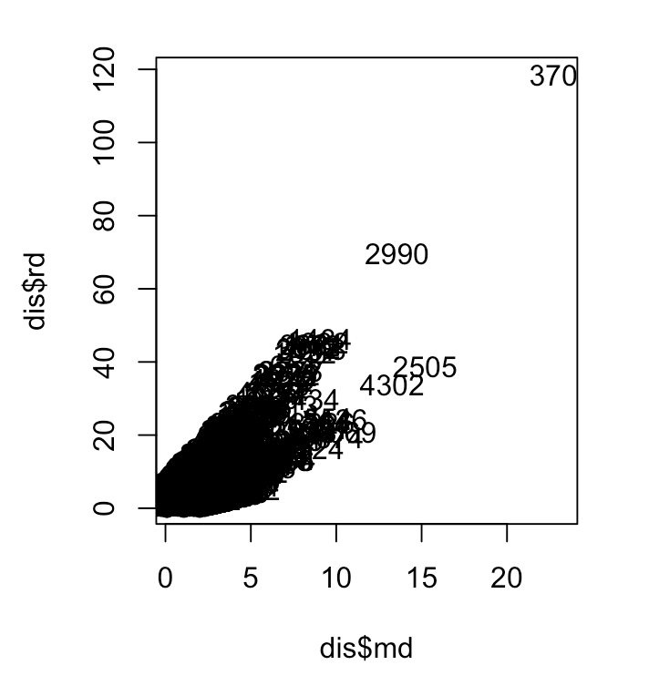
Missing Values
Outliers
pdays’ dropped -> almost 82% with -1.
Impute ‘contact’ with MICE.
Original : cellular ->90,58% , telephone -> 9.41%.
MICE. Original: cellular ->90,68%, telephone -> 9.31%
Univariate, Mahalanobis distance, Adjusted Chi-Square Q-Q plot, Local Outlier Factor (LOF)

Slide 7
3.Descriptive Analysis

Slide 8
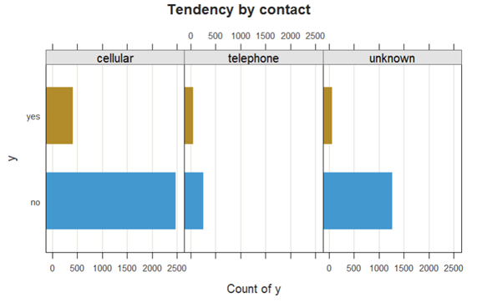
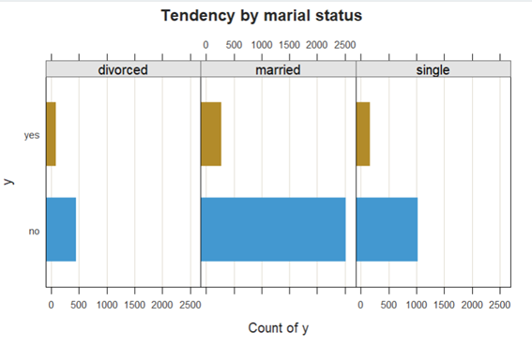
Analysis of categorical features

Slide 9
4.PCA Analysis

Slide 10
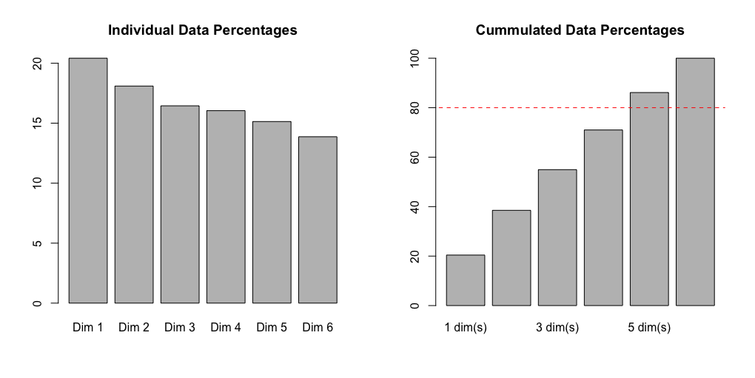
Choosing the number of dimensions

Slide 11
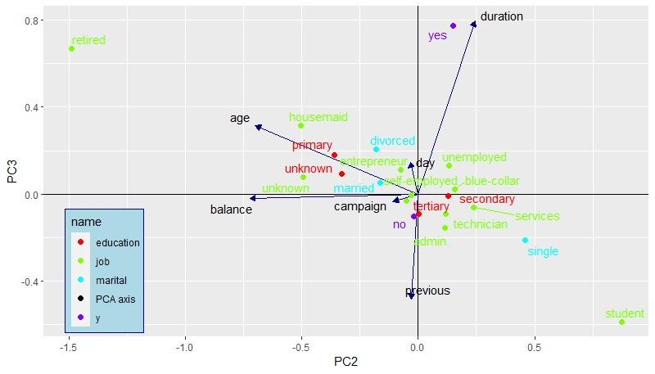
PCA plot 1

Slide 12
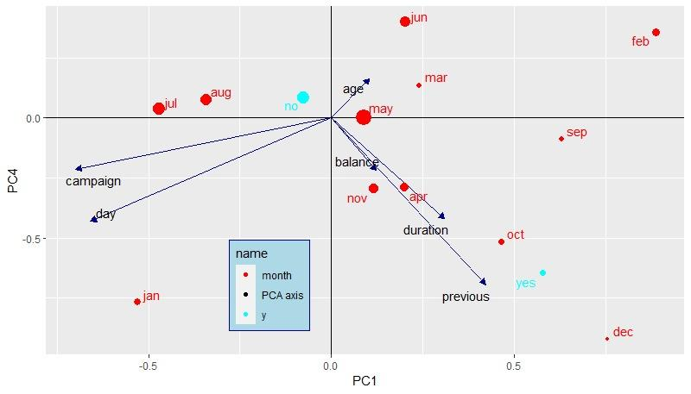
PCA plot 2

Slide 13
5.MCA Analysis

Slide 14
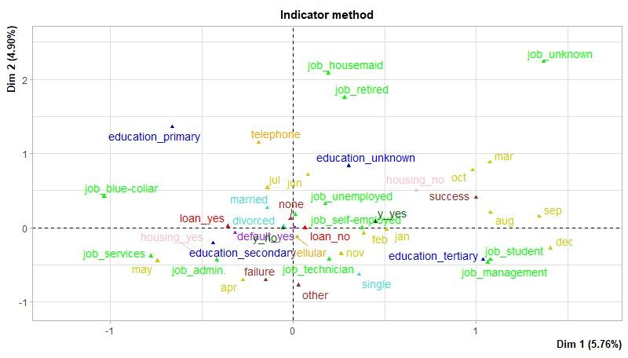
MCA plot

Slide 15
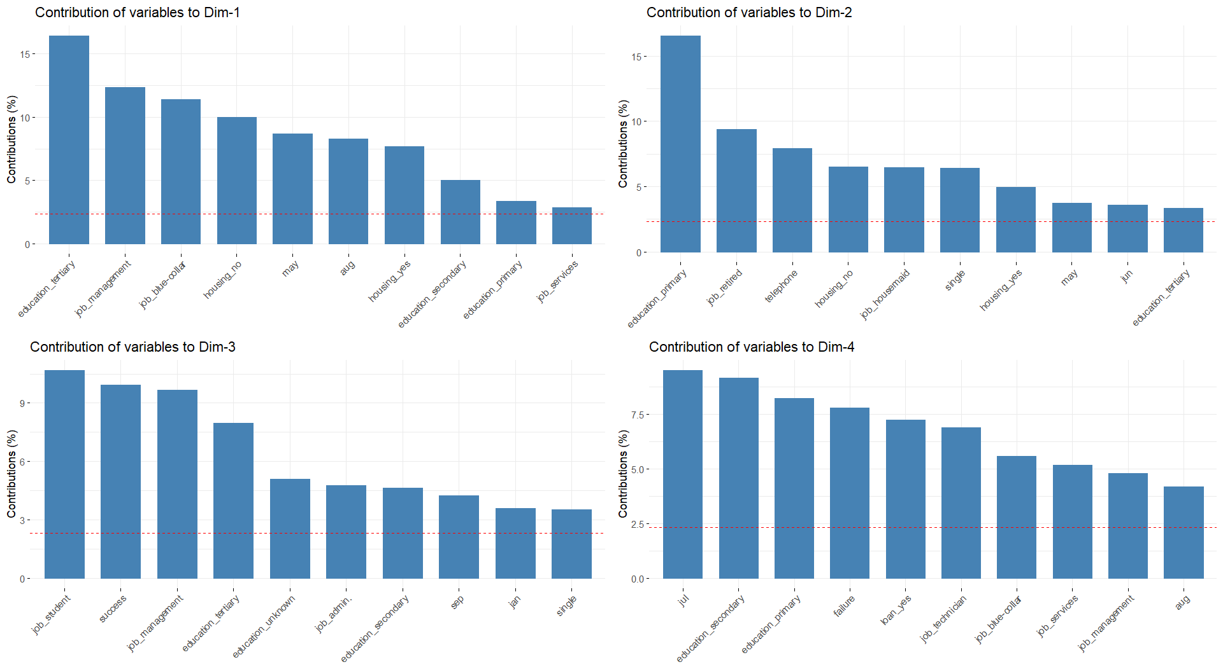
Contribution

Slide 16
6.Association Rules

Slide 17
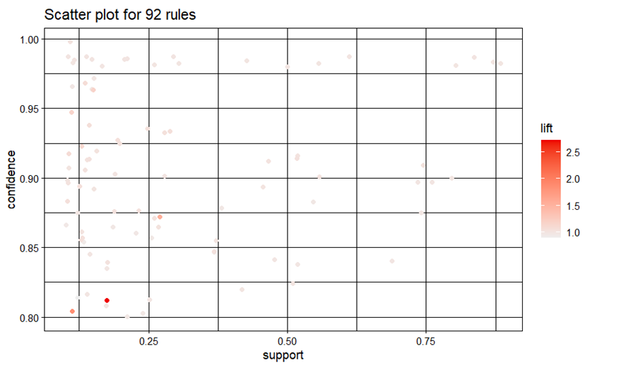
lhs | rhs | support | confidence | lift
{job=management}=> | {education=tertiary} | 0.174 | 0.8121 | 2.719
{month=aug} => | {housing=no} | 0.1125 | 0.8041 | 1.852
{month=may} => | {housing=yes} | 0.2696 | 0.8719 | 1.5404
Grid-search of support and confidence. Lift value > 1.
Redundant rules
support >= 0.1, confidence >= 0.8

Slide 18
lhs | rhs | support | confidence | lift
{loan=no} => | {y=yes} | 0.1057 | 0.1248 | 1.082
{default=no} => | {y=yes} | 0.1132 | 0.1152 | 0.9995
{contact=cellular} => | {y=yes} | 0.1035 | 0.1150 | 0.9985
Filter by ‘y’ = ‘yes’. Not relevant
lhs | rhs | support | confidence | lift
{loan=yes} => | {y=no} | 0.1433 | 0.9377 | 1.0599
{month=may} => | {y=no} | 0.2886 | 0.9334 | 1.0550
{job=blue-collar} => | {y=no} | 0.1939 | 0.9270 | 1.0478
{housing=yes} => | {y=no} | 0.5173 | 0.9140 | 1.0330
{month=jul} => | {y=no} | 0.1426 | 0.9135 | 1.0325
Loan most significant.
Filter by ‘y’ = ‘no’. Promising
Unbalanced data

Slide 19
ECLAT (Equivalence Class Transformation)
A priori -> itemsets by joining and pruning sets. Eclat -> intersecting transactions containing each item.
ECLAT no associations with ‘y=yes’.
y=no:
lhs | rhs | support | confidence | lift
{month=may} => | {y=no} | 0.2886 | 0.9334 | 1.0550
{marital=married, housing=yes} => | {y=no} | 0.3324 | 0.9249 | 1.0453
{education=secondary, housing=yes} => | {y=no} | 0.2915 | 0.9216 | 1.0417
{housing=yes} => | {y=no} | 0.5173 | 0.9140 | 1.0330
{marital=married, education= secondary} => | {y=no} | 0.2875 | 0.9110 | 1.0296
Similarities in rules + metrics
Adding items lhs

Slide 20
7. Clustering

Slide 21
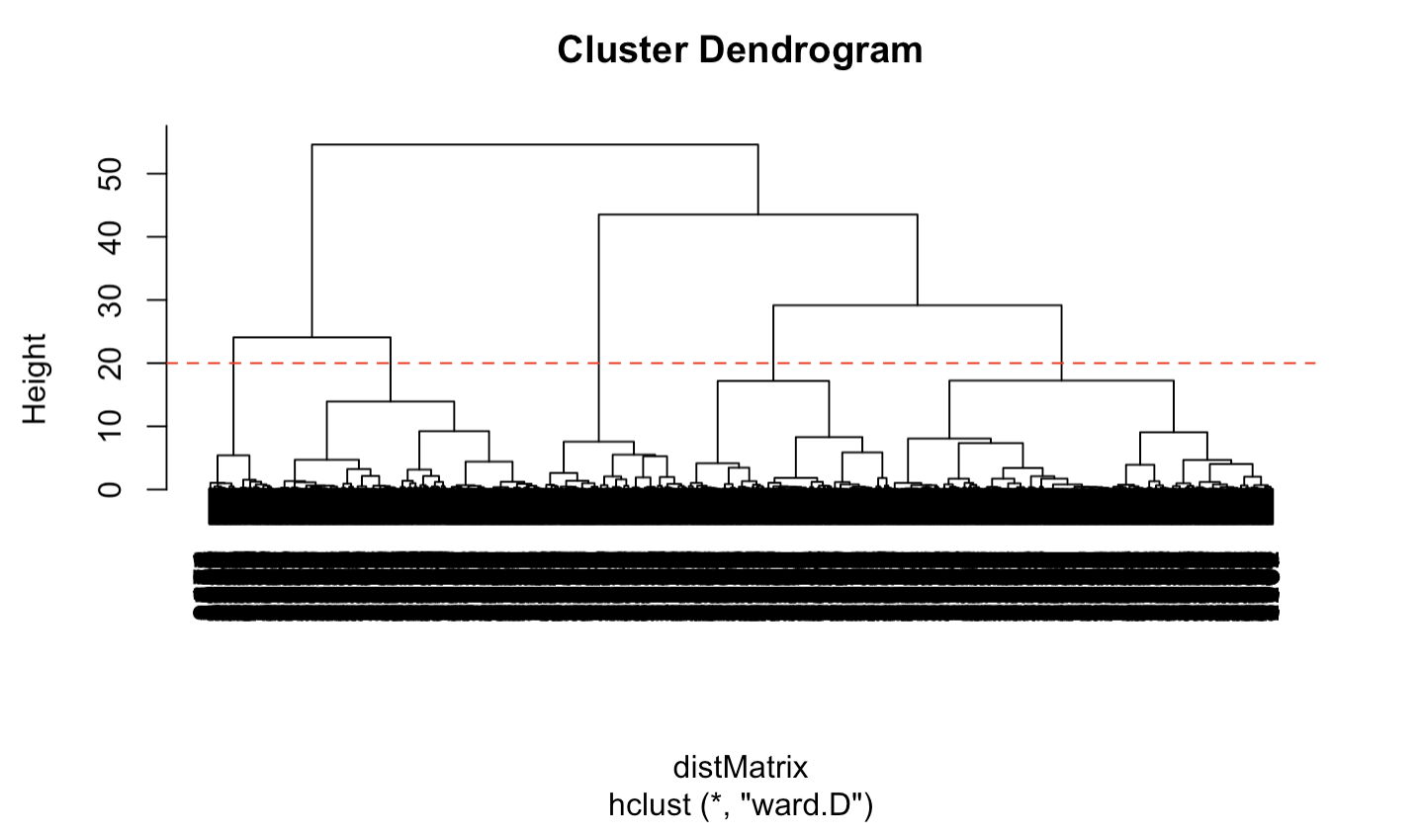
Dendrogram

Slide 22
8. Profiling of clusters

Slide 23
Variables
Numerical
  Use of one-way ANOVA and Kruskal-Wallis tests.
  Very low p-values indicating strong differences across clusters.
  Specific cluster-based p-value analysis
Categorical
  Application of Chi-squared tests.
  Extremely low p-values revealing significant distribution differences.
  Cluster-specific p-value calculations.

Slide 24
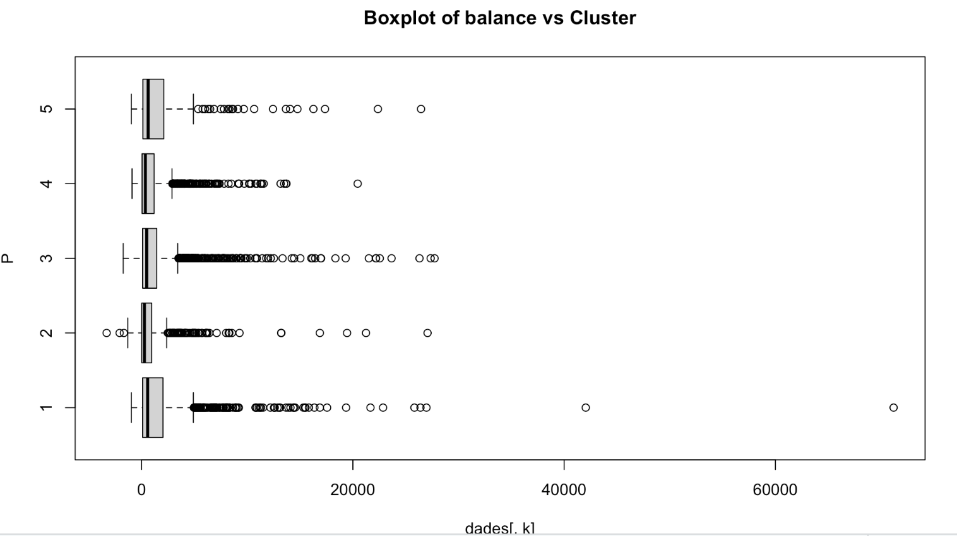
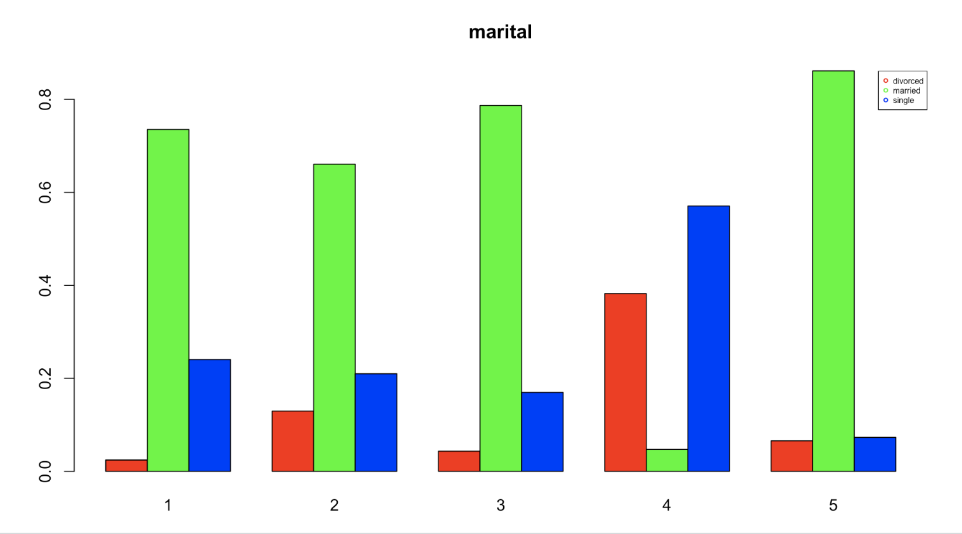
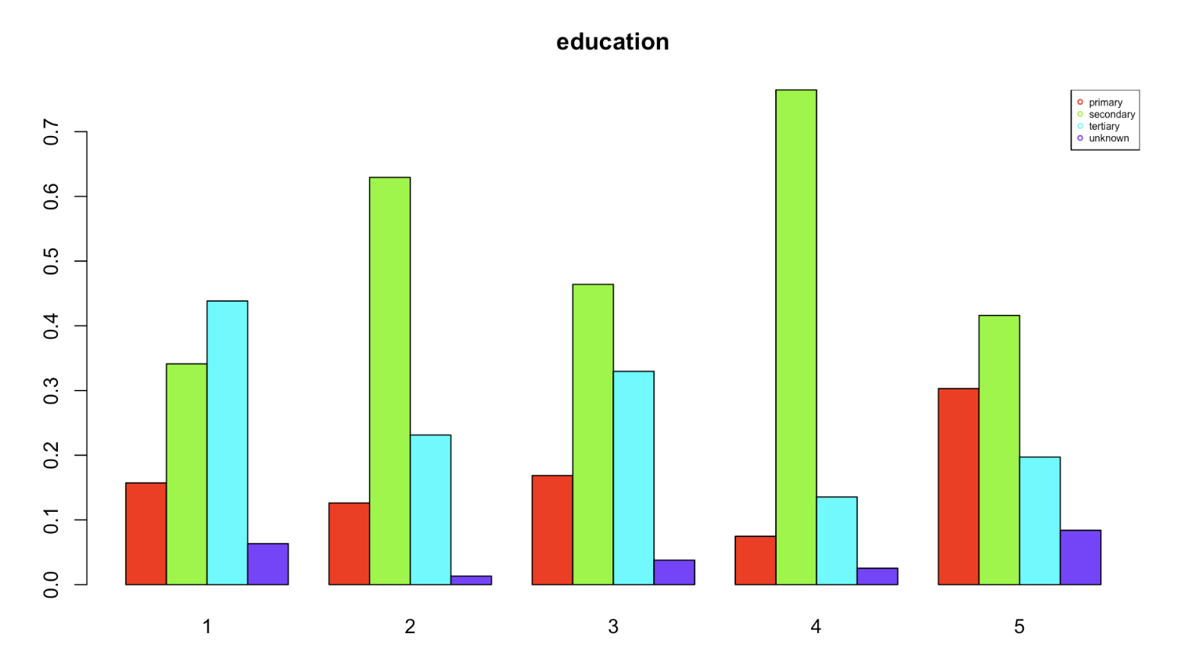
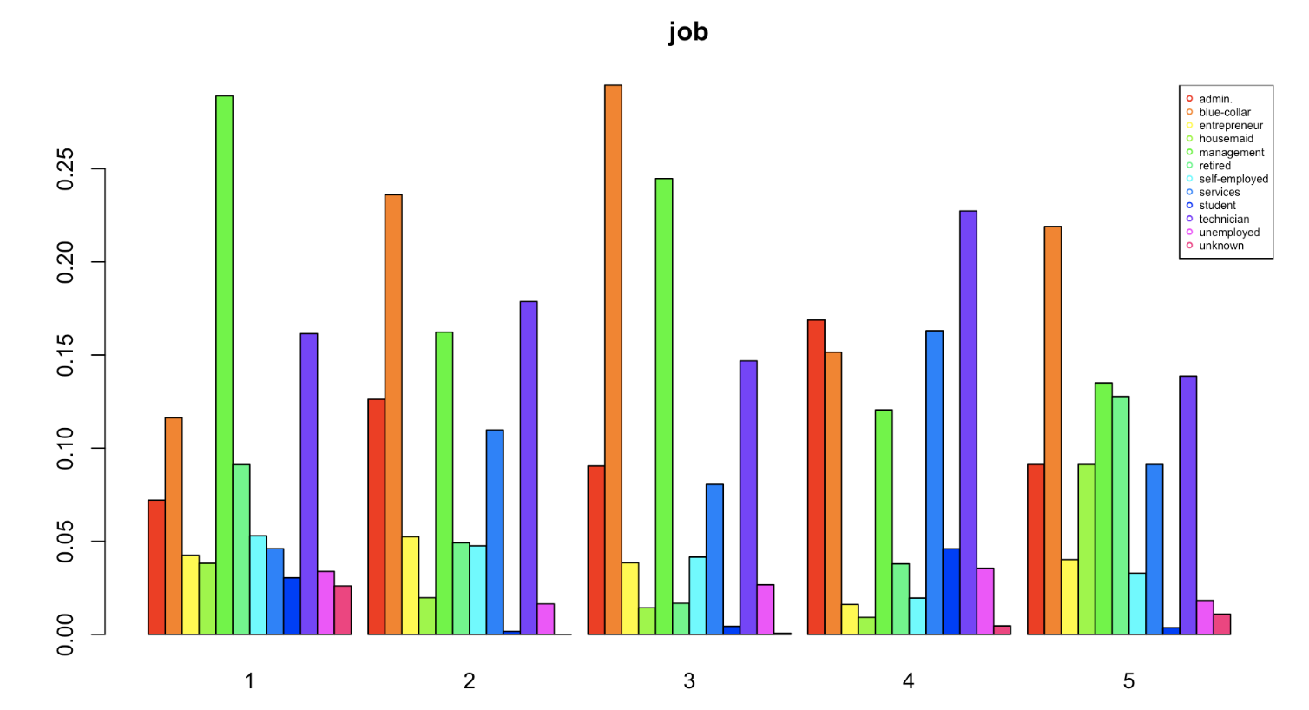

Slide 25
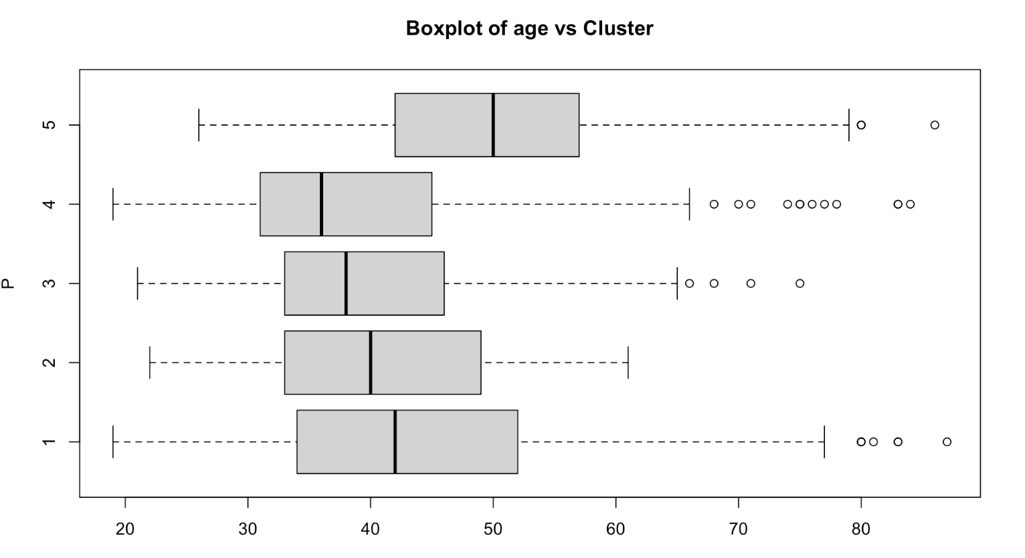
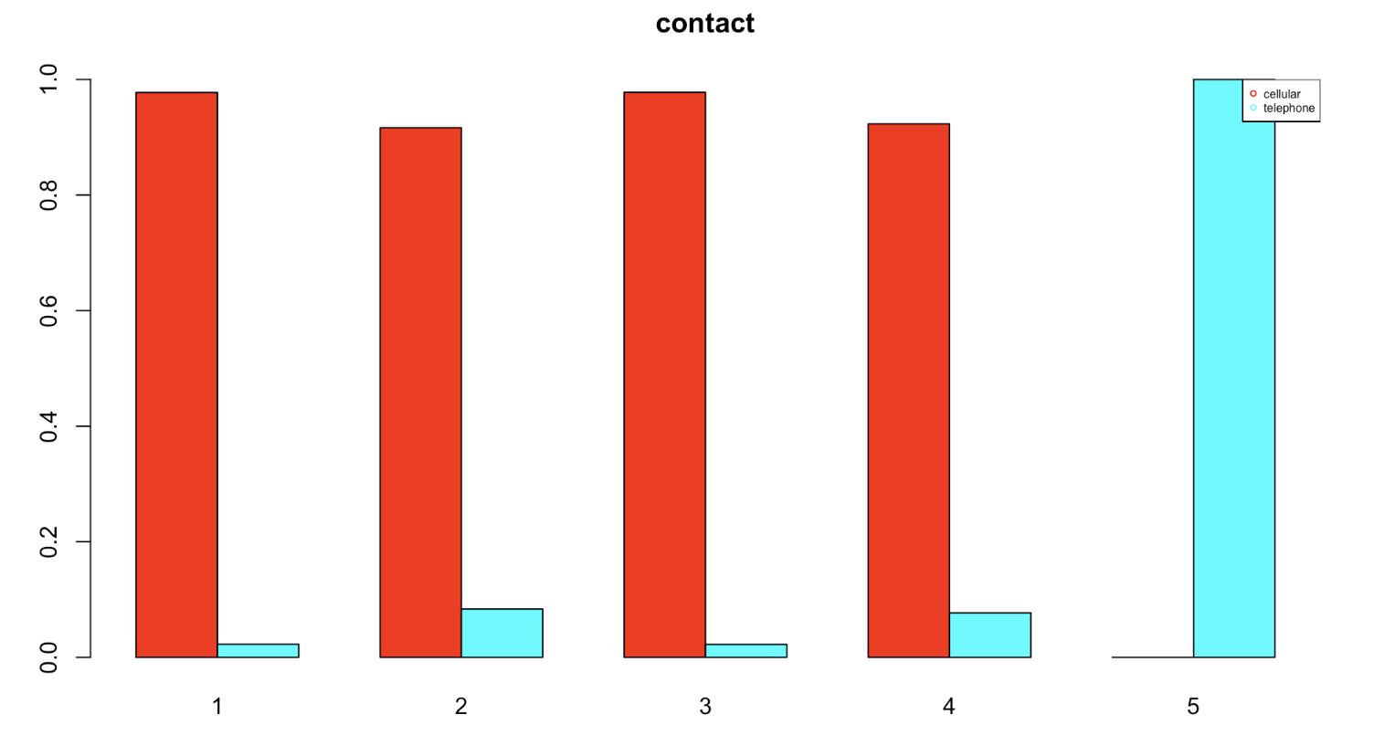
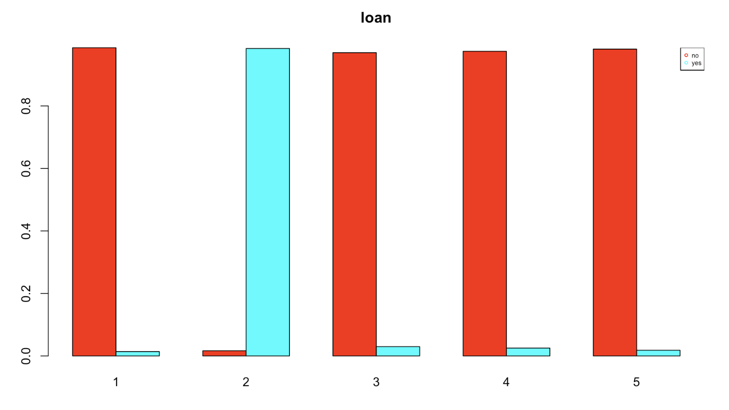
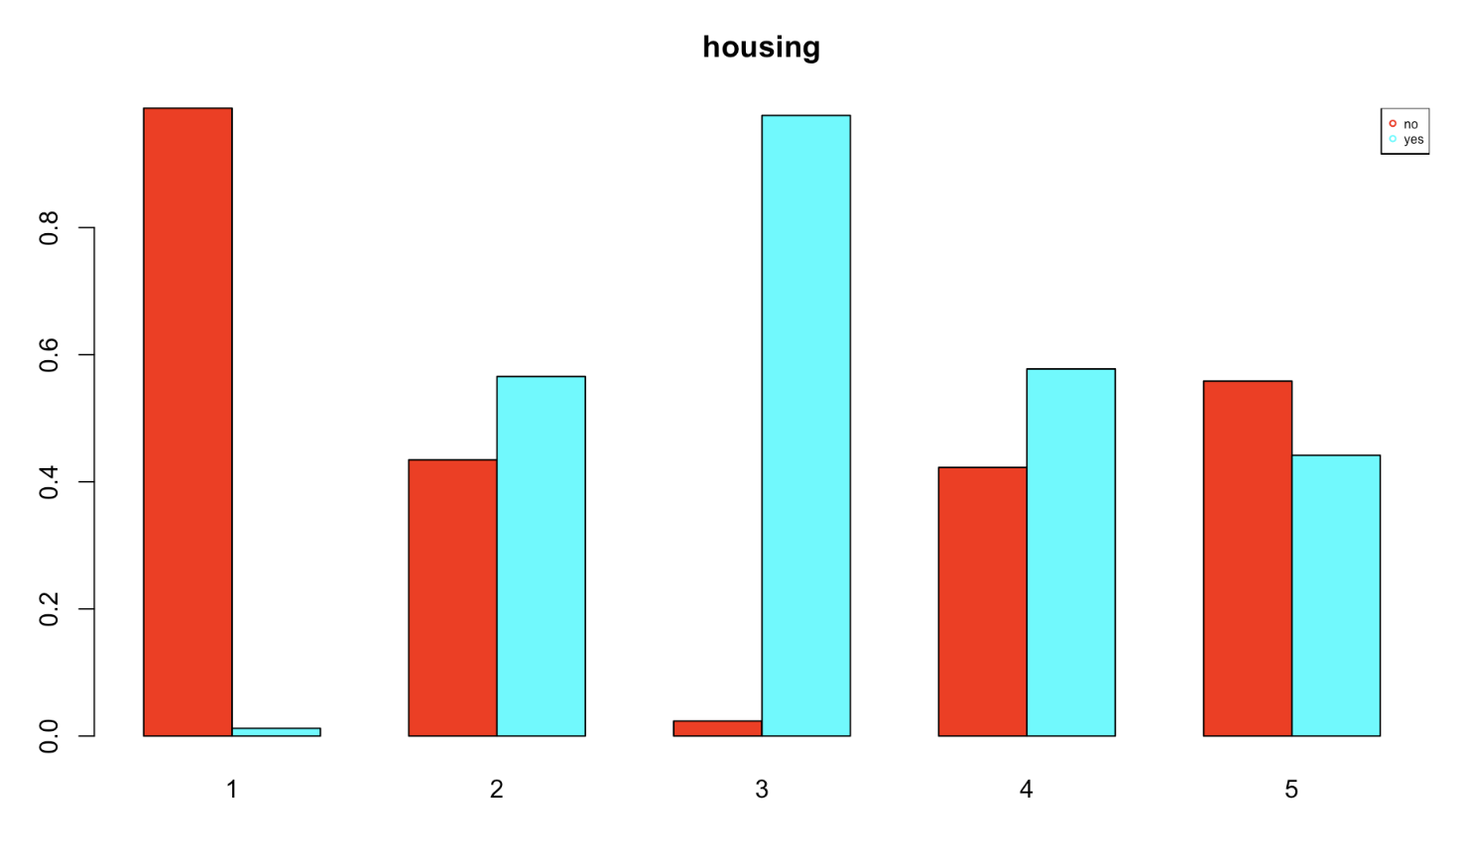

Slide 26
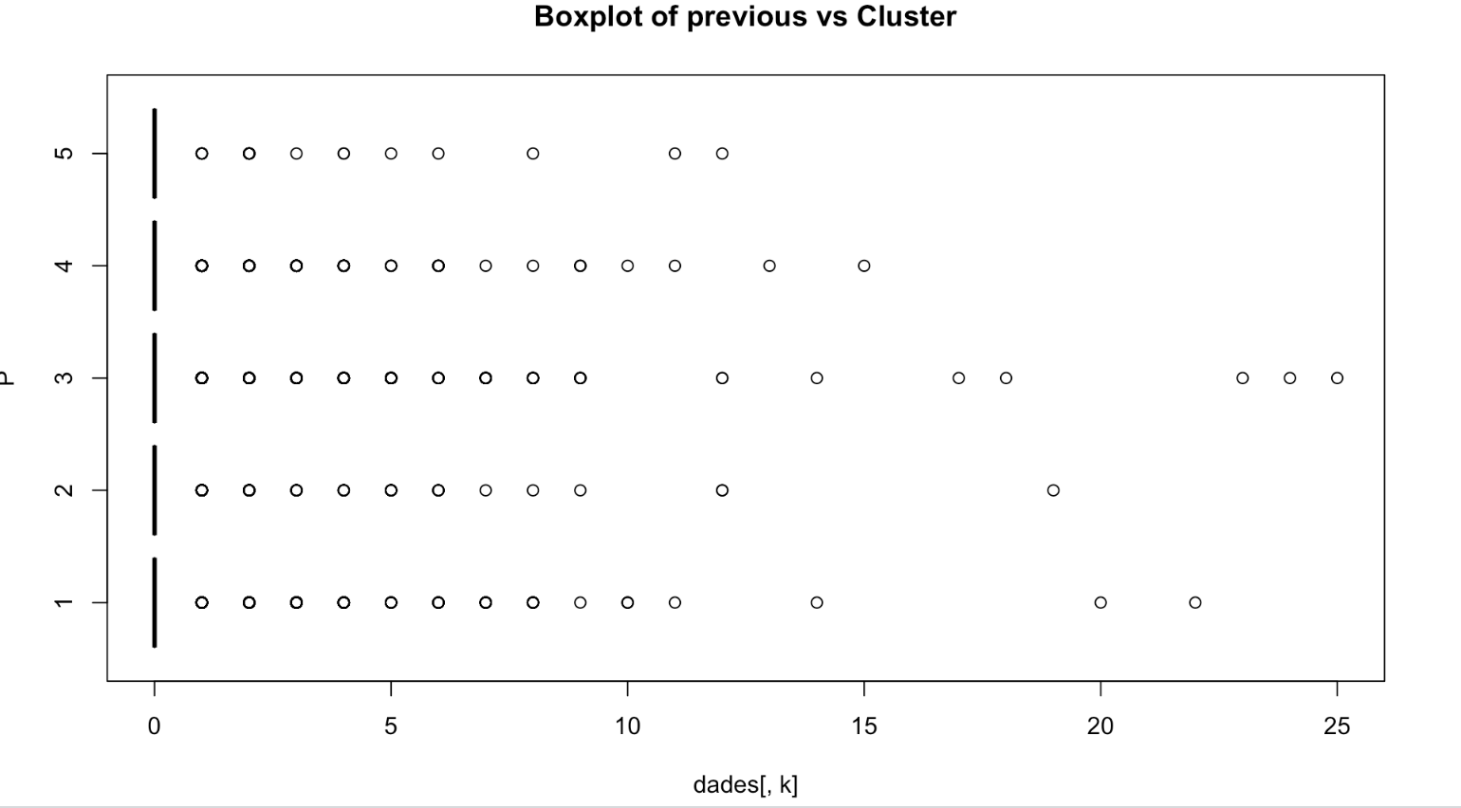
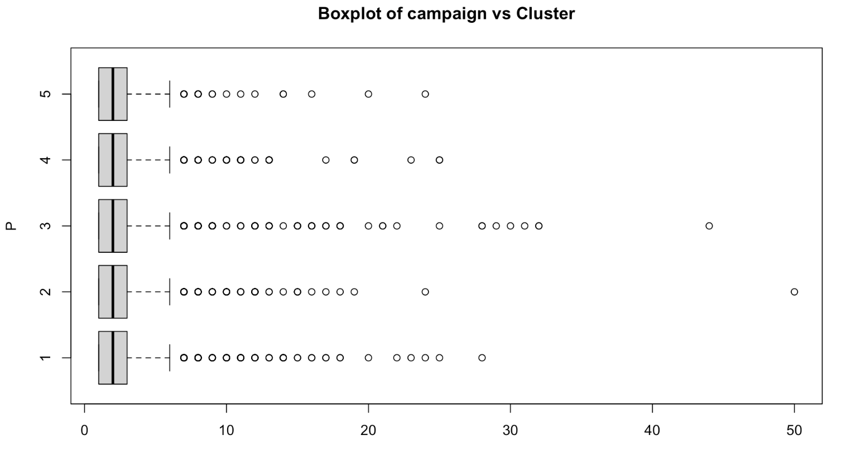
Engagement

Slide 27
Cluster Profiles and Analysis
Cluster 1: Married professionals with past campaign success
Cluster 2: Unique financial traits
Cluster 3: Engaged group
Cluster 4: Young independents
Cluster 5: Experienced traditionalists

Slide 28
9. Decision Trees

Slide 29
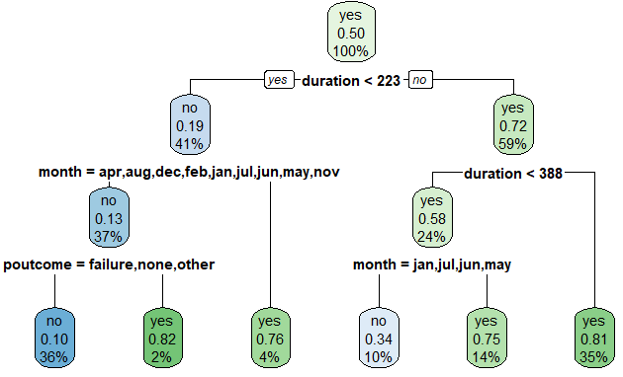
Tree apriori
Limit depth, splitting and buckets
Grid search of the parameters
duration, month and previous outcome are the important variables
TRUTH PRED | Subscribed | Not Subscribed
Subscribed | 124 | 299
Not subscribed | 21 | 896

Slide 30
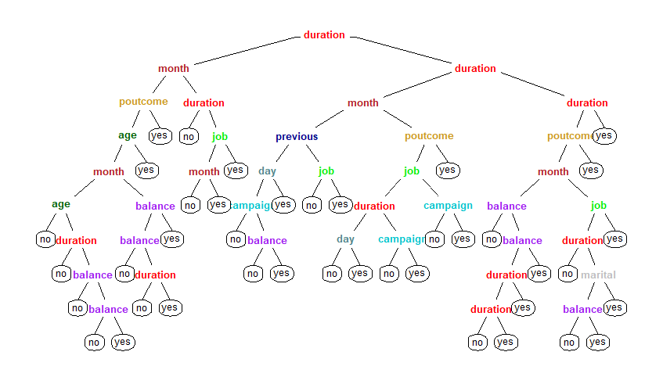
Tree a posteriori
Build full tree
Prune when improvement stops
duration, month, job, previous outcome and balance are the important variables
TRUTH PRED | Subscribed | Not Subscribed
Subscribed | 108 | 225
Not subscribed | 37 | 970

Slide 31
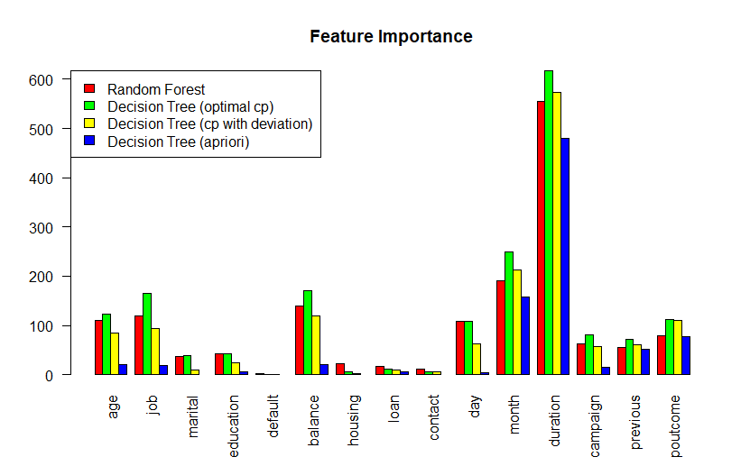
Tree ensemble
Lose interpretability
age, job, balance, day, month, duration and previous outcome are the important variables
TRUTH PRED | Subscribed | Not Subscribed
Subscribed | 98 | 103
Not subscribed | 47 | 1092

Slide 32
10. Linear Discriminant Analysis

Slide 33
Dataset & Coefficients of linear discriminants
Since LDA requires a balanced dataset, we used ROSE function to balance our target column y. Giving the following results:
 | LD1
age | 0.06531
balance | 0.27830
day | -0.00855
duration | 0.948793
campaign | -0.10630
previous | 0.13450
 | Y=no | Y=yes
Before ROSE | 3202 | 414
After ROSE | 1809 | 1807
Notes:
Now we try to classify our outcome, first using rules and then using probabilities received from the LDA analysis.

Slide 34
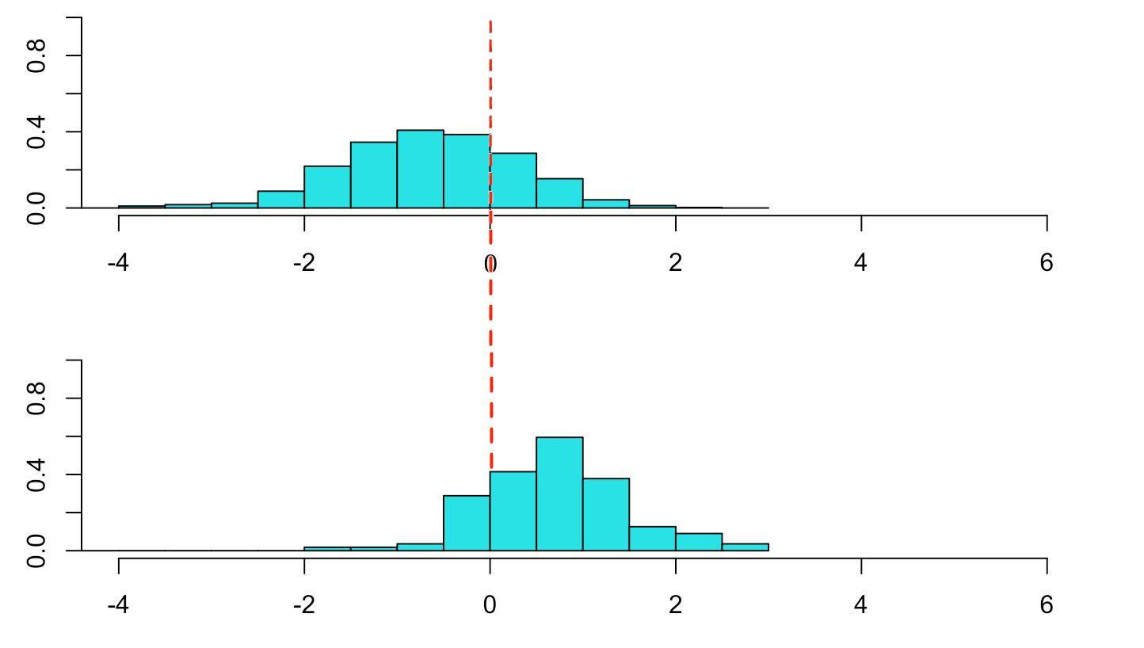
Stacked Histogram
CONFUSION MATRIX
 | No | Yes
No | 572 | 226
Yes | 24 | 83
Notes:
The separation has some overlap between the y=yes and y=no, and we get an accuracy of 72% , we plot histograms of the linear discriminant when y=no and when y=yes. Then we try to find a vertical line that best separates the response groups. We did it by taking the mean of the medians of the train dataset when y=yes and when y=no. So, we create a vertical line (our rule) at that point of the discriminant, that will separate those two groups:

Slide 35
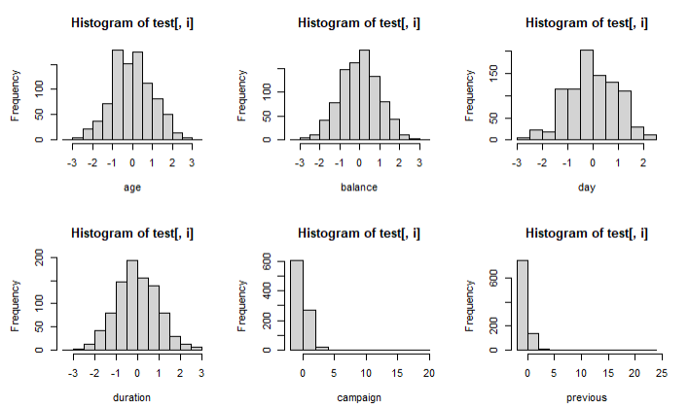
Probability Classification: Key assumptions
Univariate distribution
Notes:
Linear Discriminant Analysis (LDA) is a classification and dimensionality reduction technique that makes assumptions about the underlying distribution of the data. There are three key assumptions or conditions associated with LDA when used for probability prediction:

Slide 36
Probability Classification: Key assumptions
Multivariate distribution: Royston test and Henze-Zirkler test:
The primary goal of the Henze-Zirkler test is to evaluate whether the multivariate distribution of the data significantly deviates from a normal distribution.
Notes:
Ho: The data are multivariate normal.

Slide 37
Probability Classification: Key assumptions
Covariance Conditions: We perform a test of equality of covariance matrices for the y=yes and y=no groups within data. The result is that covariance is not equal, so the test fails.
Notes:
Linear Discriminant Analysis (LDA) is a classification and dimensionality reduction technique that makes assumptions about the underlying distribution of the data. There are three key assumptions or conditions associated with LDA when used for probability prediction:

Slide 38
Questions?

