Slide 1



ROAD TRAFFIC MANAGEMENT
Ignasi Cervero Corbella
Iker Jansà Estavillo
Andreja Andrejić
Pol Arévalo Soler
Ákos Schneider

Slide 2
TABLE OF CONTENTS
01
02
03
04
Project Motivation
Understanding the Process
Insights
Recommendations

Slide 3

01
Project Motivation

Slide 4
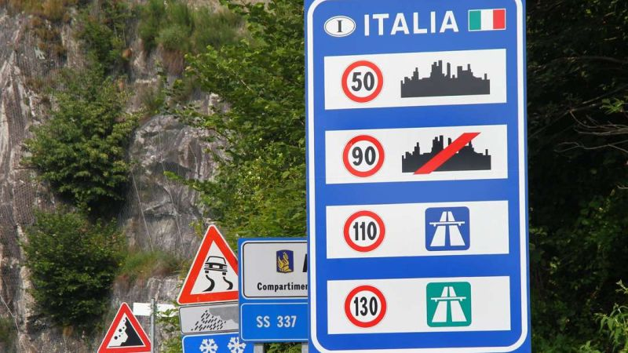
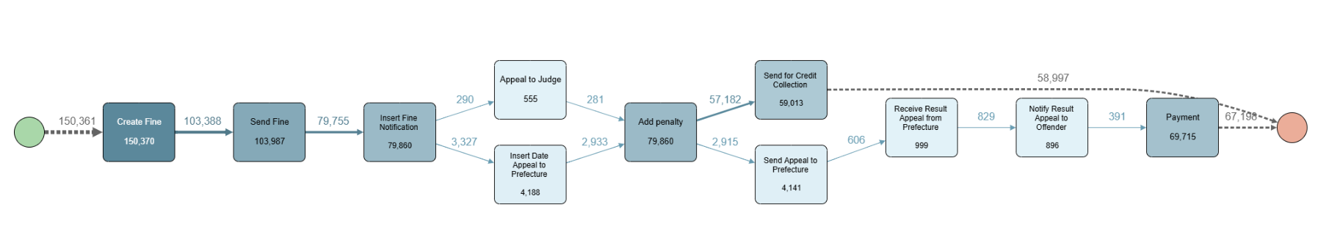
Data Description

Slide 5
Project Goals
01
02
Reduce average case duration
Reduce case escalations
Identify methods to reduce the average case duration, thereby minimizing the resources required by the government agency.
Incentivize prompt payments from individuals to expedite the resolution of cases.
Decrease the number of cases that ultimately result in being sent for credit collection.
Notes:
Managing road traffic fines plays a vital role in keeping roads safe and maintaining order.
However, the process can be complex, involving multiple steps from detecting violations to issuing fines and ensuring payments.
Understanding how these workflows function is key to spotting inefficiencies, easing administrative workloads, and improving compliance.
This project focuses on analyzing and optimizing the Italian police’s road traffic fine management system, using tools like Apromore and Python to dive deep into the data and create insightful visualizations.

Slide 6
02
Understanding the process

Slide 7
150370
235
6.5 / 11.23
Total number of cases
Case variants
Median and average case duration in months

Slide 8
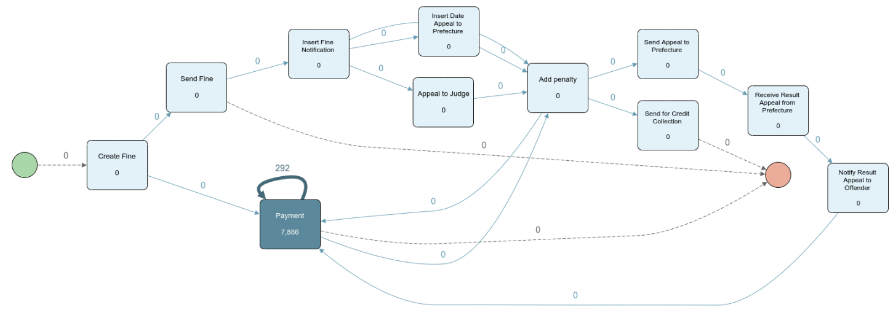

Slide 9
—COMPLETE CASES
Any case that either ends with
Payment or being Sent for credit collection

Slide 10
Process conformance
01
02
An offender has to be notified and recieve at least one penalty before being sent to credit collection agencies.
In all of the cases that were escalated, the offender has failed to pay to full amount of the fine.

Slide 11


Data cleaning – adding derived case attributes
01
02
Financial Attributes
- Total Fine Amount (including penalties)
- Total Expenses - sum of administrative costs
- Total Payment Obligation - sum of the above
- Total Amount Paid
- Payment Completed (boolean)
Process Characteristics
- Number of Penalties issued
- Number of Payment Installments
- Initial Fine Amount (without penalties)
- Total Penalty Amount
- notificationType: in case of penalty
- lastSent: Status update of notificationType

Slide 12
03
Insights

Slide 13


Insights
Reduce the average case length
Objectives
Reduce workload

Slide 14

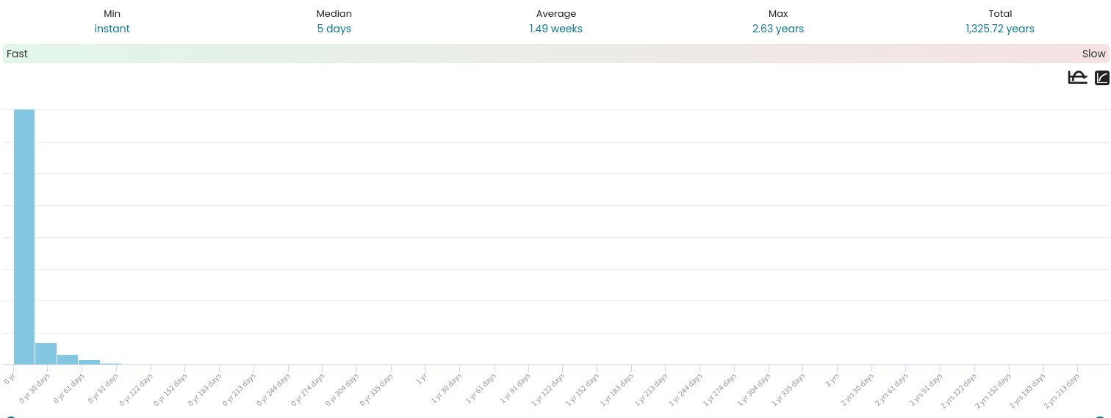
Fast path
Create Fine > Payment

Slide 15
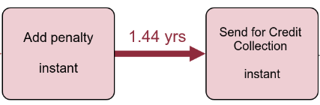
Most common, longest arc
Add Penalty > Send for Credit Collection
Goal: reduce the amount of cases that take this arc
77% of penalized offenders end up in Credit Collection

Slide 16

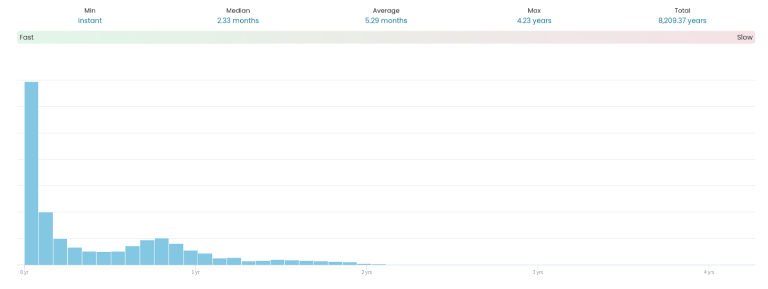
Other interesting arcs
Add Penalty > Payment
50% pay penalties before 2 months
Around 9,000 cases take longer

Slide 17
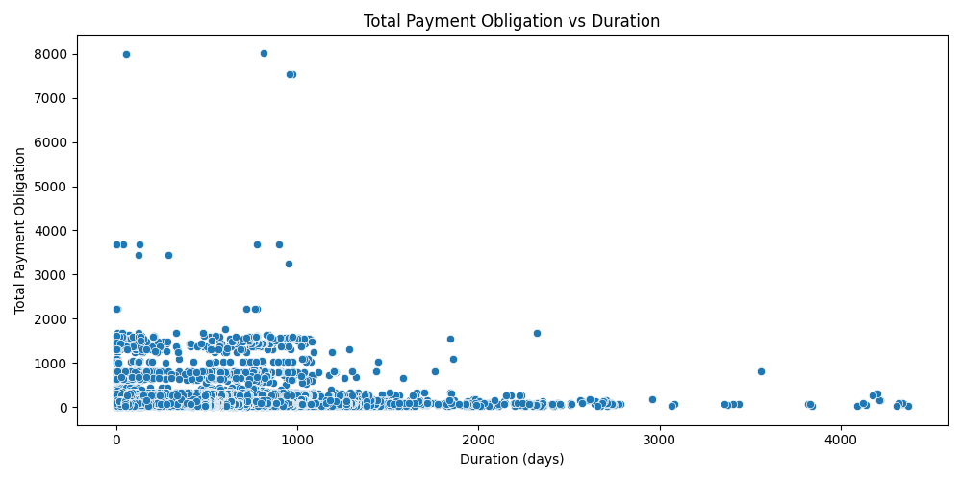
Payment Obligation
Negative correlation with the duration

Slide 18
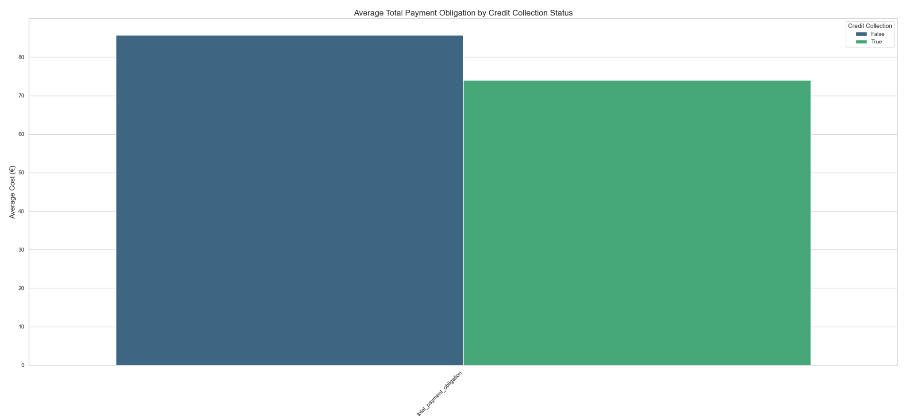
Payment Obligation
Negative correlation with the duration
Average Cost (€)
Average Total payment Obligation by Credit Collection

Slide 19
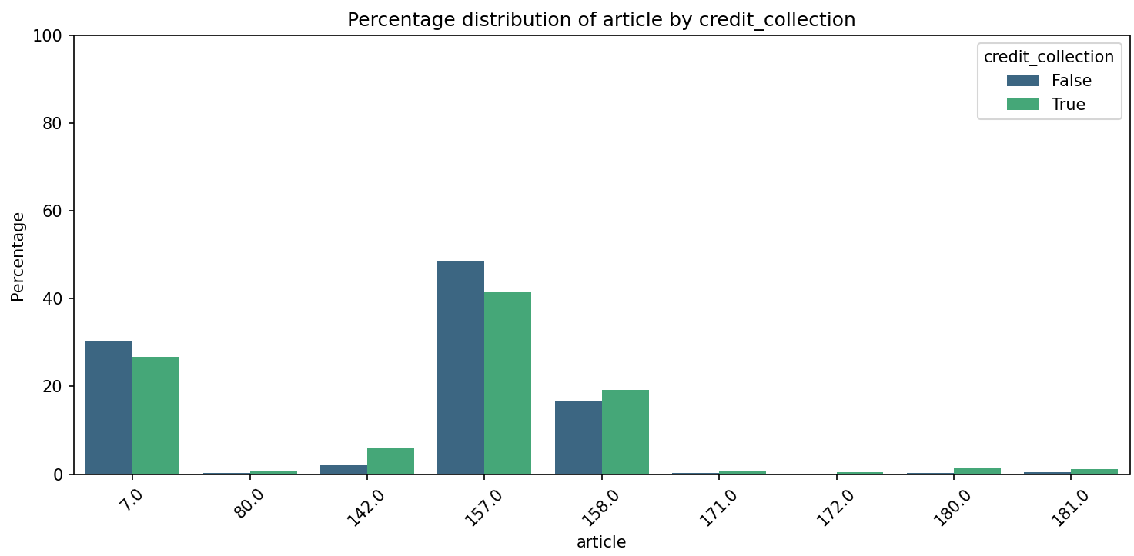
Violated Article
Article 7 prohibits the use of lanes specifically reserved for public transport
Article 157 addresses the rules concerning vehicle stopping and parking
Article 142 address speeding regulations
Article 158 addresses loading and unloading goods

Slide 20
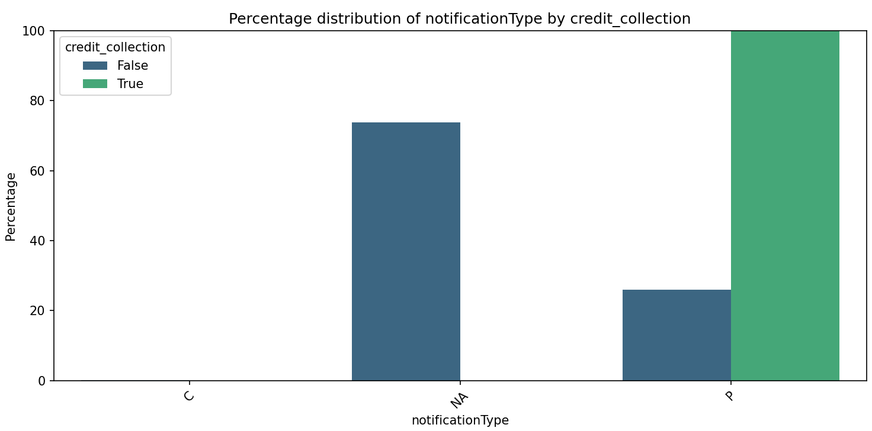
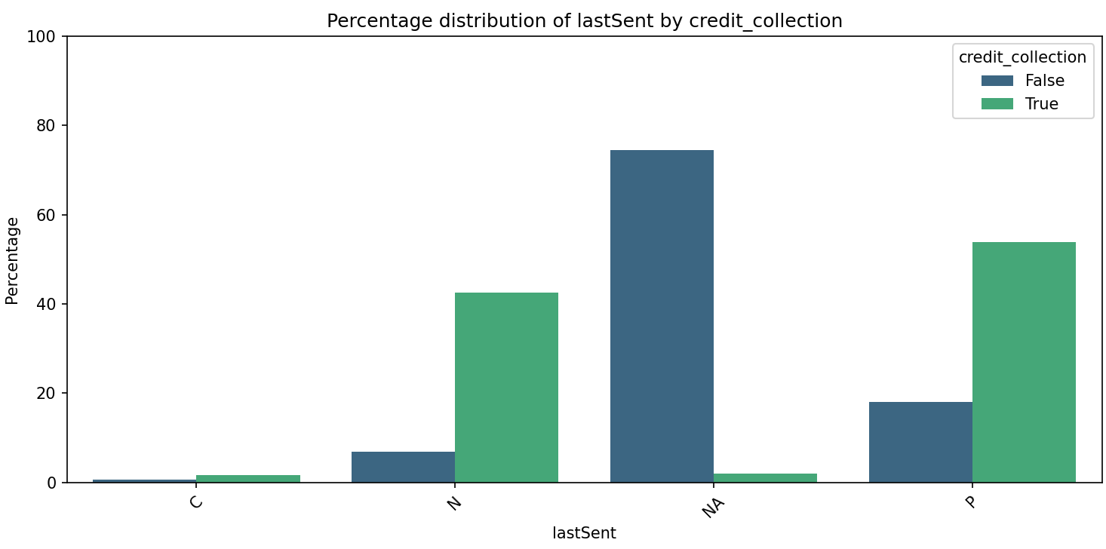
Notifying Penalties
Created in the Insert Fine Notification activity

Slide 21
04
Recommendations

Slide 22
Our proposal
Raising subsequent fines
Articles 142 and 158
Notification of of the offence sent by card
Electronic notification

Slide 23
Thank you for your attention

