Slide 1

Motilal Nehru National Institute Of Technology
Allahabad
Project Presentation
A PROJECT ON
Software Defined Networking
Submitted By:-
Mohit Ritolia 20123005 (CSE)
Neha Kain 20124054 (CSE)
Durgesh Ganesh 20124073(CSE)
Krishna Kumar Sharma 20122042(CSE)

Slide 2
Introduction to Software Defined Networking
Software-Defined Networking (SDN) is an emerging architecture that is dynamic, manageable, cost-effective, and adaptable, making it ideal for the high-bandwidth, dynamic nature of today’s applications.
This architecture decouples the network control and forwarding functions enabling the network control to become directly programmable and the underlying infrastructure to be abstracted for applications and network services.
The OpenFlow protocol is a foundational element for building SDN solutions.

Slide 3
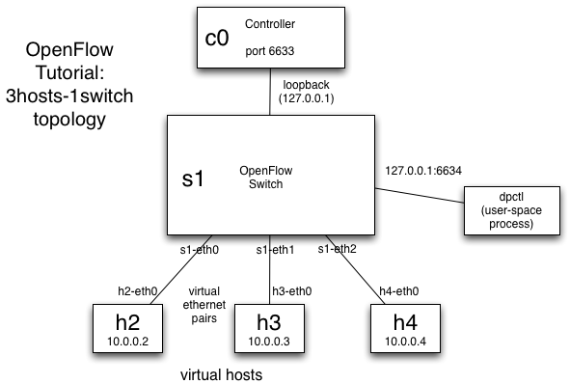
SDN Basic Architecture
Undirected Graph

Slide 4
How SDN works?
Prior to installation of SDN, router was the only means which transfers the packet from one location to another via its routing table.
In SDN such privilege is given to controller which provides access in the global view and sets the path of switches when one host tries to communicate to another via such path that has least traffic(to be implemented)

Slide 5
Motivation
Centralizing policy control for all devices on your network, to save time and reduce the chances of configuration errors.
Examining traffic flowing into massive data centers (for content providers, for instance) to improve network performance.
Enabling individual applications to directly program the network to acquire the resources they need to optimize performance in any set of network conditions .

Slide 6
Tools Necessary for Simulation
Mininet:
Mininet emulates an OpenFlow network and end-hosts within a single machine. It includes built-in support to create several common topologies, plus it allows for construction of custom topologies using a python script.
Controller ( FloodLight )
FloodLight is a type controller which has the main role in SDN. Its sets the switches how to transfer the packets keeping in the data about number of hops , traffic, cost etc.

Slide 7
SDN success in the real world
Network management
Resource utilization
Bandwidth calendaring
Energy management

Slide 8
Future Scope
Changing traffic patterns.
The rise of cloud services.
"Big data" means more bandwidth.

Slide 9
CloudSim
Introduction
Model
Need of CloudSim
Features of CloudSim

Slide 10
Introduction
With the prosperity of cloud computing, various simulation tools, such as CloudSim, are developed to experiment ever-changing user requirement and system supply before deploying a system into real-world scenarios. However, there is no existing cloud simulation tool to support Software Defined Network (SDN), which provides programmable networking paradigm.

Slide 11
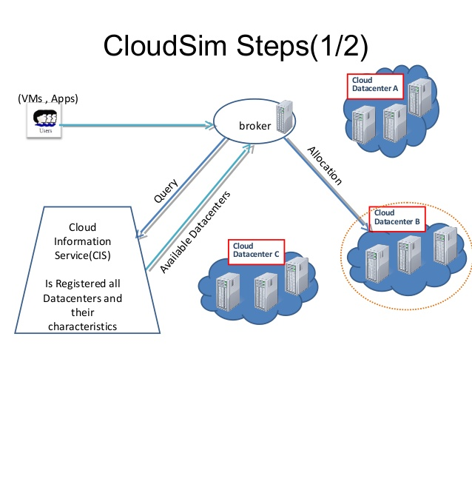
Model of CloudSim

Slide 12
Why we need CloudSim?
Utilization of real test beds limits the experiments to the scale of the test bed and makes the reproduction of results an extremely difficult undertaking, alternative approaches for testing and experimentation leverage development of new Cloud technologies.

Slide 13
Features of CloudSim
Support for modeling and simulation of large scale Cloud computing data centers
Support for modeling and simulation of virtualized server hosts, with customizable policies for provisioning host resources to virtual machines
Support for modeling and simulation of energy-aware computational resources
Support for modeling and simulation of data center network topologies and message-passing applications
Support for dynamic insertion of simulation elements, stop and resume of simulation
Support for user-defined policies for allocation of hosts to virtual machines and policies for allocation of host resources to virtual machines

Slide 14
Integration of SDN with CloudSim
Introduction
Implementation of VM Allocation Policy
Comparison With Best First Search and our own implemented algorithm

Slide 15
Introduction
CloudSimSDN is a new simulation tool built on top of CloudSim that has been briefly discussed in the context of Software-Defined Clouds where resources are dynamically managed and configured in a data center via a centralized controller.

Slide 16
Implementation of VM Allocation Policy
In this, we implemented our own algorithm inspired by an earlier algorithm for VM Allocation.
The algorithm helps in the improving the cost factors and power consumption ratio.
We compared the two algorithms with the amount of power consumed while integration of SDN with cloudsim.

Slide 17
Comparison With Best First Search and our own implemented algorithm
We compared the total power consumption with different allocation algorithms and found that we can improve the power consumption with changing factors.
TOTAL POWER CONSUMPTION for Most Full First Algorithm Host energy consumed: 1848038.3846250002 Switch energy consumed: 92361.8226511275 Total energy consumed: 1940400.2072761278 Simultaneously used hosts:30
TOTAL POWER CONSUMPTION for Own Implemented Algorithm Host energy consumed: 1850477.0179583335 Switch energy consumed: 88429.05611613806 Total energy consumed: 1938906.0740744716 Simultaneously used hosts:30
TOTAL POWER CONSUMPTION for Least Full First ALgorithm Host energy consumed: 2396379.517958334 Switch energy consumed: 111845.0765723727 Total energy consumed: 2508224.5945307068 Simultaneously used hosts:100

Slide 18
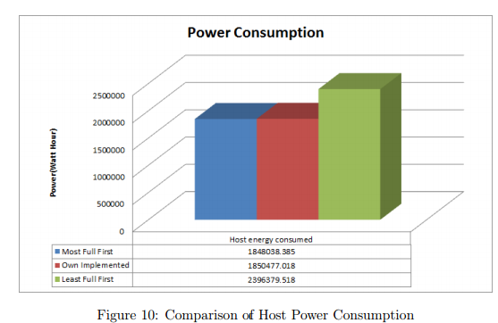
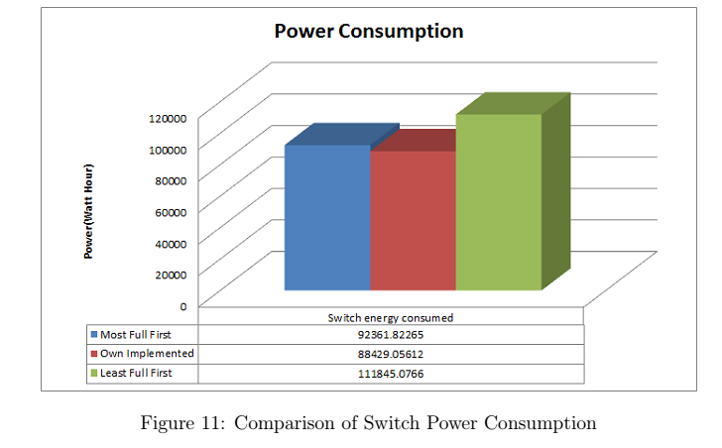
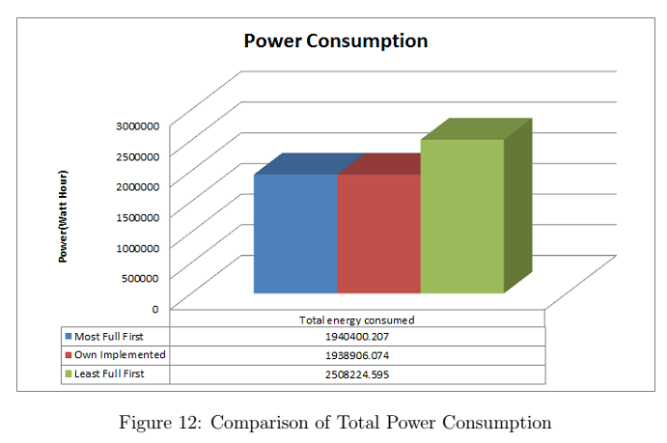
Graphs for comparison

Slide 19
Conclusion
To integrate SDN into the cloud simulation environment, this project develops a visualized extension based on the Cloud-Sim framework that supports SDN simulation in cloud environment. Thus, SDN integration in Cloud using Cloud Sim helped us to evaluate the performance while using SDN in cloud.
We also tried to observe power utilization using various VM allocation algorithms and we found that the performance was better than the available algorithms and resources were much more utilized.

Slide 20
References
[1] Garg, S. K., and Buyya, R. Networkcloudsim: Modelling parallel applications in cloud simulations. Master’s thesis, Department of Computer Science and Software Engineering The University of Melbourne, Australia, 2011. Available from gridbus.csse.unimelb.edu.au/papers/NetworkCloudSim2011.pdf.
[2] Howell, F., and Mcnab, R. Simjava: A discrete event simulation library for java. Master’s thesis, Proceedings of the first International Conference on WebBased Modeling and Simulation, 1998. Available from http://link.springer.com/.
[3] Jungmin Son, Amir Vahid Dastjerdi, R. N. C. X. J. Y. Y., and Buyya, R. Cloudsimsdn: Modeling and simulation of software-defined cloud data centers. Master’s thesis, Cloud Computing and Distributed Systems (CLOUDS) Laboratory,The University of Melbourne, Australia, 2015. Available from www.buyya.com/papers/CloudSim-SDN-CCGrid2015.pdf.
[4] Peter Mell, T. G. The nist definition of cloud computing. Master’s thesis, Computer Security Division, Information Technology Laboratory, National Institute of Standards and Technology,Gaithersburg, MD 20899-8930,USA, 2011 Sep. Available from http://csrc.nist.gov/publications/nistpubs/800-145/SP800- 145.pdf.

