Slide 1

DailyNote
Ui Design
范家铭，陶杰辉，邹薪，胡俊豪小组

Slide 2
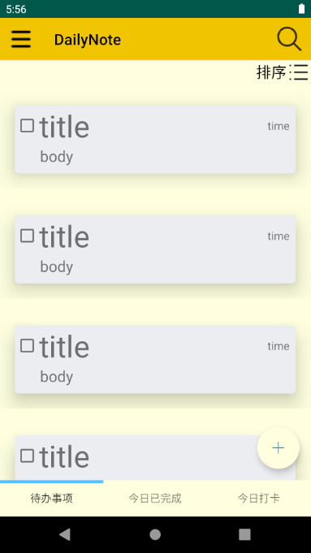
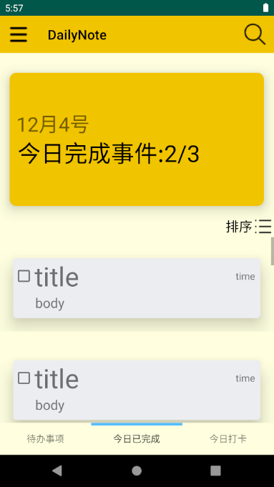
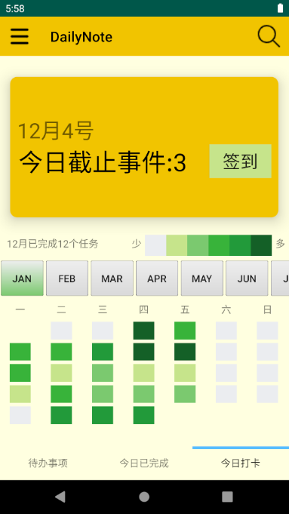
三大主要界面
todo_fragment
finishe_fragment
checkin_fragment

Slide 3
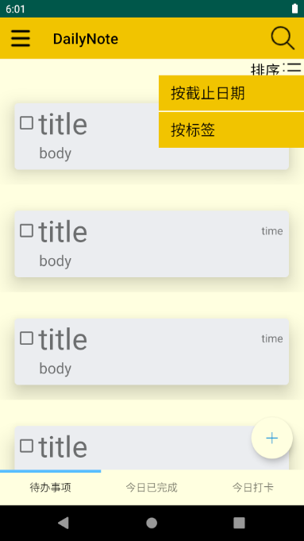
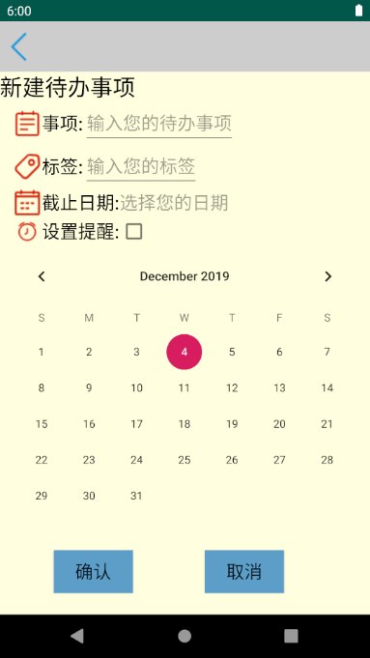
todo_fragment
sortby
floatingActionButton

Slide 4
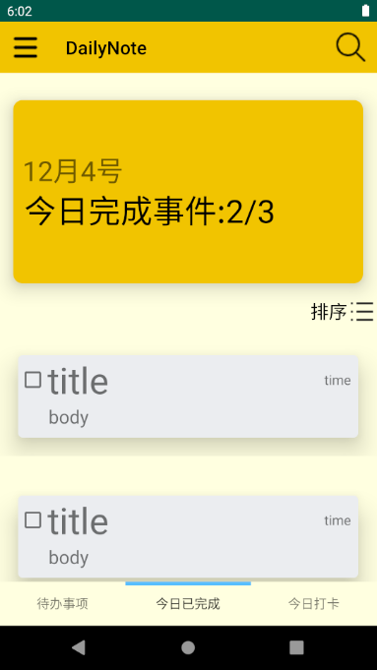
Finished_fragment
Sortby
Done/todolist

Slide 5

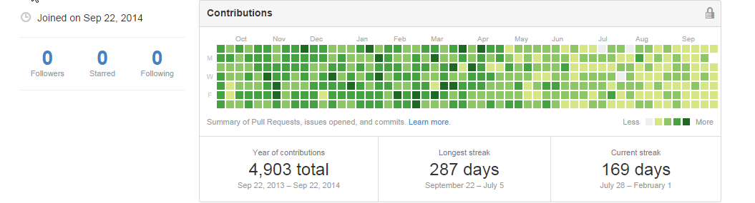
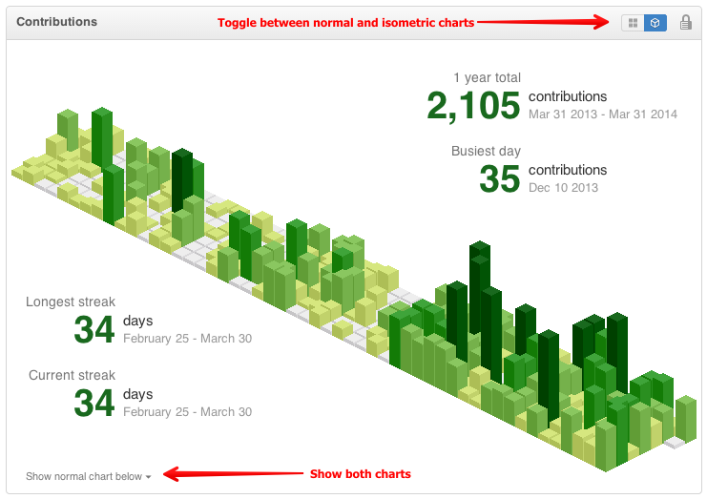
Checkin_fragment
Checkin
Contribution in last year
(inspired by Github)

Slide 6
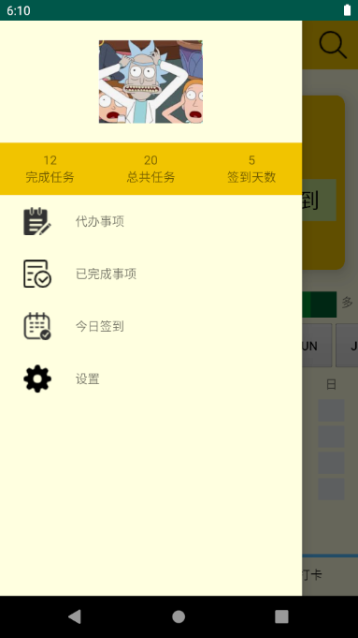
drawerlayout
allDone
allTask
Checkin days
setting

