Slide 1

ZenSleep product business plan
汇报人：第二组
2024-10-06

Slide 2


目录
Overview of the project
Product introduction
Market analysis
Business model
Marketing strategy

Slide 3
目录
Financial analysis
Team introduction
Risk assessment and response
Reference

Slide 4

01
Overview of the project

Slide 5

项目背景
Prevalence of sleep problems
With the rapid development of modern society, work pressure, faster pace of life and the
popularity of various electronic devices have led to a general decline in people's sleep quality.
The growth of market demand
There is a growing concern about health and quality of life, and a growing need to improve
sleep quality.
Integration of technology and Zen philosophy
With the popularity of mobile Internet and smart devices, it is possible to use technology to
improve sleep quality.

Slide 6

项目机遇
Market gaps
At present, there is a lack of a sleep aid app in the market that deeply integrates technology
and Zen ideas. ZenSleep fills this gap..
Strong user demand
A large number of users are eager for an app that can not only improve the quality of sleep,
but also provide spiritual support.
The technical conditions are ripe
The maturity of mobile application development technology, sensor technology and data
analysis technology provides technical support for the development and function realization
of ZenSleep.

Slide 7

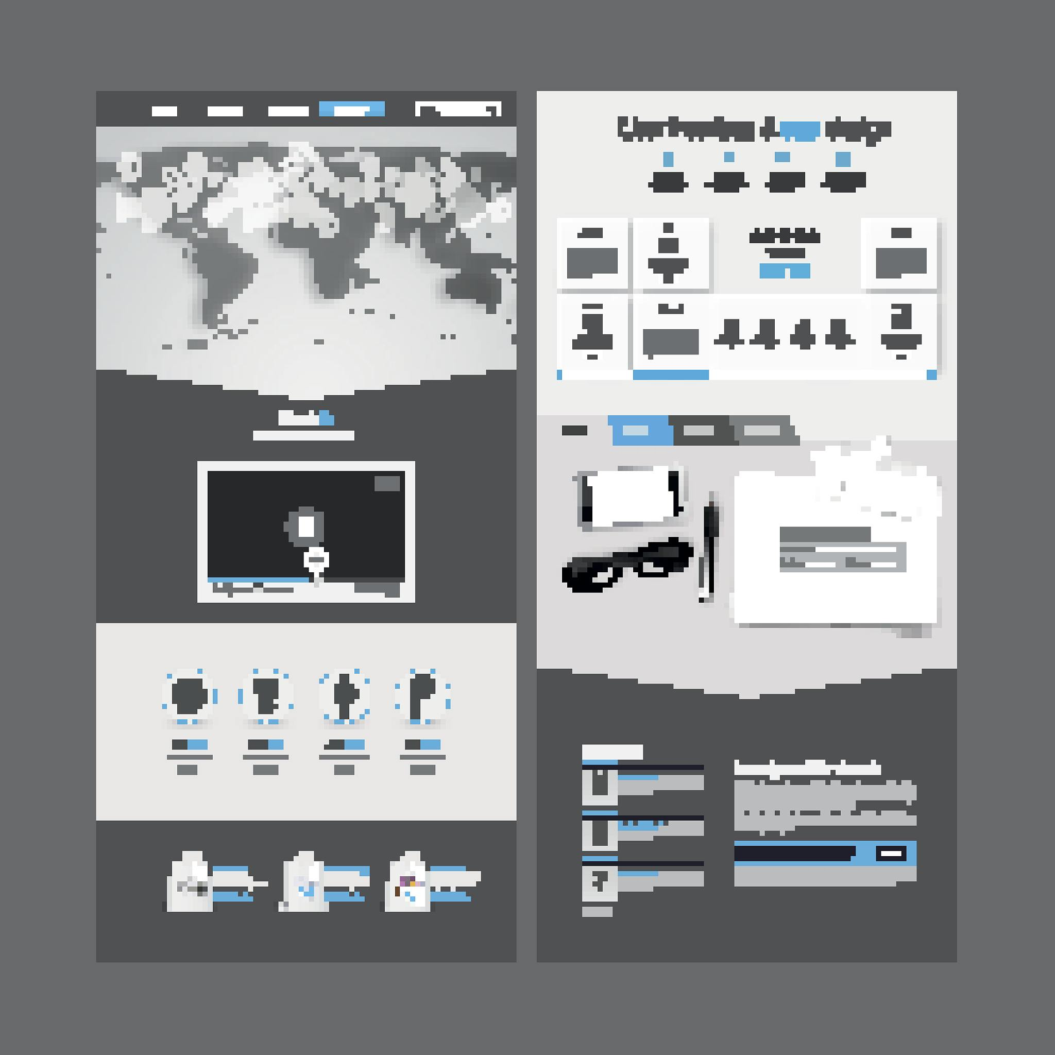

项目理念
people-oriented
Scientific and technological innovation
Green and ecvironmental protection
To the user needs as the core, through scientific and technological means to solve sleep problems, improve the quality of life.
Continuously develop new technologies and new functions to enhance product competitiveness and user experience.
Focus on the environmental performance of products, the use of green materials and production processes to reduce the impact on the environment.

Slide 8
产品功能
A supportive community platform where users can
encourage each other and share sleep experiences.
Users can record their sleep status and mood, promoting selfreflection and understanding.
Sleep Music and Sounds
Goodnight Community
Nap timer
Diary function
Provides Zen-inspired soothing music and ambient sounds
to help users relax and fall asleep.
Helps users take effective naps to improve energy and productivity during
the day.

Slide 9

营销概述
Market positioning
High-end intelligent sleep products market to meet consumers' demand for high-quality sleep
Marketing strategy
Combine online and offline, promote through social media, e-commerce platforms and other channels; Cooperate with medical institutions and health management institutions to expand sales channels and market influence.
Customer service
Establish a perfect customer service system, provide high-quality pre-sale, sale and after-sales service, improve customer satisfaction and loyalty.

Slide 10
02
Product introduction

Slide 11
产品简介
产品名称
产品定位
ZenSleep is committed to providing comprehensive and intelligent sleep aid solutions for modern urban people, improving the sleep quality of users and improving the quality of life.
ZenSleep
主要功能
目标市场
Sleep audio playback, sleep monitoring, environmental regulation (such as light, temperature), sleep aid aromatherapy, etc., to create a comfortable sleep environment
For young white-collar workers, students, middle-aged and elderly people with widespread sleep problems.

Slide 12
核心技术
Intelligent audio technology
Advanced audio processing technology is used to generate natural sounds and relaxing music in line with the human body's physiological rhythm, helping users quickly enter a deep sleep state
Sleep monitoring and analysis
It integrates high-precision sensors to monitor the user's sleep cycle, heart rate, breathing and other physiological indicators in real time, and provides personalized sleep improvement suggestions through big data analysis and machine learning algorithms.
Environmental regulation technology
Combined with the Internet of Things technology, intelligent adjustment of indoor light, temperature and other environmental factors to create the most suitable environmental conditions for sleeping.
Aromatherapy release technology
Built-in a variety of natural sleep aid aromatherapy, through the intelligent control system accurate release, to help users relax and promote deep sleep.

Slide 13
系统实现
Hardware design
The ZenSleep intelligent sleep aid system mainly consists of hardware components such as sleep aid pillow, smart speaker, environmental control module and aromatherapy release device. Each component realizes data synchronization and functional linkage through wireless connection.
Software platform
A supporting mobile APP is developed, through which users can set the sleep aid mode, view the sleep monitoring report, receive improvement suggestions, etc., to achieve remote control and personalized customization.
Cloud Service support
Relying on a powerful cloud service platform, we can achieve cloud storage, analysis and sharing of user data, and provide users with more accurate and personalized sleep improvement solutions.

Slide 14
作品特色与创新点
All-round sleep aid experience
Personalized customized service
01
02
ZenSleep not only provides audio sleep aid function, but also combines various means such as environmental regulation and aromatherapy release to create a full range of sleep aid experience for users.
Through intelligent monitoring and big data analysis, ZenSleep is able to provide personalized sleep improvement recommendations and services based on users' sleep habits and physiological characteristics.
Intelligent linkage control
Health and environmental protection concept
03
04
The hardware components are connected wirelessly to achieve intelligent linkage control, and the user can easily set and control the entire sleep aid system through the mobile phone APP.
ZenSleep adheres to the concept of health and environmental protection, and selects natural sleep aid aromatherapy materials to ensure the safety and comfort of users. At the same time, reduce energy waste and promote sustainable development through intelligent regulation.

Slide 15
03
Market analysis

Slide 16
市场现状
睡眠问题普遍性
产品多样化
With the acceleration of the pace of modern life and the increase of work pressure, sleep problems are increasingly common and become an important factor affecting people's quality of life.
The market of sleep aid products has shown a diversified development trend, including drugs, supplements, science and technology, and environmental improvement products.
法规与监管
市场需求增长
With the improvement of health awareness, consumers' demand for sleep aid products is growing, and the market potential is huge.
Sleep aid products belong to the category of medical and health products, subject to the strict supervision of relevant laws and regulations, enterprises in the marketing and sales process to comply with the relevant provisions.

Slide 17

行业消费者竞争态势深入分析
消费者需求细化
竞争格局多元化
Consumers' demand for sleep products is increasingly refined, and personalized and customized products are more popular.
The sleep aid market has a diverse competitive landscape, ranging from large pharmaceutical companies to emerging technology startups.
品牌忠诚度
渠道拓展
Brand awareness, product effect and user experience are important factors affecting consumers' purchase decisions, and enterprises should pay attention to brand building and user experience improvement.
Online channels have become one of the important channels for the sales of sleep products, and enterprises need to actively expand the online market to improve product coverage and visibility.

Slide 18


SWOT深度分析
优势（Strengths）
企业拥有先进的助眠技术研发能力、丰富的产品线和完善的销售渠道，能够满足不同消费者的需求。
劣势（Weaknesses）
企业在市场推广和品牌建设方面相对薄弱，需加强品牌宣传和用户口碑建设。
机会（Opportunities）
随着消费者对健康和睡眠质量的关注度提高，助眠产品市场前景广阔，企业需抓住市场机遇，不断创新产品和技术。
威胁（Threats）
市场竞争加剧，竞争对手不断增多；法规政策变化可能对产品销售产生影响；消费者对产品效果和副作用的担忧等。企业需密切关注市场动态和政策变化，制定有效的应对策略。

Slide 19
04
Business model

Slide 20

目标用户
睡眠障碍人群
高压工作族
For adults who suffer from chronic sleep disorders such as insomnia, dreaminess and early waking, ZenSleep products provide personalized sleep aid solutions.
It is aimed at professionals with high work pressure and fast pace of life to help them relieve stress and improve sleep quality.
老年人群
孕妇及产后妈妈
Pay attention to sleep problems caused by physiological changes during pregnancy and postpartum women, and provide safe and comfortable sleep assistance experience.
ZenSleep products provide a gentle, effective way to help people sleep, which is a common problem in the elderly.

Slide 21
盈利模式
产品销售
订阅服务
Direct sales of ZenSleep sleep products through online and offline channels, including intelligent sleep monitoring devices, sleep aid aromatherapy, sleep aid music, etc., to achieve direct profits.
Launched a member subscription service to provide users with regular sleep assessment reports, personalized sleep improvement programs and exclusive sleep aid resources, and obtain stable income through long-term service.
合作伙伴分成
数据分析服务
Cooperate with medical institutions, health management institutions, etc., take ZenSleep products as one of the service contents, and share the revenue through the sharing model.
Use the user data collected by intelligent sleep monitoring equipment to conduct in-depth mining and analysis, provide valuable sleep research reports for related industries, and open up new profit growth points.

Slide 22
05
Marketing strategy

Slide 23

定价与促销策略
差异化定价
According to the different functions and configurations of ZenSleep products, differentiated pricing strategies are developed to meet the needs of different consumers.
捆绑销售
Bundle sales with mattresses, pillows and other sleep-related products to provide one-stop sleep solutions, increase the added value of products, and improve the overall sales.
限时折扣与优惠券
Launch limited-time discounts and coupons at key time nodes such as holidays and new products to attract more potential consumers' attention and purchase.

Slide 24
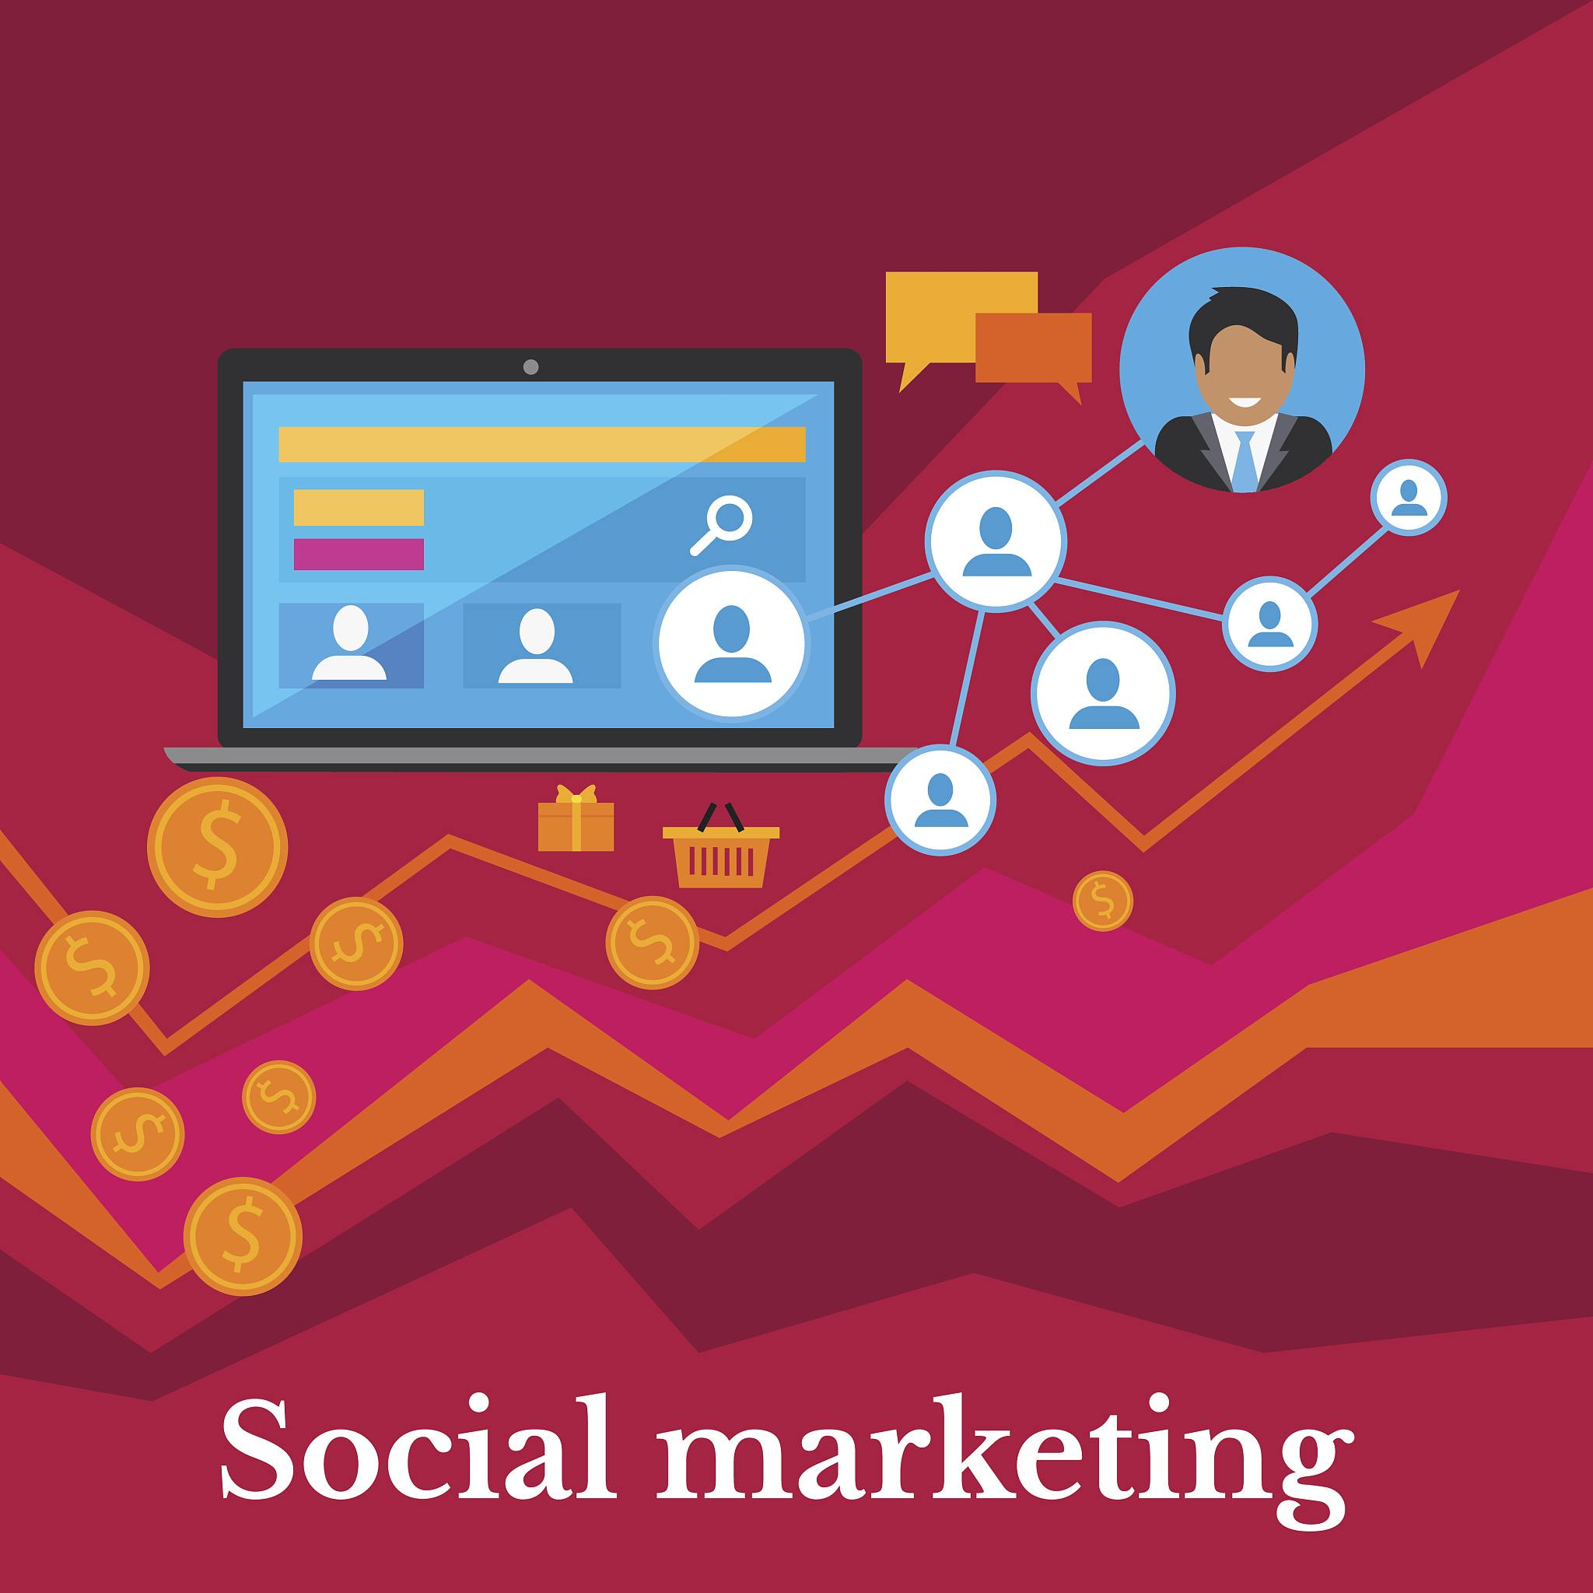


定价与促销策略
客户推荐计划
Encourage existing customers to recommend family and friends to buy ZenSleep products, and provide incentives for referees and referees, such as discounts, giveaways, etc., to drive sales growth through word-of-mouth marketing.

Slide 25
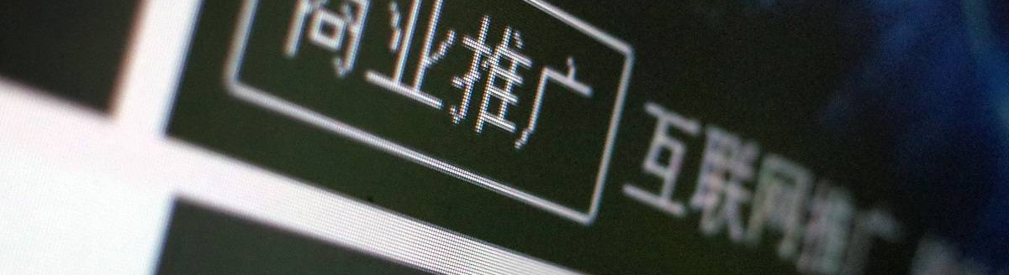
推广策略
线上推广
Use social media, blogs, video sharing platforms and other online channels to conduct extensive publicity, release product introduction, user tutorials, user reviews and other content to attract the attention of target users. At the same time, we cooperate with well-known sleep experts and health bloggers to evaluate and recommend products to improve product authority and trust.
线下体验店
Set up ZenSleep offline experience stores in the bustling commercial areas of first-tier cities, so that consumers can experience the effect of products to help them sleep. Set up a professional sleep consultation area in the store to provide personalized sleep improvement suggestions to enhance consumers' purchase intention.

Slide 26
推广策略
Cooperate with well-known Kols in the field of sleep and lifestyle, show the use scenarios and effects of ZenSleep products through live broadcasting, video sharing and other forms, and expand product exposure and popularity with the influence of KOL.
Participate in well-known sleep health exhibitions, forums and other activities at home and abroad to show the innovative technology and excellent performance of ZenSleep products to enhance brand image and industry status. At the same time, online and offline sleep health lectures and seminars will be held to popularize sleep health knowledge and improve consumers' attention to sleep problems.

Slide 27
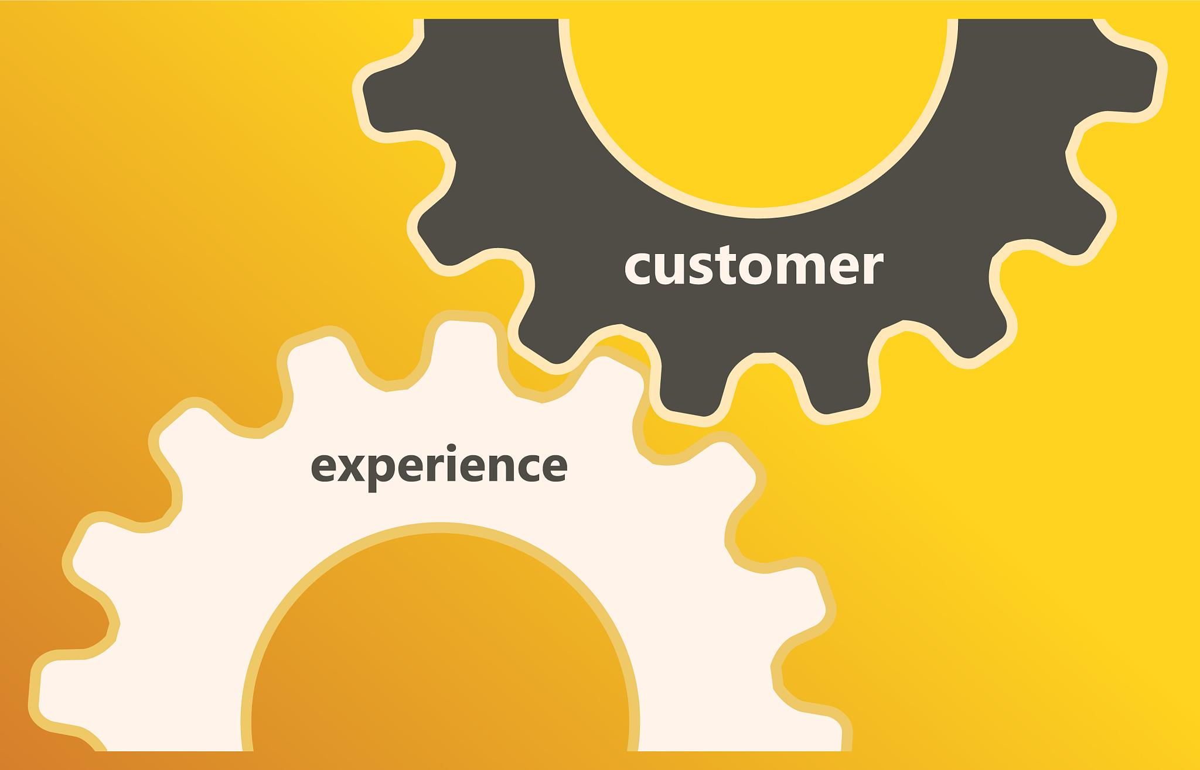
客户服务
售前咨询
Set up a professional pre-sales consulting team, through telephone, online customer service and other ways to answer consumers' questions, provide detailed product introduction and purchase advice. At the same time, recommend the most suitable product configuration and package plan according to the needs of consumers.
售中服务
Provide tracking services throughout the consumer purchase process to ensure that the order is accurate and timely delivery. For consumers with special needs, such as customized services, expedited delivery, provide personalized solutions.

Slide 28

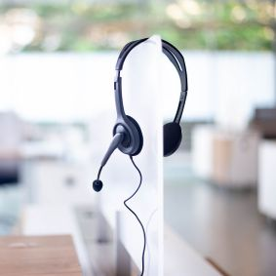
客户服务
售后服务
Establish a perfect after-sales service system, including product return, maintenance, technical support and so on. Set up a special after-sales service hotline to ensure that consumers can get a timely response and solution when they encounter problems. At the same time, regular customer visits and satisfaction surveys are conducted to collect feedback and constantly improve the quality of products and services.
会员服务
Launched a membership system to provide members with more preferential prices, exclusive customer service channels, regular sleep health reports and other value-added services. Through membership services to enhance consumer loyalty and stickiness, promote re-purchase and word-of-mouth spread.

Slide 29
06
Financial analysis

Slide 30

资金来源与结构
自有资金
天使投资
Detail the initial capital investment of the founders and core team, including personal savings, family support, etc.
Describe the strategy to attract angel investors, including the investor's background, investment intentions and expected investment amount.
风险投资
政府补助与贷款
Analyze the concerns and cooperation possibilities of potential venture capital institutions, and formulate financing plans
Explore the feasibility and specific procedures of applying for government grants for science and technology projects, innovation funds and bank loans.

Slide 31
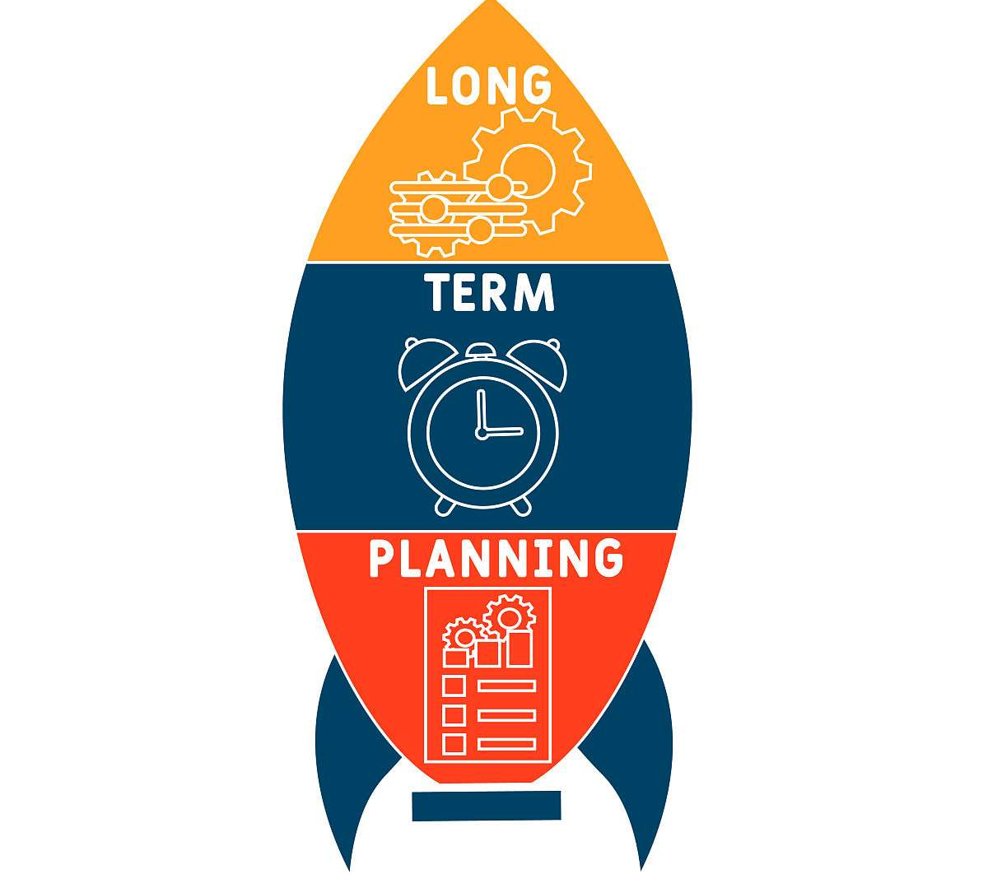
启动资金运用
研发支出
01
Explain in detail the capital requirements and distribution plan for product development, testing, certification and other stages.
市场推广
02
Market promotion strategy, channel construction and initial brand promotion of capital investment.
运营准备
03
Including office space rental, equipment purchase, team building and other operational preparation needs.

Slide 32


成本分析与预测
成本趋势分析
成本优化策略
Predict future cost trends based on historical data and industry trends.
Proposed cost reduction measures, such as economies of scale, supply chain management optimization, technological innovation, etc.

Slide 33

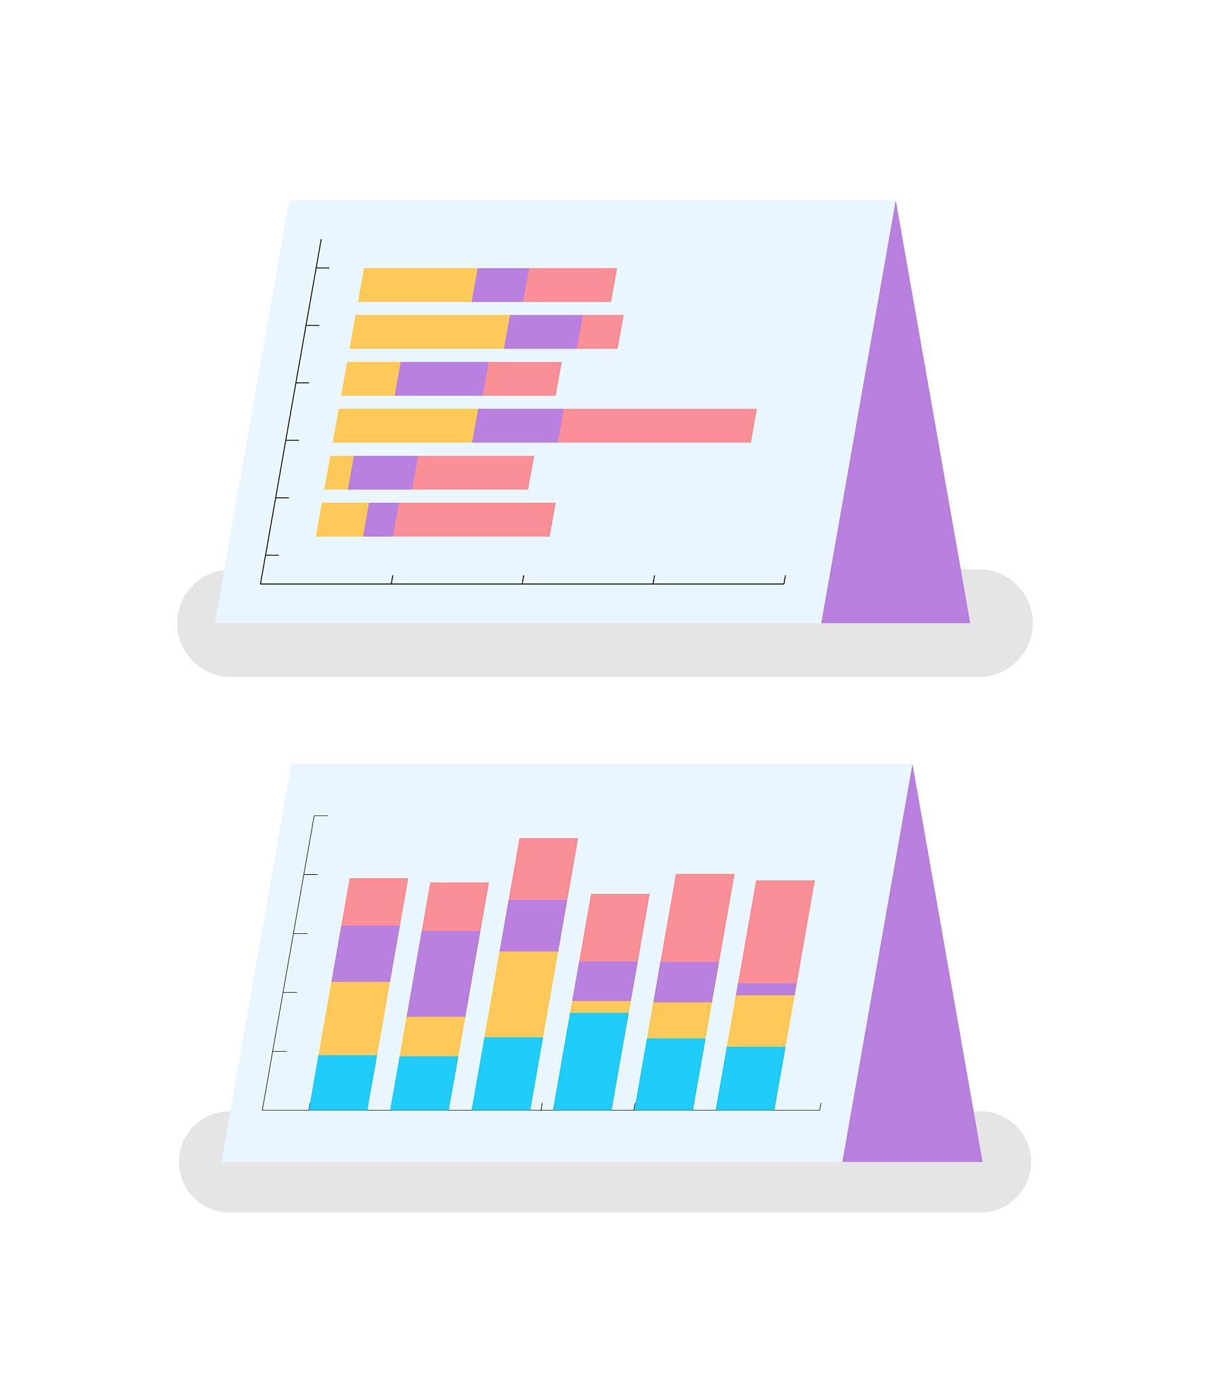

收入分析与预测
收入来源
收入预测模型
敏感性分析
Identify the main sales channels and revenue sources of the product, such as online sales, offline retail, enterprise cooperation, etc.
Establish a revenue forecasting model based on market capacity, penetration rate, pricing strategy and other factors.
Evaluate the robustness of revenue forecasts under different market conditions and identify potential risk points..

Slide 34
07
Team introduction

Slide 35

团队概况
团队名称
ZenSleep创业团队。
团队理念
致力于通过科技改善人们的睡眠质量，提高生活品质。
团队规模
由2名全职成员和兼职顾问组成。

Slide 36
团队成员介绍
01
张嘉慧
03
睡眠研究专家
首席执行官（CEO）兼首席技术官（CTO）。
背景：华南师范大学本科生。
职责：负责公司战略规划和整体运营。
职责：提供专业的睡眠知识支持，确保产品的科学性。
02
温晓雪
首席营销官（CMO）。
背景：华南师范大学本科生。
职责：负责市场策略和品牌建设。

Slide 37
团队架构
管理层
研发部
市场部
负责制定公司战略和决策，监督团队运营。
负责产品设计和开发，技术创新和知识产权管理。
负责市场调研、推广和销售，与客户保持沟通和反馈。
财务部
法律顾问团
负责公司财务管理和资金运作，确保公司稳健发展。
为公司提供法律支持和合规建议，规避法律风险。

Slide 38
08
Risk assessment and response

Slide 39
风险类型详细分析
01
02
03
04
05
市场风险：市场需求变化、消费者偏好转移、竞争对手策略调整等可能导致市场份额下降。需密切关注市场动态，定期进行市场调研，确保产品符合市场需求。
技术风险：产品研发过程中可能遇到技术难题，导致产品延期上市或性能不达标。需建立专业的研发团队，加强技术储备，确保技术方案的可行性和稳定性。
供应链风险：原材料供应不稳定、生产成本波动等可能影响产品生产和交付。需建立多元化的供应商体系，优化库存管理，确保供应链的稳定性和灵活性。
财务风险：资金筹措困难、成本控制不力等可能导致项目资金短缺。需制定合理的财务计划，加强成本控制，确保项目资金充足且使用效率最大化。
法规政策风险：政策法规变化可能对产品上市、销售等环节产生影响。需密切关注政策法规动态，确保产品符合相关法规要求，及时调整经营策略。

Slide 40
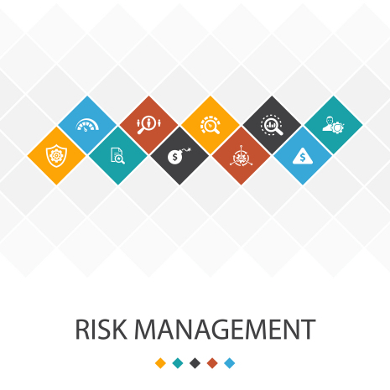
风险应对策略
市场风险应对
加强市场调研，了解消费者需求变化；优化产品组合，提高产品竞争力；加强品牌建设和营销推广，提升品牌知名度和美誉度。
技术风险应对
加大研发投入，引进先进技术；建立技术合作机制，与高校、科研机构等建立合作关系；加强知识产权保护，确保技术成果的安全和稳定。
供应链风险应对
建立多元化的供应商体系，降低对单一供应商的依赖；加强库存管理，确保原材料供应充足且成本可控；优化生产流程，提高生产效率和质量。

Slide 41



风险应对策略
财务风险应对
制定合理的财务计划，确保项目资金充足；加强成本控制，优化资源配置；建立风险预警机制，及时发现并应对潜在的财务风险。
法规政策风险应对
密切关注政策法规动态，及时调整经营策略；加强合规管理，确保产品符合相关法规要求；建立与政府部门的良好沟通机制，争取政策支持和优惠待遇。

Slide 42
退出机制
01
03
上市退出
清算退出
02
04
当企业发展到一定规模且具备上市条件时，可通过上市融资实现资本退出。需提前规划上市路径和时间表，确保上市过程的顺利进行。
并购退出
若项目无法继续推进或面临重大风险时，可考虑进行清算退出。需制定详细的清算方案和时间表，确保清算过程的合法、合规和有序进行。
股权转让退出
积极寻求与行业内领先企业的并购机会，通过被并购实现资本退出。需明确并购对象和条件，确保并购过程的公平、公正和透明。
通过向其他投资者转让股权实现资本退出。需明确股权转让的对象和条件，确保股权转让过程的公平、公正和透明。同时，需关注股权转让后的企业治理结构和经营策略变化。

Slide 43
09
References

Slide 44
参考文献
市场调研数据
行业报告分析
竞争对手分析
根据多项市场调研数据显示，现代人普遍面临睡眠问题，超过60%的人表示自己睡眠不足，近40%的人表示睡眠质量不佳。这一市场需求为ZenSleep产品的推出提供了坚实的基础。
参考了贝哲斯咨询、恒州恒思等行业报告，对全球及国内睡眠市场的规模、增长趋势、竞争格局等进行了深入分析，为ZenSleep产品的市场定位和发展战略提供了有力支持。
对国内外知名睡眠品牌如SleepInnovations、SleepCouncil等进行了详细的产品线、品质、口碑以及营销策略的分析，为ZenSleep产品的差异化竞争提供了参考。

Slide 45

THANKS
感谢观看

