Slide 1

ART TEMPLATE
iLife生活记录册界面展示
MANAGE TIME AND MONEY FOR YOU.
袁博伦 袁达强 林小龙

Slide 2
C O N T E N T S
THE TEMPLATE DESIGN BY JIUJIU.
主界面
子界面
界面关系
本次分工

Slide 3


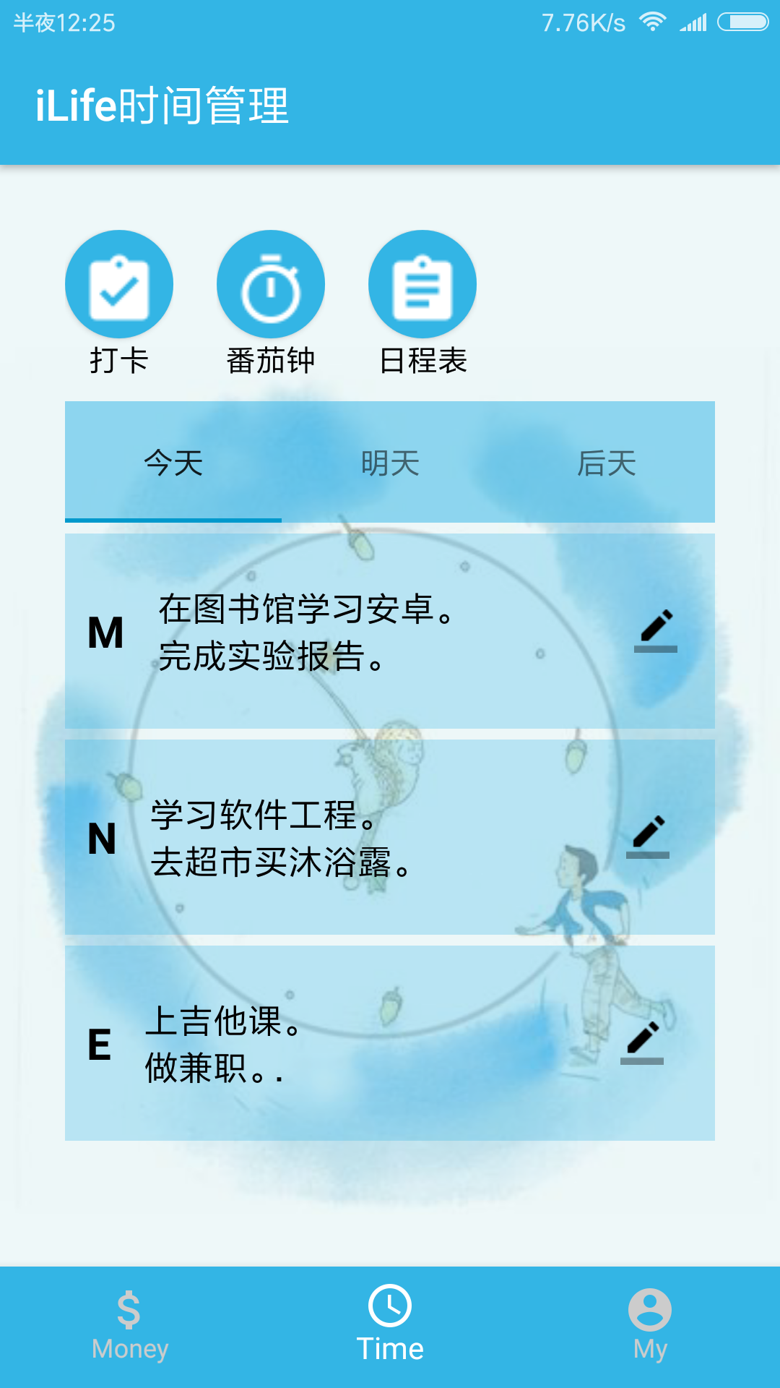
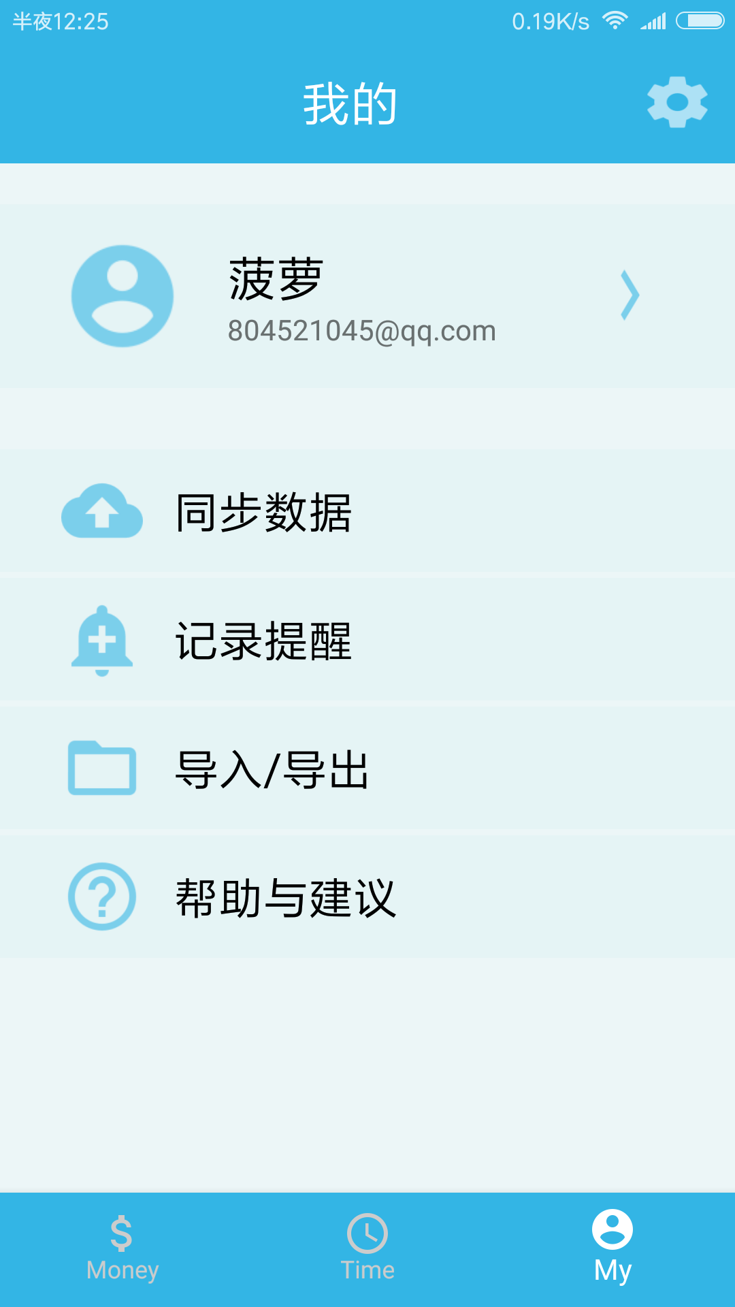
01
主界面
Made by Android Studio.

Slide 4

iLIfe记账本
THIS IS A account book .Hope you like it.
three ways. I will do somebody a good turnJust for today I will try to live through this day only and not tackle my three ways. I will do somebody a good turnJust for today I will try to live through this day only and not tackle my
three ways. I will do somebody a good turnJust for today I will try to live through this day only and not tackle my three ways. I will do

Slide 5
01
查看日程
Just for today I will try to live through this day only and not tackle my whole life at once.
编辑日程
02
iLife 时间管理
Just for today I will try to live through this day only and not tackle my whole life at once.
Just for today I will try to live through this day only and not tackle my whole life problem at once. I can do for twelve hours that
每日打卡
03
Just for today I will try to live through this day only and not tackle my whole life at once.
番茄时间
04
Just for today I will try to live through this day only and not tackle my whole life at once.

Slide 6
THIS IS A REMO TEMPLATE ,THANK YOU WATCHING THIS ONE
My
Here to set your account.
Just for today I will try to live through this day only and not tackle my whole life problem at once. I can do for twelve
hours that Just for today I will try to live through this day only and not tackle my whole life problem at once. I can do for twelve hours that

Slide 7
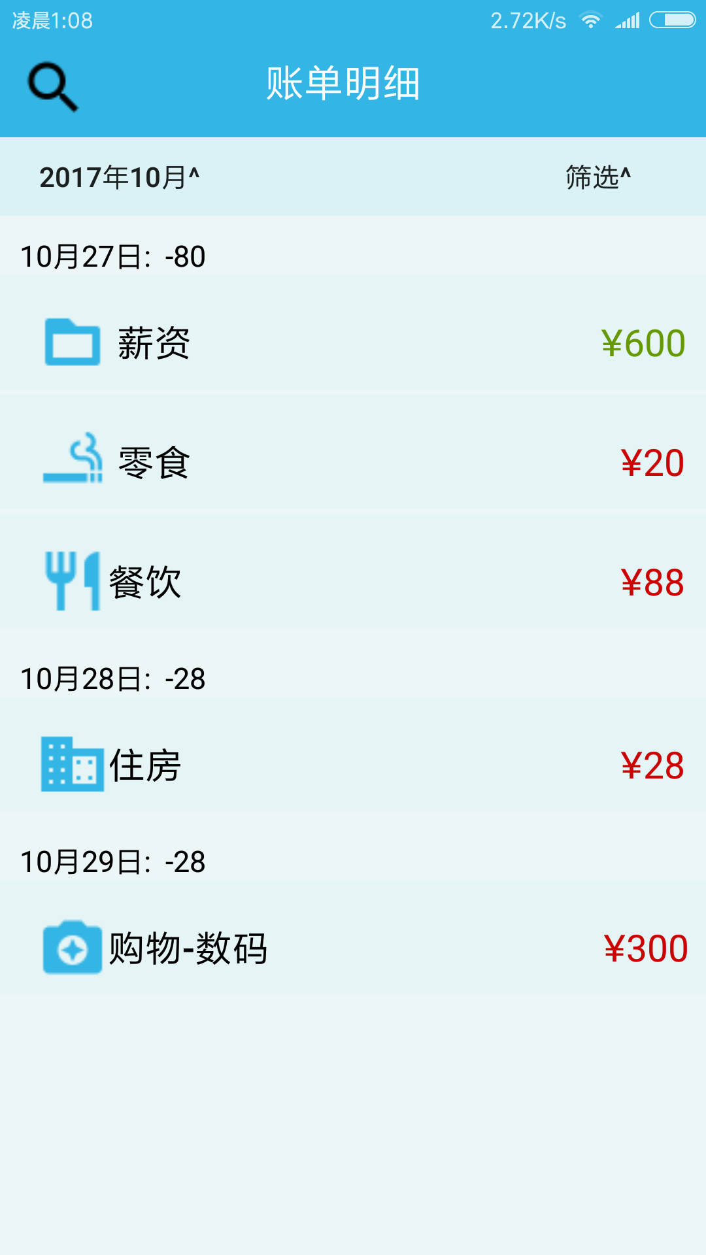
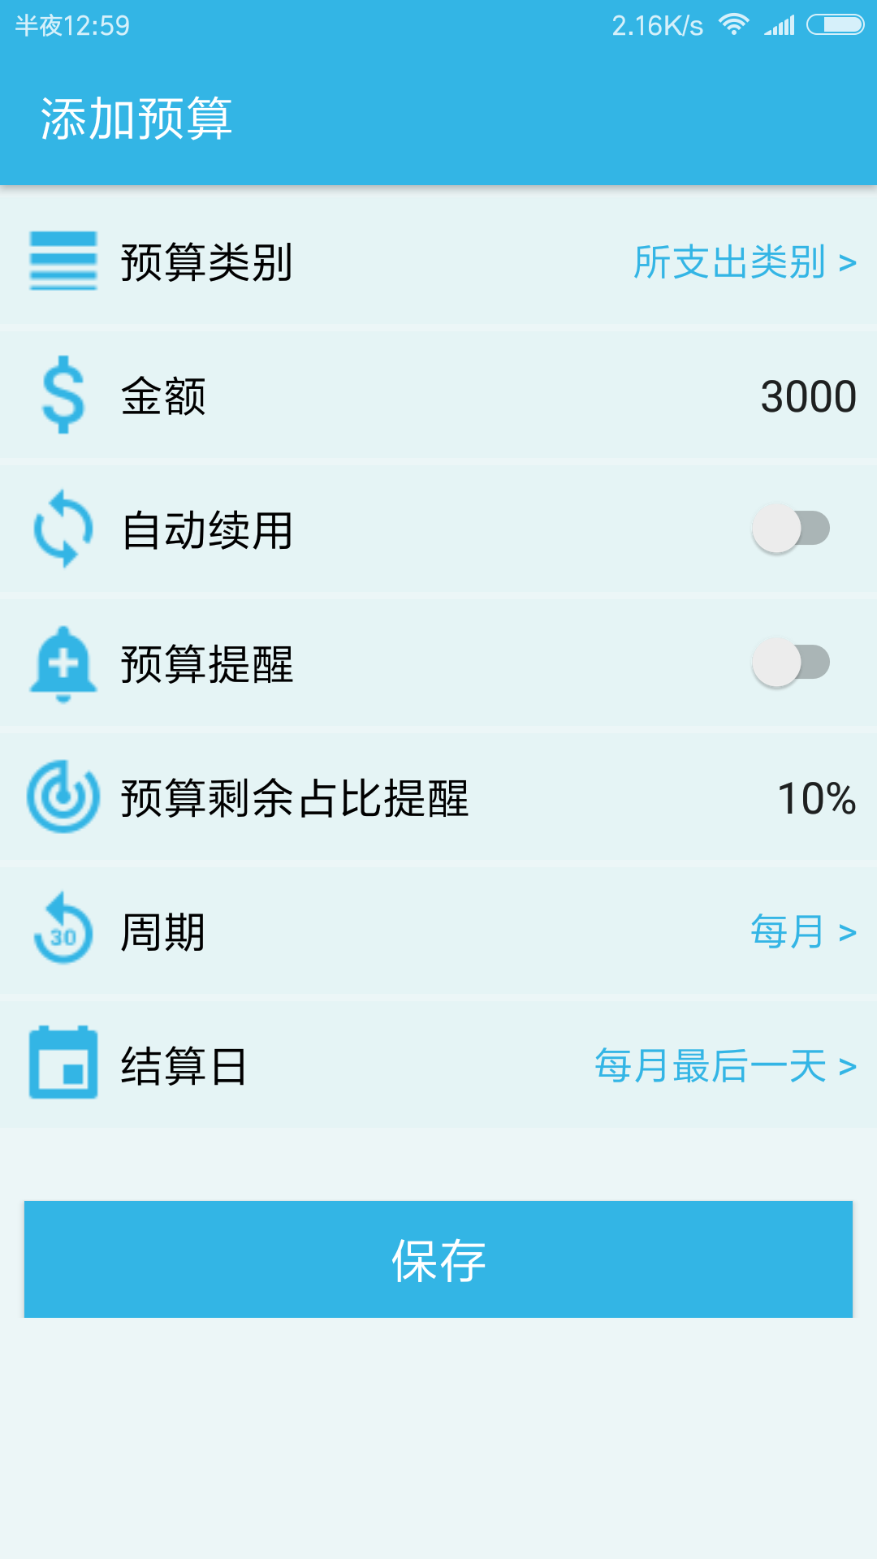
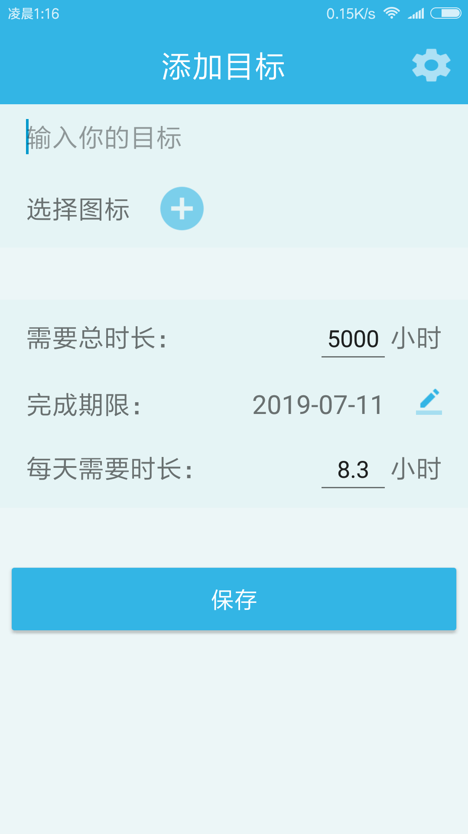
02
子界面
Made by Android Studio. Just for today I will try to live through this day only and not tackle my whole life at once.

Slide 8
Check account book
The waves beside them danced; but they Just for today I will exercise my soul in three ways.
Edit budget
The waves beside them danced; but they Just for today I will exercise my soul in three ways. I will do somebody a good turn

Slide 9
04
任务分工
Just for today I will try to live through this day only and not tackle my whole life at once.

Slide 10
UI设计、制作分工
THIS IS A ART TEMPLATE ,THANK YOU WATCHING THIS ONE
袁博伦、袁达强、林小龙
袁博伦
界面模块划分、主题配色确定
主界面设计与实现（记账本、时间管理、My界面）
各界面整合
PPT制作
袁达强
林小龙
记账本子界面设计与实现
图片素材搜集
时间管理模块子界面设计与实现
界面动态效果优化

Slide 11


Thank you
Just for today I will try to live through this day only and not tackle my whole life at once. I can do Just for today I will try to live through Just for today I will try to live through this day only and not tackle my
Just for today I will exercise my soul in three ways. I will do somebody a good turnJust for today I will exercise my soul

