Slide 1

Mobile Visual Campus Guide
Jon van der Hilst

Slide 2
Hello
  My Project
    What it does
    How it works
    Interesting things I am using

Slide 3
My Project
Mobile Visual Campus guide
Android Application
Point the camera at a building on campus
Take photo of said building
System processes the image using image recognition techniques
System tells you details about that building
  Name
  Classes held inside
  etc

Slide 4
Application
Contains two main activities
First: Simple camera preview
  Click the camera preview to invoke the second activity
Second: Processes the resulting image
  Then presents user with results
Not so flash at the moment
  Doesn't really need to be for the purpose of research

Slide 5
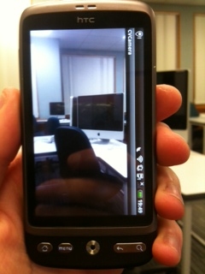

Slide 6
How it works
Tapping the camera preview invokes the camera API to take a photo
  We need 3 callbacks
    Shutter
    Raw Data
    JPEG
  Save image to a file(temporarily)
This invokes native C++ code
  Done by using JNI(Java Native Interface)
    Generated automatically using SWIG

Slide 7
How it works
  Native code makes heavy use of OpenCV
    Open Computer Vision
      Use the NDK to cross-compile OpenCV for the ARM architecture(It has a compiler)
    Won't Work with Emulator(ARM7 only)

Slide 8
How it Works
In the C++ code, we make heavy use of OpenCVs functions
Open the image(As a cv::Mat)
Compute SURF descriptors(which describe an image) (Query)
System has precomputed descriptors for images of various buildings around campus(Database)
For each descriptor set in the database:
  Compute Similarities
Descriptor set with most similarities is most likely image of the same thing
  Do a simple lookup

Slide 9
BUT
It's not that quick
My database and query images are 512x384 pixels
Takes roughly 1 second to compare two descriptor sets
So, I use a combination of GPS and the Compass to filter out matches

Slide 10
Filtering using GPS
We need to create a class which implements"LocationListener" class. This must implement method
onLocationChanged(Location loc)
double lat = loc.getLatitude()
double lon = loc.getLongitude()
GPS coordinates come in the form of two numbers, for example:
  Lat: -45.54321 (45deg South, 32m31s)
  Lon: 170.12345 (170eg East, 8m12s)

Slide 11
Filtering using GPS
Store coordinates of all buildings
For each building:
  Calculate distance between building and our current position
    Using Trig(Inaccurate)
    Using Great-Circle distance
      Takes into account sphericy of earth
  If smaller than some distance(100m), add building to list that needs to be compared

Slide 12
Same with Compass
Create class which implements SensorEventListener
  Must implement
    onSensorChanged(SensorEvent env)
    onAccuracyChanged(Sensor sens, int accuracy)
In onSensorChanged, compass heading is SensorEvent.values[0] - From 0-359 degrees
  Gets called whenever the compass is adjusted
Compass follows magnetic North and NOT true North

Slide 13
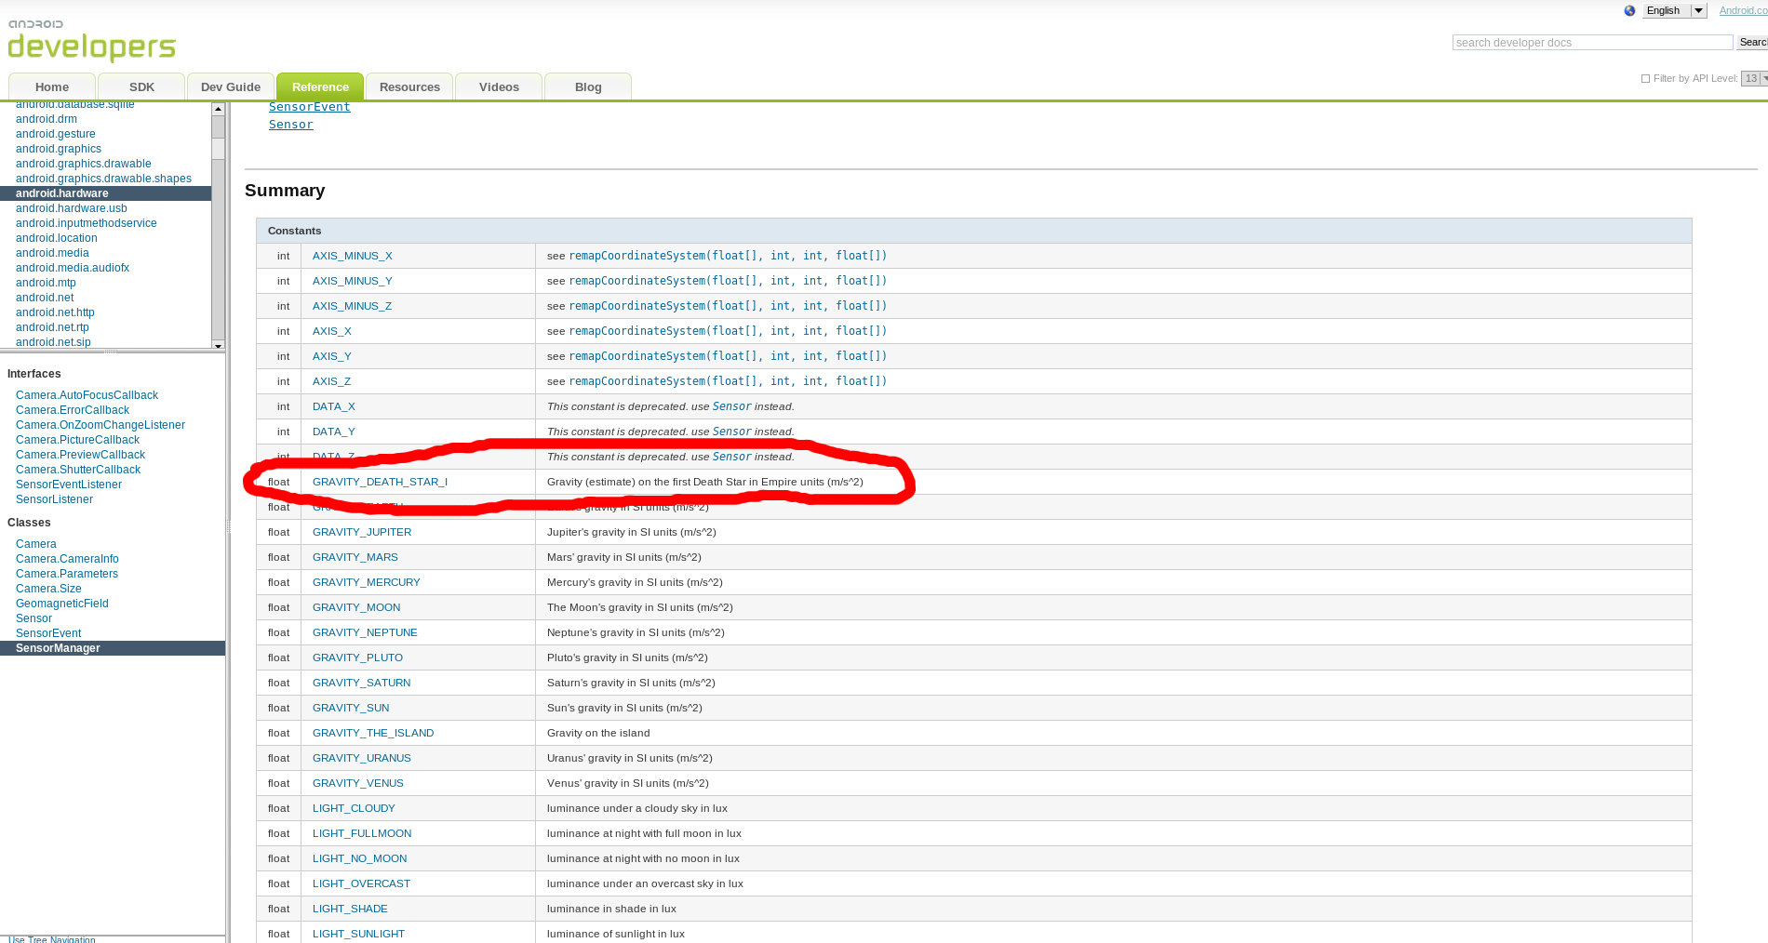

Slide 14
Compass
For each building
  Calculate angle between current position(user), building position and True North
  If our current heading is close to that angle(Say, within 90deg)
    Add building to list that need to have image matching done
If Phone is in Landscape mode, Compass will be off by 90 degrees!

Slide 15
Thanks

