Slide 1
Android Forensics
“What your phone knows about you, and how to persuade it to start talking”

Slide 2
Traditional IT Forensics
Make a perfect copy of the machine without changing anything; analyse this copy
Can’t read the memory without starting the device
But starting the device changes the machine state!
What will the judge say???
Chip-off methods are very expensive…

Slide 3
Sucks to be law enforcement(?)
Traditional forensic analysis is very difficult to do on Android devices
Must accept some degree of post-custody changes to the OS and filesystem
OR
Spend a huge amount of $$$ on chip-off methods

Slide 4
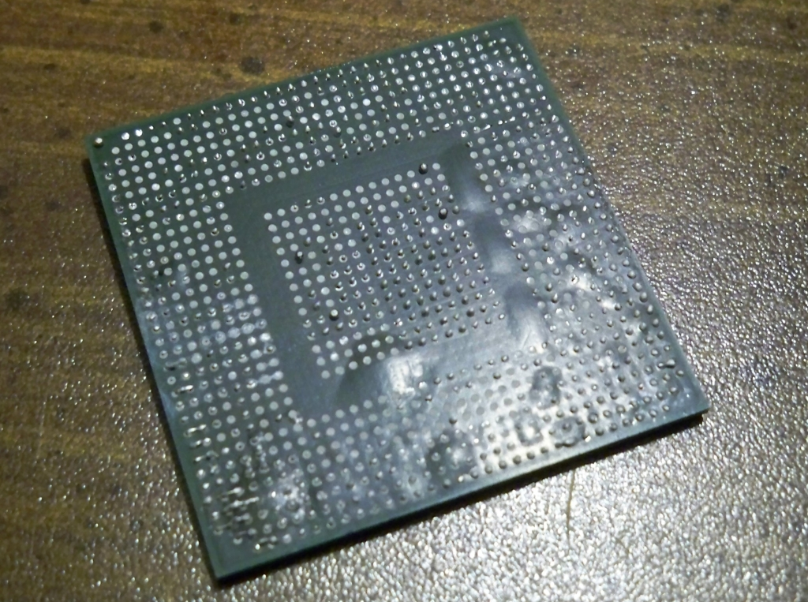
Chip-off aka Forensic Desoldering

Slide 5
Android OS Security features
Android has a very robust security framework by default
Each app is a unique Linux user in the device it’s installed on, therefore:
Internal storage data can’t be read by other apps unless explicitly allowed (Files on external storage are world read and writable)
Thus, “impossible” to make an app that can read the data stored by other apps on internal memory.
Except…

Slide 6
Rooting (not just for humans)
A Linux superuser can read and write to anything.
So a forensic app needs to run as root (otherwise we can’t read all aspects of the device filesystem)
99.99% of phones do not normally run as root (good!) per the usual Linux security model
Getting root access is different for each phone!
Every commercial Android forensics product requires root for full functionality

Slide 7
Memory Layout
Boot Loader
Starts first, just boots other partitions. Normally boots default Android OS partition (aka “ROM”). You can usually bring up boot loader menu (if you know how) and choose which partition to boot into. NB: Boot loader is always “root!” (because it starts outside of OS permissions)
Default OS Partition
Android OS from manufacturer/carrier.
Dalvik VM
Apps running as unique, non-root users within their own VMs inside the Android security framework.
Service Tools and Functions
Like restoring an OS image to the default partition. Usually locked down to “authorised” functions. However, you can modify the recovery OS…
Recovery Partition
OS from manufacturer/carrier with service functions. Recovery OS also has to run as root because it may need to write to the default OS partition.
External Storage Partition
This partition is on the SD card if you have one. Is world readable and writeable. Just stores your porn data.
Data
Sometimes apps are stored on the SD card if you choose to do so (e.g. APP2SD)

Slide 8
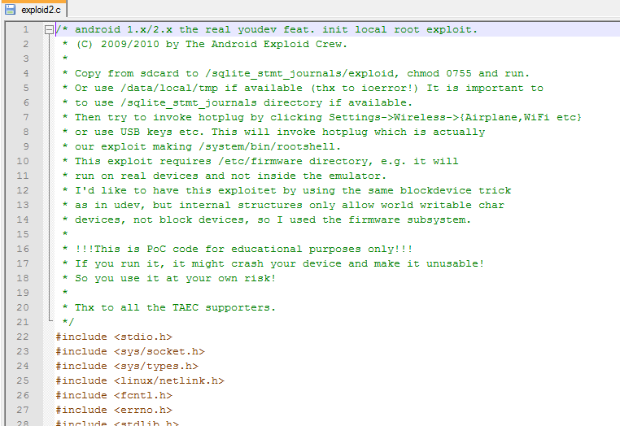
Rooting positions methods
Udev aka Exploid2/Exploid code. Exploits CVE-2009-1185: udev before 1.4.1 does not verify whether a NETLINK message originates from kernel space, which allows local users to gain privileges by sending a NETLINK message from user space.

Slide 9
Rooting methods
Often some form of “attack” against:
Bootloader
Not common – most manufacturers use very simple bootloaders. Exception: Samsung Nexus series
Recovery Partition
Common. Replace original recovery partition with a custom or modified recovery image with additional features. Allows modification to existing OS or replacement with pre-rooted OS image
E.g. ClockWorkMod, AllInOne Recovery, Amon RA Recovery, Open Recovery
Android/Linux Partition (aka SoftBreaks)
Variations of CVE-2009-1185 udev vulnerability⁰ (aka Exploid/Exploid2. e.g. SuperOneClick)
Variations of adb setuid exhaustion vulnerability⁰ (aka RageAgainstTheCage/”CVE-2010-EASY”)
Similar method used by Zygote/Zimperlich rooting method against /system/bin/app_process
Both fixed in Android 2.2.2
Variations of CVE-2011-1823 volume manager (vold) out of bounds array access exploit (aka Gingerbreak and Gingerbreak2¹)
Fixed in Android 2.3.4²³⁴
Malware containing all the above exploits has been discovered in the wild.

Slide 10
Making a secure app
Encrypt network traffic – SSL/HTTPS
Be mindful of MITM attacks against SSH
Prevents intrusion at the packet level

Slide 11
Making a secure app
Encrypt local storage data with password
Yes you can be forced to reveal the password, but would prevent casual snooping
Slightly inconvenient, somewhat secure

Slide 12
Making a secure app
Encrypt local storage data with password and multiple user defined keyfiles selected on app launch
If keyfiles are stored on external storage, destroy the SD card to lock your data forever
If keyfiles are stored on internal storage, the attacker must be clever enough to figure out which file(s) are used
Somewhat inconvenient, very secure

Slide 13
Making a secure app FTW
Encrypt local storage data with password and multiple user defined keyfiles selected on app launch
Feature: Open different encrypted storage areas depending on which passwords and keyfiles are used
Under duress, open a “decoy” storage area
Now you have plausible deniability
Profit (Will users pay more for more security?)

Slide 14
Encryption Libraries
Dalvik uses BouncyCastle for the general framework and for many, but not all cipher implementations.
http://source.android.com/tech/encryption/android_crypto_implementation.html
AES - use javax.crypto.Cipher (along with helpers CipherInputStream and CipherOutputStream)

