Slide 1
Health Information System
Peter Michuki
Internship Task Date:04/26/2025

Slide 2
Problem Statement
Manual tracking of clients and health programs is error-prone and inefficient for healthcare providers.
Solution Strategy:
Adopted Agile methodology for iterative development
Prioritized core features first (client registration, Health program enrollment, search)
API-first design for future integrations
Tools & Frameworks:
ASP.NET Core MVC, Entity Framework Core, SQL Server
REST API with Swagger documentation
Bootstrap for responsive UI

Slide 3
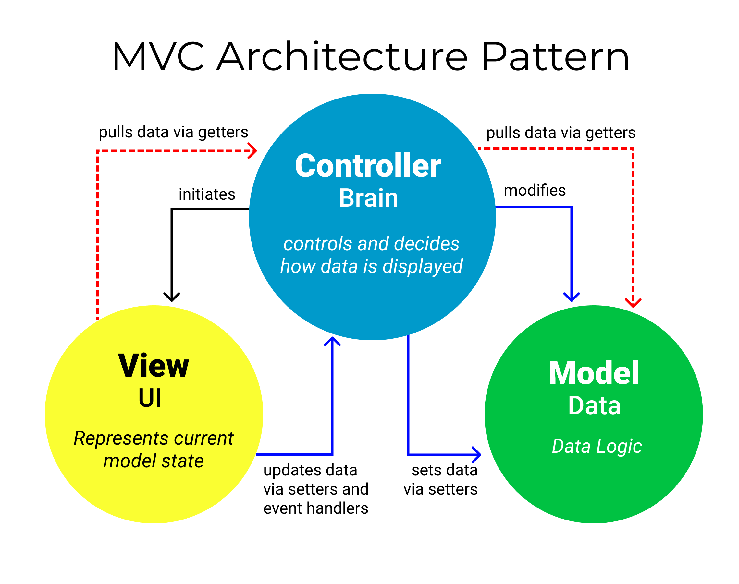
Design
System Architecture:
Diagram: MVC Pattern (Model-View-Controller)

Slide 4
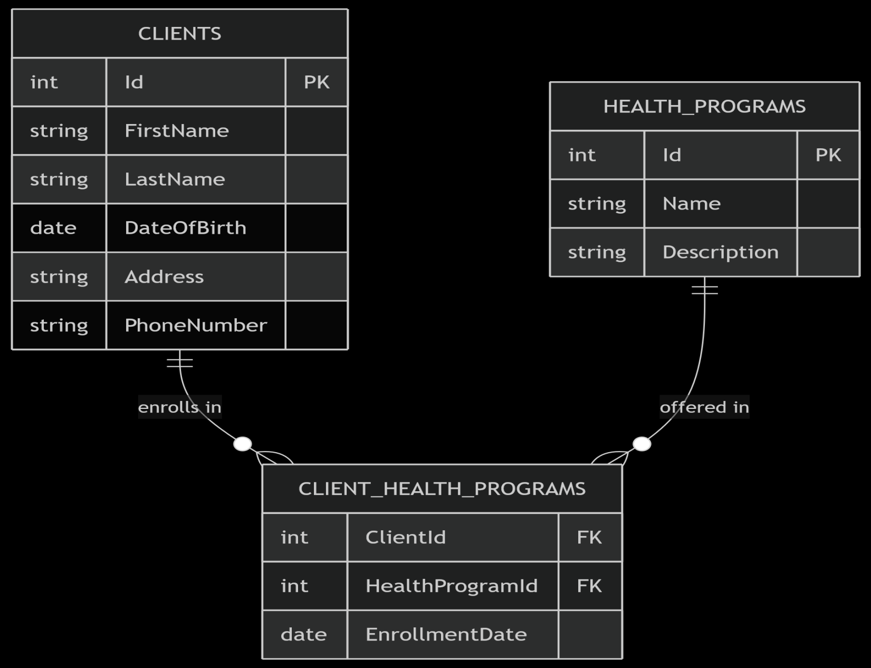
Database Schema
Tables: Clients, HealthPrograms, ClientHealthPrograms (junction table)
Relationships: Many-to-many between Clients and Programs

Slide 5
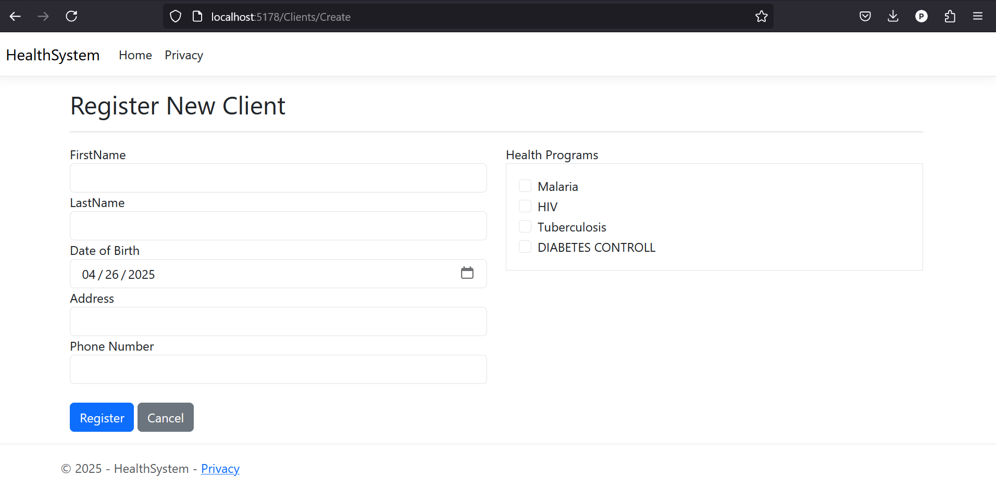
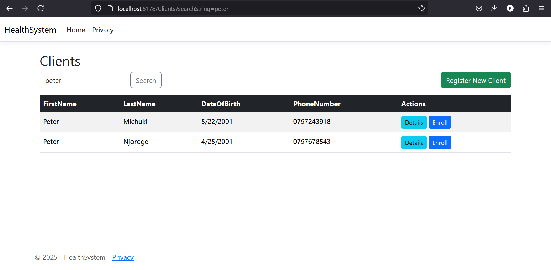
UI Wireframes

Slide 6
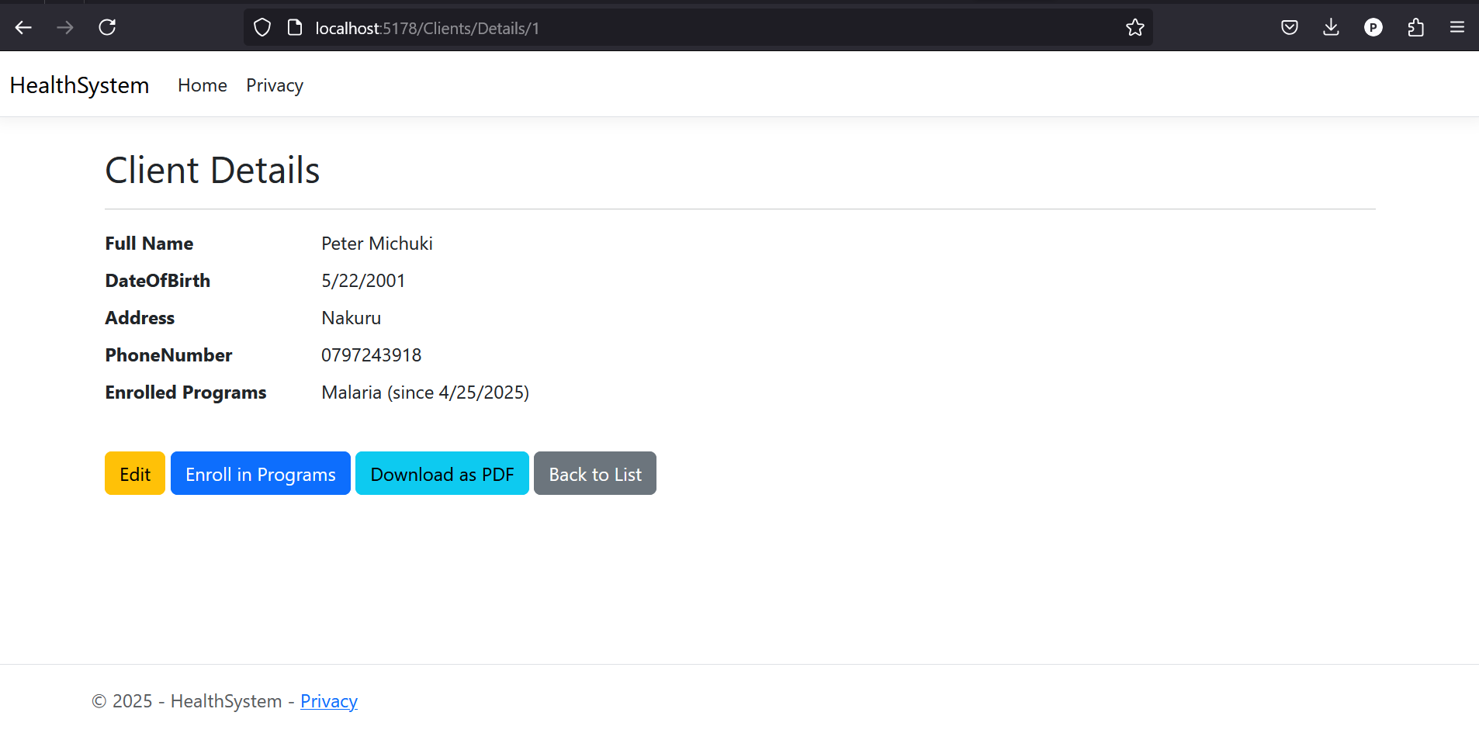
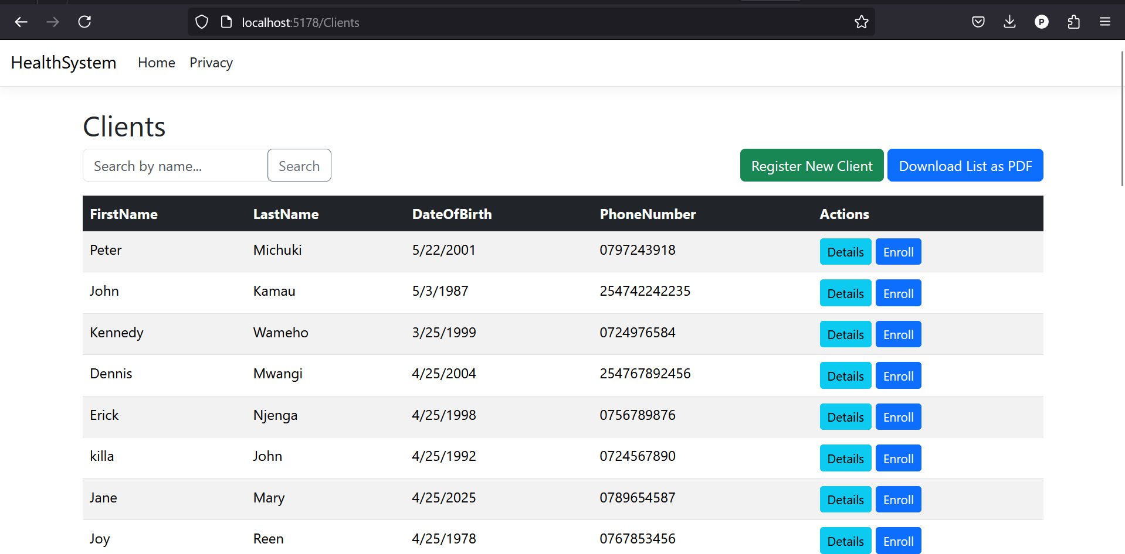

Slide 7
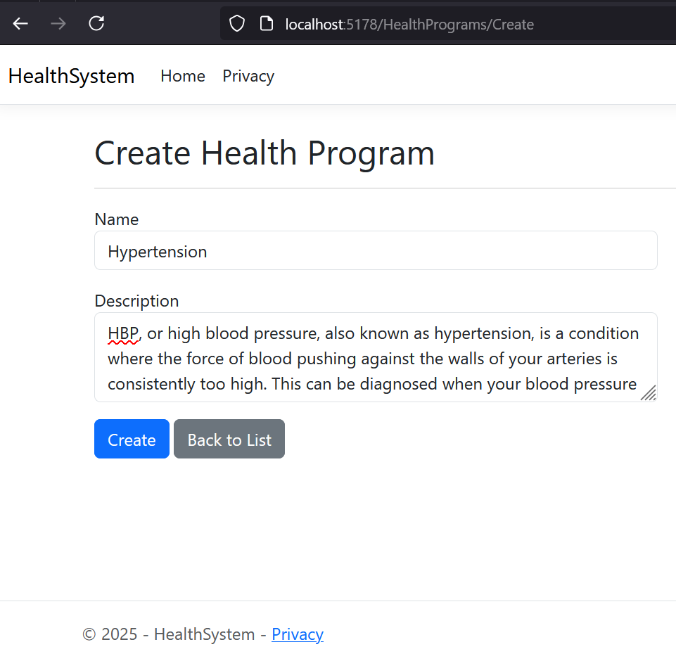
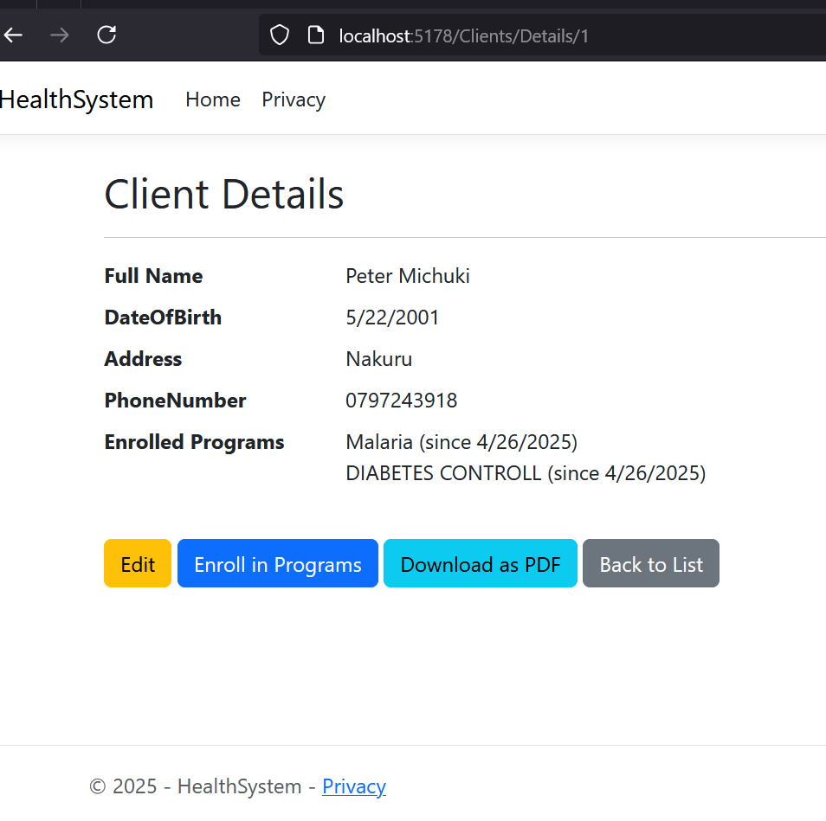
Solution Implementation
Multi-select programs during registration

Slide 8
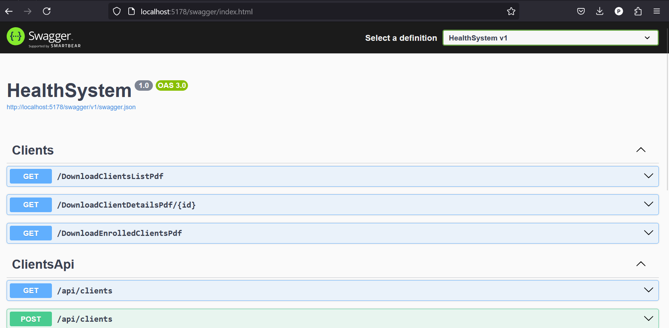
API Endpoint:
GET /api/clients/{id} with JSON response

Slide 9
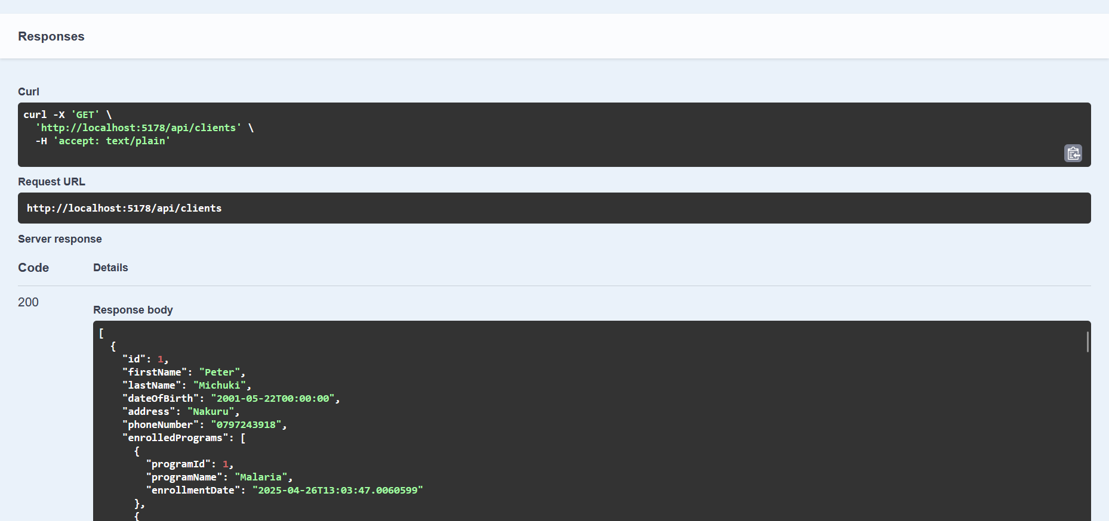

Slide 10
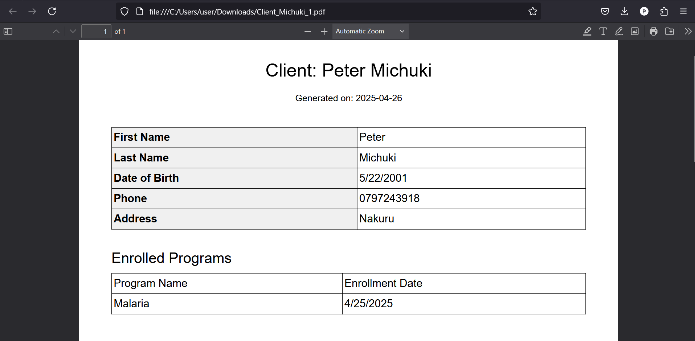
Exporting Client Details as Pdf:

