Slide 1


RCSJTA implementation
Open source management
Jean-Marc AUFFRET, jeanmarc.auffret@orange.com
Orange Labs
07/04/2014
Notes:
presentation title

Slide 2
Introduction
This document summarizes all the information related to the RCSJTA open source project.
RCSJTA means « RCS Java Terminal API », a Java/Android Terminal API.
The project is available at https://code.google.com/p/rcsjta/.
The project offers a Reference Implementation (RI) of a RCS-e service for the Android platform only.
The project contains:
  a RCS stack offering the background RCS service on a device.
  a RCS API on top of the stack used by applications (native Address Book, Messaging, Dialer apps or any other third party apps).
  Several tools to test the RCS service.
  Docs (samples of code, API Javadoc, etc.).

Slide 3
Repository
All the source code, docs, tools and samples of the project are under Apache 2 license.
The repository is managed via GIT a distributed revision control and source code management (SCM) system.
Main directories:
  \core -> RCS stack
  \docs -> project documents
  \CR -> Change Requests
  \javadoc -> API Javadoc reference
  \RI -> Basic test tool using the API
  \samples -> samples of source code using the API
  \sdk-joyn -> SDK (all in one zip)
  \tests -> API signature test harness

Slide 4
GIT branchs
The master branch contains the official release.
The integration branch contains the release under implementation.
Orther branches contains contributions (CR, Bug fixes, .etc) to be integrated in the integration branch.
Issue XXX
integration branch
rev 3
rev 4
rev 3
rev 4
rev 5
new release
rev 1
rev 2
rev N
rev N+1
master branch

Slide 5
How to report a bug
Create a new Issue from the RCSJTA web site at https://code.google.com/p/rcsjta/issues/list.
For any Issue:
  Describe in detail the error.
  Describe the way to reproduce the issue if possible.
  Give any information of the OS platform (Android release at least).
  And the most important: add device traces (ie. logcat output).
The Issue will be corrected asap by the core open source team depending on the issue priority .
Any developer can also propose a fix for the issue which will be merged by the core team after a code review.

Slide 6
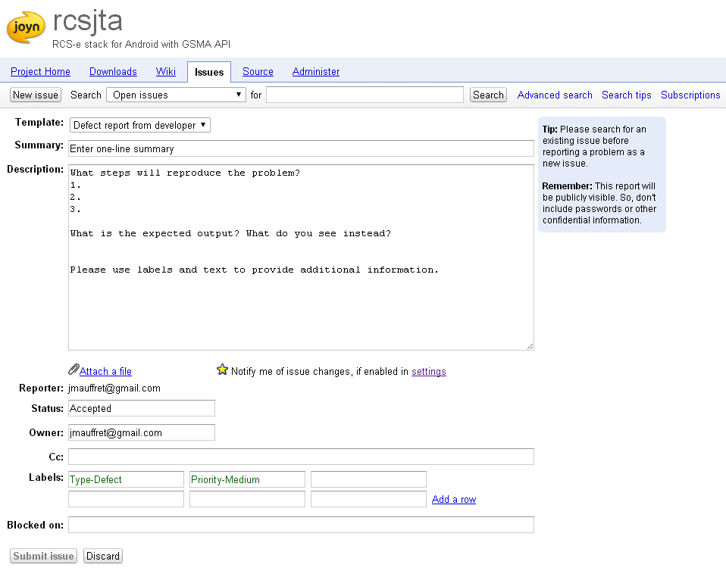
How to report a bug

Slide 7
How to contribute to the API
Any modification on the API should be agreed by GSMA, OEM, and Telcos during a dedicated meeting.
For any API change request or proposed evolution:
  Create a new CR (Change Request) document based on the following template « /docs/CR/RCSJTA_TT_CR_Template.doc ».
  Ask for a specification review (contact is Kelvin Qin at GSMA).
  When the CR is agreed between all actors (GSMA, OEMs, etc), an implementation is proposed thanks to a dedicated GIT branch in the RCSJTA repository.
  The core team (Orange Labs, SONY or any main open source contributor) reviews the CR implementation and decide to merge it or not in the integration branch.
The current API release is available at https://rcsjta.googlecode.com/git/docs/index.html.

Slide 8
How to contribute to the API
All API CRs are stored in the RCSJAT repository at « /docs/CR ».
See the implementation procedure with GIT:
CR XXX
rev 3
rev 4
start CR from a new branch
merge CR
rev 1
rev 2
rev N
integration branch

Slide 9
How to contribute to the stack implementation
For any source code fix or proposed evolution:
  Create a new Issue from https://code.google.com/p/rcsjta/issues/list.
  Attach source code or create a new GIT branch with the source code contribution.
  Request a code review to the core team.
  The core team reviews the implementation and decide to merge it or not in the integration branch.

Slide 10
How to contribute to the stack implementation
See the implementation procedure with GIT:
Issue XXX
rev 3
rev 4
start bug fix from a new branch
merge fix
rev 1
rev 2
rev N
integration branch

