Slide 1

Applied Data Science Portfolio
Andrew Zelazny
December 6, 2021

Slide 2
Program Goals
Collecting, storing, and accessing data with applicable technologies
Creating actionable insights for many different contexts
Applying visual and predictive models to generate insights
Communicating insights to a broad range of audiences, both technical and business minded
Applying ethics in the development, use and evaluation of data and models
Demonstrating the ability to gain insight from data and models with industry standard software packages, including R, Python, and SQL

Slide 3
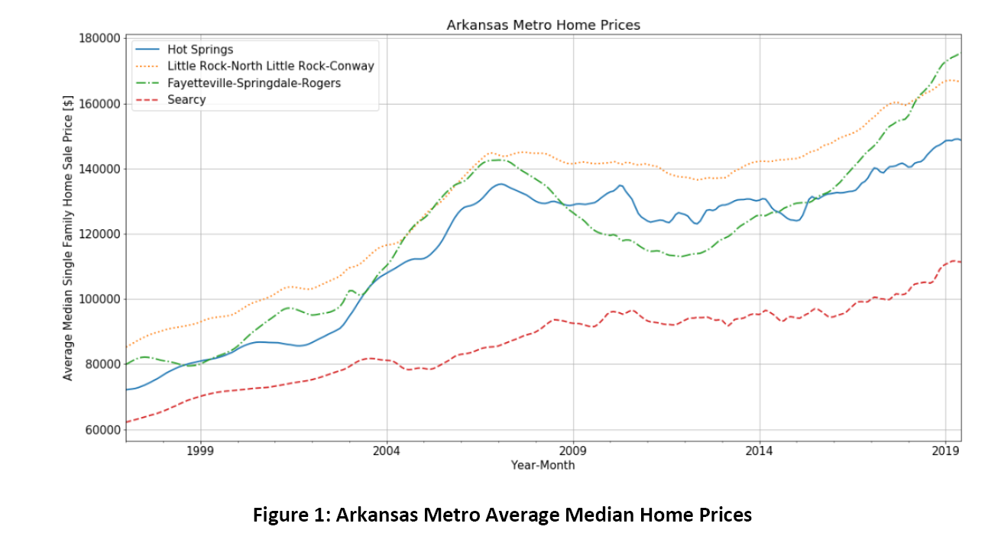
IST 718: Big Data Analysis
Python
Collecting data
Visual and predictive models

Slide 4
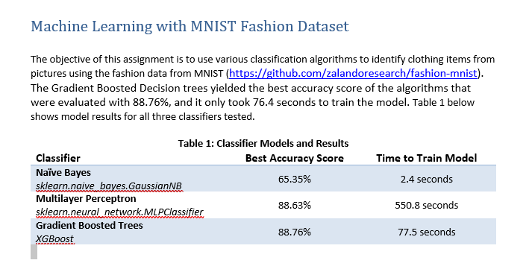
IST 718: Big Data Analysis
Communicating insights
Bottom Line up Front

Slide 5
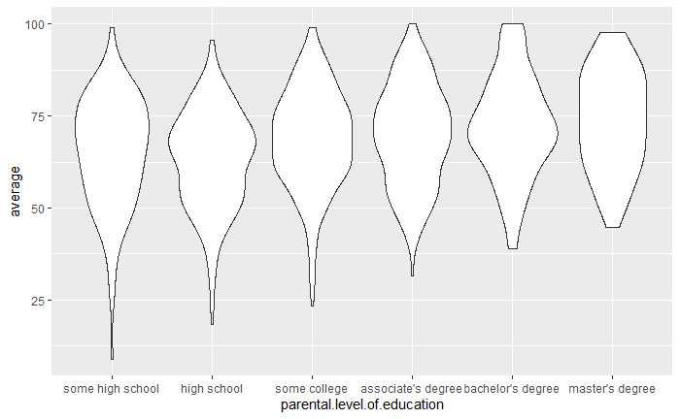
IST 707: Data Analysis
R/RStudio
Collecting data
Visual and predictive models
Communicating insights
Actionable insights in different contexts

Slide 6
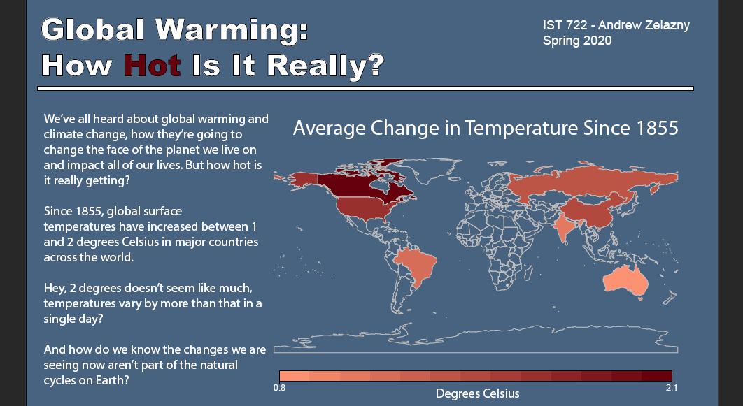
IST 719: Information Visualization
Adobe Illustrator
Communicating insights
Ethics in development and use of data

Slide 7
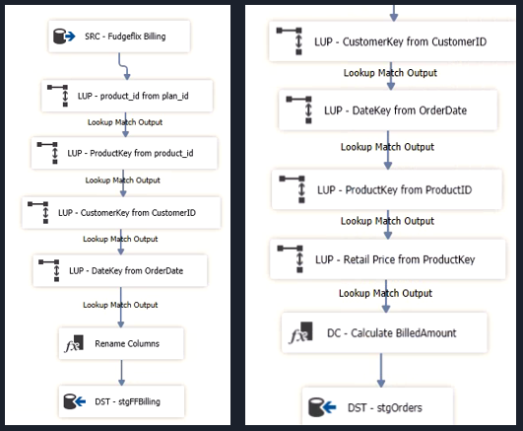
IST 722: Data Warehouse
SQL Server/PowerBI
Collecting, storing, cleaning data
Full data life-cycle

Slide 8
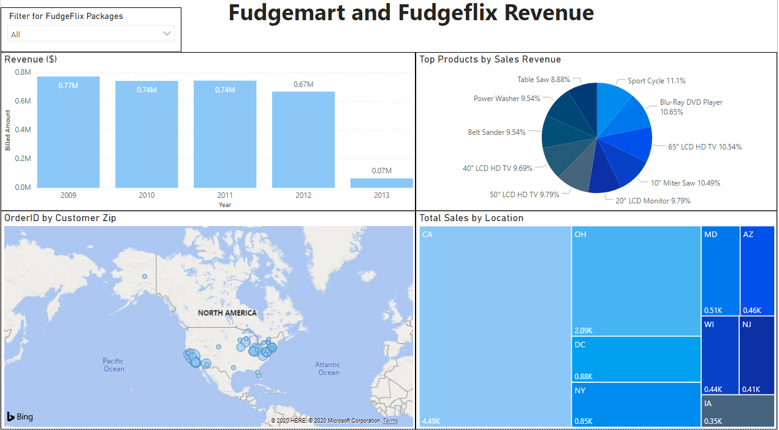
IST 722: Data Warehouse
SQL Server/PowerBI
Communicating insights

Slide 9
THANK YOU!

