Slide 1
An Introduction to Android Development
Basics, Technical Constructs and Practices.

Slide 2
Before We Start, make sure….
The app is checked out and running from - git@github.com:NazneenRupawalla/Android-Bootcamp-V1.1.git

Slide 3
What we did ….
Intents
Database Handling

Slide 4
Agenda
AdapterViews
Introduction to Adapters
Default Adapters
Custom Adapters
Themes

Slide 5
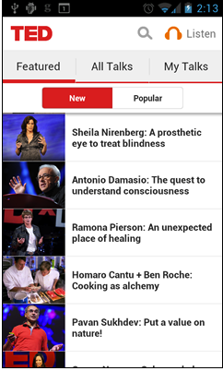
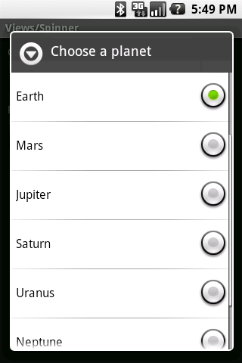
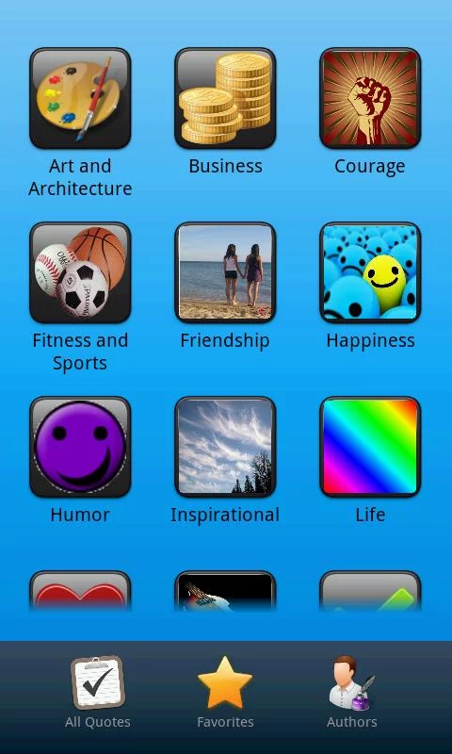
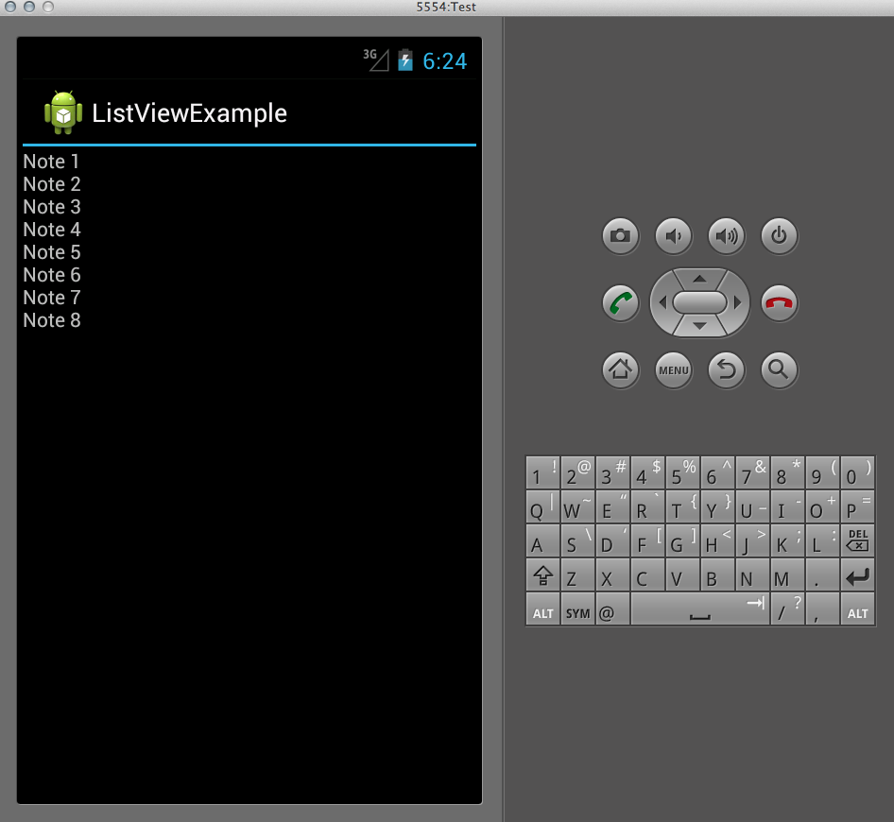
AdapterViews

Slide 6
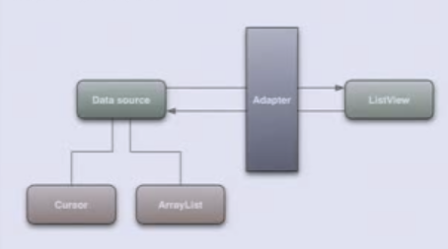

Adapters
What are adapters?
Need
Data Source
Adapter
ListView
Cursor
ArrayList

Slide 7
Assignment 8
Design a shopping application using Grid View
Use Array adapters

Slide 8
ArrayAdapter
To use ArrayAdapter
ArrayAdapter<Product> adapter = new ArrayAdapter<Product>(context, resource ID of a view to use, actual array/list of items);

Slide 9
Custom Adapter

Slide 10
Custom Adapter
public abstract getView (int position, convertView, parent)

Slide 11
Assignment 9
Customize a shopping application using Custom Adapters

Slide 12
Assignment 10
Navigate to a Product Details page on clicking a product.

Slide 13
Styles and Themes
Styles
Themes – a skin for the application
Notes:
A style is a collection of properties that specify the look and format for a View or window. A style can specify properties such as height, padding, font color, font size, background color, and much more.
Styles in Android share a similar philosophy to cascading stylesheets in web design—they allow you to separate the design from the content.
A theme is a style applied to an entire Activity or application, rather than an individual View (as in the example above). When a style is applied as a theme, every View in the Activity or application will apply each style property that it supports.

Slide 14
Assignment 10
Create a custom theme for the application
Change the Action Bar colour to your favourite colour
Make the main page look neater and cleaner

Slide 15
Customisation
Attributes

Slide 16
Assignment 11
Create an attribute in an attrs.xml file.
Create a style for this attribute.
Create a custom component.
Use the custom attribute to your custom component.

Slide 17

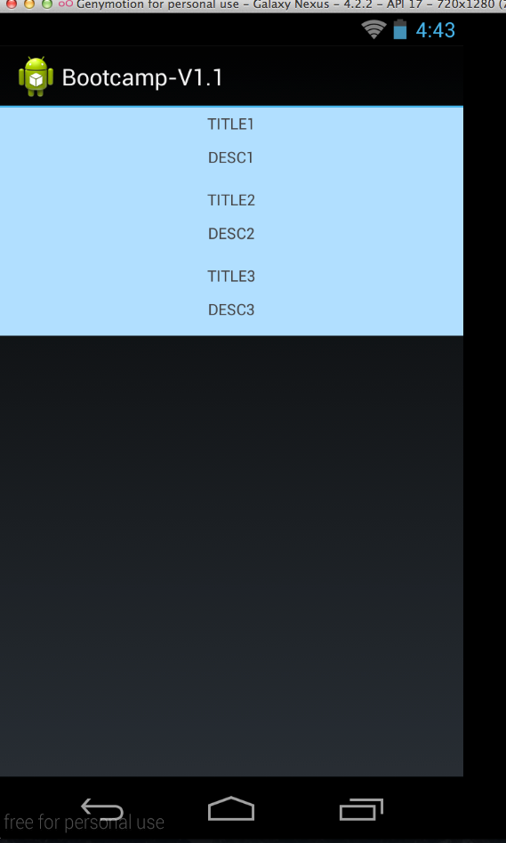
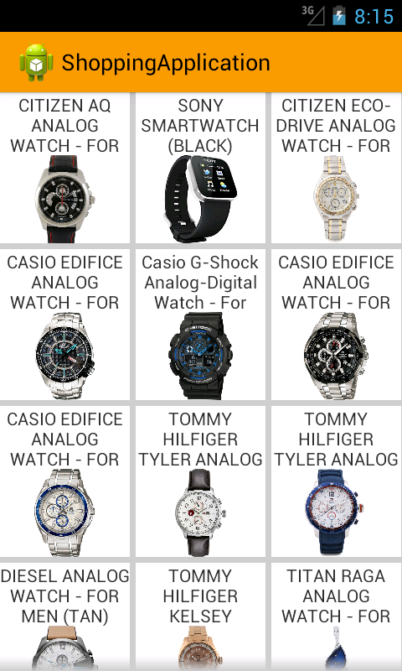
Final …

Slide 18
References
http://developer.android.com/guide/topics/ui/themes.html
http://developer.android.com/reference/android/database/sqlite/package-summary.html
http://developer.android.com/training/custom-views/create-view.html#customattr

