Slide 1
Lending Club Case Study Upgrad

Slide 2
Problem Statement
Lending Club Case Study
Risk analytics in banking and financial services and understand how data is used to minimize the risk of losing money while lending various types of loans to urban customers.
Risks Involved
If the applicant is likely to repay the loan, then not approving the loan results in a loss of business to the company
If the applicant is not likely to repay the loan, i.e. he/she is likely to default, then approving the loan may lead to a financial loss for the company

Slide 3
Decisions taken by the company Based on Applicant
Loan Rejected
Loan Accepted
Fully paid: Applicant has fully paid the loan.
Current: Applicant is in the process of paying the instalments.
Charged-off: Applicant has not paid the instalments in due time for a long period of time, i.e. he/she has defaulted
Loan Rejected:
The company had rejected the loan for the candidates who does not meet the Loan Processes requirements so no data available

Slide 4
Identifying Risks of Credit loss
Using EDA To Identify the Reasons for defaulters
Identify these risky loan applicants, then such loans can be reduced thereby cutting down the amount of credit loss.
In other words, the company wants to understand the driving factors (or driver variables) behind loan default, i.e. the variables which are strong indicators of default. The company can utilize this knowledge for its portfolio and risk assessment.

Slide 5
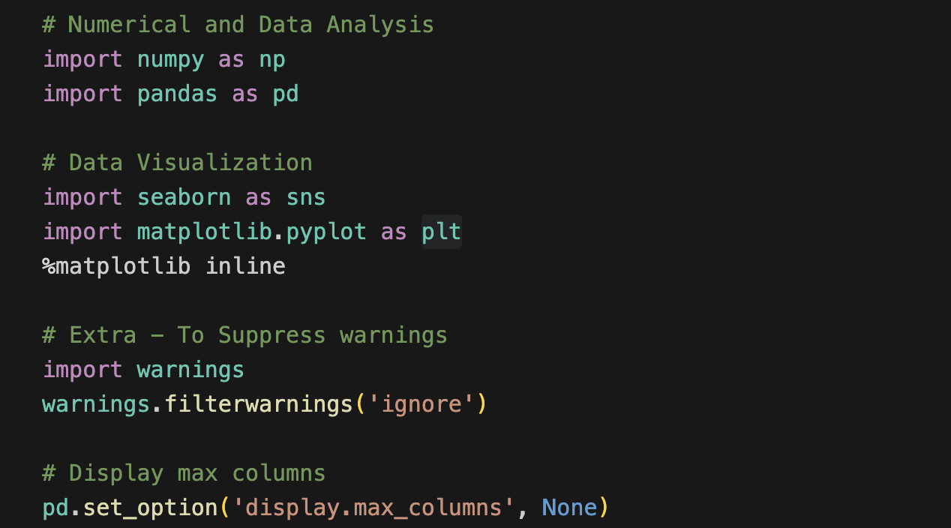
Necessary Libraries
Numerical and Data Analysis
Importing numpy and pandas
Data Visualization
Importing seaborn and matplotlib.pyplot
Extra - To Suppress warnings
Warnings

Slide 6
Analysis Approach
Data Handling and Cleaning
Check for duplicate rows
Missing Value Treatment
Removing the Irrelevant columns
Imputing Missing Values
Standardizing Values in required columns

Slide 7
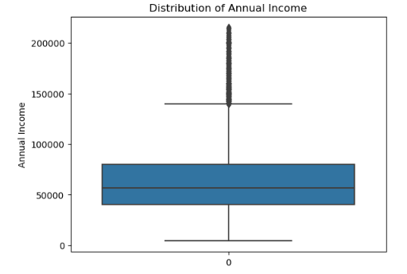
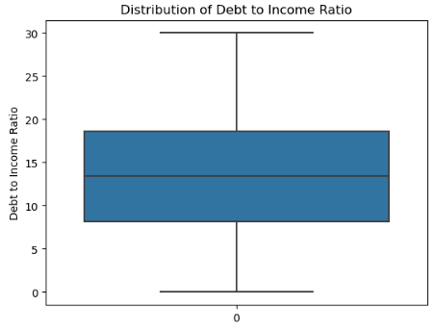
Distribution of Annual income
Distribution of Annual Income
Distribution of Debt to Income Ratio

Slide 8
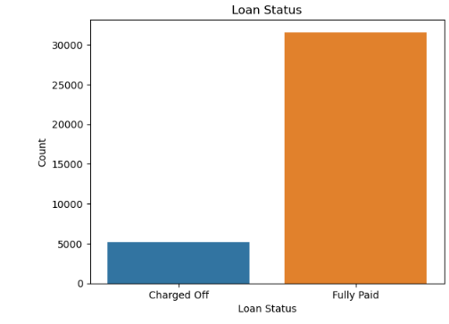
Univariate Analysis
Univariate of Loan Status
Analysis shows that 85.90 % loans are fully paid and 14.09 % loans are charged off. It means defaulted loans are lower than fully paid loans

Slide 9
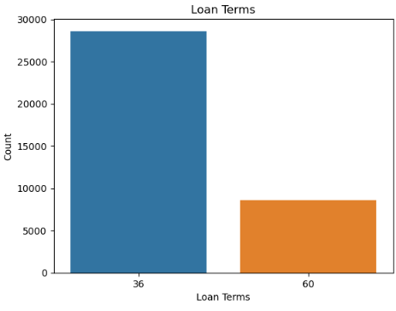
Analysis Of Loan Terms
Analysis shows that 77.45 % loan terms are 36 months and 22.54 % loan terms are 60 months. It means people taking shorter loans than long duration loans.

Slide 10
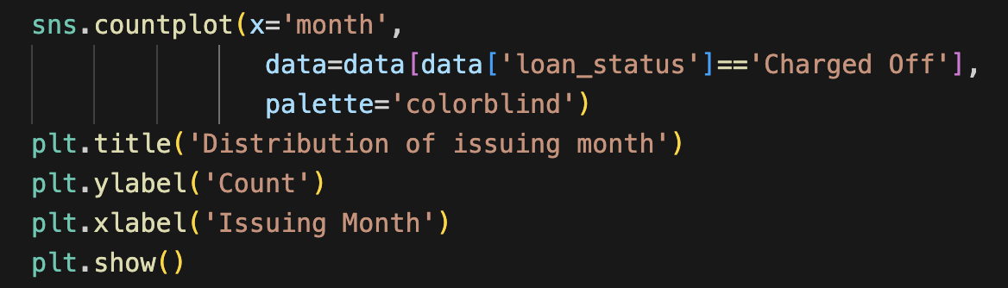
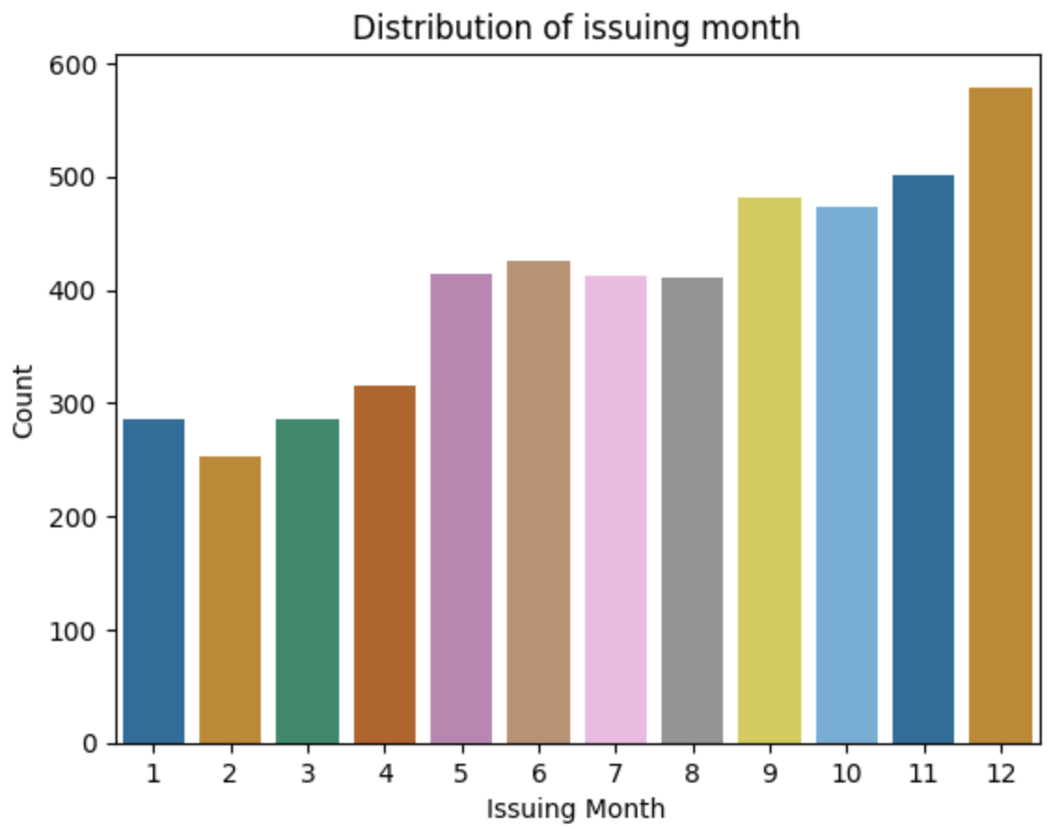
Analysis of Issuing Month
Analysis of Issuing Month: It is showing that loan count is increasing towards year ends. As year progress, loan counts increase in every month compare to last month.

Slide 11
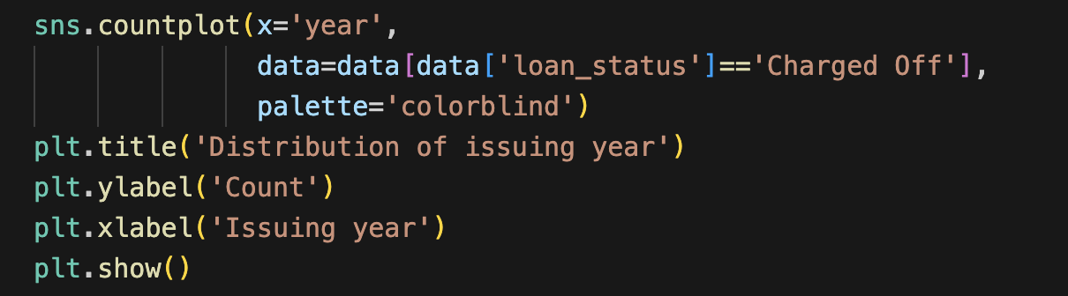
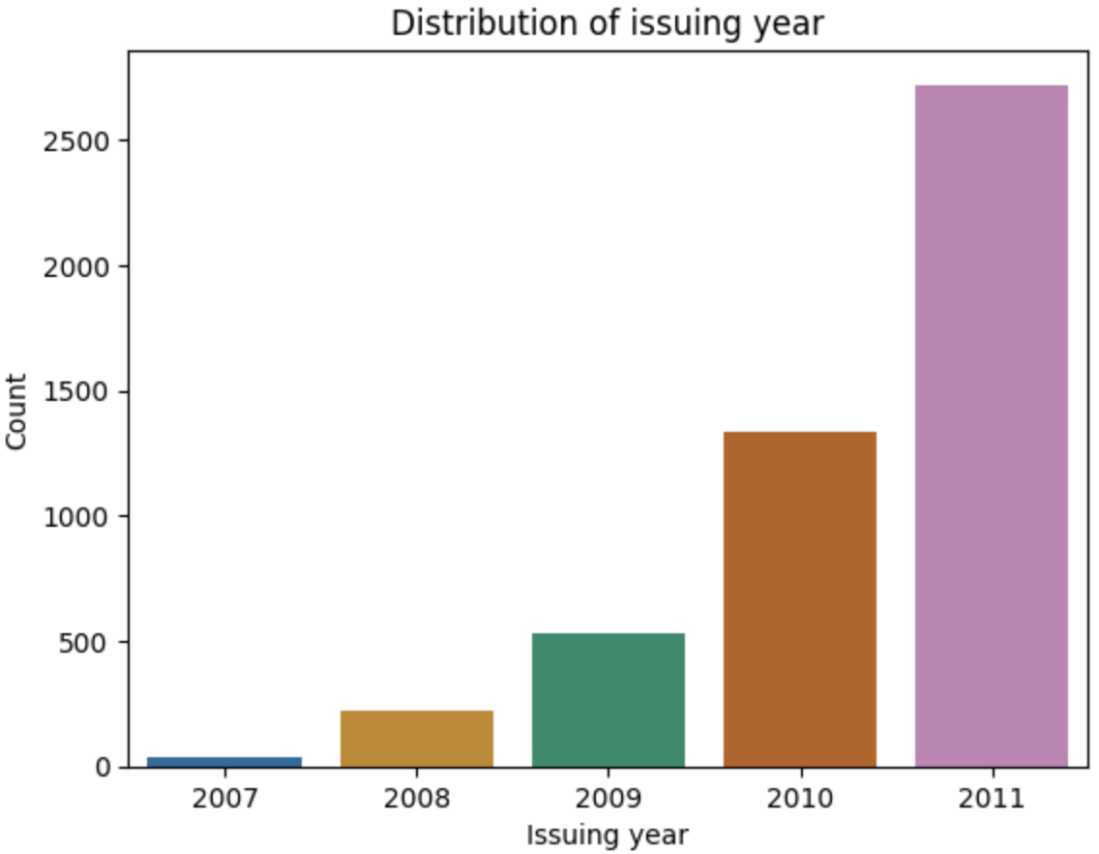
Analysis of Issuing Year
Analysis of Issuing Year: It is showing that loan approval increasing exponential rate. Increasing every year compare to previous year.

Slide 12
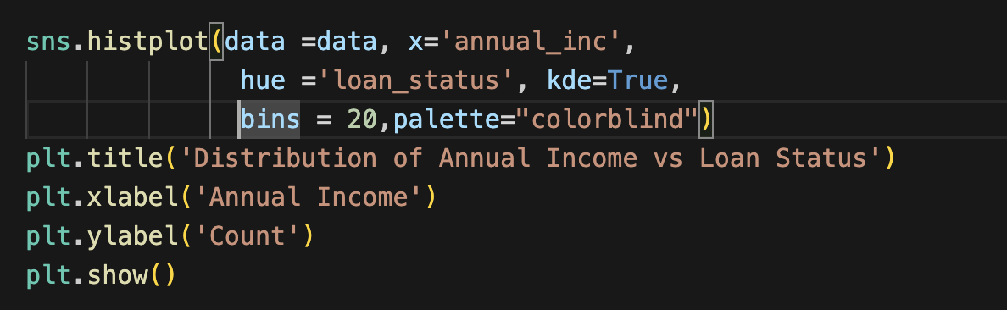
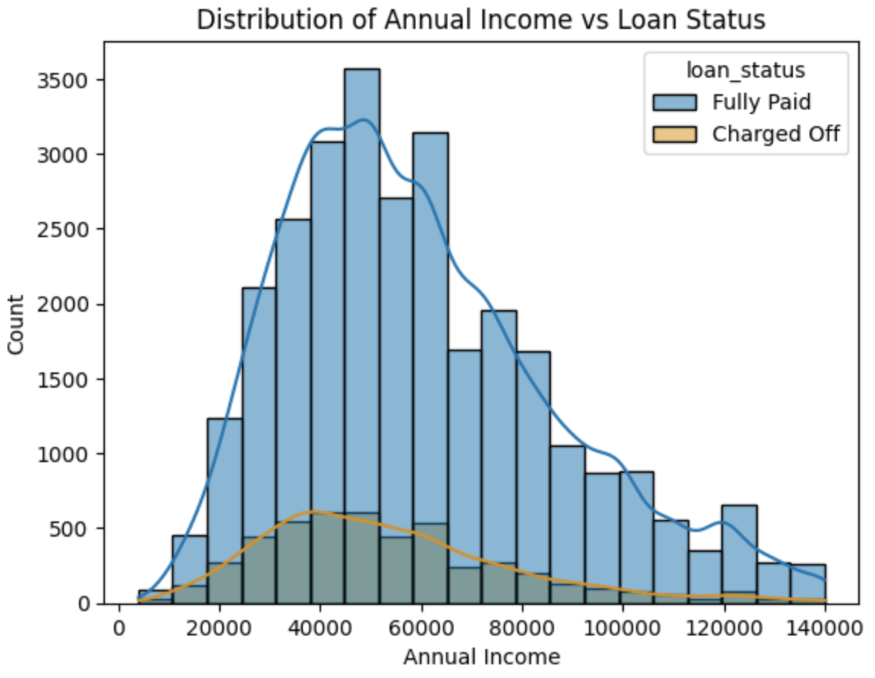
Bivariate Analysis
To find relationship between two sets of values.
Analysis of Annual Income against Loan Status: Income group having income 50000 and less are more likely to default than higher income groups.

Slide 13
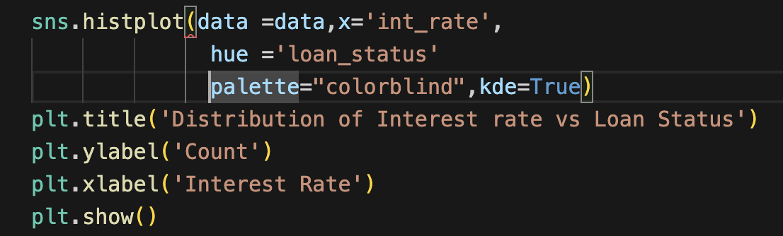
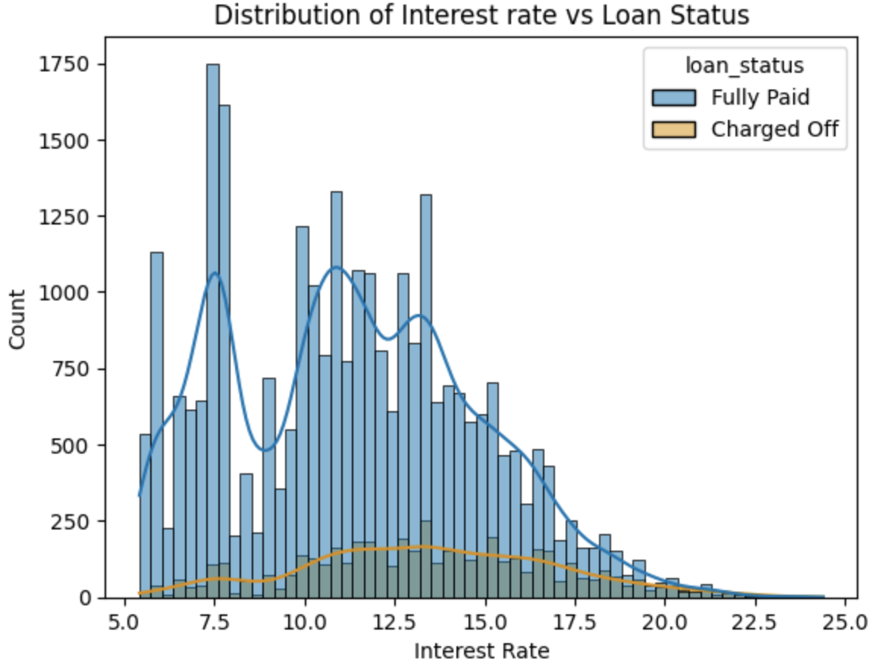
Bivariate Analysis of Interest Rate against Loan Status
Analysis of Interest Rate against Loan Status: As Interest Rate of loan increases default ratio for loans is also increasing.

Slide 14
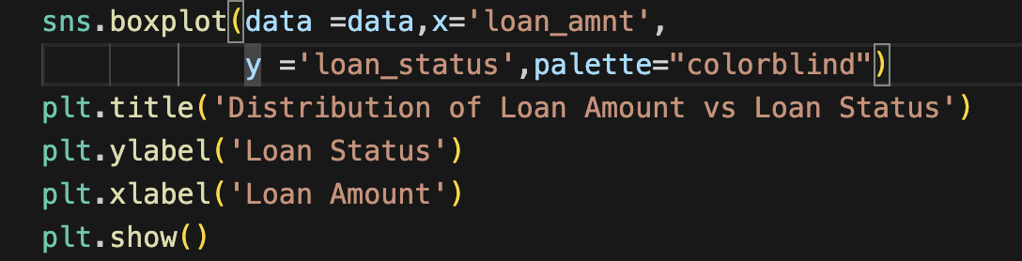
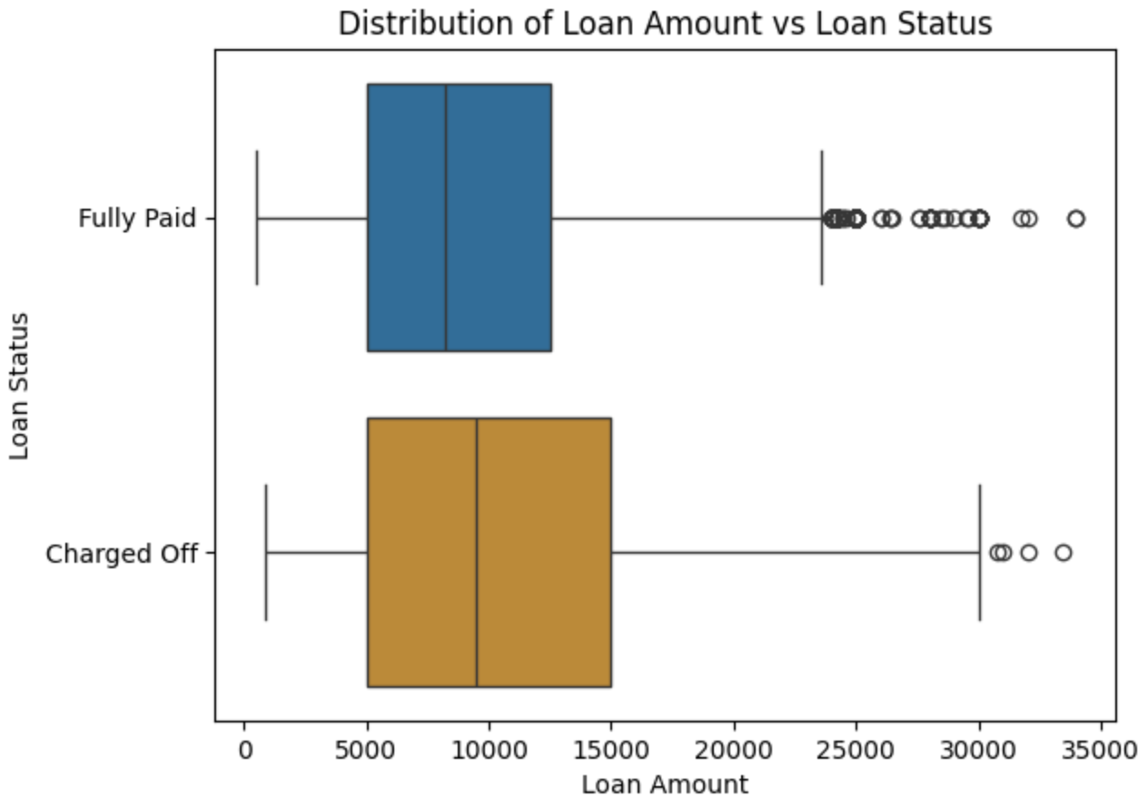
Bivariate Analysis of Loan Amount against Loan Status
Analysis of Loan Amount against Loan Status: Fully Paid and Charged Off are almost same for 25% but Charged Off is getting higher after 50% and above than Fully Paid. It means higher the loan amount higher chances of getting defaulted.

Slide 15
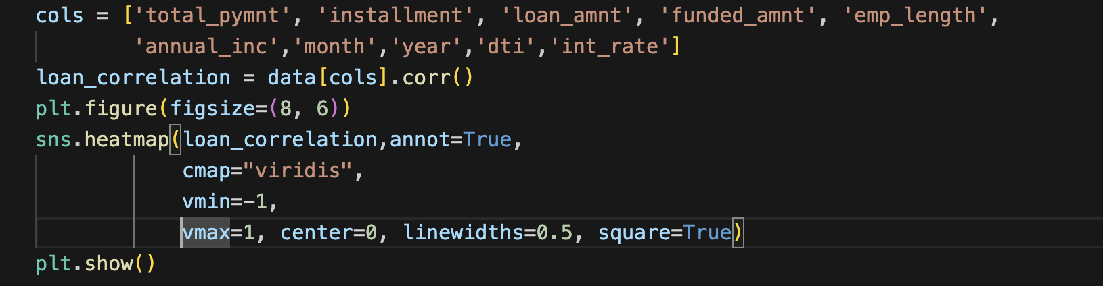
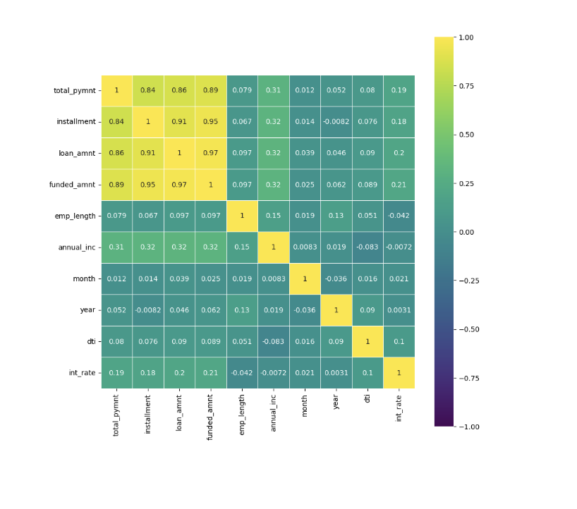
Heat map correlation between variables of loan dataset.

Slide 16
Observations
Univariate Analysis
The number of defaulted loan is 6 times less than the number of fully paid loan.
People have taken most of loan with 5 to 7.5 and 10 to 15 percent Interest Rate.
People are mostly belongs to 10 years of employment. It shows that these people are most capable to take loans.
Loans are taken by mostly lower income(20000 to 90000) group people.
50 % of people and above are verified by lending company or source verified.
It is showing that loan count is increasing towards year ends. As year progress, loan counts increase in every month compare to last month.
It is showing that loan approval increasing exponential rate. Increasing every year compare to previous year.

Slide 17
Observations
Bivariate Analysis
Income group having income 50000 and less are more likely to default than higher income groups.
As Interest Rate of loan increases default ratio for loans is also increasing.
The employees having 10+ years of experience are less likely to default and higher chance to fully paid the loans.
It shows that the Grade A(Sub Grade) has higher risk and the Grade(Sub Grade) G has lower risk. We can say higher grade(Sub Grade)
People are making defaulter with Loan amount 10000 and less with None Home ownership. So, Bank should avoid giving loan these people.

Slide 18
Observations
Factors which can be used to predict about chances of loan default are:
Income group
Interest Rate
Grade
Home ownership
DTI

Slide 19

THANK YOU !!

