Slide 1
TEACHING SERIES · INTRO TO AI SYSTEMS
Retrieval-Augmented
Generation (RAG)
Focus: Embeddings & Retrieval — with worked examples
Part 2 · After chunking — how search actually finds the right text

Slide 2
RAG TEACHING SERIES
What we'll cover
From vectors → search → better answers
01
What embeddings are (and a tiny numeric example)
02
Similarity: how "near" becomes "relevant"
03
Indexing: embed chunks, store vectors + metadata
04
Retrieval: dense, hybrid, top-k, rerank — with examples
05
Failure modes, evaluation, and a classroom lab
RAG · Embeddings & Retrieval
2 / 34

Slide 3
RAG TEACHING SERIES
Where we left off — and what's next
Chunking decides the units. Embeddings + retrieval decide which units you get.
Documents
→
Chunk
→
Embed
→
Store
→
Retrieve
→
Answer
Today's focus: turn chunks into vectors, store them, then find the best ones for a question.
Example corpus throughout: Employee Handbook (Remote Work, Benefits, Security).
RAG · Embeddings & Retrieval
3 / 34

Slide 4
RAG TEACHING SERIES
What is an embedding?
A list of numbers that captures meaning — so similar text lands near similar text
In plain English
Mental model
• Input: a chunk of text (or a query)
• Model: an embedding model (not the chat LLM)
• Output: a vector, e.g. 384 or 1536 floats
• Property: meaning-near ⇒ vector-near
• Used for: similarity search, clustering, rerank features
"Equipment stipend is $500/year"
↓ embed
[ 0.12, -0.44, 0.91, … 0.03 ]
Same idea in different words
lands nearby in that space.
RAG · Embeddings & Retrieval
4 / 34

Slide 5
RAG TEACHING SERIES
Example · Tiny 2D embedding space
x and y here are a teaching picture — not the real embedding format
Closer points = more related meaning. Search needs coordinates so a computer can rank “near” vs “far.”
On this slide (hypothetical)
In real RAG
Each sentence is a fake 2D point (x, y)
so we can draw “near” on a flat map.
Same idea, many more axes — e.g. 384 or 1536 numbers:
[0.12, −0.44, 0.91, …] (you don’t plot these by hand)
A Remote work: 3 days/week
Policy
D Vision coverage after 90 days
Benefits
B Manager approval by Friday
Policy
E MFA required for VPN
Security
C Equipment stipend $500
Money
Q "How much is the stipend?"
Query
Takeaway: Q should land nearest to C. We need coordinates for search — x,y is just the 2D cartoon of that.
RAG · Embeddings & Retrieval
5 / 34

Slide 6
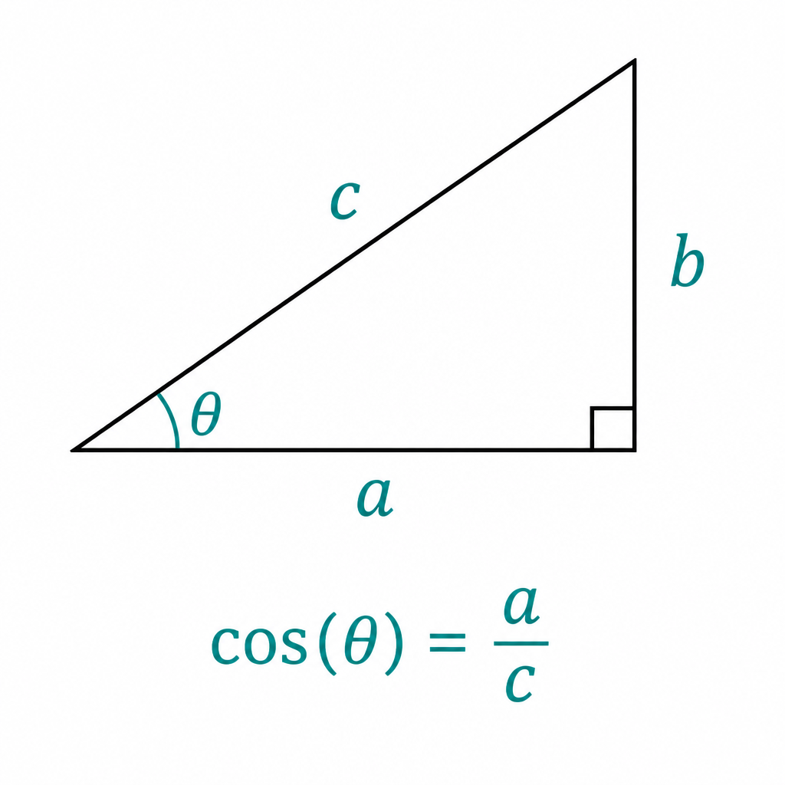
RAG TEACHING SERIES
Similarity: cosine (the usual default)
Score from -1 to 1 (often 0–1 after normalization). Higher = more alike.
Geometry reminder
In RAG (vectors)
Why use it?
cosine(q, d) =
(q · d) / (|q| |d|)
• Ignores vector length
• Focuses on direction = meaning
• Embeddings often normalized
• Then cosine ≈ dot product
• Vector DBs optimize for this
Same idea: angle between query vector and chunk vector.
• 1.0 nearly identical meaning
• 0.7–0.9 strong match
• < 0.4 usually off-topic
Closer angle θ → larger cos(θ)
RAG · Embeddings & Retrieval
6 / 34

Slide 7
RAG TEACHING SERIES
Example · Rank three chunks for one query
Toy 3D vectors (made-up numbers) — same process at 1536-D
Query Q: "How much is the equipment stipend?" → q = [0.90, 0.20, 0.10]
Chunk | Text (short) | Vector | Cosine ≈
C stipend | Equipment stipend $500/year | [0.88, 0.25, 0.08] | 0.99
C remote | Remote work up to 3 days/week | [0.20, 0.85, 0.15] | 0.41
C MFA | MFA required before VPN access | [0.10, 0.15, 0.90] | 0.22
Retrieval returns C stipend first (top-1). Top-k=3 would still include weaker neighbors for the LLM to ignore.
RAG · Embeddings & Retrieval
7 / 34

Slide 8
RAG TEACHING SERIES
Embedding models you'll meet
Different sizes, languages, and price — same job: text → vector
OpenAI / Azure text-embedding-3
Cohere embed-v3
API · Foundry or OpenAI · Small 1536 / Large 3072 dims
API · strong retrieval · 1024 dims
Common prod default in Azure AI Foundry
Good multilingual + search modes
all-MiniLM-L6-v2
bge / e5 family
Local · free · 384 dims
Local or hosted · 768+ dims
Labs, demos, offline apps
Strong open retrieval baselines
RAG · Embeddings & Retrieval
8 / 34

Slide 9
RAG TEACHING SERIES
What does “dims” mean?
Dims = dimensions = how many numbers are in each embedding vector
Example: 1536 dims → each chunk/query becomes a list of 1536 numbers (a fingerprint of meaning).
384 dims
1536 dims
3072 dims
MiniLM-style
embedding-3-small
embedding-3-large
Smaller · faster · fine for labs
Common Azure / OpenAI default
Richer fingerprint · heavier
More dims can mean richer meaning — but also more storage, cost, and index size. Not always “bigger = must use.”
RAG · Embeddings & Retrieval
9 / 34

Slide 10
RAG TEACHING SERIES
Azure AI Foundry · Small vs Large embeddings
Same job (text → vector). Different size, quality, and cost.
Text Embedding Small
Text Embedding Large
Usually text-embedding-3-small
Usually text-embedding-3-large
• Default dims: 1536
• Cheaper and faster enough for most RAG
• Great starting point for learning / prod
• Analogy: a clear phone photo
• Default dims: 3072
• Often better on hard retrieval questions
• Costs more; vectors use more storage
• Analogy: a higher-resolution photo
Rule: use the SAME model for indexing docs and embedding queries. Don’t mix Small docs + Large queries.
RAG · Embeddings & Retrieval
10 / 34

Slide 11
RAG TEACHING SERIES
How to choose an embedding model
Start with a known retrieval model — then measure on your questions
Prototype / class lab
MiniLM or Foundry Small
Fast, cheap, good enough to learn
Most Azure RAG apps
text-embedding-3-small
Cost vs quality sweet spot in Foundry
Hard retrieval / high stakes
text-embedding-3-large
Try when Small misses too often
Multilingual handbook
Cohere / multilingual e5
Don't assume English-only models
Must stay on-prem
Local bge / e5
No API data leaving the building
RAG · Embeddings & Retrieval
11 / 34

Slide 12
RAG TEACHING SERIES
Indexing: chunk → embed → store
Runs once (or on every doc update). Queries never re-embed the whole corpus.
1. Chunk
2. Embed
3. Attach meta
4. Upsert
Split handbook into units
(from Part 1)
Call embedding API /
local model per chunk
source, section, page,
parent_id, dates
Write vector + meta
into vector store
Rule: same embedding model at index time and query time. Mixing models breaks similarity.
RAG · Embeddings & Retrieval
12 / 34

Slide 13
RAG TEACHING SERIES
Example · Indexing three handbook chunks
What actually gets written to the store
id | text | section | vector (abbrev) | embedded?
c1 | Remote work up to 3 days/week | Remote | [0.21, 0.84, …] | Yes
c2 | Equipment stipend is $500/year | Remote | [0.88, 0.24, …] | Yes
c3 | MFA required before VPN access | Security | [0.11, 0.14, …] | Yes
p_remote | Full Section 3 body (parent) | Remote | — | No*
* Parent-child reminder: parents may be stored as plain text only; children carry the vectors used for search.
RAG · Embeddings & Retrieval
13 / 34

Slide 14
RAG TEACHING SERIES
What is a vector store?
A database optimized to find nearest neighbors among many vectors
Stores
Searches
Vectors + payload (metadata + often the text)
ANN: approximate nearest neighbor (HNSW, IVF…)
Filters
Examples
"section = Security" before/after ANN
Pinecone, Weaviate, Qdrant, pgvector, Chroma
RAG · Embeddings & Retrieval
14 / 34

Slide 15
RAG TEACHING SERIES
Example · Metadata filters save bad hits
Query: "VPN login rules" — without filters, Benefits chunks can sneak in
No filter (top-3)
Filter: section = "Security"
• 1. MFA required before VPN ✓
• 2. Vision coverage after 90 days ✗
• 3. Device wipe on offboarding ~
• Problem: "access" words confuse Benefits
• 1. MFA required before VPN ✓
• 2. VPN only on company devices ✓
• 3. Device wipe on offboarding ✓
• Same query — cleaner context for the LLM
RAG · Embeddings & Retrieval
15 / 34

Slide 16
RAG TEACHING SERIES
Query time: retrieve → (optional) rerank → prompt
This path runs on every user question
1
User asks
"How much is the equipment stipend?"
2
Embed query
Same model as index → q vector
3
ANN search
Top-k nearest chunk vectors
4
Optional rerank
Cross-encoder rescoring
5
Build prompt
Stuff top passages + ask LLM
6
Answer + cite
Return text + source ids
RAG · Embeddings & Retrieval
16 / 34

Slide 17
RAG TEACHING SERIES
Example · Dense retrieval end-to-end
One question, three scored neighbors, one answer
Q: "How much is the equipment stipend?"
#1 score 0.91
#2 score 0.62
#3 score 0.41
c2 Equipment stipend is $500/year
c1 Remote work up to 3 days/week
c4 Managers approve schedules by Friday
Prompt gets #1–#3. LLM answers: "$500 per year" and can cite c2.
If you only passed #2–#3 (bad top-k), the model may guess or say it doesn't know.
RAG · Embeddings & Retrieval
17 / 34

Slide 18
RAG TEACHING SERIES
Top-k: how many chunks to fetch?
Too few misses context; too many wastes tokens and adds noise
k too small (e.g. 1–2)
k balanced (e.g. 4–8)
k too large (e.g. 20+)
• Miss second fact in multi-hop Qs
• Brittle if #1 is slightly wrong
• Good for ultra-precise factoids
• Room for related neighbors
• Fits most chat context budgets
• Default starting point for labs
• Noise dilutes the prompt
• Higher cost / latency
• Rerank becomes almost required
RAG · Embeddings & Retrieval
18 / 34

Slide 19
RAG TEACHING SERIES
Example · Same query, different k
Q: "Stipend amount and who approves remote days?"
k = 1
k = 4 (+ overlap/parent)
• Returns only stipend chunk
• LLM knows $500
• Misses "manager approval by Friday"
• Half-answer — looks like a model bug
• Stipend + approval both present
• Full answer possible in one shot
• Still small enough for a clean prompt
• Fix was retrieval design, not a bigger LLM
RAG · Embeddings & Retrieval
19 / 34

Slide 20
RAG TEACHING SERIES
Hybrid search: vectors + keywords
Dense finds paraphrase; sparse finds exact IDs, codes, names
Dense (embeddings)
Sparse (BM25 / keyword)
• Great at synonyms & paraphrase
• "pay for laptop" ≈ "equipment stipend"
• Weak at rare tokens / SKUs
• Needs a good embedding model
• Great at exact strings
• Policy-ID-442, error codes, names
• Weak when wording differs a lot
• Often free / already in your search stack
RAG · Embeddings & Retrieval
20 / 34

Slide 21
RAG TEACHING SERIES
Example · Why hybrid wins on IDs
Q: "What does policy RW-12 say about stipends?"
Method | Top hit | Why
Dense only | Generic stipend paragraph | Misses rare token RW-12
BM25 only | Doc titled RW-12 | May miss paraphrased body
Hybrid (fuse) | RW-12 section with $500 text | ID match + meaning match
Common fuse: Reciprocal Rank Fusion (RRF) — merge ranked lists without fragile score calibration.
RAG · Embeddings & Retrieval
21 / 34

Slide 22
RAG TEACHING SERIES
Reranking: a second, smarter sort
Retrieve broad (cheap), then rescore top candidates (precise)
Retrieve
Rerank
Keep
Fetch k=20 with ANN / hybrid
Cross-encoder scores (query, chunk) pairs
Pass top 3–5 to the LLM
Why it helps: bi-encoders embed query & doc separately (fast). Cross-encoders read both together (accurate, slower).
Use when first-stage recall is good but precision@5 is messy.
RAG · Embeddings & Retrieval
22 / 34

Slide 23
RAG TEACHING SERIES
Example · Rerank fixes a near-miss
Q: "Is security training required before VPN?"
After ANN (k=5 order)
After cross-encoder rerank
• 1. VPN only on company devices
• 2. MFA required before VPN
• 3. Security training before access ← true answer
• 4. Remote work 3 days/week
• 5. Device wipe policy
• 1. Security training before access ✓
• 2. MFA required before VPN
• 3. VPN only on company devices
• …
• LLM now sees the decisive sentence first
RAG · Embeddings & Retrieval
23 / 34

Slide 24
RAG TEACHING SERIES
Diversity: MMR (Maximal Marginal Relevance)
Avoid sending five near-duplicate chunks about the same sentence
Without MMR
With MMR
• Top hits all paraphrase "$500 stipend"
• Approval rule never appears
• Wastes context window
• Multi-hop answers fail quietly
• Keeps best stipend chunk
• Prefers a different but still relevant chunk
• Approval + stipend both in prompt
• Trade a bit of pure similarity for coverage
RAG · Embeddings & Retrieval
24 / 34

Slide 25
RAG TEACHING SERIES
Common retrieval failures (with fixes)
These look like "the LLM is dumb" — usually it never saw the right text
Wrong embedding model mix
Chunk too big / too small
Re-index with one model end-to-end
Revisit Part 1 strategies
No metadata filters
k too low for multi-hop
Filter by product, locale, section
Raise k or use parent-child
Exact ID queries
Good recall, bad order
Add BM25 / hybrid
Add a reranker
RAG · Embeddings & Retrieval
25 / 34

Slide 26
RAG TEACHING SERIES
Evaluate retrieval before blaming the LLM
Build 20–50 labeled questions; score the search step alone
Recall@k
Was the needed chunk in the top-k?
Must-have for RAG
MRR
How high was the first relevant hit?
Order quality
nDCG
Graded relevance across the list
When multiple goods exist
Answer accuracy
Did the final LLM answer match gold?
End-to-end check
RAG · Embeddings & Retrieval
26 / 34

Slide 27
RAG TEACHING SERIES
Example · Scoring three strategies on 10 questions
Same handbook corpus — only retrieval setup changes
Setup | Recall@5 | MRR | What happened
Dense, k=5 | 0.70 | 0.55 | Missed RW-12 ID questions
Hybrid, k=5 | 0.85 | 0.68 | IDs fixed; still some order noise
Hybrid + rerank | 0.90 | 0.82 | Best precision for the prompt
Teaching takeaway: measure retrieval first. Don't swap LLMs until Recall@k is healthy.
RAG · Embeddings & Retrieval
27 / 34

Slide 28
RAG TEACHING SERIES
Retrieval toolkit at a glance
Layer techniques as quality needs grow
Technique | Helps with | Cost | Start here?
Dense ANN | Paraphrase / meaning | Low–Med | Yes
Metadata filters | Wrong-section noise | Low | Yes
Hybrid + RRF | IDs, codes, names | Med | Often
Reranker | Precision of top-5 | Med–High | When noisy
MMR | Duplicate neighbors | Low | Multi-hop
Parent expand | Thin children | Low | Long manuals
RAG · Embeddings & Retrieval
28 / 34

Slide 29
RAG TEACHING SERIES
How to choose a retrieval setup
Start simple; upgrade when evals fail a specific way
Shipping a class demo this week?
→ Dense + k=5 + citations
Users type product IDs / error codes?
→ Add hybrid (BM25 + dense)
Top-k has the answer but buried?
→ Add reranker
Answers need a whole section?
→ Parent-child expand after hit
Many near-duplicate chunks?
→ MMR or better chunking
Wrong department docs appear?
→ Metadata filters first
RAG · Embeddings & Retrieval
29 / 34

Slide 30
RAG TEACHING SERIES
Applications · retrieval patterns in the wild
Same embedding idea — different retrieval recipes
Support bot
HR handbook Q&A
Code assistant
Hybrid + filters by product
Dense + parent expand
Code embeddings + path filters
Cite help-center URL
Policy section in prompt
Don't mix random files
Legal search
Research papers
Internal wiki
Hybrid + rerank
Dense + section metadata
Hybrid + recency boost
Clause IDs must hit
Methods vs results
Prefer newer pages
RAG · Embeddings & Retrieval
30 / 34

Slide 31
RAG TEACHING SERIES
Classroom lab (40–50 min)
Same corpus as chunking lab — now score retrieval
1
Reuse the handbook chunks from Part 1 (or re-chunk once)
2
Embed with one model; store vectors + metadata
3
Write 12 questions: 4 easy, 4 paraphrase, 2 ID, 2 multi-hop
4
Run dense-only vs hybrid; measure Recall@5
5
Optional: add rerank; compare MRR and answer quality
6
Discuss: which failure was retrieval vs chunking vs LLM?
RAG · Embeddings & Retrieval
31 / 34

Slide 32
RAG TEACHING SERIES
Key takeaways
What students should leave remembering
Embeddings = meaning as numbers
Retrieval is a product decision
Same model at index + query
k, filters, hybrid, rerank
Measure search separately
Examples beat slogans
Recall@k before swapping LLMs
Always debug with a real question
RAG · Embeddings & Retrieval
32 / 34

Slide 33
NEXT UP
Augmenting prompts,
citations, and RAG evaluation
Questions? Run the lab — then we'll grade your retrievers, not just your prompts.

