Slide 1
HAMMERTIME
Race telemetry and
graph learning
Research prototype / 2023 FastF1 season evaluation
A saved ST-GNN evaluation with race-level holdout, a matched zero predictor, and explicit limits on what the result shows.
EVIDENCE THROUGH 2026-11-02
Notes:
Sources: README.md; EXECUTIVE_ONE_PAGER.md; hammertime_100/frontend/data/season_model.json.
Run identifier: 769a76aab164b514cc0a. This is a project research prototype, not a production race-strategy system.

Slide 2
HAMMERTIME / RESEARCH OVERVIEW
The model estimates a calibrated sector residual
OBSERVED
REFERENCE
PREDICT
Mini-sector
duration
−
Same-session
clean-air pace
=
Signed
residual
Positive and negative labels are possible. The reference is calibrated within each race because sector times do not transfer across circuits.
Interpretation limit
The current target uses observed clean sectors from the full session, including future held-out observations. This is retrospective session calibration, not a strict prospective forecast target.
FASTF1 2023 / SAVED EVALUATION / NOV 2026
02
Notes:
Sources: hammertime_100/REPORT.md, Data and model flow; ASSUMPTIONS.md, A03 and A11; OPEN_QUESTIONS.md, item 2.
The archived season run labels the target as an existing full-session-calibrated residual. The report distinguishes session-scoped label calibration from train-only model feature scaling.

Slide 3
HAMMERTIME / MODEL FLOW
Race telemetry becomes a time-varying graph
Each time step aligns observed car states. A directed traffic graph carries proximity context into a temporal graph model.
RACE OBSERVATIONS
TRAFFIC GRAPH
ST-GNN OUTPUT
Speed, throttle,
tyre state, track progress
Cars as nodes
Wake proximity as edges
Predicted sector
residual at a future step
The audited implementation masks pit, invalid, and safety-car-contaminated samples. Those rules describe data eligibility, not measured aerodynamic effects.
FASTF1 2023 / SAVED EVALUATION / NOV 2026
03
Notes:
Sources: EXECUTIVE_ONE_PAGER.md; hammertime_100/REPORT.md, Data and model flow; hammertime_100/src/graph.py; hammertime_100/src/dataset.py.
This slide describes the pipeline concept. It does not assert that a graph edge is a measured aerodynamic wake effect.

Slide 4
HAMMERTIME / RESEARCH OVERVIEW
The 2023 evaluation holds out whole races
15
3
4
training races
validation races
test races
model fit
checkpoint selection
held out by race
HELD-OUT TEST RACES
Abu Dhabi Las Vegas Mexico São Paulo
25,129 test graph windows
37,956 valid node-target predictions
race split · 15 training / 3 validation / 4 test races. Graph windows and valid prediction rows are different units.
FASTF1 2023 / SAVED EVALUATION / NOV 2026
04
Notes:
Source: hammertime_100/frontend/data/season_model.json, split and count_note. Archived source paths and fingerprints appear under provenance.
Test race IDs, test windows and target-row counts come from the tracked season_model.json split and count_note fields.

Slide 5
HAMMERTIME / RESEARCH OVERVIEW
Matched test MAE differs by about 2 ms
TEST MAE / SECONDS / ZERO-BASED AXIS
ST-GNN
0.09046 s
R² 0.03314
Zero predictor
0.09247 s
R² -0.01194
Same 37,956 target rows. MAE falls by 2.17%; the R² acceptance gate still fails.
FASTF1 2023 / SAVED EVALUATION / NOV 2026
05
Notes:
Source: hammertime_100/frontend/data/season_model.json. Both values use the same held-out target rows. Relative MAE gain is computed from the tracked test and matched zero-predictor metrics. The ST-GNN MAE gate passes; its R² gate fails.

Slide 6
HAMMERTIME / RESEARCH OVERVIEW
Held-out MAE varies across the four races
Race-level MAE and target counts
HELD-OUT RACE | TEST MAE (s) | VALID NODE-TARGETS
Abu Dhabi | 0.09416 | 10,609
Las Vegas | 0.10896 | 7,077
Mexico | 0.08550 | 10,759
São Paulo | 0.07819 | 9,511
Across-race values sum to the archived test prediction count. Each race stays on its own row; no per-race ranking is adjusted for target coverage.
FASTF1 2023 / SAVED EVALUATION / NOV 2026
06
Notes:
Source: hammertime_100/frontend/data/season_model.json, race_metrics. Counts are valid node-target predictions; values remain separated by race.

Slide 7
HAMMERTIME / RESEARCH OVERVIEW
Acceptance checks return mixed results
CHECK | STATUS | OBSERVED EVIDENCE
Test MAE target | PASS | 0.09046 s
Test R² target | FAIL | 0.03314
Clean-air calibration | PASS | 0.01275 s MAE across 15,736 samples
DRS train check | UNMEASURABLE | No complete qualifying held-out lap
A missing qualifying DRS lap is not a pass or a measured aerodynamic effect. The check remains open until coverage supports a complete-lap result.
FASTF1 2023 / SAVED EVALUATION / NOV 2026
07
Notes:
Source: hammertime_100/frontend/data/season_model.json, metrics.physics_tests and target gate flags.
Clean-air threshold and result come from the tracked season JSON: expected Mean absolute predicted penalty <= 0.050 s, observed MAE 0.012748934051396451 s over 15736 samples. DRS complete-lap count is 0; zero makes the check unmeasurable.

Slide 8
HAMMERTIME / COMPARISON DESIGN
Model-family comparisons need matching evidence
FASTF1 2023 HELD-OUT TEST
OPENF1 HUNGARY 2023 VALIDATION
ST-GNN vs zero predictor
Separate model-family suite
0.09046 s / 0.09247 s MAE
Same held-out races and target rows
37,956 valid predictions
MODEL | VALIDATION MAE (s)
ST-GNN legacy graph | 0.06277
LSTM | 0.06536
XGBoost | 0.08439
Same 3,068-target validation split within this suite.
The OpenF1 table is validation-only. It uses a different provider, split, and target from the FastF1 season test. Do not compare its absolute scores with the left-hand result.
FASTF1 2023 / SAVED EVALUATION / NOV 2026
08
Notes:
FastF1 source: hammertime_100/frontend/data/season_model.json.
Separate OpenF1 validation source: hammertime_100/frontend/data/experiments.json, group openf1-hungary-circuit-screen. The group records the OpenF1 2023 Hungary validation screen; variants are not compared with the season test.
These are separate evidence tiers. Only ST-GNN and zero predictor share the FastF1 season test target set.

Slide 9
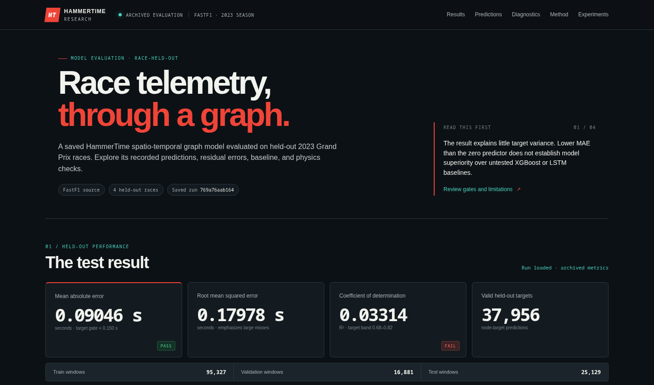
HAMMERTIME / RESEARCH OVERVIEW
The dashboard presents saved evidence, not live inference
The frontend connects the archived season run to a research view with race filters, held-out predictions, race-level summaries, and gate context.
RUN 769a76aab164b514cc0a
Archived metrics
linked to checkpoint
A deterministic sample
of held-out predictions
Race, driver and
mini-sector views
The browser displays saved outputs. It does not load the checkpoint or run fresh model inference.
FASTF1 2023 / SAVED EVALUATION / NOV 2026
09
Notes:
Screenshot: reports/HammerTime_Project_Overview_2026/assets/dashboard-preview.png. The page presents archived FastF1 evaluation metrics and saved predictions; it does not run checkpoint inference in the browser.
Sources: hammertime_100/frontend/data/season_model.json; hammertime_100/frontend/data/export_season_model.py; hammertime_100/frontend/app.js; frontend audit notes.
The browser charts a deterministic sample of archived held-out predictions. It does not run checkpoint inference. Independent Chromium smoke verified the exact metrics, race and driver filters, the 20-row mini-sector table, mobile width without horizontal overflow, and explicit fetch-error state.

Slide 10
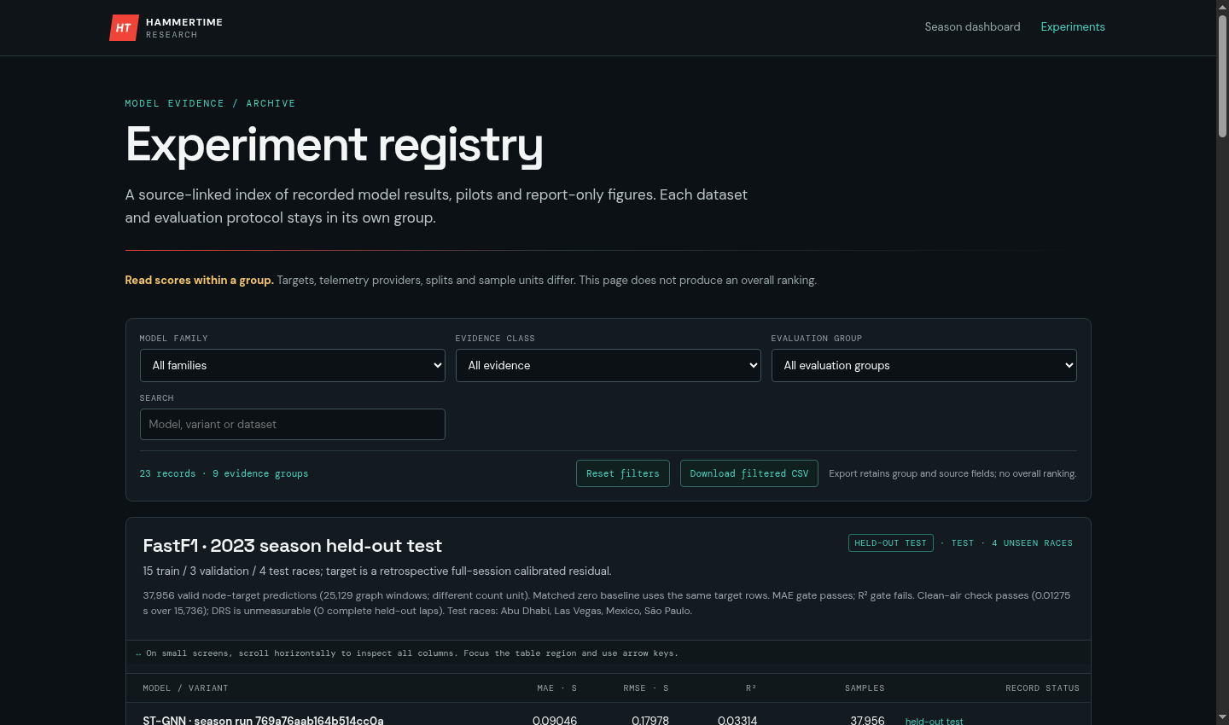
HAMMERTIME / RESEARCH OVERVIEW
Experiment records stay inside their evidence groups
The registry keeps test, validation, pilot and report-only results apart, with source paths and hashes attached to each group.
23
archived records
9
evaluation groups
Filters cover model family, evidence class, evaluation group and text search. Filtered CSV retains protocol and source hashes.
ST-GNN family has 12 scored records and 2 failed attempts with no scores.
HAMMERTIME / MODEL EVIDENCE REGISTRY / NOV 2026
10
Notes:
Screenshot: reports/HammerTime_Project_Overview_2026/assets/experiment-registry-preview.png, captured from the registry browser smoke at 1440x1200.
Data source: hammertime_100/frontend/data/experiments.json, generated by hammertime_100/frontend/data/export_experiments.py. The JSON contains 23 records across 9 evidence groups: 21 scored and 2 failed with null metric fields.
The ST-GNN family count is 14 records: 12 with scores and 2 failed/no-score pilot attempts. Filtered CSV preserves each evidence group's dataset, protocol, unit and source paths/hashes. The registry does not rank incompatible evidence groups.

Slide 11
HAMMERTIME / WHAT REMAINS
The next evaluation must close four evidence gaps
01
Explained variance
R² is 0.03314 and misses its configured gate.
02
Prospective target
Full-session references use future clean-air observations.
03
DRS validation
No complete qualifying held-out lap was available.
04
Model-family test
XGBoost and LSTM need the same FastF1 held-out protocol before test-score comparison.
Current reading: MAE 0.09046 s versus 0.09247 s matched zero predictor, R² 0.03314, clean-air pass, DRS unmeasurable.
FASTF1 2023 / SAVED EVALUATION / NOV 2026
11
Notes:
Sources: hammertime_100/frontend/data/season_model.json; OPEN_QUESTIONS.md, items 2, 8, and 11; RESEARCH_CHANGELOG.md, 2026-11-01 full-season and model enhancement records.
This slide records unresolved research and evidence gaps. No new threshold, split, or acceptance criterion is proposed.

