Slide 1
How enjoy with Raspberry Pi
#01

Slide 2
About Raspberry Pi (RPi)

Slide 3
About Raspberry Pi (RPi)
== $35 PC

Slide 4
Specification
・Broadcom BCM2835
(ARM1176JZFS processor (700MHz),
FPU, VideoCore 4 GPU）
・GPU Open GL ES 2.0 available,
hardware-accelerated OpenVG,
1080p30 H.264 high-profile decode
・GPU is capable of 1Gpixel/s, 1.5Gtexel/s
or 24GFLOPs with texture filtering
and DMA infrastructure
・512MB RAM (Rev.B)
・boot with SD Card
・10/100 BaseT Ethernet socket

Slide 5
Case 1 :
Tiny Core

Slide 6
About Tiny Core
Minimum Linux
Site:
http://distro.ibiblio.org/tinycorelinux/
For ARM:
http://distro.ibiblio.org/tinycorelinux/arm.html
For RPi
http://distro.ibiblio.org/tinycorelinux/4.x/armv6/

Slide 7
[Tiny Core] Getting Started on Ubuntu
Format SD Card. (enough more than 64MB)
$ sudo mkfs.ext4 /dev/sdX (sdX: your SD drv.)
Download “rpiCore.img.gz” or
“rpiCore-[YYYYMMDD].img.gz” (latest ver.).
Burn image to SD.
$ gunzip < rpiCore.img.gz | sudo dd of=/dev/sdX bs=1M
Connect RPi and TV with “yellow” plug.
Insert SD to RPi and Power ON.

Slide 8
[Tiny Core] Getting Started on Ubuntu
That's all.

Slide 9
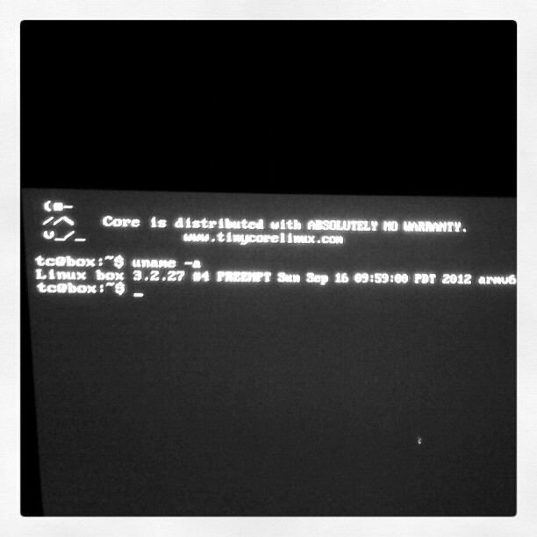
[Tiny Core] console

Slide 10
[Tiny Core] attention
What is password of root ?
→ set yourself
$ sudo passwd

Slide 11
[Tiny Core] more informations
Tiny Core Wiki
http://wiki.tinycorelinux.net/wiki:start

Slide 12
Case 2 :
Reading attached Manual

Slide 13
What is written ?
[A] Regulatory Compliance and ...
  Attention about safe usage and
  Required power supply is 5V and 0.7 – 1.2A
[B] QUICK START GUIDE
  Before you begin
  How to start
    Image : http://www.raspberrypi.org/downloads
    Setup : http://elinux.org/RPi_Easy_SD_Card_Setup
  Getting the best out of your RPi

Slide 14
Setup with official image
Download image.
  Raspbian “wheezy” (zip: 435MB, unzip: 1.9GB)
  “Raspbian” is customized Debian.
Setup referring elinux.org
http://elinux.org/RPi_Easy_SD_Card_Setup
  There are manuals for Windows, Mac, and Linux

Slide 15
Presented by
Official site
http://www.raspberrypi.org/
elinux.org - RPi Hub
http://elinux.org/RPi_Hub
Tiny Core Project
http://distro.ibiblio.org/tinycorelinux/

Slide 16
Appendix

Slide 17
Linaro supports RPi ?
First, what is “Linaro”
  Linaro is a community (supported by companies)
  to optimize OSS resources for ARM.
  http://www.linaro.org/
Linaro supports RPi ? - NO
  Because Linaro is optimizing for ARMv7 arch.
    RPi is ARMv6 (ARM11)
  http://ask.linaro.org/questions/402/will-linaro-support-raspberry-pi
  I am tired of Raspberry/Pi
  http://planet.linaro.org/tag/raspberrypi/

Slide 18
Picked up News
Fedora for RPi
http://news.mynavi.jp/news/2012/06/22/023/index.html
“RISC OS” for RPi
http://jp.techcrunch.com/archives/20121106raspberry-pi-gets-risc-os-a-25-year-old-system-made-by-the-wizards-of-arm/
TinyBASIC
http://jp.techcrunch.com/archives/2012102910-print-tinybasic-ported-to-raspberry-pi-mini-computer-20-goto-10-run/
Playing “Minecraft”
http://jp.techcrunch.com/archives/20121127minecraft-raspberry-pi-edition-to-help-kids-learn-to-code-while-they-build/

Slide 19
Other News
Tech Crunch
http://japanese.engadget.com/tag/RaspberryPi/
http://jp.techcrunch.com/
  Search “raspberry pi” on right-up textbox.
Japanese Engadget
http://japanese.engadget.com/search/?query=raspberry%20pi&r=reflink
mynavi news
http://news.mynavi.jp/search-result.html?q=raspberry+pi&term=365

